Slide 1
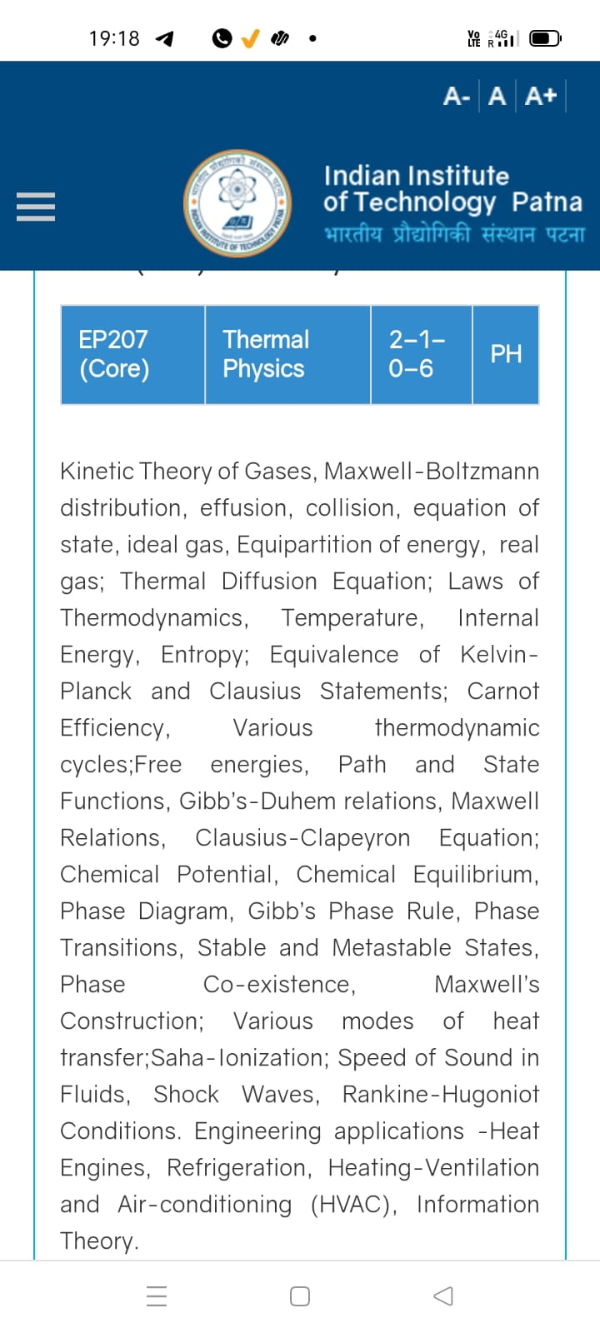
Season 5, Lecture 12 (S5,L12):
EP2104 Thermal physics with engineering applications
3-1-0-4

Slide 2
EP2104 Thermal physics with engineering applications
3-1-0-4
Syllabus
Course Outline Kinetic Theory of Gases, Maxwell-Boltzmann distribution, Mean free path, collision, equation of state, ideal gas, Equipartition of energy, real gas; Thermal Diffusion Equation, effusion; Laws of Thermodynamics, Temperature, Internal Energy, specific heat, Entropy;
Carnot engine, Various thermodynamic cycles; Thermodynamic potentials, Path and State Functions, Gibb’s-Duhem relations, Maxwell Relations; Clausius-Clapeyron Equation; Chemical Potential, Chemical Equilibrium, Phase Diagram, Gibb’s Phase Rule, Phase Transitions, Stable and Metastable States, Phase Co-existence, Maxwell’s Construction; Various modes of heat transfer; Saha-Ionization; Speed of Sound in Fluids, Shock Waves, Rankine-Hugoniot Conditions. Engineering applications -Heat Engines, Joule-Thompson effect and applications to cryogenics, Refrigerators, Heating-Ventilation and Air-conditioning (HVAC), Exergy analysis of engineering systems, Information Theory.
Additional Topics: Thermal Physics and Quantum Memory for Quantum Communication.

Slide 3
Time | 11:11:55 | 12-12:55 | 3-3:55 | 4- 4:55 | 02-02:55
Day
Monday |  | R103
Tuesday |  |  | R103
Wednesday |  |  |  | R103
Thursday | R101

Slide 4
 |  | L1 | L2 | L3 | L4 | L5 | L6 | L7 | L8 | L9 | L10 | L11 | L12
 | "Anirudh Karthikeyan" <anirudh_2501ph19@iitp.ac.in>; | p | p | p | p | p | p | q | P | a | a | p | p
2. | "Anshita Meena" <anshita_2501ph08@iitp.ac.in>; | p | p | p | p | p | p | q | P | p | p | p | p
3. | "Aritro Ghosh" <aritro_2501ph03@iitp.ac.in>; | p | a | p | p | p | p | a | P | p | p | p | p
4. | "Arunya Guha" <arunya_2501ph28@iitp.ac.in>; | p | p | a | p | p | p | a | P | p | p | p | p
5. | "Avala Venkata Hemanth" <avala_2501ph37@iitp.ac.in>; | a | a | a | p | p | p | p | P | p | p | p | p
6. | "Ayush Kumar" <ayush_2501ph24@iitp.ac.in>; | p | p | a | p | p | p | p | p | p | p | a | p
7. | "Badavath Madhulatha" <badavath_2501ph38@iitp.ac.in>; | p | p | a | p | p | p | q | P | p | p | p | a
8. | "Banothu Somanna" <banothu_2501ph36@iitp.ac.in>; | p | p | p | p | p | p | a | A | p | a | p | a
9. | "Chenche Shankara Suman" <chenche_2501ph07@iitp.ac.in>; | p | p | p | p | p | a | a | P | p | p | p | p
10. | "Davala Bhuvana Karthik" <davala_2501ph25@iitp.ac.in>; | p | p | p | p | p | p | a | A | p | p | p | p

Slide 5
 |  | L1 | L2 | L3 | L4 | L5 | L6 | L7 | L8 | L9 | L10 | L11 | L12
11. | "David Pratap Singh" <david_2501ph26@iitp.ac.in>; | p | p | q | p | p | p | p | P | p | p | p | a
12. | "Deepak Kumar" <deepak_2503ph03@iitp.ac.in>; | p | p | q | p | p | p | p | P | p | a | p | p
13. | "Dekka Nivas" <dekka_2501ph29@iitp.ac.in>; | p | p | q | p | p | p | p | P | p | p | p | p
14. | "Gamit Marlon Maheshbhai" <gamit_2501ph21@iitp.ac.in>; | p | p | q | p | p | p | p | P | p | a | a | p
15. | "Himesh Katare" <himesh_2501ph33@iitp.ac.in>; | p | p | q | p | p | p | p | P | p | p | p | p
16. | "Jadhav Vedant Rajesh" <jadhav_2501ph06@iitp.ac.in>; | p | p | q | p | p | p | p | P | p | p | p | p
17. | "Johaan Peter Thekkan" <johaan_2501ph05@iitp.ac.in>; | p | p | q | p | p | p | p | P | p | p | p | p
18. | "Karri Akshara" <karri_2501ph13@iitp.ac.in>; | p | p | q | p | p | p | p | P | p | p | p | p
19. | "Kashvi Mehta" <kashvi_2501ph32@iitp.ac.in>; | p | p | q | p | p | p | p | P | p | p | p | p
20. | "Kirti Chandra" <kirti_2501ph35@iitp.ac.in>; | p | p | q | a | p | p | p | P | p | p | p | p

Slide 6
 |  | L1 | L2 | L3 | L4 | L5 | L6 | L7 | L8 | L9 | L10 | L11 | L12
21 | "Krishna Mule" <krishna_2501ph04@iitp.ac.in>; | p | p | q | p | p | p | p | P | p | p | p | p
22. | "Kummetha Sai Darshan Reddy" <kummetha_2501ph17@iitp.ac.in>; | p | p | p | p | p | p | p | P | p | p | p | p
23. | "Maddirala Bhanu Kiran" <maddirala_2501ph31@iitp.ac.in>; | p | p | q | a | a | a | p | P | p | p | p | p
24. | "Manish" <manish_2501ph22@iitp.ac.in>; | p | p | q | p | p | p | p | P | p | p | p | p
25. | "Mohammad Owais Ansari" <mohammad_2501ph18@iitp.ac.in>; | p | p | q | p | p | p | p | P | p | p | p | p
26. | "Muhammed Rehaan Sharafudheen" <muhammed_2501ph20@iitp.ac.in>; | p | p | q | p | p | p | p | P | p | p | p | p
27. | "Nikhil" <nikhil_2501ph34@iitp.ac.in>; | p | p | q | p | p | p | p | P | p | p | p | p
28. | "Poodari Shivani" <poodari_2503ph04@iitp.ac.in>; | p | p | q | p | p | p | p | P | p | p | p | p
29. | "Rahul Yadav" <rahul_2501ph23@iitp.ac.in>; | p | p | q | p | p | p | p | P | p | p | p | p
30. | "Rohit David Paul" <rohit_2501ph11@iitp.ac.in>; | p | p | a | p | a | a | a | P | p | a | p | a

Slide 7
 |  | L1 | L2 | L3 | L4 | L5 | L6 | L7 | L8 | L9 | L10 | L11 | L12
31 . | "Ronak Jakhar" <ronak_2501ph10@iitp.ac.in>; | p | p | p | p | p | p | P | P | p | p | p | p
32. | "Rudraneel Shee" <rudraneel_2501ph15@iitp.ac.in>; | p | p | p | p | p | p | P | P | p | p | a | p
33. | "S Ragul Raagav" <s_2503ph02@iitp.ac.in>; | p | p | p | p | p | p | P | P | p | p | p | p
34. | "Sara Khan" <sara_2501ph30@iitp.ac.in>; | p | p | p | p | p | p | P | P | p | p | p | p
35. | "Shaik Jabeer Sulthan" <shaik_2501ph16@iitp.ac.in>; | p | p | p | p | p | p | a | A | p | a | p | p
36. | "Shourya Sharma" <shourya_2503ph01@iitp.ac.in>; | p | p | a | a | p | a | a | A | a | a | a | a
37. | "Shreyas Saraswatiprasad Waikar" <shreyas_2501ph02@iitp.ac.in>; | p | p | p | p | p | p | p | P | p | p | p | p
38. | "Snehardra Das" <snehardra_2501ph14@iitp.ac.in>; | p | p | p | a | p | p | a | P | a | a | a | a
39. | "Tejeswin R" <tejeswin_2501ph09@iitp.ac.in>; | p | p | a | p | p | a | p | P | p | p | p | p
40. | "Varkatam Akshaya" <varkatam_2501ph12@iitp.ac.in>; | p | p | p | p | p | p | p | P | p | a | p | a

Slide 8
 |  | L1 | L2 | L3 | L4 | L5 | L6 | L7 | L8 | L9 | L10 | L11 | L12
41. | "Vivanshu Chauhan" <vivanshu_2501ph01@iitp.ac.in>; | p | p | p | p | p | p | a | P | p | p | p | p
42. | "Yogesh Kumar" yogesh_2501ph27@iitp.ac.in | p | p | p | p | p | p | a | P | p | p | p | p
Attendance: 75% mandatory

Slide 9
Concept of “Diffusion” and “Effusion” of gas

Slide 10
Thermal Diffusion equation: Fick’s Laws
(Kinetic theory)

Slide 12
Heat Flow
Charge Flow
Gas/mass Flow
Flux
Heat Flux q
Charge Flux J
Molecular/mass Flux J
Gradient
Law
Material Property
Thermal conductivity K
Electrical conductivity
Diffusion Coefficient

Slide 13
Area A

Slide 14
effect
cause
Flux
Concentration
gradient

Slide 15
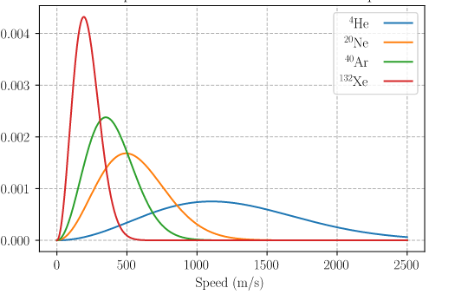
T = 300K
Mass decrease

Slide 17
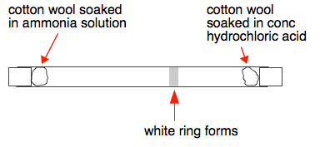

Slide 18
Bringing time dependency on concentration
(Ficks second law for diffusion)

Slide 19
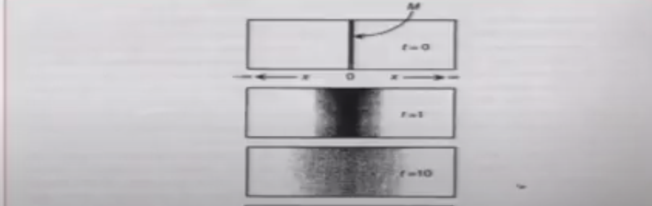

Slide 20
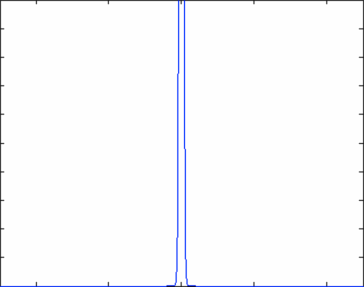
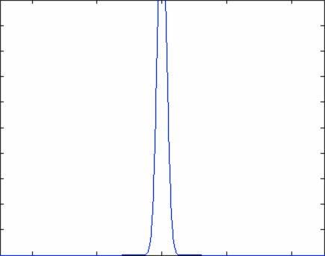

Slide 21
Time dependency of concentration (Fick’s second law)
Area =A
C
x

Slide 22
How much concentration inside
this volume change with time?
Apply
Fick’s
Law
C
x

Slide 24
Fick’s second law

Slide 25
Fick’s second law

Slide 26
Thermal Diffusion equation: Fick’s Law
Fick’s second law

Slide 27
Thermal Diffusion equations: Fick’s Law
Fick’s second law

Slide 28
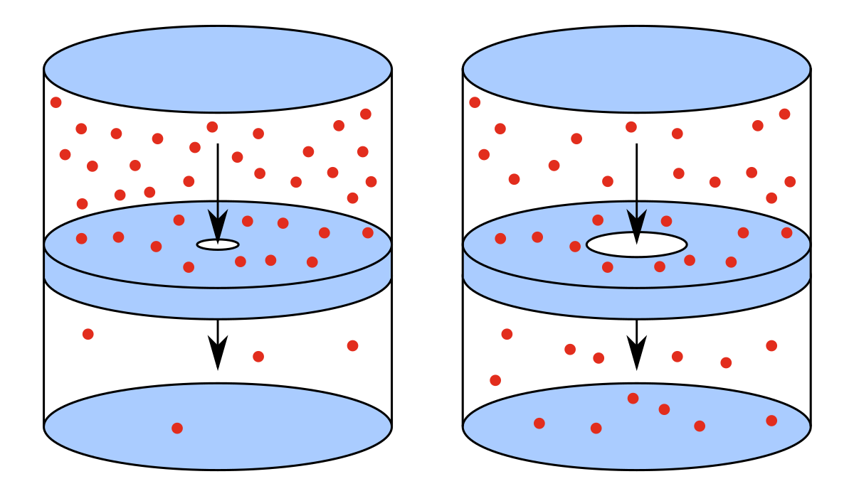
Effusion: A special Case
Effusion
Diffusion
Effusion occurs through an orifice smaller than the mean free path of the particles in motion

Slide 29
Effusion
Effusion
Effusion occurs through an orifice smaller than the mean free path of the particles in motion

Slide 30
Gas in left chamber is under equilibrium

Slide 31
To maintain gas in left chamber is under equilibrium
Ensures little or no collisions near the opening hence the equilibrium is maintained

Slide 32
Equilibrium is not disturbed
Under the above condition escape of molecules through hole is called as EFFUSION
OR
EFFUSION occurs through an orifice smaller than the mean free path of the particles in motion

Slide 33


