Slide 1
 |  |  | Lec9 | Lec 10
1 | 1921PH19 | SAUMYASHREE BARAL | p | p
2 | 2321PH02 | ARYA KUMAR SIDDHARTH | p | p
3 | 2321PH07 | NAINCY SHRIVASTAVA | p | p
4 | 2321PH09 | PRITAM SAMANTA | p | p
5 | 2321PH10 | REETU SAINI | p | p
6 | 2321PH13 | SOUBHIK MUKHERJEE | p | p
7 | 2321PH14 | NEHA CHOUDHARY | p | p
8 | 2321PH15 | RABI DAS | p | p
9 | 2321PH19 | SHRUTI SARSWAT | p | p
10 | 2212PH02 | AMAN KUMAR | p | p
11 | 2212PH10 | BINAYAK ROUT | p | p
12 | 2212PH11 | DARPAN SARKAR | p | p
13 | 2212PH13 | GAURAV JAISWAL | p | p
14 | 2212PH17 | KAUSHIP SAHA | p | p
15 | 2212PH20 | NEELLOHIT KARMAKAR | p | p
16 | 2212PH23 | RITIK PAL | p | p
17 | 2212PH26 | SOUMIK KARMAKAR | p | p
18 | 2212PH32 | KAUSTAB BHARASA | p | p

Slide 2
Concept of Doppler Cooling of Atoms

Slide 3
Cooling phases
Doppler
Cooling
Milli Kelvin range
MOT
Atomic density
Increased
Magnetic Trapping
Need
Multi-Level
Treatment.
2 level model fails…
Quantum nature of atoms observed
Evaporative Cooling

Slide 4
Some tricks to improve Doppler Cooling Using Magnetic field on Atoms
Magneto Optical Trap (MOT)

Slide 19
Effects of magnetic field on 2 Level atom
Uniform B
Uniform magnetic field (Helmholtz coil)
ZEEMAN SPLITTING
+1
0
-1

Slide 21
Effects of magnetic field on 2 Level atom (Using anti-helmhlotz coil)
-1
+1
0
0
+1
-1
-B
0
+B

Slide 26
-B
v
-1
0
ω_{zeeman}
+1
ω₀
Counter propagating σ+ Light Absorb’s: ω₀ - ω_{zeeman} + kv
The atom emits: ω₀ - ω_{zeeman} in the perpendicular direction by spontaneous
Emission.
VICE VERSA FOR σ- LIGHT FOR THE ATOM IN OTHER SIDE

Slide 27
Effects of magnetic field on 2 Level atom (Using anti-helmhlotz coil)
-1
+1
0
0
+1
-1
-B
0
+B

Slide 28
Effects of magnetic field on 2 Level atom (Using anti-helmhlotz coil)
-1
+1
0
0
+1
-1
-B
0
+B

Slide 30
Effects of magnetic field on 2 Level atom (Using anti-helmhlotz coil)
-1
+1
0
0
+1
-1
-B
0
+B

Slide 31
Magneto optical trapping
Energy
m_{F} = -1
m_{F} = +1
F=1
m_{F} = 0
m_{F} = 0
o
m_{F} = +1
m_{F} = -1
σ⁺
σ⁻
Δm_{F} = +1
Δm_{F} = -1
F=0
0
Z’’
Z’

Slide 32
Effects of magnetic field on 2 Level atom (Using anti-helmhlotz coil)
σ+
Both these will see same energy gap
At identical locations
σ-
-1
+1
0
0
+1
-1
-B
0
+B

Slide 33
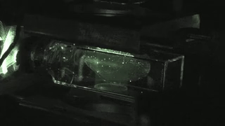

Slide 34
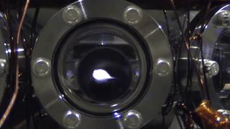

Slide 35
Some tricks to improve Doppler Cooling Using Magnetic field on Atoms
Magneto Optical Trap (MOT)

Slide 36
Effects of magnetic field on 2 Level atom
Uniform B
Uniform magnetic field (Helmholtz coil)
ZEEMAN SPLITTING
+1
0
-1

Slide 37
Magneto optical trapping
Energy
m_{F} = -1
m_{F} = +1
F=1
m_{F} = 0
m_{F} = 0
o
m_{F} = +1
m_{F} = -1
σ⁺
σ⁻
Δm_{F} = +1
Δm_{F} = -1
F=0
0
Z’’
Z’

Slide 38
MOT
v
ω_{zeeman}
+1
ω₀
Counter propagating σ+ Light Absorb’s: ω₀ - ω_{zeeman} - kv
The atom emits: ω₀ - ω_{zeeman} in the perpendicular direction by spontaneous
Emission.
VICE VERSA FOR σ- LIGHT FOR THE ATOM IN OTHER SIDE

Slide 39
Effects of magnetic field on 2 Level atom (Using anti-helmhlotz coil)
σ+
Both these will see same energy gap
At identical locations
σ-
-1
+1
0
0
+1
-1
-B
0
+B

Slide 40
Experiment Sequence

Slide 41
Doppler
Cooling
MOT
Laser
Power
ω₀-kv_{d}
Laser
frequency
ω₀ - ω_{zeeman} + kv
Magnetic
field

Slide 42
Cooling phases
Doppler
Cooling
Milli Kelvin range
MOT
Atomic density
Increased
Magnetic Trapping
Need
Multi-Level
Treatment.
2 level model fails…
Quantum nature of atoms observed
Evaporative Cooling

Slide 43
Approximate Mathematical approach for Deriving Doppler Cooling Force

Slide 44
Force equation in a MOT

Slide 45
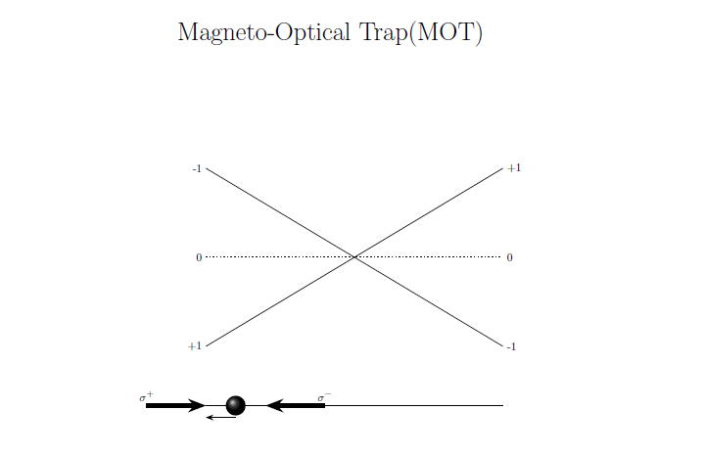
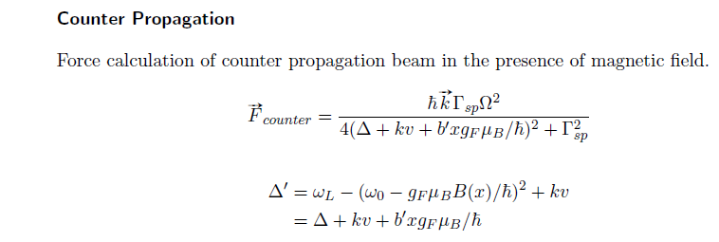

Slide 46
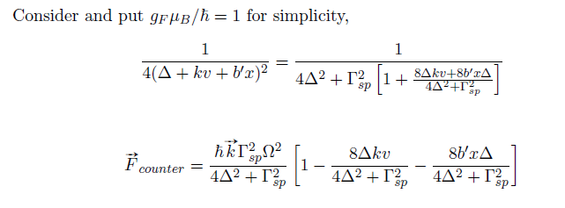
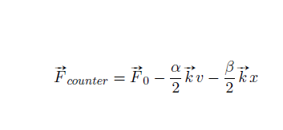

Slide 47
