Slide 1
Driven and Damped Oscillations
Forced Harmonic Oscillator

Slide 2
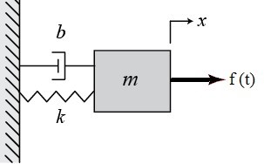
Driven and Damped Oscillations
Forced Harmonic Oscillator

Slide 3
Driven and Damped Oscillations
Forced Harmonic Oscillator

Slide 4
Driven and Damped Oscillations
Forced Harmonic Oscillator
We know the solution will be of oscillatory. Hence the general trial solution is given as

Slide 5
Driven and Damped Oscillations
Forced Harmonic Oscillator

Slide 6
Driven and Damped Oscillations
Forced Harmonic Oscillator

Slide 7
Driven and Damped Oscillations
Forced Harmonic Oscillator

Slide 8
Driven and Damped Oscillations
Forced Harmonic Oscillator

Slide 9
Resonance
The amplitude of the motion depends on driving frequency
The amplitude will be extremum for

Slide 10
Resonance
For extremum
The condition for extremum :
Resonance Frequency

Slide 11
Resonance

Slide 12
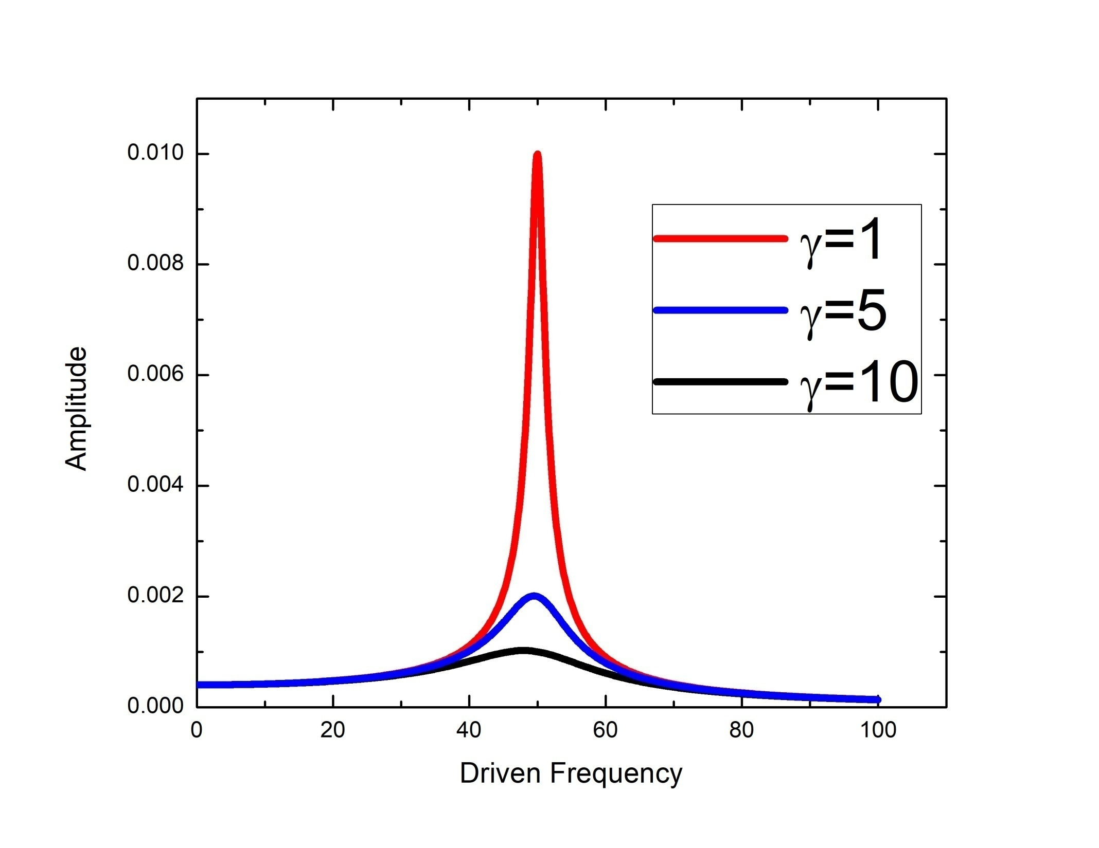
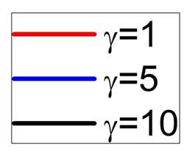

Slide 13
Complete solution of driven damped harmonic oscillator
The solution of this second-order differential equation comprises two components, the complementary solution, and the particular solution.

Slide 14
Tacoma bridge collapse
Wine glass Breaking

Slide 15
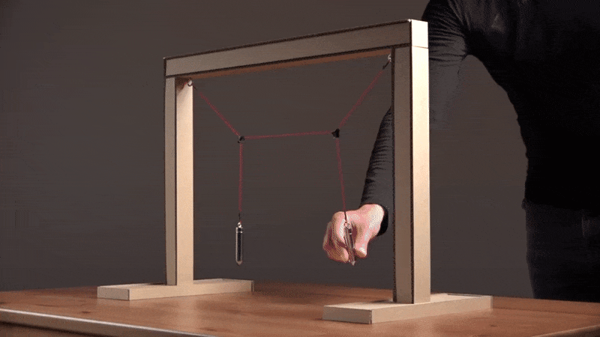
Coupled Oscillations

Slide 16
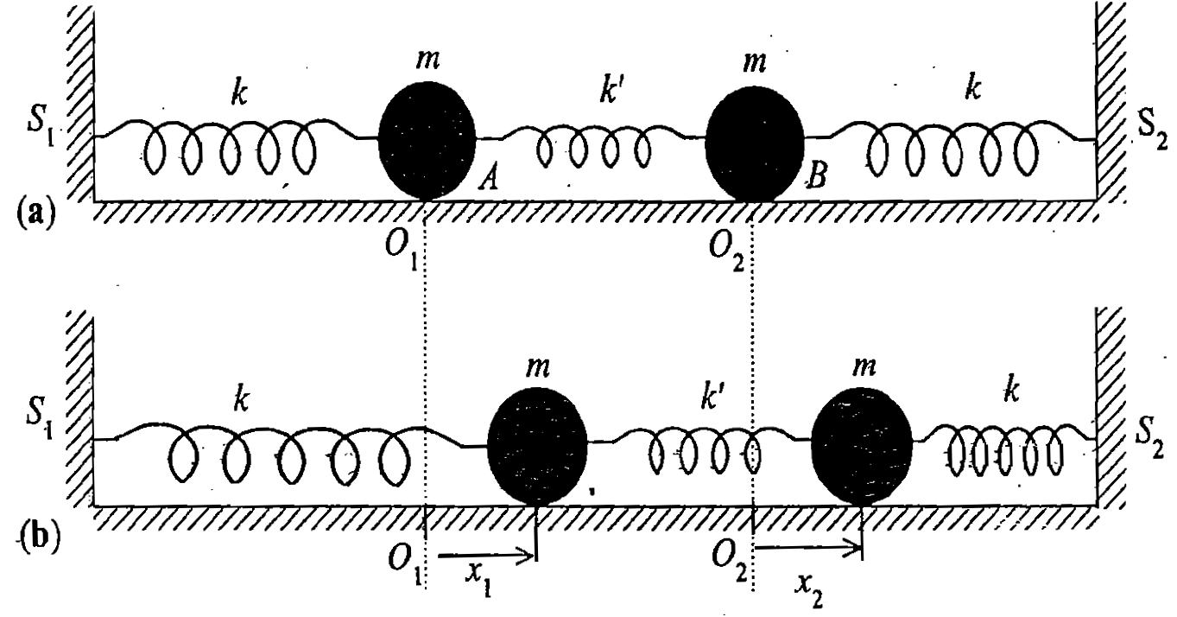
Coupled Oscillators
NON-INTITUTIVE!

Slide 17
Coupled Oscillators
Equations of motion are
Simultaneous coupled differential equation

Slide 18
Matrix equation of coupled oscillator

