Slide 1
PH 103: PHYSICS
INTRODUCTION

Slide 2
Course Instructor
Dr. Raghavan K E , PhD (France, Paris) PDF(Nottingham, UK)
Faculty in Physics
Department of Physics
Indian Institute of Technology Patna
www.raghavanke.com
G4,G5,G6
Main Physics theory Instructor
Professor-in Charge: Physics Lab for all batches
Dixith M
Indranil Maity
Rohit Kumar
SAMAYUN SAIKH
Saumyashree Baral
Subhadeep Sarkar
Vivek Mehta
Tutorials:

Slide 3
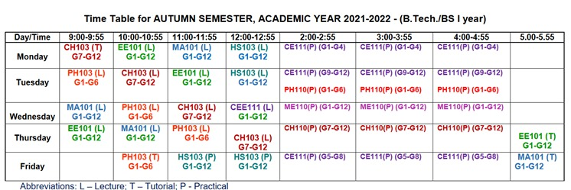
Time Table

Slide 4
Course Syllabus
Orthogonal coordinate systems and frames of reference, conservative and non-conservative forces, work-energy theorem, potential energy and concept of equilibrium; Rotation about fixed axis, translational-rotational motion, vector nature of angular velocity, rigid body rotation and its applications, Euler's equations; Gyroscopic motion and its application; Accelerated frame of reference, centrifugal and Coriolis forces.
Harmonic oscillator, damped and forced oscillations, resonance, coupled oscillations, small oscillation, normal modes, longitudinal and transverse waves, wave equation, plane waves, phase velocity, superposition wave packets and group velocity, two and three dimensional waves.
Failure of classical concepts, Black body radiation, photo-electric effect, Compton effect, Davison and Germer's experiment, Frank-Hertz experiment, Bohr's theory, Sommerfeld's model, correspondence principle, Planck hypothesis, De Broglie's hypothesis, Hilbert space, observables, Dirac notation, principle of superposition, wave packets, phase and group velocities, probability & continuity equation, eigenvalues and eigen-functions, orthonormality, expectation values, uncertainty principle, postulates of QM, Schrodinger equation & its applications to 1D potentials, field quantization, periodic potential wells: Kronig Penny model and origin of band gap.

Slide 5
Text Books and References
Textbooks:
D. Kleppner and R. J. Kolenkow, An introduction to Mechanics, Tata McGraw-Hill, New Delhi, 2000.
David Morin, Introduction to Classical Mechanics, Cambridge University Press, NY, 2007
Frank S. Crawford, Berkeley Physics Course Vol 3: Waves and Oscillations, McGraw Hill, 1966.
Arthur Beiser, Concepts of Modern Physics, McGraw Hill, 2003
Eyvind H. Wichmann, Berkeley Physics Course Vol 4: Quantum physics, McGraw Hill, 1971.
P. C. Deshmukh, Foundations of Classical Mechanics, Cambridge University Press, 2019
References:
R. P. Feynman, R. B. Leighton and M. Sands, The Feynman Lecture in Physics, Vol I, Narosa Publishing House, New Delhi, 2009.
R. P. Feynman, R. B. Leighton and M. Sands, The Feynman Lecture in Physics, Vol III, Narosa Publishing House, New Delhi, 2009.
R. Eisberg and R. Resnick, Quantum Physics of atoms, molecules, solids, nuclei and particles, John Wiuley and Sons (Asia) Pvt. Ltd., Singapore, 2002.
A. J. Dekker, Solid State Physics, Macmillan Pub. India Ltd., New Delhi, 2009
David J. Griffith, Introduction to Quantum Mechanics, Pearson Education Ltd, New Delhi, 2009.
B.H. Bransden & C.J. Joachain, Quantum Mechanics, Pearson Education Ltd, New Delhi, 2008.

Slide 6
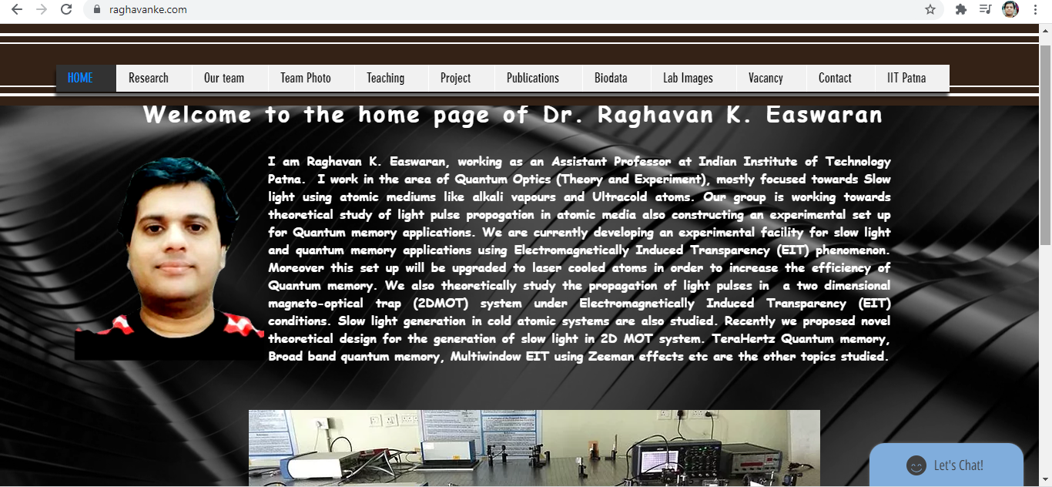
How to find the course materials?
Go to www.raghavanke.com

Slide 7
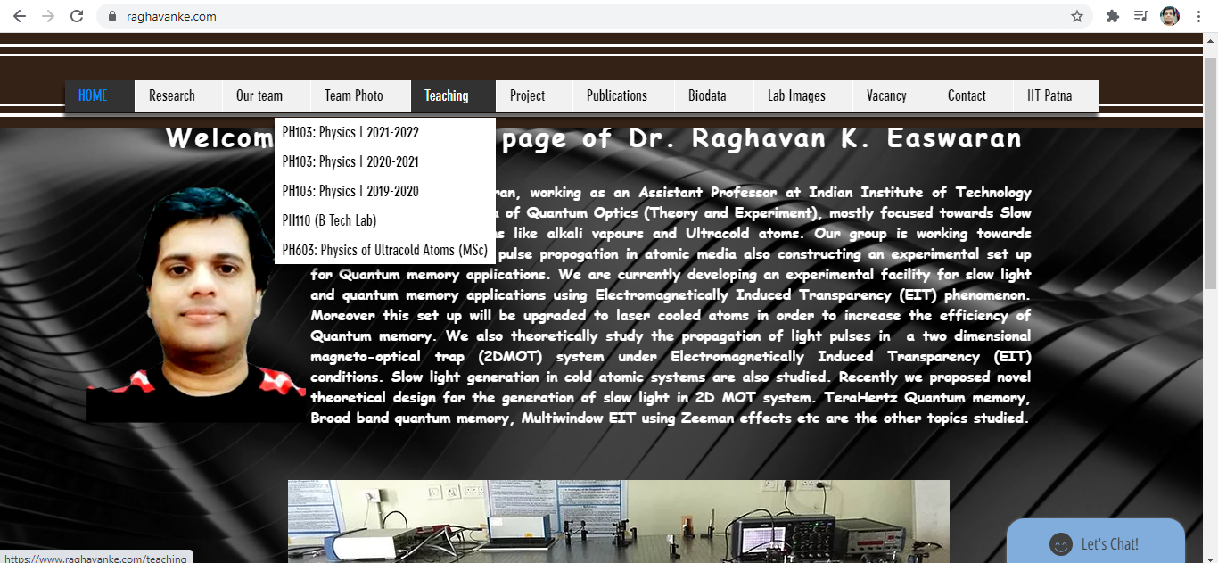

Slide 8
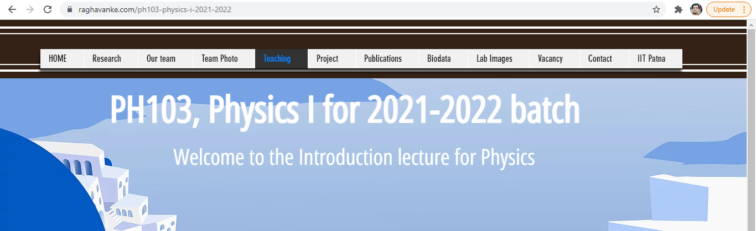
Day to Day Lecture videos, pptx slides, course materials, Assignments, will be available online

Slide 10
Evaluation Scheme
Will get updated soon…..

Slide 11
What have you learned so far?
Scalars and Vectors
Motion in straight line
Laws of Motion
Torque and Angular momentum
Harmonic Motion
Dual Nature of Matter and Radiation

Slide 12
Highlights of the course
Co-ordinate Systems
Introduction to Vector Operators
Work , Energy and Conservation laws
Rigid body in motion
Oscillations and Waves
Quantum Physics

Slide 13
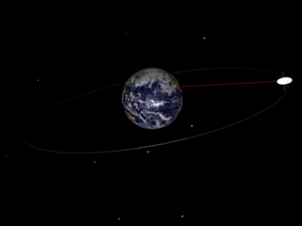
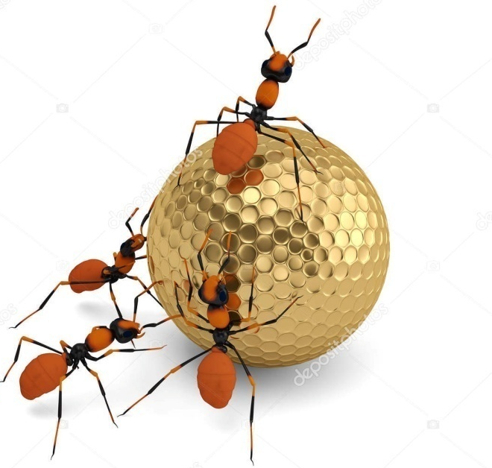
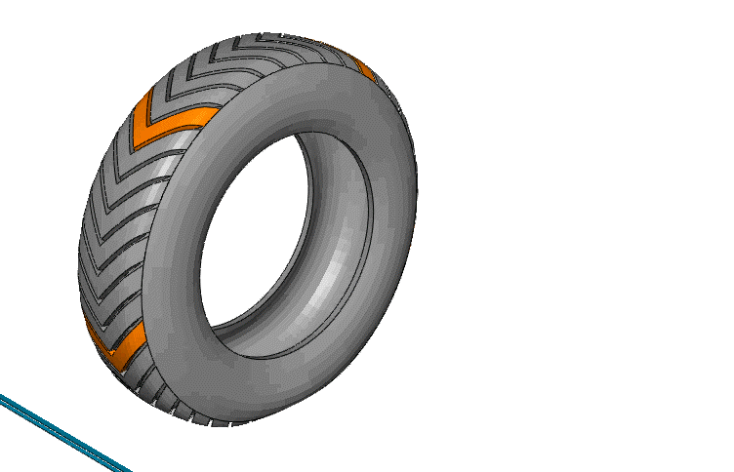
Co-ordinate Systems

Slide 14
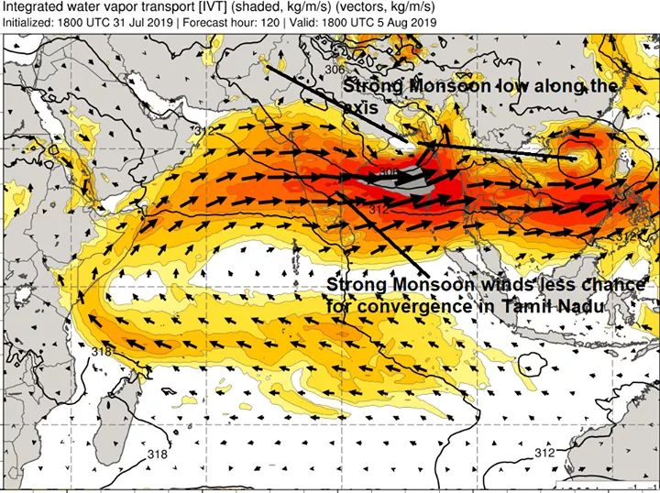
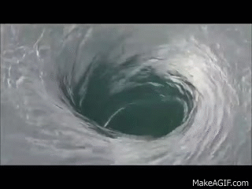
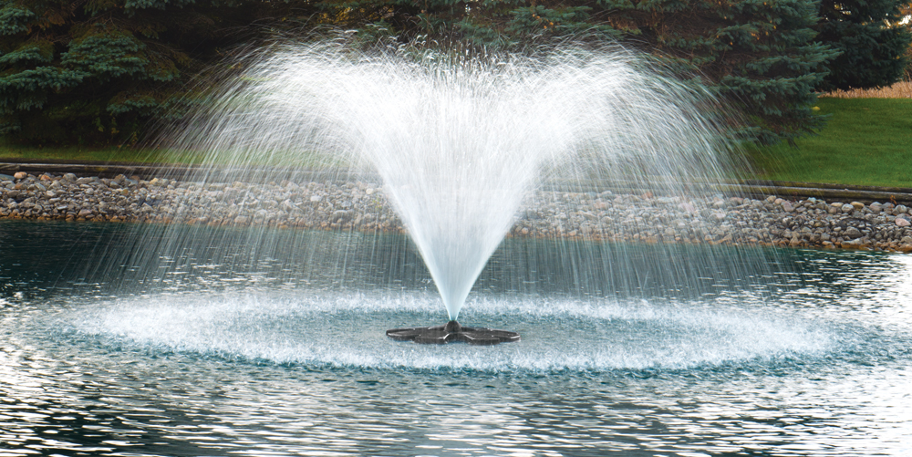
Introduction to Vector Operators

Slide 15
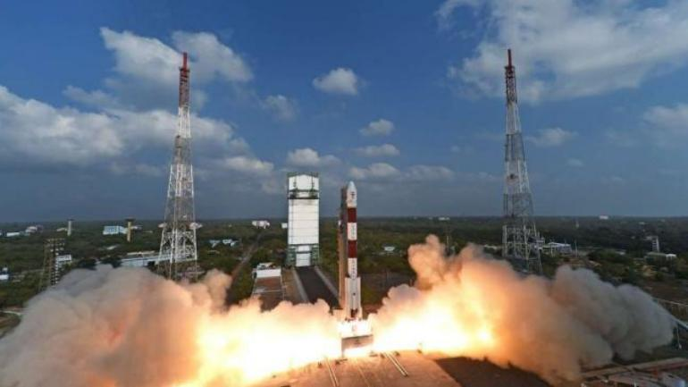
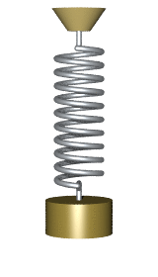
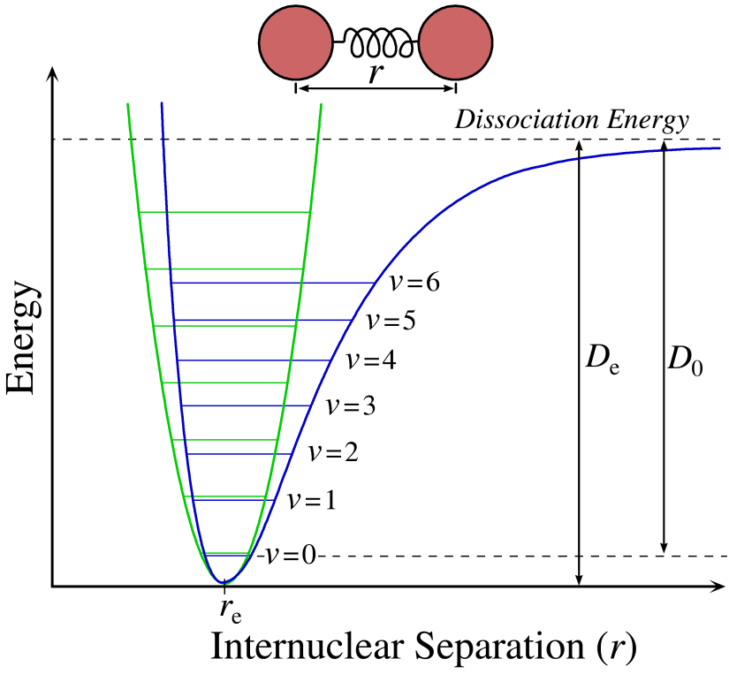
Work , Energy and Conservation laws

Slide 16
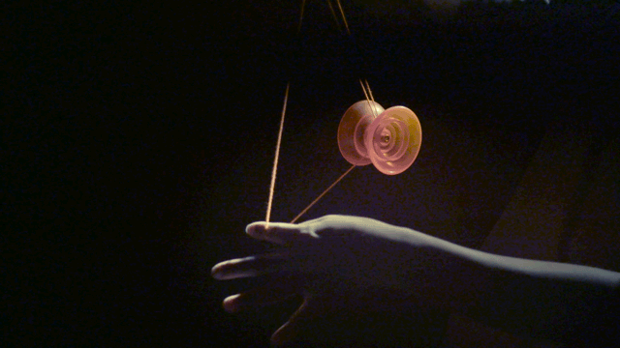
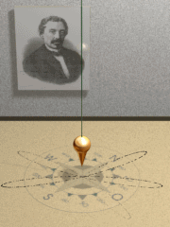
Rigid body in motion

Slide 17
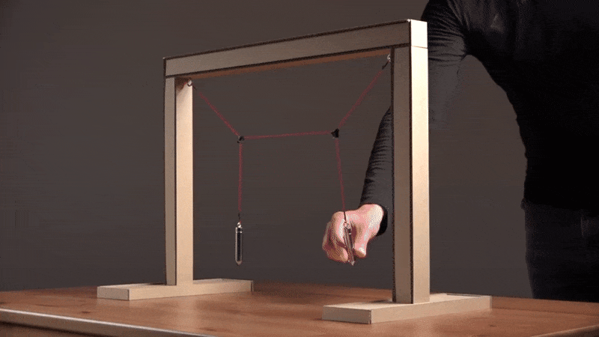
Oscillations and Waves

Slide 18
Mechanical effects of sound

Slide 19
Classical physics in modern era

Slide 20
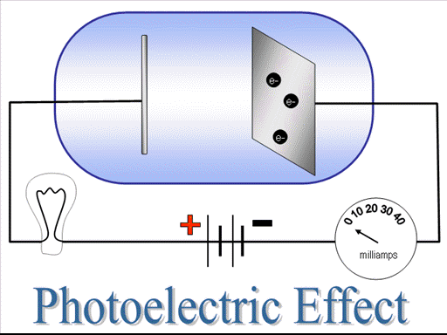
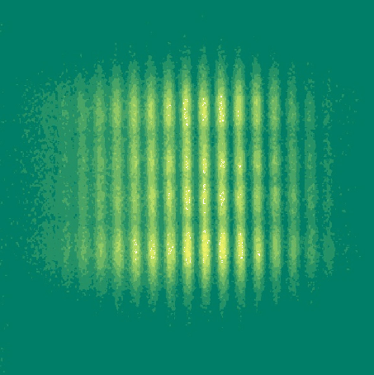
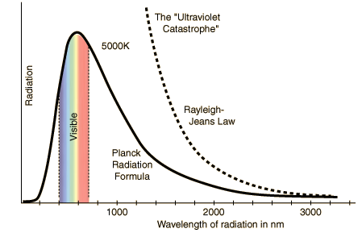
Limitations of Classical Physics

Slide 21
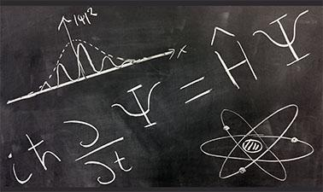
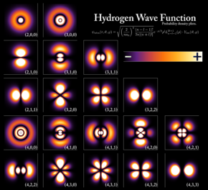
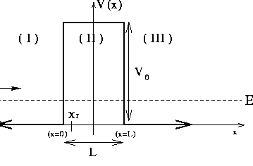
Quantum Physics

Slide 22
A boy and his atom (Quantum)

Slide 23
Thank you

