Slide 1
Season 2, Lecture 11 (S2,L11):
Effusion

Slide 6
Name | L9 | L10 | L11
"2201ph34_dolly" <2201ph34_dolly@iitp.ac.in>; | p | P | p
"Adhila Aslam" <2201ph01_adhila@iitp.ac.in>; | p | P | p
"Aditi Baghel" <2201ph31_aditi@iitp.ac.in>; | p | P | p
"Aditya Kumar" <2201ph02_aditya@iitp.ac.in>; | p | A | A
"Aditya Singh" <2201ph03_aditya@iitp.ac.in>; | p | P | p
"Anil Ram" <2201ph04_anil@iitp.ac.in>; | a | A | A
"Animesh Sharma" <2201ph05_animesh@iitp.ac.in>; | p | P | p
"Arun Mishra" <2201ph06_arun@iitp.ac.in>; | a | P | p
"Aryan Raj" <2201ph32_aryan@iitp.ac.in>; | p | P | p
"Ayush Gautam" <2201ph07_ayush@iitp.ac.in>; | a | P | a
"Boda Vishnuwardhan" <2201ph08_boda@iitp.ac.in>; | p | A | A
"Chanchal Tolani" <2201ph09_chanchal@iitp.ac.in>; | p | P | p
"Devansh Srivastava" <2201ph33_devansh@iitp.ac.in>; | a | A | A
"Gaurav Verma" <2201ph10_gaurav@iitp.ac.in>; | p | P | p

Slide 7
Name | L9 | L10
"Gourav Jha" <2201ph11_gourav@iitp.ac.in>; | a | P | p
"Gurinder Dhillon" <2201ph12_gurinder@iitp.ac.in>; | p | P | A
"Harsh Joshi" <2201ph13_harsh@iitp.ac.in>; | p | P | p
"Himanshu Patel" <2201ph35_himanshu@iitp.ac.in>; | p | P | p
"Jigyasa Agrawal" <2201ph36_jigyasa@iitp.ac.in>; | a | A | A
"Khushal Yadav" <2201ph14_khushal@iitp.ac.in>; | p | P | p
"Krishnakant Chourey" <2201ph15_krishnakant@iitp.ac.in>; | p | A | A
"Manas Gupta" <2201ph16_manas@iitp.ac.in>; | a | P | p
"Mohit Saini" <2201ph17_mohit@iitp.ac.in>; | a | P | p
"Mude Naik" <2201ph18_mude@iitp.ac.in>; | p | P | p
"Murari Kumar" <2201ph19_murari@iitp.ac.in>; | p | P | A
"Nishant Yadav" <2201ph20_nishant@iitp.ac.in>; | p | P | A
"Pranitha Moluguri" <2201ph21_pranitha@iitp.ac.in>; | p | P | p

Slide 8
Name | L9 | L10
"Premanandh Sigamala" <2201ph22_premanandh@iitp.ac.in>; | p | P | A
"Ruchi Thakur" <2201ph23_ruchi@iitp.ac.in>; | p | P | p
"Satyam Sahoo" <2201ph25_satyam@iitp.ac.in>; | p | P | p
"Satyam Shandilya" <2201ph24_satyam@iitp.ac.in>; | p | P | A
"Shyam Hembram" <2201ph26_shyam@iitp.ac.in>; “ | p | P | p
Sougata Saha" <2201ph27_sougata@iitp.ac.in>; | a | A | A
"Sumit Rajpoot" <2201ph28_sumit@iitp.ac.in>; | p | P | p
"Suprajit Dewanji" <2201ph29_suprajit@iitp.ac.in>; | a | P | p
"Yepuri Subhash" <2201ph30_yepuri@iitp.ac.in> | p | A | A
Attendance: 75% mandatory

Slide 9
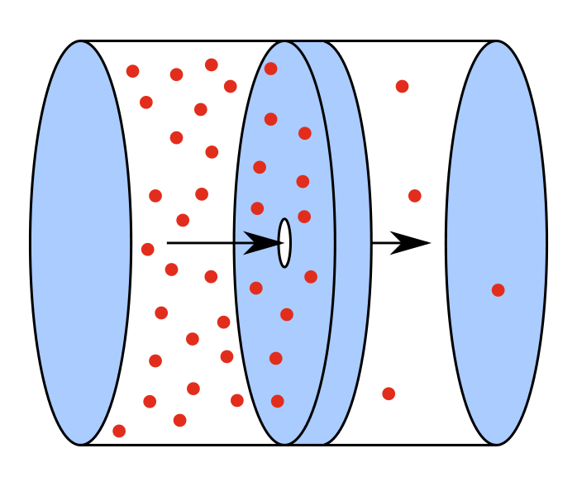
Effusion
Effusion
Effusion occurs through an orifice smaller than the mean free path of the particles in motion

Slide 10
Gas in left chamber is under equilibrium

Slide 11
To maintain gas in left chamber is under equilibrium
Ensures little or no collisions near the opening hence the equilibrium is maintained

Slide 12
Equilibrium is not disturbed
Under the above condition escape of molecules through hole is called as EFFUSION
OR
EFFUSION occurs through an orifice smaller than the mean free path of the particles in motion

