Slide 1
L17
Engineering application Problems

Slide 2
Roll No. | Name | L1 | L2 | L3 | L4 | L5 | l6 | l7 | l8 | l9 | l10 | l11 | l12 | l13 | l14 | l15 | l16 | l17
2301PH01 | Aditya Chandra | p | P | p | p | P | p | a | p | a | p | a | p | p | a | p | a | p
2301PH02 | Aditya Mittal | p | P | a | p | P | p | p | p | a | a | a | p | a | a | p | a | p
2301PH03 | Aditya Prakash Gupta | p | P | p | p | P | p | p | p | p | a | p | p | a | p | p | a | p
2301PH04 | Amit Kumar | a | P | p | p | P | p | p | p | p | a | p | a | p | a | p | p | a
2301PH05 | Angaanba Ningthoujam | p | P | p | p | P | p | p | p | p | p | p | p | p | p | p | a | p
2301PH06 | Arunvishal Palanisamy | p | P | p | p | P | p | p | p | p | a | p | a | p | p | p | p | p
2301PH07 | Ashmit Verma | p | P | p | p | P | p | p | p | p | p | p | p | p | p | p | p | p
2301PH08 | Azariah Peter | a | A | p | p | P | p | p | p | a | p | a | p | p | p | p | a | p
2301PH09 | Deveshsingh Kuldeepsingh Tomar | p | P | p | p | P | p | c | c | c | c | c | c | c | c | c | c | c

Slide 3
 |  | L1 | L2 | L3 | L4 | l5 | l6 | l7 | l8 | l9 | l10 | l11 | l12 | l13 | l14 | l15 | l16
2301PH10 | Muskan Singh | p | P | a | p | P | p | p | p | p | p | p | p | p | p | p | p | p
2301PH11 | Naveen Saini | a | P | p | p | P | p | p | p | p | a | p | p | p | a | p | p | a
2301PH12 | Nishanth Kumaran | p | P | p | a | P | p | a | p | p | a | a | p | a | p | p | a | p
2301PH13 | Nived Krishna M | p | P | p | p | P | p | p | a | a | a | a | p | a | p | p | p | p
2301PH14 | Ratan Deep Prasad | p | P | p | p | P | p | p | p | a | a | a | p | p | p | p | a | a
2301PH15 | Ritesh | p | P | p | p | P | p | c | c | c | c | c | c | c | c | c | c | c
2301PH16 | Shivam Kumar Kannojia | p | P | p | p | P | p | p | a | a | p | a | p | p | p | p | a | p
2301PH17 | Shivang Rayat | p | P | p | p | P | p | p | p | p | p | p | p | a | p | p | a | p
2301PH18 | Yashraj Singh Thakur | p | P | p | p | P | p | p | a | p | p | p | p | a | p | p | a | p
2301PH19 | Aekampreet Singh Dhir | p | P | p | p | P | p | p | p | p | p | p | p | a | a | p | p | p
2301PH20 | Banoth Naveen | a | A | a | a | A | a | a | a | a | p | p | p | p | p | a | a | a

Slide 4
 |  | L1 | L2 | L3 | L4 | l5 | l6 | l7 | l8 | l9 | l10 | l11 | l12 | l13 | l14 | l15 | l16
2301PH21 | Neerati Pranay | p | P | p | p | P | p | p | p | a | p | a | p | p | p | p | p | a
2301PH22 | Tanish Dhankhar | p | P | p | p | P | p | p | p | p | a | a | p | a | a | p | a | p
2301PH23 | Farhan Farhan | p | P | p | a | P | p | p | p | p | a | p | a | a | p | p | p | p
2301PH24 | Utpal Raj Ambastha | p | P | p | p | P | p | p | p | p | p | p | p | p | p | p | p | p
2301PH25 | Riya Singh | p | P | p | p | P | p | p | p | p | p | a | p | p | p | p | p | p
2301PH26 | Aakarsh Sinha | a | P | p | p | P | p | c | c | c | c | c | c | c | c | c | c
2301PH27 | Rahul Katravath | a | A | p | p | P | p | p | p | p | a | p | p | a | p | p | p | p
2301PH28 | Shivani | p | P | p | p | P | p | p | p | p | p | p | p | p | p | p | p | p
2301PH29 | Rakesh Bairwa | p | P | a | p | P | p | p | p | p | a | p | p | p | a | p | p | p
2301PH30 | Nikhil Pratap Singh | a | P | p | p | P | p | p | p | p | p | p | p | p | p | p | p | p
2301PH31 | Sridutt Rugada | a | P | p | p | P | p | p | p | p | p | p | p | p | a | p | p | a
2301PH32 | Anmisha Jadi | p | P | p | p | P | p | p | p | p | p | a | a | p | p | p | p | p
Attendance: 75% mandatory

Slide 5
$$A gas is contained in a frictionless piston \\ cylinder mechanism at an initial pressure of 1 bar. \\ The diameter of the piston is 10 cm and it rests \\ on stops initially as shown in the figure. The \\ piston weight is such that it requires a pressure \\ of 1.5 bar to be lifted from the stops. The gas is \\ now heated which causes the piston to rise slowly. \\ After a rise of 10cm, the piston touches a linear \\ spring with a stiffness value of 10 N/mm. The \\ heating of the gas is finally stopped when the \\ spring is compressed by 1cm. Determine the \\ work interaction for the gas, piston, spring and \\ the atmosphere. Also sketch the \\ process undergone by the gas on a p−V diagram \\ by mentioning the values of pressure and volumes in different stages$$
Wherever possible$and show the four work interactions mentioned$ $$above by hatching the appropriate areas.$$
stops

Slide 6
$$A gas is contained in a frictionless piston \\ cylinder mechanism at an initial pressure of 1 bar. \\ The diameter of the piston is 10 cm and it rests \\ on stops initially as shown in the figure. The \\ piston weight is such that it requires a pressure \\ of 1.5 bar to be lifted from the stops. The gas is \\ now heated which causes the piston to rise slowly. \\ After a rise of 10cm, the piston touches a linear \\ spring with a stiffness value of 10 N/mm. The \\ heating of the gas is finally stopped when the \\ spring is compressed by 1cm. Determine the \\ work interaction for the gas, piston, spring and \\ the atmosphere. Also sketch the \\ process undergone by the gas on a p−V diagram \\ by mentioning the values of pressure and volumes in different stages$$
Wherever possible$and show the four work interactions mentioned$ $$above by hatching the appropriate areas.$$
stops

Slide 14
By calculating the different areas we can calculate
All the regions mentioned

Slide 15
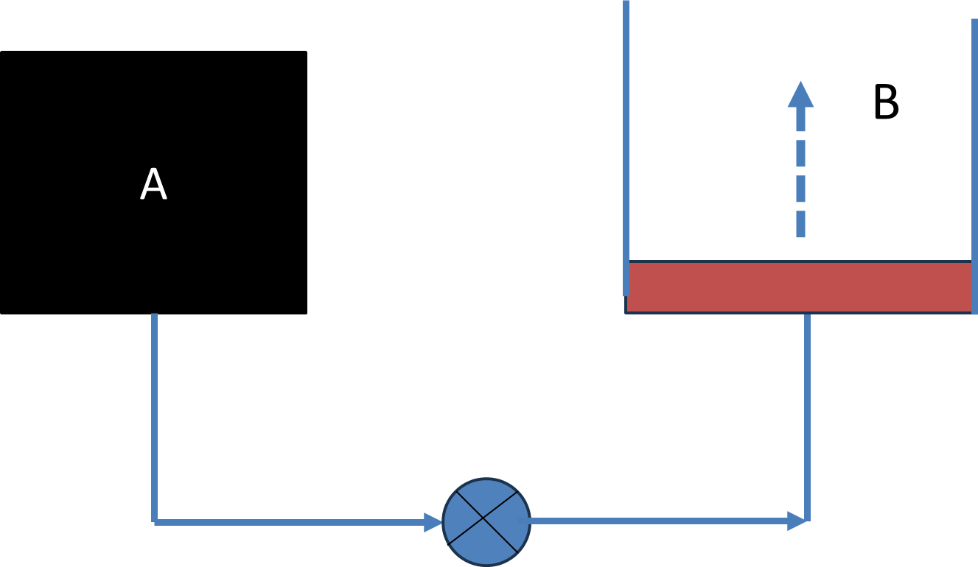
Tank A and a piston-cylinder arrangement B are connected through pipes as shown. The piston is frictionless. Tank A contains Nitrogen at 300 kPa and its volume is 0.4 m³. It requires 150 kPa to lift the piston. As the connecting valve opens, Nitrogen flows into the piston – cylinder arrangement B and attains a steady state after some time. What is the final pressure and work interaction for Nitrogen if the initial and final states are related by pV=C, where p and V represent pressure and volume of the gas and C represents a constant

Slide 16
Tank A and a piston-cylinder arrangement B are connected through pipes as shown. The piston is frictionless. Tank A contains Nitrogen at 300 kPa and its volume is 0.4 m³. It requires 150 kPa to lift the piston. As the connecting valve opens, Nitrogen flows into the piston – cylinder arrangement B and attains a steady state after some time. What is the final pressure and work interaction for Nitrogen if the initial and final states are related by pV=C, where p and V represent pressure and volume of the gas and C represents a constant

Slide 17
“Cutting tool Lathe”

Slide 19
R = 40 mm

Slide 20
R = 40 mm
Cutting Torque
Work done by the Torque

Slide 21
R = 40 mm

Slide 22
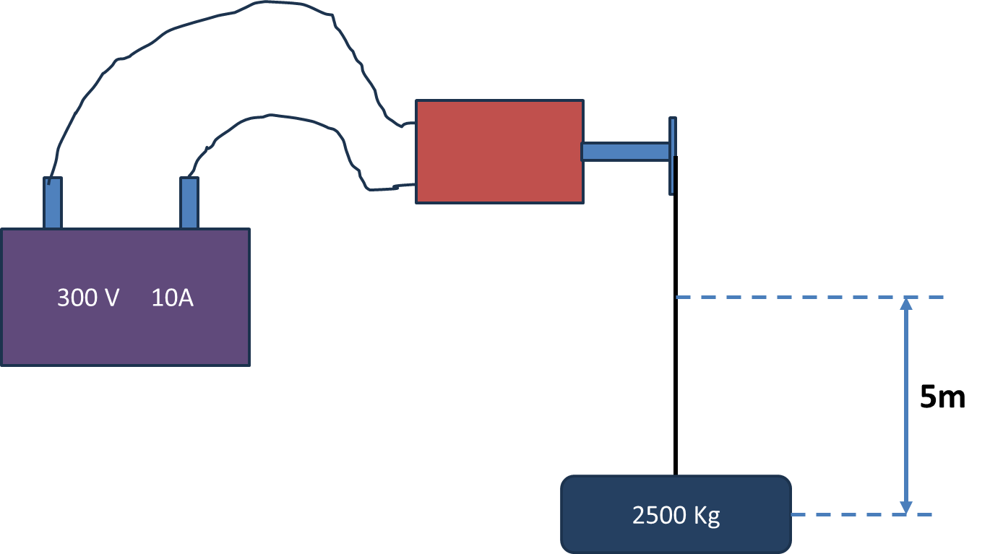
DC electrical motor is used to operate a hoist mechanism (which does lifting of objects) in a crane. The motor is supplied with 300 V and 10 Ampere from a DC source for a period of 2 min. The torque provided by the motor to the hoist shaft is 250 Nm at 50 rpm. The hoist mechanism lifts a mass of 2500 Kg through a height of 5m. Calculate the work interaction for the DC source, motor, hoist and the mass

