Slide 1
Co-ordinate Systems
Introduction to Vector Operators
Work , Energy and Conservation laws
Rigid body in motion
Oscillations and Waves
Quantum Physics

Slide 2
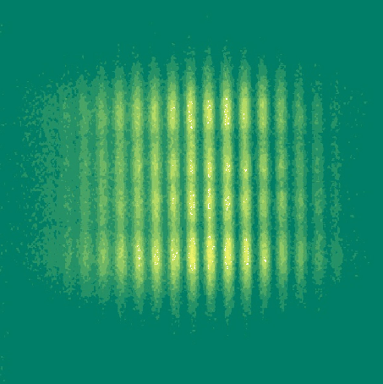
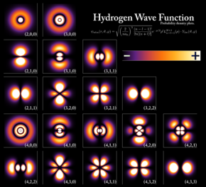
Chapter 6 Quantum Physics

Slide 3
Quantum Physics
Historical Overview: Revision of what you may know from 12th std syllabus
Particle nature of Light
Wave nature of Particle
De Broglie hypothesis and its experimental proof
Uncertainty principle
Quantum nature of energy in light and matter

Slide 4
Few surprises/Contradictions in the beginning of 19th Century!
Particle nature of light

Slide 5
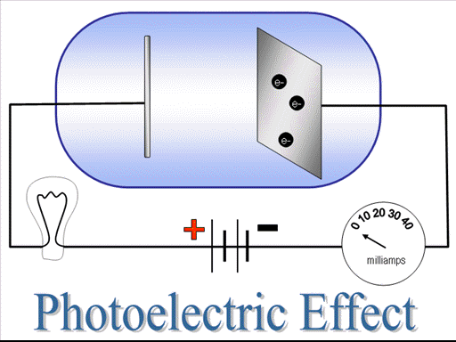
Photoelectric Effect

Slide 6
The Black-Body Radiation
A black body is a perfect absorber and emitter

Slide 7
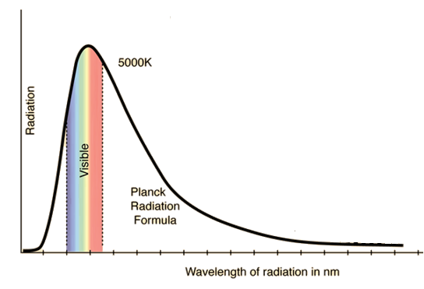
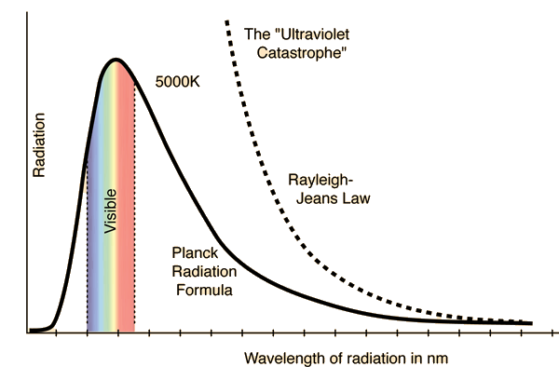
Spectrum of sun
Ultraviolet Catastrophe

Slide 8
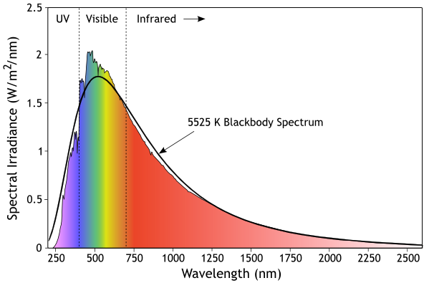
Planck’s Radiation Formula
Planck
Hypothesis

Slide 9
Compton Effect
λ’
e
λ
λ’> λ

Slide 10
Few surprises/Contradictions in the beginning of 19th Century!
Wave nature of particle

Slide 11
De Broglie hypothesis
Velocity 5m/s
Mass=70 kg
Find the De-broglie wavelength!

Slide 12
De Broglie hypothesis
Velocity 5m/s
Mass=9.1X10⁻³¹ kg
e
Find the De-broglie wavelength!

Slide 13
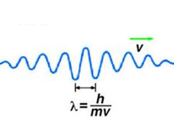
How do we understand the motion?
e

Slide 14
Confirmation of De Broglie hypothesis 1. Electron beam Interference

Slide 15
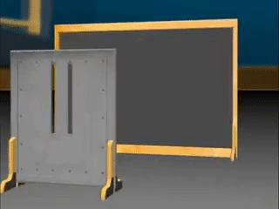
Confirmation of De Broglie hypothesis

Slide 16
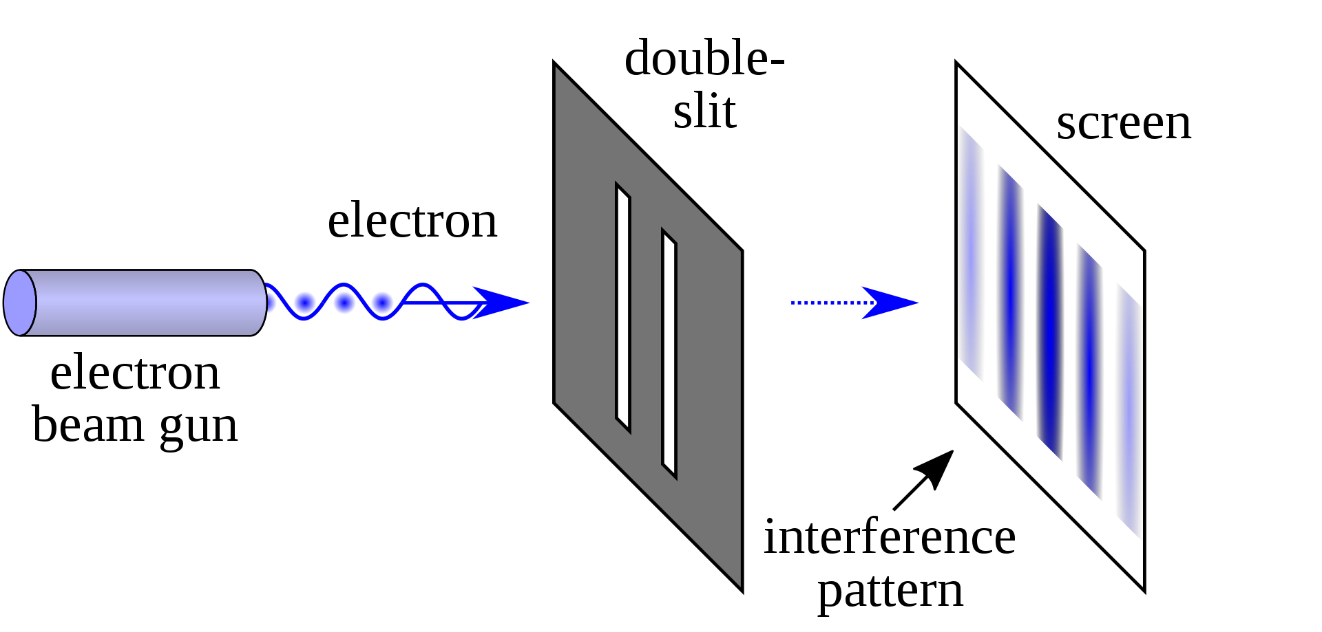
Confirmation of De Broglie hypothesis

Slide 17
Confirmation of De Broglie hypothesis 2. Davisson Germer Experiment

Slide 18
Davisson Germer experiment

Slide 19
Davisson Germer experiment

Slide 20
Davisson Germer experiment
For a given accelerated voltage
maximum Intensity was
recorded for
particular angle
E-Gun
Detector
ϴ
I
Nickel Target
θ

Slide 21
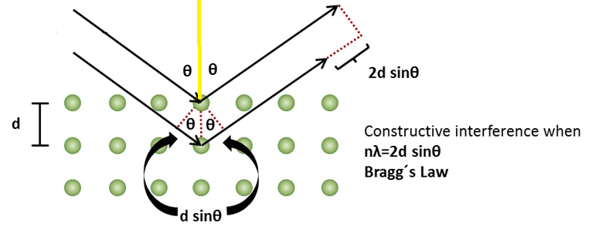
Davisson Germer experiment
Experimental determination of λ
E-Gun
Detector
By finding θ from experiment, knowing “d”
For Nickel crystal and substituting
n=1, 2,3………… λ is found experimentally

Slide 22
Davisson Germer experiment
Theoretical determination of λ
In Davison-Germer experiment, electron was accelerated to a kinetic energy of 54 eV and Bombarded into a nickel crystal with lattice spacing d=0.091 nm. Maximum intensity was observed (for n=1) in the detector at an angle θ=65º.Calculate the De-Broglie wavelength of the diffracted electron using the given experimental parameters. Also verify theoretically using De-Brogle hypothesis.
Experiment and Theoretical values of λ match

Slide 23
Davisson Germer experiment
E-Gun
Detector
By changing the accelerated voltage maximum Intensity was recorded for a different angle

Slide 24
How does this wave nature of particle effect the measurements of position and momentum?
UNCERTAINITY PRINCIPLE

Slide 25
Lets look at moving electron a quantum particle
Δx: large, means measurement of position is not accurate
Measurement of λ will be more precise, which means momentum p would be more accurate

Slide 26
Lets look at a localized electron a quantum particle
Δx: small, means measurement of position is accurate
Position and momentum of a particle can not be determined simultaneously and accurately

Slide 27
All these experiments confirm dual nature of sub atomic particles and light
Light as PHOTON and electron as MATTER WAVES
Classical or Newtonian Mechanics could not explain all these
New field called Quantum Physics emerged
What is “Quantum” here?

Slide 28
Quantum
Discrete or fixed or allowed entity
Photon picture of light defines energy as
quantized entity: E = hν
Quantum Nature of Light
Some experiments showed energy of matter is also quantized

Slide 29
A thought experiment
Throwing a ball
One can throw ball
to any height
K.E is converted to P.E
Classical Experiment

Slide 30
Quantum nature of energy of matter

Slide 31
Shining light to a matter
LIGHT
SOURCE
Only
Discrete Energies
are absorbed
Something Quantum inside Matter?

Slide 32
What happens Inside?
Matter
is
Quantized
P.E. of atom is increased for a selective frequency by absorption
RECOLLECT HARMONIC OSCILLATOR: RESONANT FREQUENCY

Slide 33
Emission by spontaneous decay

