Slide 1
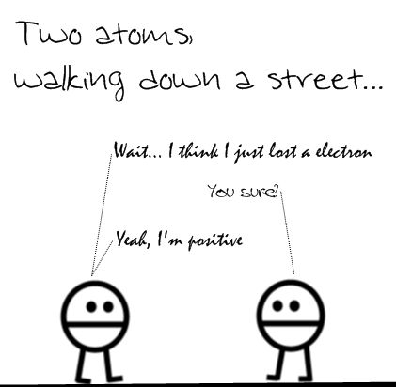
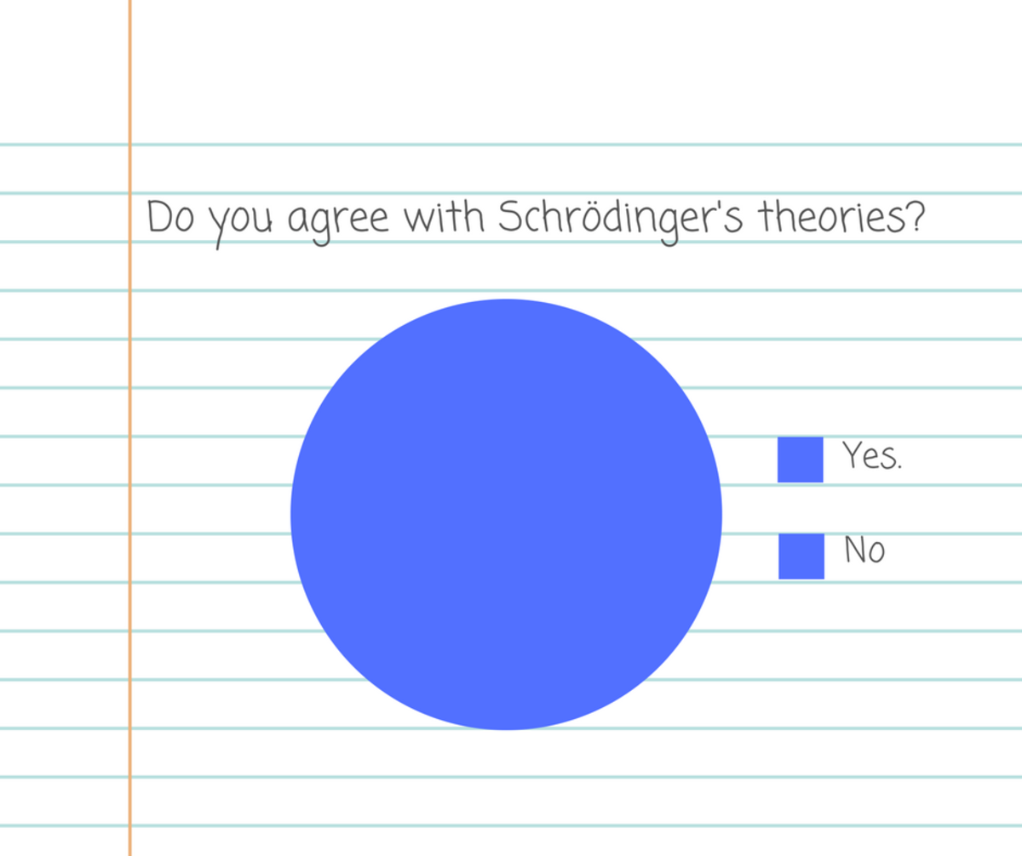
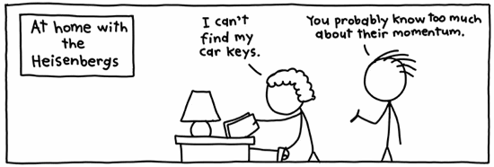
Quantum Physics-Lecture 6

Slide 3
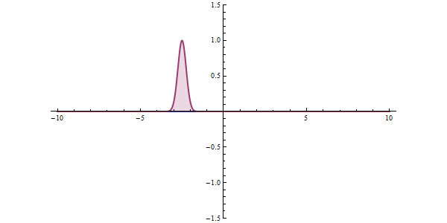
Quantum Tunneling

Slide 4
Quantum: Wave function
Classical
U
I
E
x

Slide 5
Solving in region II
Quantum wave function
U
II
E
x

Slide 6
Region III
V
III
x

Slide 7
Wave functions in 3 regions

Slide 8
Physical Interpretation
V
I
II
III
E

Slide 9
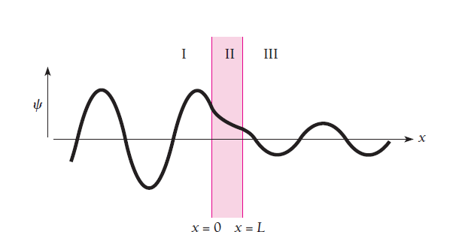
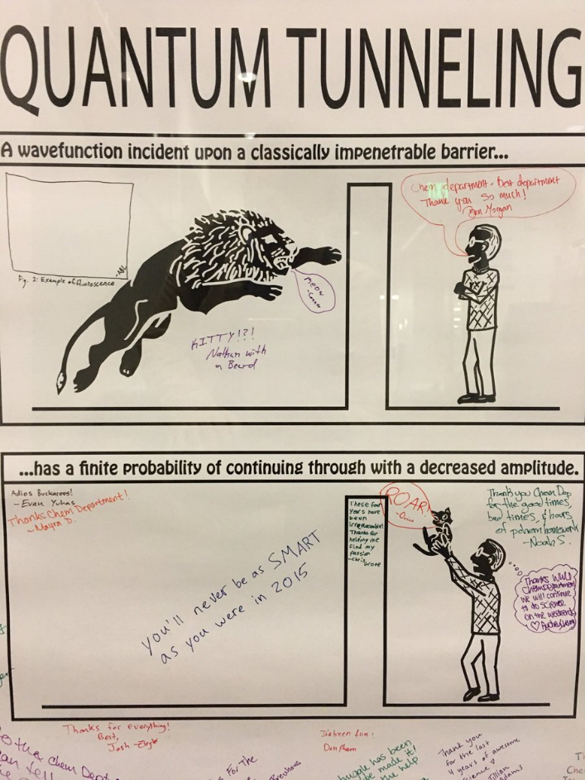
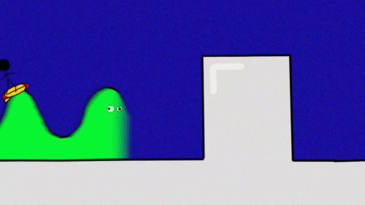
Effect of Tunneling!

Slide 10
Determining the relation between the coefficients A’s and B’s
Tunneling Probability or Tunneling coefficient

Slide 11
Using Boundary Conditions
Recollect
x=0

Slide 12
Using first boundary conditions
Using second boundary conditions

Slide 13
V
II
III
x=a

Slide 14
Using first boundary conditions
Using second boundary conditions

Slide 15
Find the relation between coefficients A_{III} and A_{I} from eqns 1,2,3 and 4

Slide 16
Tunneling Probability or Tunneling coefficient

Slide 17
Applications
Alpha decay
Scanning Tunneling Microscope (STM)

Slide 18
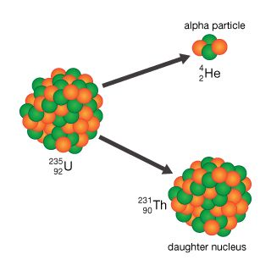

Slide 22
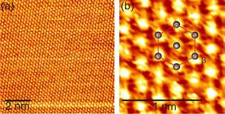

Slide 23
Finite Square well

Slide 24
V(x)
X=-a
X=a
(X)

Slide 26
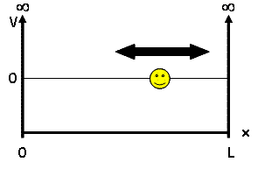
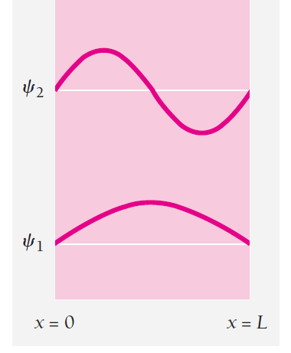
n=1,2,3,….
Consider a particle in a symmetrical box
-L/2
L/2
Guess the wavefunction!
-L/2
L/2
For n=1
For n=2

Slide 27
-L/2
L/2
For m=even
For n=odd

Slide 28
V(x)
X=-a
X=a
(X)

Slide 29
Case 1 : E<0
In the region –a<x<a :
The solutions are

Slide 30
The solutions are
V(x)
X=-a
X=a
(X)
Will the wavefunction be zero at the boundaries ?

Slide 31
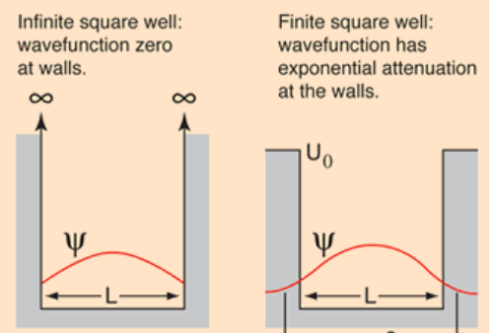

Slide 32
Case 1 : E<0
In the region x<-a, the potential is zero. Therefore:
The general solution is

Slide 33
Case 1 : E<0
In the region x>a, the potential is zero. Therefore:
The general solution is

Slide 34
Case 1 : E<0

Slide 35
Case 1 : E<0
Let us work with even solution
The continuity of the wave function at x=a yields:
The continuity of the derivative of the wave function at x=a yields:
Taking the ratio of the two equations yields :

Slide 36
The continuity of the wave function and its derivative at x=a yields:
Squaring and adding the equations yield:
Have the variable transformations for simplicity

Slide 37
Therefore:
Therefore from the continuity of wavefunction and its derivative at boundaries, we get

Slide 38
Solve graphically
Z
Look for the intersection points

Slide 39
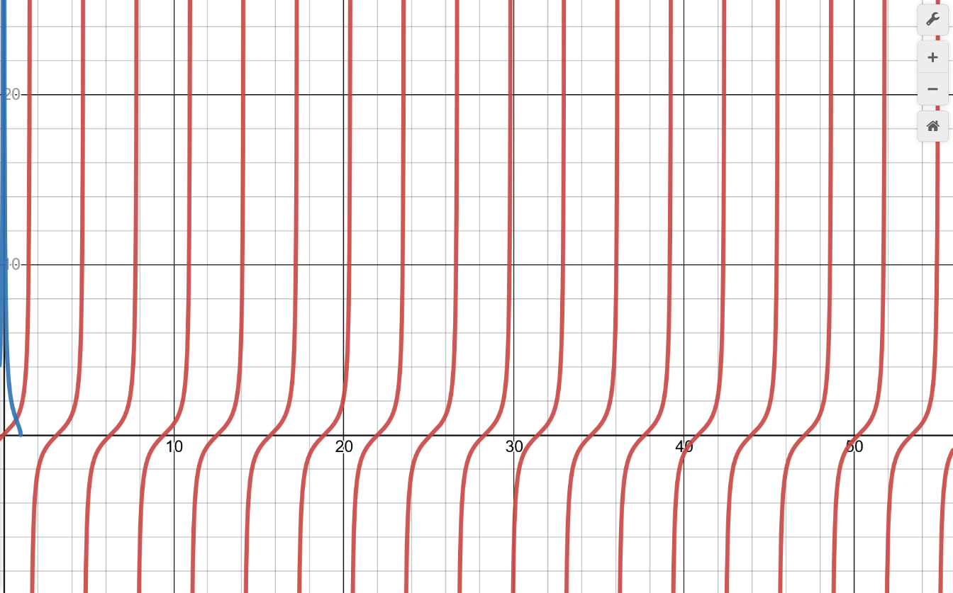
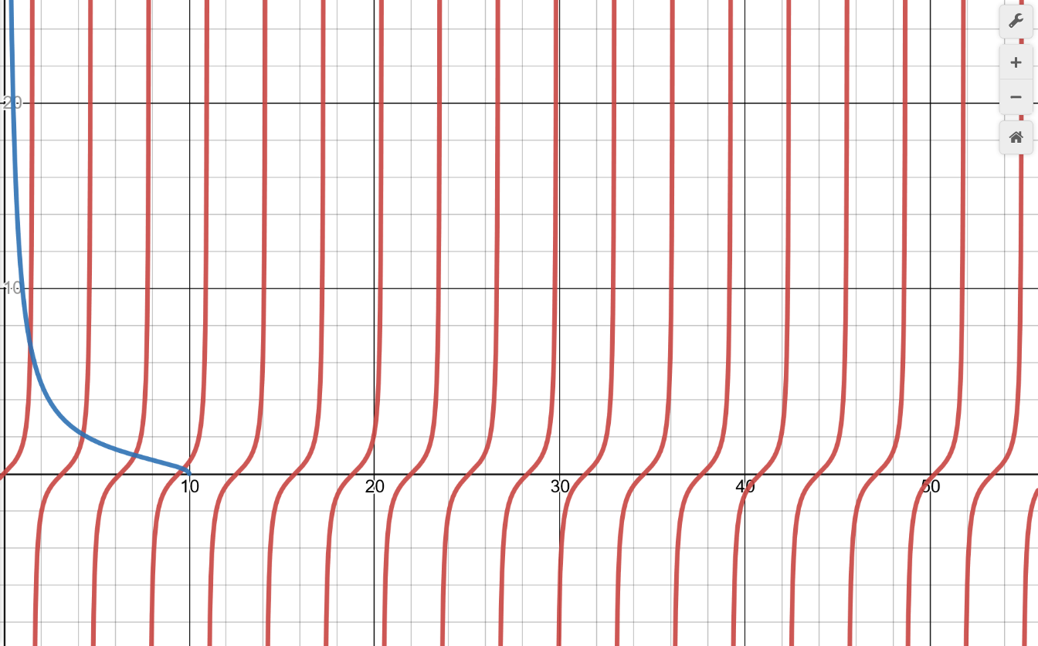

Slide 40
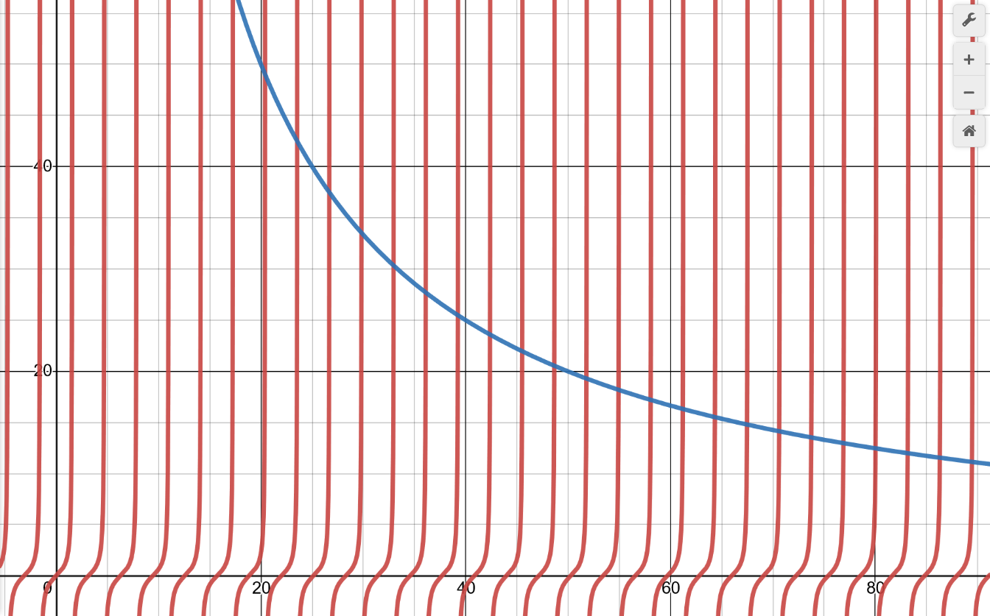
Wide, deep well
Corresponds to the KE of particle in a box!

Slide 41
Try the even function yourself
Hint:

Slide 42
What about shallow, narrow well?
As z₀ decreases, there are fewer and fewer bound states, until finally only one remains!
There is always minimum one bound state, no matter how weak is the well!

