Slide 1
Fano parameterization and Fano resonance

Slide 7
Few facts!
q is the hard-sphere part and ε is the resonant part.
What happens when q=-ε at resonance (ε=0) ?
The scattering cross-section can be zero even when E=E_{r}

Slide 8
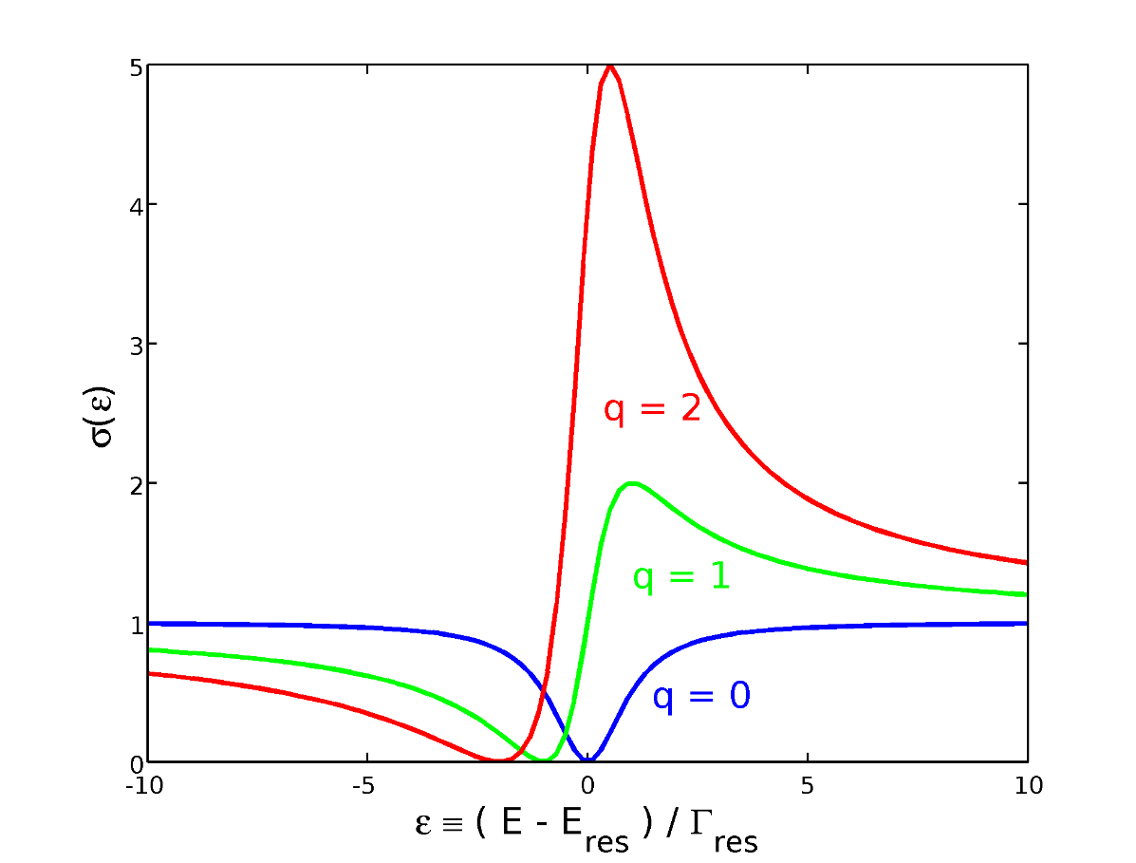

Slide 9
In physics, a Fano resonance is a type of resonant scattering phenomenon that gives rise to an asymmetric line-shape. Interference between a background and a resonant scattering process produces the asymmetric line-shape.

Slide 10
The square well potential analysis will remain valid for other general form of potential?

Slide 19
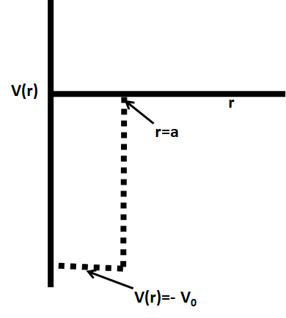
In Short….

Slide 20
The resonant condition E=E_{r,} corresponds to
Which parameter would change for different potentials?

Slide 22
For the case of square well,
This enables to write tangent of phase shift in the original form we dealt with in the case of square well scattering.

Slide 23
The square well potential analysis will remain valid for other general form of potential?
Yes

Slide 24
Phase shift and Time delay

Slide 25
Phase shift and time delay

Slide 27
Stationary phase approximation!
Spatial shift
What about time delay?

Slide 29
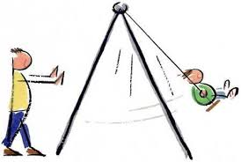
Time delay in resonance

Slide 32
Maximum of time delay reaches at E_{r}=E
Resonance is a temporary trapping!

