Slide 1
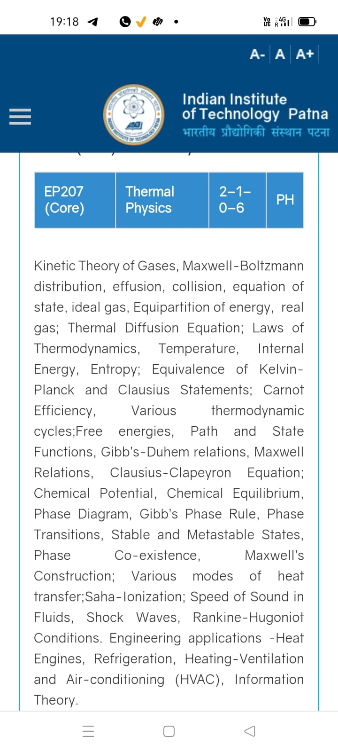
Season 5, Lecture 8 (S5,L8):
EP2104 Thermal physics with engineering applications
3-1-0-4

Slide 2
Time | 11:11:55 | 12-12:55 | 3-3:55 | 4- 4:55 | 02-02:55
Day
Monday |  | R103
Tuesday |  |  | R103
Wednesday |  |  |  | R103
Thursday | R101

Slide 3
 |  | L1 | L2 | L3 | L4 | L5 | L6 | L7 | L8
 | "Anirudh Karthikeyan" <anirudh_2501ph19@iitp.ac.in>; | p | p | p | p | p | p | q | P
2. | "Anshita Meena" <anshita_2501ph08@iitp.ac.in>; | p | p | p | p | p | p | q | P
3. | "Aritro Ghosh" <aritro_2501ph03@iitp.ac.in>; | p | a | p | p | p | p | a | P
4. | "Arunya Guha" <arunya_2501ph28@iitp.ac.in>; | p | p | a | p | p | p | a | P
5. | "Avala Venkata Hemanth" <avala_2501ph37@iitp.ac.in>; | a | a | a | p | p | p | p | P
6. | "Ayush Kumar" <ayush_2501ph24@iitp.ac.in>; | p | p | a | p | p | p | a | A
7. | "Badavath Madhulatha" <badavath_2501ph38@iitp.ac.in>; | p | p | a | p | p | p | q | P
8. | "Banothu Somanna" <banothu_2501ph36@iitp.ac.in>; | p | p | p | p | p | p | a | A
9. | "Chenche Shankara Suman" <chenche_2501ph07@iitp.ac.in>; | p | p | p | p | p | a | a | P
10. | "Davala Bhuvana Karthik" <davala_2501ph25@iitp.ac.in>; | p | p | p | p | p | p | a | A

Slide 4
 |  | L1 | L2 | L3 | L4 | L5 | L6 | L7 | L8
11. | "David Pratap Singh" <david_2501ph26@iitp.ac.in>; | p | p | q | p | p | p | p | P
12. | "Deepak Kumar" <deepak_2503ph03@iitp.ac.in>; | p | p | q | p | p | p | p | P
13. | "Dekka Nivas" <dekka_2501ph29@iitp.ac.in>; | p | p | q | p | p | p | p | P
14. | "Gamit Marlon Maheshbhai" <gamit_2501ph21@iitp.ac.in>; | p | p | q | p | p | p | p | P
15. | "Himesh Katare" <himesh_2501ph33@iitp.ac.in>; | p | p | q | p | p | p | p | P
16. | "Jadhav Vedant Rajesh" <jadhav_2501ph06@iitp.ac.in>; | p | p | q | p | p | p | p | P
17. | "Johaan Peter Thekkan" <johaan_2501ph05@iitp.ac.in>; | p | p | q | p | p | p | p | P
18. | "Karri Akshara" <karri_2501ph13@iitp.ac.in>; | p | p | q | p | p | p | p | P
19. | "Kashvi Mehta" <kashvi_2501ph32@iitp.ac.in>; | p | p | q | p | p | p | p | P
20. | "Kirti Chandra" <kirti_2501ph35@iitp.ac.in>; | p | p | q | a | p | p | p | P

Slide 5
 |  | L1 | L2 | L3 | L4 | L5 | L6 | L7 | L8
21 | "Krishna Mule" <krishna_2501ph04@iitp.ac.in>; | p | p | q | p | p | p | p | P
22. | "Kummetha Sai Darshan Reddy" <kummetha_2501ph17@iitp.ac.in>; | a | a | a | a | a | a | a | P
23. | "Maddirala Bhanu Kiran" <maddirala_2501ph31@iitp.ac.in>; | p | p | q | a | a | a | p | P
24. | "Manish" <manish_2501ph22@iitp.ac.in>; | p | p | q | p | p | p | p | P
25. | "Mohammad Owais Ansari" <mohammad_2501ph18@iitp.ac.in>; | p | p | q | p | p | p | p | P
26. | "Muhammed Rehaan Sharafudheen" <muhammed_2501ph20@iitp.ac.in>; | p | p | q | p | p | p | p | P
27. | "Nikhil" <nikhil_2501ph34@iitp.ac.in>; | p | p | q | p | p | p | p | P
28. | "Poodari Shivani" <poodari_2503ph04@iitp.ac.in>; | p | p | q | p | p | p | p | P
29. | "Rahul Yadav" <rahul_2501ph23@iitp.ac.in>; | p | p | q | p | p | p | p | P
30. | "Rohit David Paul" <rohit_2501ph11@iitp.ac.in>; | p | p | a | p | a | a | a | P

Slide 6
 |  | L1 | L2 | L3 | L4 | L5 | L6 | L7 | L8
31 . | "Ronak Jakhar" <ronak_2501ph10@iitp.ac.in>; | p | p | p | p | p | p | P | P
32. | "Rudraneel Shee" <rudraneel_2501ph15@iitp.ac.in>; | p | p | p | p | p | p | P | P
33. | "S Ragul Raagav" <s_2503ph02@iitp.ac.in>; | p | p | p | p | p | p | P | P
34. | "Sara Khan" <sara_2501ph30@iitp.ac.in>; | p | p | p | p | p | p | P | P
35. | "Shaik Jabeer Sulthan" <shaik_2501ph16@iitp.ac.in>; | p | p | p | p | p | p | a | A
36. | "Shourya Sharma" <shourya_2503ph01@iitp.ac.in>; | p | p | a | a | p | a | a | A
37. | "Shreyas Saraswatiprasad Waikar" <shreyas_2501ph02@iitp.ac.in>; | p | p | p | p | p | p | p | P
38. | "Snehardra Das" <snehardra_2501ph14@iitp.ac.in>; | p | p | p | a | p | p | a | P
39. | "Tejeswin R" <tejeswin_2501ph09@iitp.ac.in>; | p | p | a | p | p | a | p | P
40. | "Varkatam Akshaya" <varkatam_2501ph12@iitp.ac.in>; | p | p | p | p | p | p | p | P

Slide 7
 |  | L1 | L2 | L3 | L4 | L5 | L6 | L7 | L8
41. | "Vivanshu Chauhan" <vivanshu_2501ph01@iitp.ac.in>; | p | p | p | p | p | p | a | P
42. | "Yogesh Kumar" yogesh_2501ph27@iitp.ac.in | p | p | p | p | p | p | a | P
Attendance: 75% mandatory

Slide 8
Concept of Mean free path

Slide 9
EP2104 Thermal physics with engineering applications
3-1-0-4
Syllabus
Course Outline Kinetic Theory of Gases, Maxwell-Boltzmann distribution, Concept of Mean free path, Pressure, effusion, collision, equation of state, ideal gas, Equipartition of energy, real gas; Thermal Diffusion Equation; Laws of Thermodynamics, Temperature, Internal Energy, specific heat, Entropy;
Carnot engine, Various thermodynamic cycles; Thermodynamic potentials, Path and State Functions, Gibb’s-Duhem relations, Maxwell Relations; Clausius-Clapeyron Equation; Chemical Potential, Chemical Equilibrium, Phase Diagram, Gibb’s Phase Rule, Phase Transitions, Stable and Metastable States, Phase Co-existence, Maxwell’s Construction; Various modes of heat transfer; Saha-Ionization; Speed of Sound in Fluids, Shock Waves, Rankine-Hugoniot Conditions. Engineering applications -Heat Engines, Joule-Thompson effect and applications to cryogenics, Refrigerators, Heating-Ventilation and Air-conditioning (HVAC).
Additional Topics: Thermal Physics and Quantum Memory for Quantum Communication.
Suggested Readings: Textbooks:
1. Stephen J. Blundell and Katherine M. Blundell, Concepts in Thermal Physics, 3rd Ed, Oxford University Press, 2014.
2. R. H. Dittman and M. W. Zemansky, Heat and Thermodynamics, McGraw-Hill College; Subsequent Ed, 1996.
3. M. A. Boles, Y. A. Cengel, M. Kanoglu, Thermodynamics: An Engineering Approach
4. Finn’s Thermal Physics, Andrew Rex
5. Thermal Physics, C. Kittel, H. Kroemer, W. H. Freeman, 2nd ed., 2012
References:
1. M. N. Saha and B. N. Srivastava, Treatise on Heat, 3rd Edition, The Indian Press, Allahabad, 1950.
2. R.Baierlein, Thermal Physics, Cambridge University Press, 2005.

Slide 10
“Concept building” + “Problem solving skills”
Covering the syllabus with exact time-lines
Building student interest towards core concept
Time to time connection with modern-cutting edge technology
and real-life engineering applications
Emphasis: On time lectures meeting neat board work + Digital work +pptx
Systematic course updation in www.raghavanke.com

Slide 11
Knowledge of mean free path in engineering:
Gas transport:
Determines how gases flow and diffuse, which is crucial in designing piping, ventilation, and combustion systems.
Heat transfer:
Used to calculate the rate of heat transfer between surfaces, impacting heat exchanger and insulation performance.
Thermal conductivity:
Influences the efficiency of conductivity
Vacuum technology and Vacuum design:
Dictates the behavior of gases at low pressures, affecting the operation of pumps and the design of vacuum chambers

Slide 12
Vacuum technology related to Quantum Technology applications
Quantum Memory units, Ultracold atoms, Laser cooling of gas etc (Modern cutting edge experiments)

Slide 13
Free paths
…………………
Target Molecule
Assumption: All other molecules are static

Slide 14
Mean free path: Definition
“Average distance travelled by a gas molecule between two successive collisions”

Slide 15
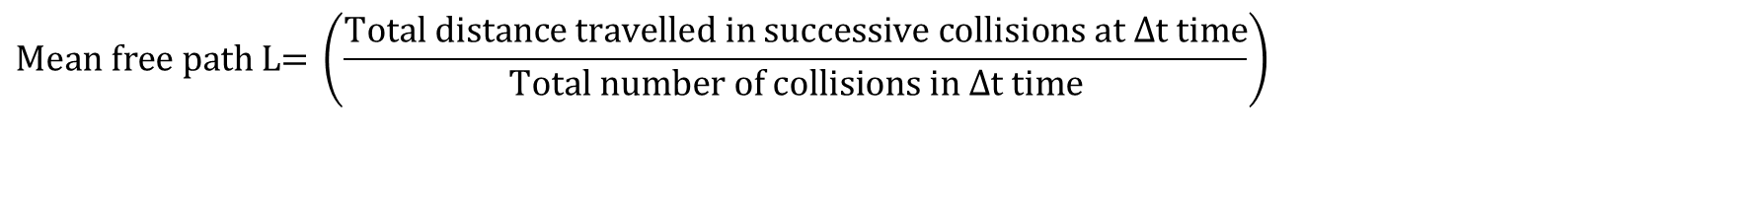
Mean free path: Definition
$$\text{Mean free path L= }\left(\frac{\text{Total distance }\text{travelled in successive collisions at }Δ\text{t time}}{\text{Total number of collisions in }Δ\text{t} \text{time}}\right)$$

Slide 16
Assumption: All identical
d

Slide 17
=2d
Greater than d
lesser than d

Slide 18
How to calculate the mean free path?
d
d

Slide 19
How to calculate the mean free path?
Assumption: All other molecules are static
d
d

Slide 20
How to calculate the mean free path?
Assumption: All other molecules are static
d
d

Slide 22
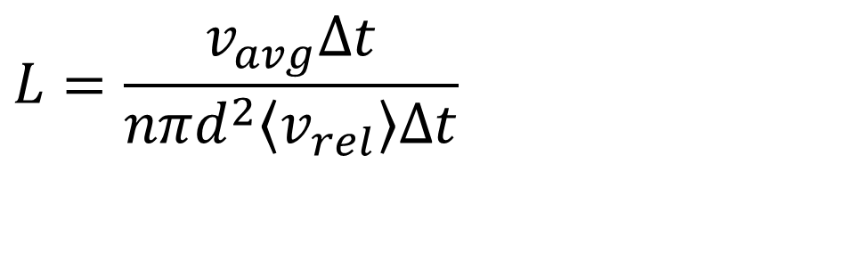
Maxwell’s correction when molecules are moving
$$L=\frac{v_{avg}Δt}{nπd^{2}\left\langle v_{rel}\right\rangle Δt}$$
$$v_{avg}(\left\langle v\right\rangle )\text{ replaced by }Average relative speed(\left\langle v_{rel}\right\rangle )$$

Slide 23
Average relative speed

Slide 24
0

Slide 25
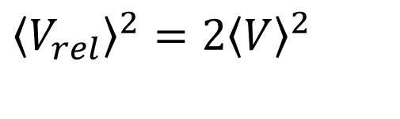
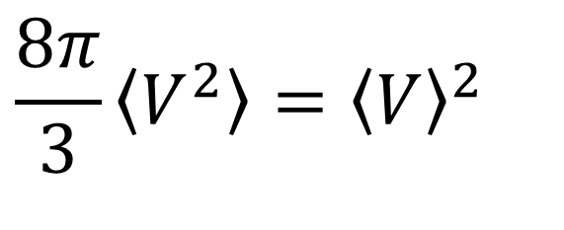
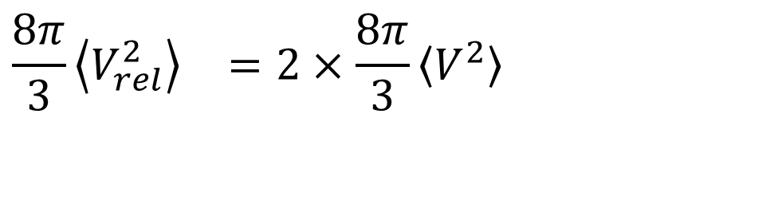
$$\frac{8π}{3}\left\langle V^{2}\right\rangle ={\left\langle V\right\rangle }^{2}$$
Applying on both sides
$$\frac{8π}{3}{\left\langle V_{rel}^{2}\right\rangle }^{}=2×\frac{8π}{3}{\left\langle V^{2}\right\rangle }^{}$$
$${\left\langle V_{rel}\right\rangle }^{2}=2{\left\langle V\right\rangle }^{2}$$

Slide 28
Mean free path, Pressure, Temperature

Slide 29
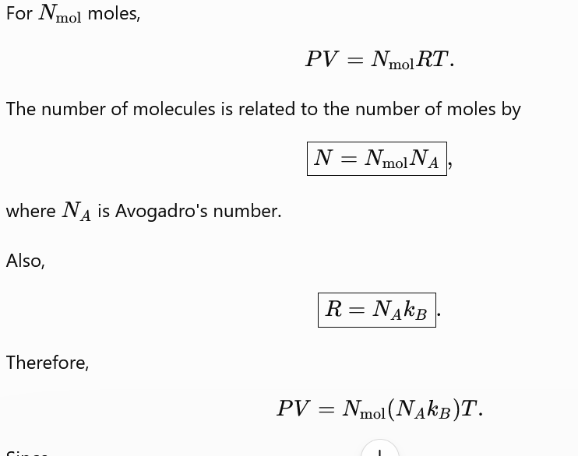

Slide 30
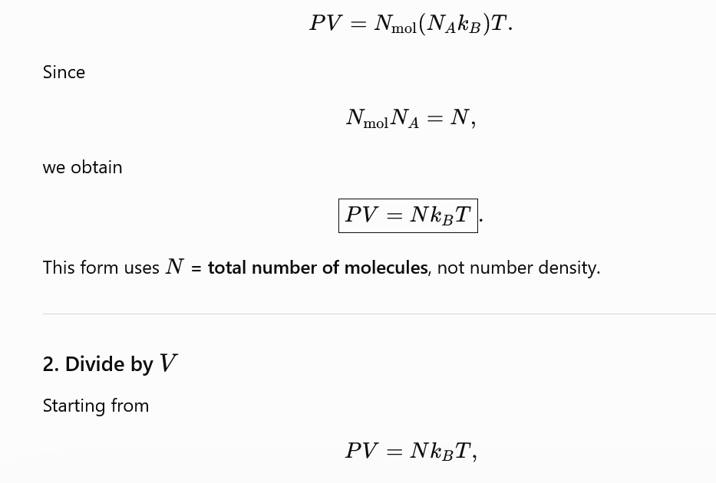
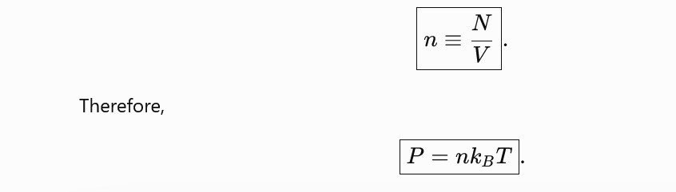

Slide 31
Mean free path, Pressure, Temperature

