Slide 1
Highlights of the course
Co-ordinate Systems
Introduction to Vector Operators
Work , Energy and Conservation laws
Rigid body in motion
Oscillations and Waves
Quantum Physics

Slide 2
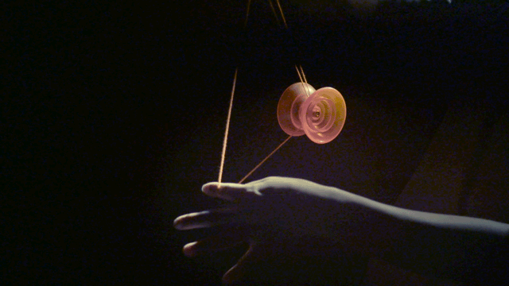
RIGID BODY IN MOTION
Chapter 4

Slide 3
Find the net angular acceleration in this case also compare it, when the whole system is rotated in x-z plane
y
Angular acceleration
y
Recap
(1,1)
F_{z} in –z direction
(- $\sqrt{2}$,0)
($\sqrt{2}$,0)
x
o
x
o
(-1,-1)
F_{z} in –z direction
y=1

Slide 4
Problem 3
Find whether angular momentum and angular velocity are parallel in the below figure
y
y
x-y plane
(1,1)
(-$\sqrt{2}$,0)
($\sqrt{2}$,0)
x-z plane
x
o
x
o
(-1,-1)

Slide 5
y
x-y plane
(-$\sqrt{2}$,0)
x-z plane
($\sqrt{2}$,0)
o
x

Slide 6
y
x-y plane
(-$\sqrt{2}$,0)
($\sqrt{2}$,0)
o
x
z

Slide 7
Problem 2
y
(1,1)
o
(-1,-1)

Slide 9
Angular momentum and Angular velocity have same slopes

Slide 10
In the matrix form we may write

Slide 13
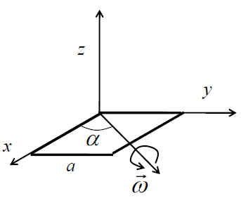
Rotation of a square plate
Problem 4
Consider rotation of a square plate of side a and mass M about an axis in the plane of the plate and making an angle α with the x-axis.
Write the matrix for angular momentum L
For what angle L and ω becomes parallel?
For square plate when the moment of inertia tensor becomes diagonal?

Slide 14
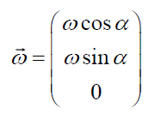
Rotation of a square plate
angular momentum L

Slide 15
Rotation of a square plate
angular moment L

Slide 17
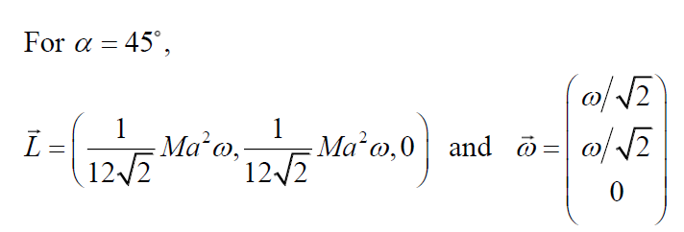
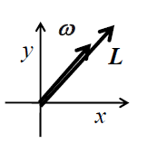
Rotation of a square plate
(b) For what angle L and ω becomes parallel?

Slide 18
Rotation of a square plate
(b) For what angle L and ω becomes parallel?

Slide 19
Rotation of a square plate (Implications)
Z
X
ω
L and ω are parallel!

Slide 20
Concept behind the problem
Z
Z
X
X
PHYSICAL NATURE OF ROTATION IS SAME AS IN 45 DEGREE ROTATION
ω
Use of symmetry will ensure diagonal Moment of Inertia tensor

Slide 21
Principal Axis
Cumbersome!
Principal axes are the orthogonal axes for
Which [I] is diagonal
Z
X
Y

Slide 22
Note!
Whenever ω is parallel to L, choosing the corresponding direction of rotation as co-ordinate axis will be the principal axes.
Let’s recollect the problems we did………

Slide 23
Whenever ω is parallel to L, choosing the corresponding direction of rotation as co-ordinate axis will be the principal axes
y
x-y plane
(-1,0)
(1,0)
x-z plane
x
o

Slide 24
Whenever ω is parallel to L, choosing the corresponding direction of rotation as co-ordinate axis will be the principal axes
y
(1,1)
x
o
(-1,-1)

Slide 25
Whenever ω is parallel to L, choosing the corresponding direction of rotation as co-ordinate axis will be the principal axes
y
x-y plane
(-$\sqrt{2}$,0)
($\sqrt{2}$,0)
x-z plane
o
x

Slide 26
Whenever ω is parallel to L, choosing the corresponding direction of rotation as co-ordinate axis will be the principal axes
Z
Z
X
X
ω

Slide 27
Quiz 2
07/01/2022
10 AM – 11 AM
Chapter: 3
MS TEAMS (Similar to Tutorials)
Must be Online Mandatorily
Google Form
MCQ type 8 Questions (10 marks)
Video should be ON

Slide 28
Mid-Semester Exam
12/01/2022
Chapters: 1, 2, 3 and 4 (Which ever finished)
Evaluation A (Quiz)
10 AM – 11 AM
MS TEAMS (Similar to Tutorials)
Must be Online Mandatorily, Video should be ON
Google Form
MCQ/one word type (10 marks)
Evaluation B (Assignment)
12/01/2022, 11 AM – 13/01/2022, 11 AM
Submit in Google form.
Format accepted: PDF
Mid Semester Evaluation (A) ( Real time quiz/any other mode to be decided by course instructor ) | 1 | 10
Mid Semester Evaluation (B) (Assignment based, one day time to be given for submitting the assignment) | 1 | 15

