Slide 1
PH 603 Physics of ultracold atoms
Force experienced by atoms

Slide 4
Model: Force on a Hypothetical two level atom under motion interacting with
two lights (Co-prop and Counter Prop) simultaneously in 1-D

Slide 5
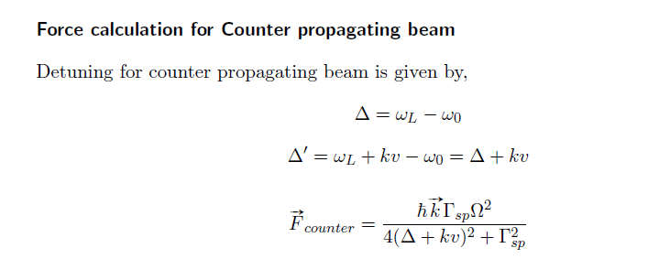

Slide 6
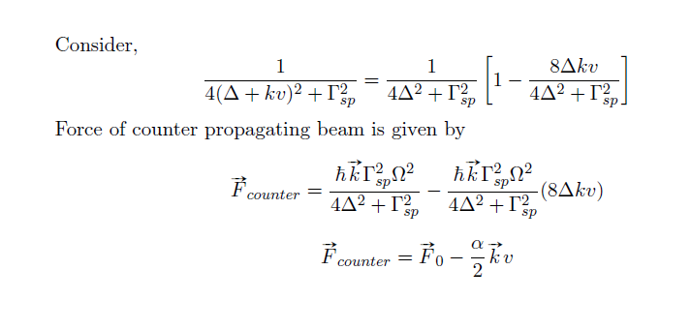

Slide 7
