Slide 1
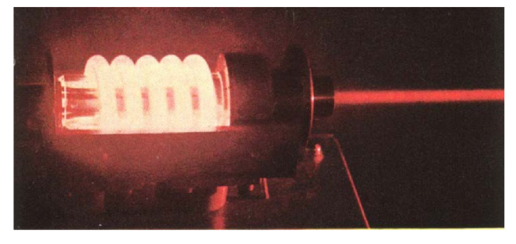
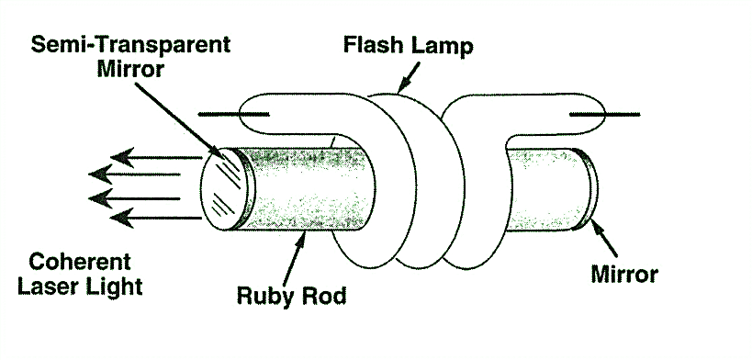

Solid State Lasers
1. Ruby Laser
First LASER: Ted Maiman (Hughes Research Labs, May 17, 1960)
Operates at 694.3 nm
Ruby rod : Sapphire crystal (Al₂O₃) with Cr³⁺doped
Optical Resonator + Gain Medium + Pump
Mirrors
Ruby rod
Xenon Flash Lamp
Operating with 3 Level Energy System

Slide 2
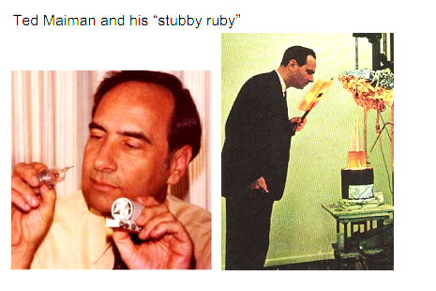
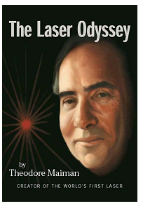
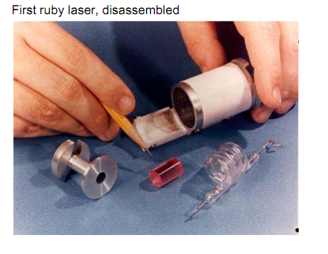
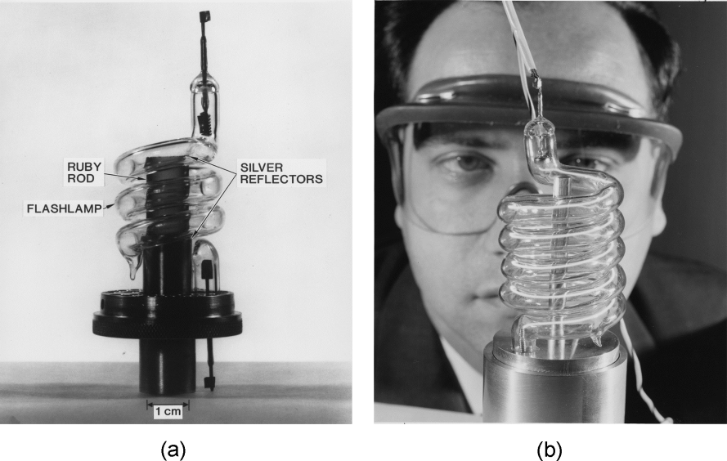
Some old pics…..

Slide 3
Basic Components
The ruby crystal is in the form of cylinder. Length of ruby crystal is usually 2 cm to 30 cm and diameter 0.5 cm to 2 cm. As very high temperature is produced during the operation of the laser, the rod is surrounded by liquid nitrogen to cool the apparatus.
Active medium or active center: Chromium ions act as active centers in ruby crystal. So it is the chromium ions that produce the laser.
Pumping source: A helical flash lamp filled with xenon is used as a pumping source. The ruby crystal is placed inside a xenon flash lamp. Thus, optical pumping is used to achieve population inversion in ruby laser.
Optical resonator system: The ends of ruby crystal are polished, grounded and made flat. The one of the ends is completely silvered while the other one is partially silvered to get the output. Thus the two polished ends act as optical resonator system.

Slide 4
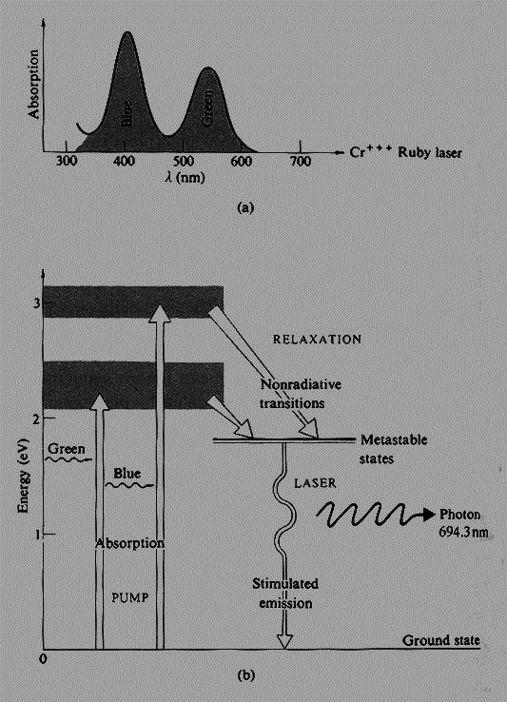
Energy Level Diagram

Slide 5
Typical Ruby Laser Parameters
Laser wavelength
Upper laser level lifetime
gain bandwidth
Laser gain-medium length (L)
Operating temperature
Thermal conductivity of laser rod
Pumping method
Pumping bands
Output power
694.3 nm
3.0 ms
0.53 nm
0.1m
Room temperature
42 W/m-K at 300 K
Flash lamp
404 nm and 554 nm
up to 100 J/pulse

Slide 6
Ruby Lasers
Drawbacks of ruby laser
As the terminus of laser action is the ground state, it is difficult to maintain the population
inversion. This fact results in ruby laser’s low efficiency
The ruby laser requires high power pumping source.
The laser output is not continuous but occurs in the form of pulses of microsecond
duration.
The defects due to crystalline imperfection are also present in ruby laser.
Uses of ruby laser
Ruby laser has very high output power of the order of 10⁴ Watts. It has wavelength
of 6943 Angstroms.
Ruby lasers are used for holography, industrial cutting and welding.

Slide 7
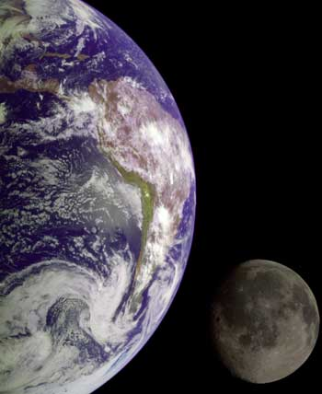
Historical Importance of Ruby Laser
First Lunar Laser Ranging Experiment [Light Detection And Ranging (LIDAR)]
Lunar Laser Ranging Experiment measures the distance between the Earth and the Moon using laser ranging.
A pulsed ruby laser was used for the famous laser ranging experiment which was conducted with a corner reflector placed on the Moon by the Apollo astronauts. This determined the distance to the Moon with an accuracy of about 15 cm

Slide 8
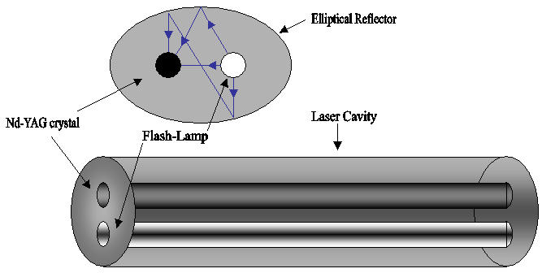
Nd YAG Laser
The host medium for this laser is Yttrium Aluminium Garnet (YAG = Y₃Al₅O₁₂) with 1.5% trivalent neodymium ions (Nd³⁺) present as impurities
The (Nd³⁺) ions occupy the lattice sites of yttrium ions as substitution impurities and provide the energy levels for both pumping and lasing transitions
Side view
Reflector
Nd YAG Crystal
Flash Lamp (Krypton)
Operates at 1064 nm
First demonstrated at Bell Labs , 1964, USA

Slide 9
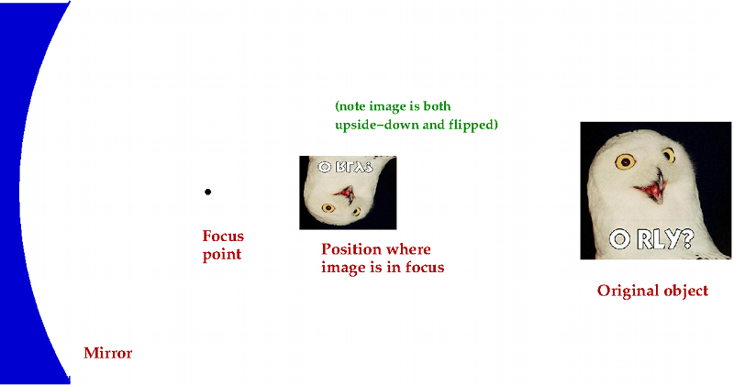
Nd YAG Basic Components
Nd YAG Crystal
Flash Lamp
Power Supply

Slide 10
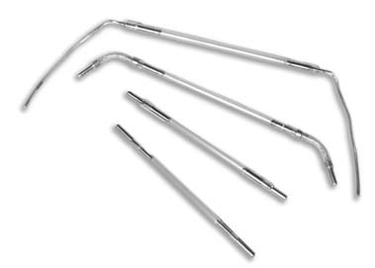
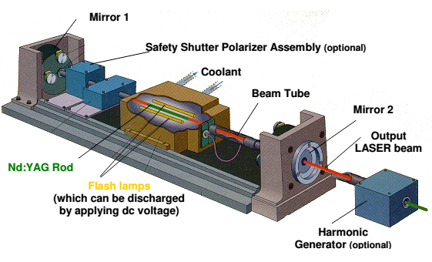
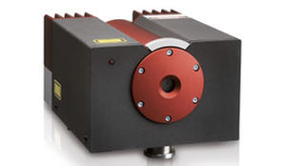
Nd YAG Schematic
Krypton Flash Lamp
A commercial Nd YAG

Slide 11
Energy Levels
Pumping bands
Non radiative decay
1064 nm
Excitation (Pumping)
730–760 nm and
790–820 nm
Laser transition
Non radiative decay

Slide 12
Typical Nd YAG Laser Parameters
Laser wavelength
Upper laser level lifetime
gain bandwidth
Laser gain-medium length (L)
Operating temperature
Thermal conductivity of laser rod
Pumping method
Pumping bands
Output power
1064 nm
0.23 ms
0.45 nm
0.1 to 0.15 m
Room temperature
14 W/m-K at 300 K
Flash lamp
730–760 nm and 790–820 nm
up to KW at CW operation and in MW at pulsed operation

Slide 13
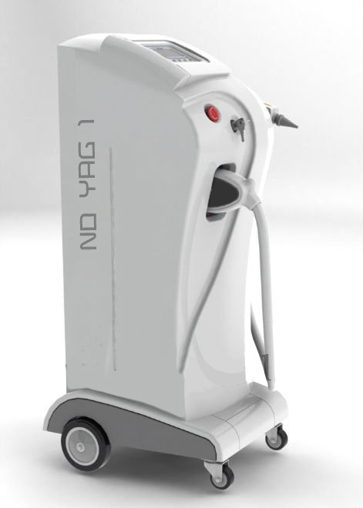
Wide Applications of Nd YAG Lasers
Physics and Engineering: NEW AREA developed due to High Powers
NON LINEAR OPTICS: We will discuss this important research area
Medicine: Ophthalmology, Oncology (In oncology, Nd:YAG
lasers can be used to remove skin cancers)
Cosmetic medicine
These lasers are also used extensively in the field of cosmetic
medicine for laser hair removal and the treatment of minor vascular
defects such as spider veins on the face and legs
Manufacturing
Nd:YAG lasers are extensively used in manufacturing for cutting
and welding steel and various alloys.
Fluid dynamics
Dentistry
Nd:YAG lasers are used for soft tissue surgeries in the oral cavity
Laser range finders
The Nd:YAG laser is the most common laser used in military laser rangefinders

Slide 14
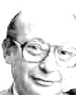
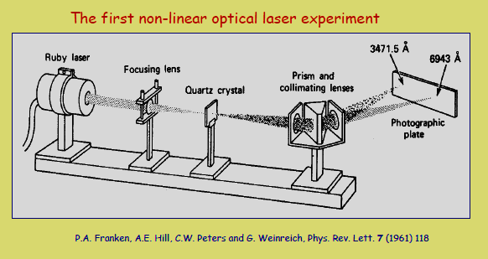
Non-linear Optics
P.AP.A. Franken
Nicolaas Bloembergen, recipient of the Nobel Prize for Physics (1981), wrote Nonlinear Optics in 1964, when the field of nonlinear optics was only three years old

Slide 15
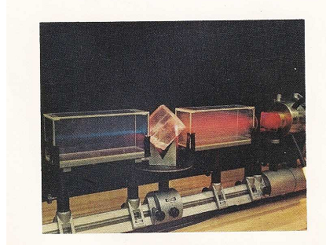
Red to blue Laser

Slide 16
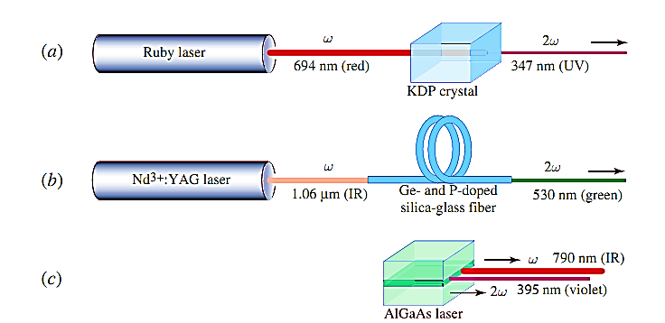
Frequency doubling

Slide 17
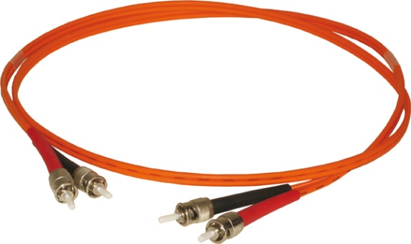
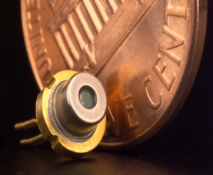
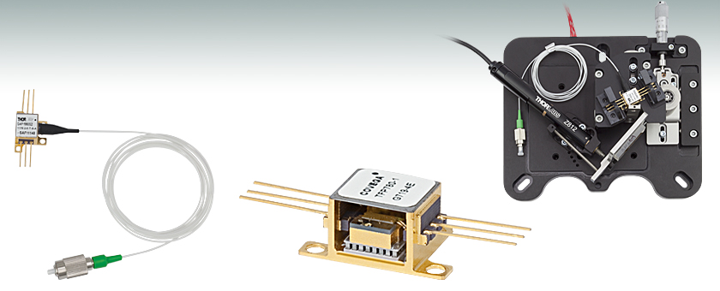
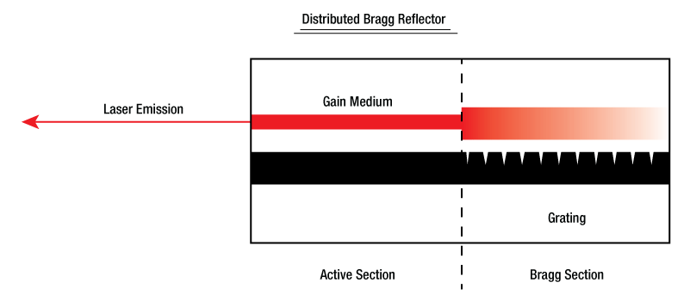
Semiconductor Laser

Slide 18
Semiconductor Laser
Optical communication
Broad areas of Physics and chemistry
Applications in Gas sensors, Interferometer
Atomic clocks
Wide range of applications

Slide 19
Optical communication
Attenuation/Loss in Optical Fiber
3.0
First
Window
2.5
Second
Window
2.0
1.5
Third
Window
ATTENUATION (dB/km)
1.0
0.5
800
900
1000
1100
1200
1300
1400
1500
1600
1700
WAVELENGTH (nm)
850nm
1310nm
1550nm
First window, second window, third window correspond (roughly) to first, second and third generation optic network technology
First Window @ 850nm
  High loss; First-gen. semiconductor diodes (GaAs)
Second Window @ 1310nm
  Lower Loss; good dispersion; second gen. InGaAsP
Third Window @ 1550nm, InGaAsNSb
  Lowest Loss; Erbium Amplification possible

Slide 20
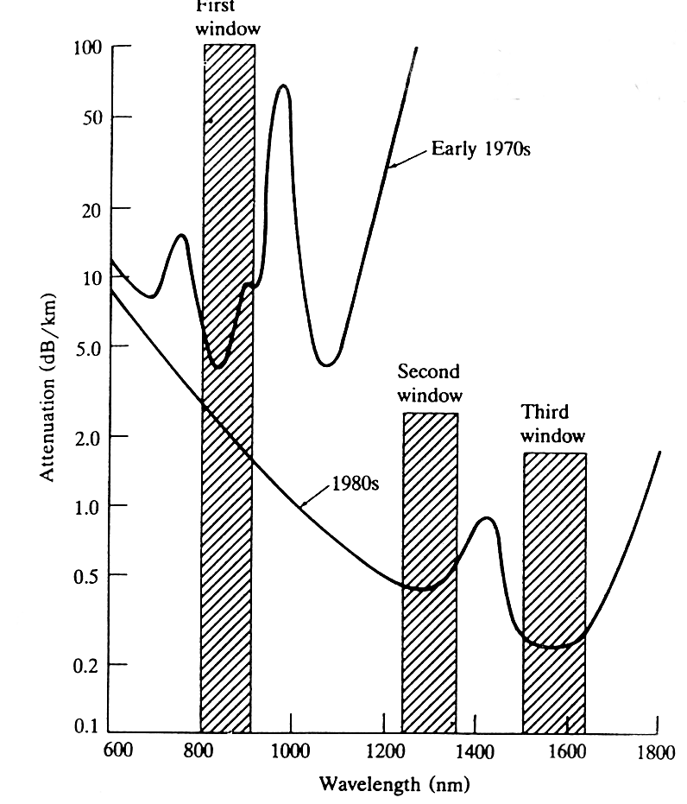
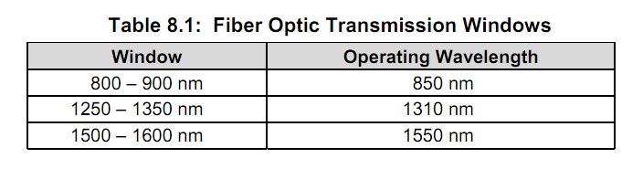

Slide 21
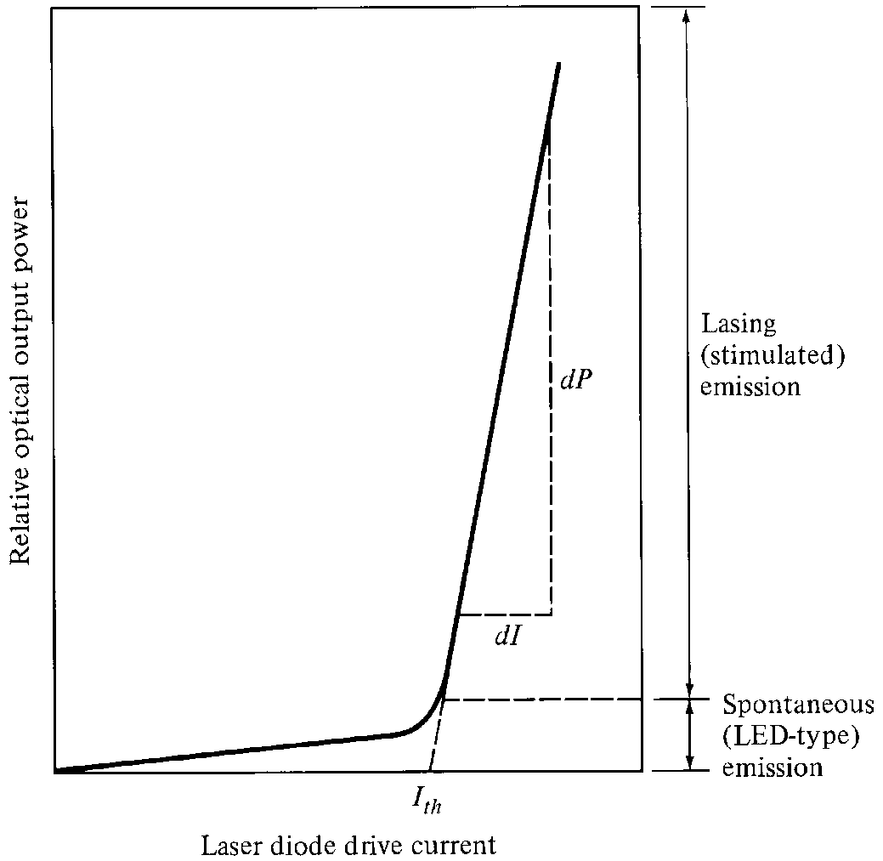
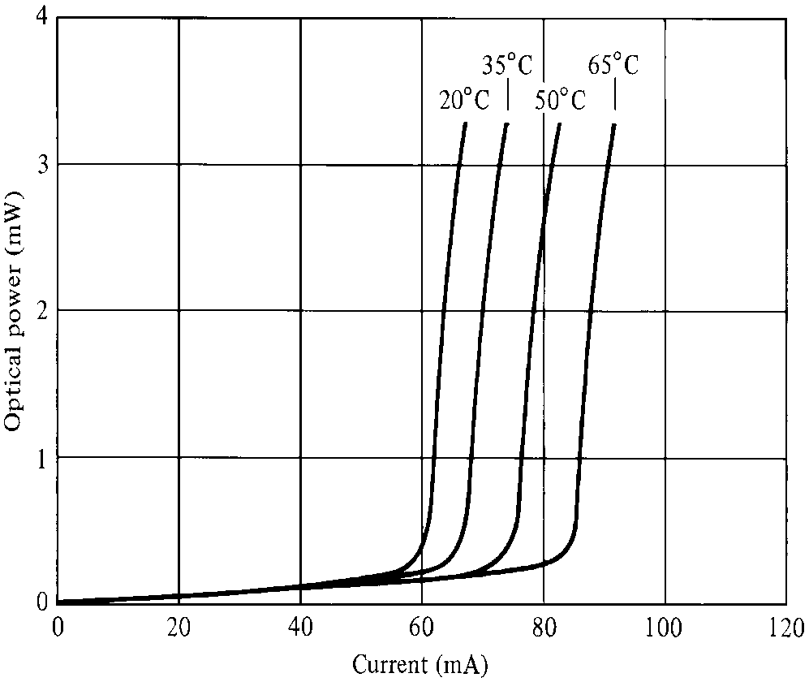
Laser Diode Characteristics

Slide 27
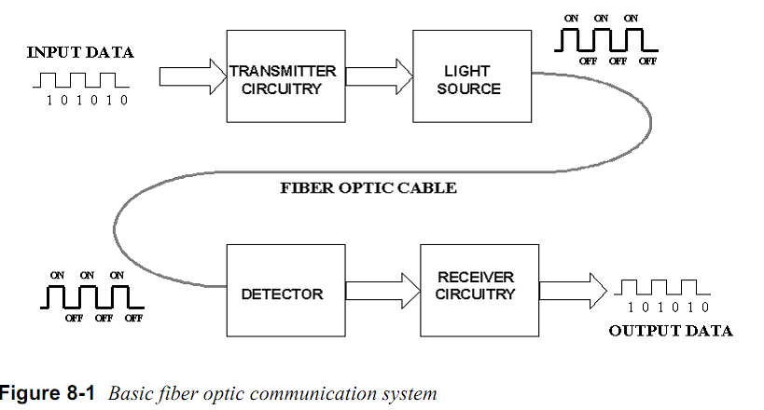
Basic optical communication

Slide 28
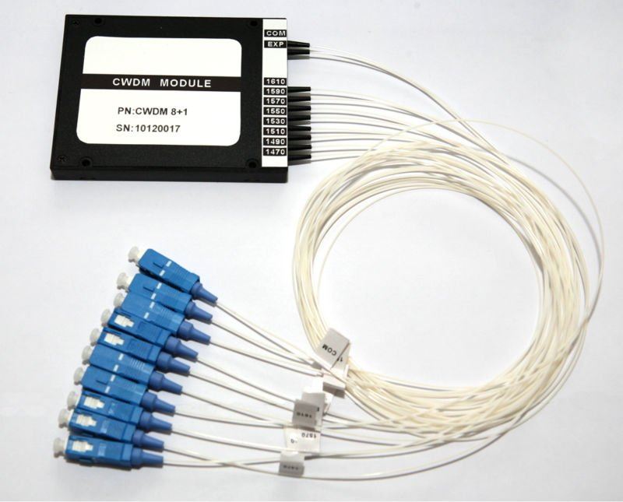
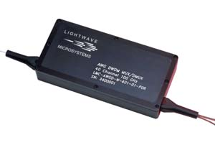
WDM MUX

