Slide 1
Post-Mid Sem
PH 608 Atomic Collision Physics
Lec 1 (04/03/2024)
Raghavan K E
Associate Professor
Indian Institute of Technology Patna

Slide 2
Attendance (Post-Mid Sem)
firstname | lastname | roll_no | lec1 | lec2 | lec3 | lec4 | lec5 | lec6 | lec7 | lec8 | lec9 | lec10 | lec11 | lec12 | lec13 | lec14 | lec15
Rajsekhar | Bhowmick | 2212PH36 p
Gaurav | Jaiswal | 2212PH13 a
Neellohit | Karmakar | 2212PH20 p
Soumik | Karmakar | 2212PH26 p
Aman | Kumar | 2212PH02 p
Ritik | Pal | 2212PH23 p
Binayak | Rout | 2212PH10 p
Kauship | Saha | 2212PH17 a
Naincy | Srivastava | 2321ph07 p
Rabi | Das | 2321ph15 p
Shruti | Sarswat | 2321ph19 p

Slide 3
Pre-Mid-Sem (Topics Covered)
Description of collision process
Quantum Scattering
Collision cross-section
Partial wave analysis
Scattering Matrix elements
Phase-shift for repulsive and attractive potentials
Calculation of Phase shift
Behaviour of phase shift and cross-section at low energies
S-wave scattering and Zero energy resonance
Behaviour of phase shift at higher energies

Slide 4
Post-Mid-Sem Topics
Simple Understanding of Atomic Collision and Inter- atomic potential
Recap of Phase-shift analysis for atom-atom collision
Hard-sphere scattering
Case-study: Low-energy scattering in attractive square well
Phase-shift Analysis
Resonances and its widths
Energy differences between the resonances
Scattering length and Scattering Cross-section
Contributions from background (hard sphere), pure resonance and Interference parts
Breit-Wigner resonance and Fano parameterization
Will Square well potential analysis remain valid for other general form of potential?
Phase shift and Time delay in resonances
Some case-studies in cold atoms and Engineering Applications

Slide 5
Interatomic Potential: Lennard Jones Potential

Slide 6
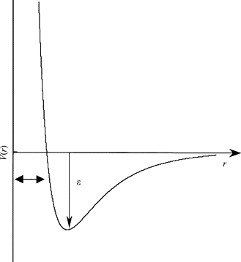
Interatomic Potential: Lennard Jones Potential
Lennard Jones Potential

Slide 7
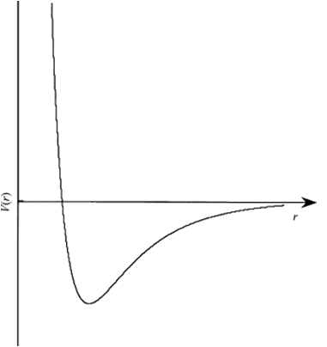
Interatomic potential
A
B
r_{a}
r_{b}
B
E

Slide 8
Interatomic potential
A
B
E
r_{a}
B

Slide 9
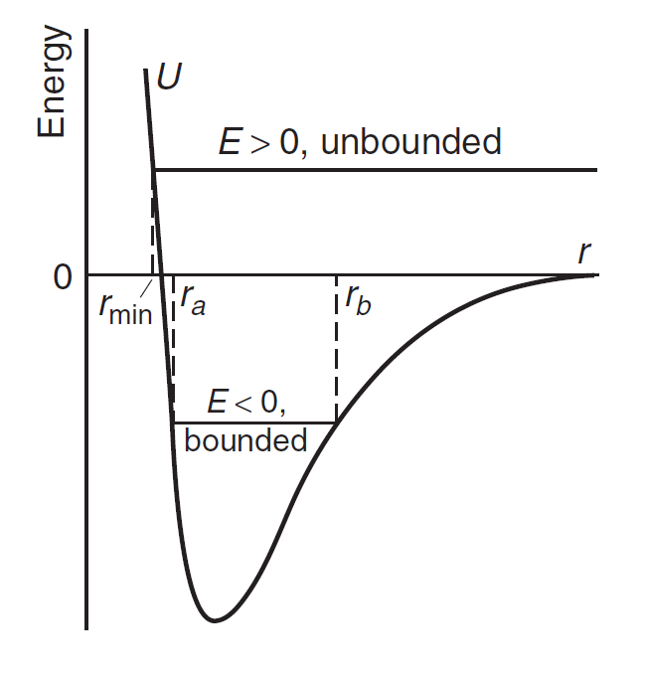
Interatomic potential
Lennard Jones Potential
Nearly Parabolic

Slide 10
Small Oscillations
Taylor series expansion of a function f(x), about
A point x=a is given as
Nearly Parabolic
Harmonic Oscillator

Slide 11
Velocity Vs. Position plot
V
Around
Equilibrium
For small oscillations only
r₀
r
Note that velocity will be maximum at equilibrium point

Slide 12
In a Quantum Scattering we expect………..

Slide 13
Pure background
Pure resonance
Interreference term

Slide 14
Post-Mid-Sem Topics
Recap of Phase-shift analysis for atom-atom collision
Hard-sphere scattering
Case-study: Low-energy scattering in attractive square well
Phase-shift Analysis
Resonances and its widths
Energy differences between the resonances
Scattering length and Scattering Cross-section
Contributions from background (hard sphere), pure resonance and Interference parts
Breit-Wigner resonance and Fano parameterization
Will Square well potential analysis remain valid for other general form of potential?
Phase shift and Time delay in resonances
Some case-studies in cold atoms and Engineering Applications

Slide 15
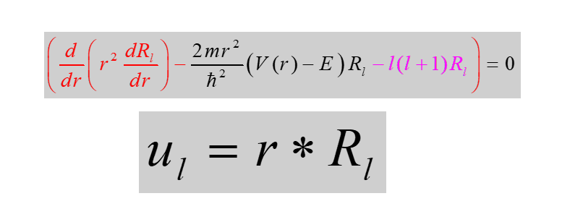
The general expression of phase shift without the knowledge of exact form of potential (Recap)

