Slide 1
Season 2, Lecture 20 (S2,L20):
Thermodynamic Functions
Maxwells relations
Revision

Slide 2
Name | L9 | L10 | L11 | L12 | L13 | L14 | L15 | L16 | L17 | L18 | % | L19 | L20
"2201ph34_dolly" <2201ph34_dolly@iitp.ac.in>; | p | P | p | A | p | p | p | P | p | A | 77 | p
"Adhila Aslam" <2201ph01_adhila@iitp.ac.in>; | p | P | p | p | p | p | p | P | p | P | 100 | a
"Aditi Baghel" <2201ph31_aditi@iitp.ac.in>; | p | P | p | p | p | p | p | A | p | P | 100 | a
"Aditya Kumar" <2201ph02_aditya@iitp.ac.in>; | p | p | p | p |  | p | p | P | p | p | 83 | p
"Aditya Singh" <2201ph03_aditya@iitp.ac.in>; | p | P | p | p | p | p | p | P | a | P | 83 | p
"Animesh Sharma" <2201ph05_animesh@iitp.ac.in>; | p | P | p | p | P | p | p | P | p | P | 100 | a
"Arun Mishra" <2201ph06_arun@iitp.ac.in>; | a | P | p | p | P | p | p | A | p | p | 88 | p
"Aryan Raj" <2201ph32_aryan@iitp.ac.in>; | p | P | p | p | P | p | p | A | a | P | 88 | p
"Boda Vishnuwardhan" <2201ph08_boda@iitp.ac.in>; | p | A | A | p | P | a | p | P | p | P | 72 | p
"Chanchal Tolani" <2201ph09_chanchal@iitp.ac.in>; | p | P | p | p | P | p | p | P | a | P | 94 | p
"Gaurav Verma" <2201ph10_gaurav@iitp.ac.in>; | p | P | p | A | A | P | P | P | P | P | 88 | p

Slide 3
Name | L9 | L10 | L11 | L12 | L13 | L14 | L15 | L16 | L17 | L18 | % | L19 | L20
"Gourav Jha" <2201ph11_gourav@iitp.ac.in>; | a | P | p | p | P | P | p | P | p | P | 77 | p | p
"Gurinder Dhillon" <2201ph12_gurinder@iitp.ac.in>; | p | P | A | A | P | P | P | P | p | P | 88 | p
"Harsh Joshi" <2201ph13_harsh@iitp.ac.in>; | p | P | p | p | P | a | p | P | a | P | 77 | p
"Himanshu Patel" <2201ph35_himanshu@iitp.ac.in>; | p | P | p | P | P | p | p | P | P | P | 83 | p
"Khushal Yadav" <2201ph14_khushal@iitp.ac.in>; | p | P | p | P | P | p | a | P | p | P | 88 | a
"Krishnakant Chourey" <2201ph15_krishnakant@iitp.ac.in>; | p | A | P | p | P | p | p | P | P | P | 83 | p
"Manas Gupta" <2201ph16_manas@iitp.ac.in>; | a | P | p | P | P | p | p | P | a | P | 77 | p
"Mohit Saini" <2201ph17_mohit@iitp.ac.in>; | a | P | p | p | P | p | p | A | p | P | 88 | p
"Mude Naik" <2201ph18_mude@iitp.ac.in>; | p | P | p | p | P | p | a | P | p | P | 77 | p
"Murari Kumar" <2201ph19_murari@iitp.ac.in>; | p | P | A | p | P | a | a | A | p | A | 50 | p
"Nishant Yadav" <2201ph20_nishant@iitp.ac.in>; | p | P | A | p | P | p | p | P | a | P | 77 | p
"Pranitha Moluguri" <2201ph21_pranitha@iitp.ac.in>; | p | P | p | p | P | p | p | P | a | P | 94 | p

Slide 4
Name | L9 | L10 | L11 | L12 | L13 | L14 | L15 | L16 | L17 | L18 | % | L19 | L20
"Premanandh Sigamala" <2201ph22_premanandh@iitp.ac.in>; | p | P | A | p | p | p | p | P | a | P | 77 | a
"Ruchi Thakur" <2201ph23_ruchi@iitp.ac.in>; | p | P | p | p | P | p | p | P | p | P | 88 | p
"Satyam Sahoo" <2201ph25_satyam@iitp.ac.in>; | p | P | p | p | P | p | a | P | p | P | 94 | p
"Satyam Shandilya" <2201ph24_satyam@iitp.ac.in>; | p | P | A | p | P | p | p | P | p | P | 100 | p
"Shyam Hembram" <2201ph26_shyam@iitp.ac.in>; “ | p | P | p | p | P | a | a | P | p | P | 88 | a
Sougata Saha" <2201ph27_sougata@iitp.ac.in>; | a | p | p | p | P | p | p | A | P | P | 88 | p
"Sumit Rajpoot" <2201ph28_sumit@iitp.ac.in>; | p | P | p | p | P | p | a | P | p | P | 83 | p
"Suprajit Dewanji" <2201ph29_suprajit@iitp.ac.in>; | a | P | p | p | A | p | p | P | p | P | 77 | a
Attendance: 75% mandatory

Slide 5
Summary

Slide 6
Name | L9 | L10 | L11 | L12 | L13 | L14 | L15 | L16 | L17 | L18 |  | L19 | L20
"2201ph34_dolly" <2201ph34_dolly@iitp.ac.in>; | p | P | p | A | p | p | p | P | p | A |  | p | p
"Adhila Aslam" <2201ph01_adhila@iitp.ac.in>; | p | P | p | p | p | p | p | P | p | P |  | a | a
"Aditi Baghel" <2201ph31_aditi@iitp.ac.in>; | p | P | p | p | p | p | p | A | p | P |  | a | a
"Aditya Kumar" <2201ph02_aditya@iitp.ac.in>; | p | p | p | p |  | p | p | P | p | p |  | p | p
"Aditya Singh" <2201ph03_aditya@iitp.ac.in>; | p | P | p | p | p | p | p | P | a | P |  | p | a
"Animesh Sharma" <2201ph05_animesh@iitp.ac.in>; | p | P | p | p | P | p | p | P | p | P |  | a | p
"Arun Mishra" <2201ph06_arun@iitp.ac.in>; | a | P | p | p | P | p | p | A | p | p |  | p | p
"Aryan Raj" <2201ph32_aryan@iitp.ac.in>; | p | P | p | p | P | p | p | A | a | P |  | p | a
"Boda Vishnuwardhan" <2201ph08_boda@iitp.ac.in>; | p | A | A | p | P | a | p | P | p | P |  | p | p
"Chanchal Tolani" <2201ph09_chanchal@iitp.ac.in>; | p | P | p | p | P | p | p | P | a | P |  | p | a
"Gaurav Verma" <2201ph10_gaurav@iitp.ac.in>; | p | P | p | A | A | P | P | P | P | P |  | p | a

Slide 7
Name | L9 | L10 | L11 | L12 | L13 | L14 | L15 | L16 | L17 | L18 |  | L19 | L20
"Gourav Jha" <2201ph11_gourav@iitp.ac.in>; | a | P | p | p | P | P | p | P | p | P |  | p | p
"Gurinder Dhillon" <2201ph12_gurinder@iitp.ac.in>; | p | P | A | A | P | P | P | P | p | P |  | p | p
"Harsh Joshi" <2201ph13_harsh@iitp.ac.in>; | p | P | p | p | P | a | p | P | a | P |  | p | a
"Himanshu Patel" <2201ph35_himanshu@iitp.ac.in>; | p | P | p | P | P | p | p | P | P | P |  | p | a
"Khushal Yadav" <2201ph14_khushal@iitp.ac.in>; | p | P | p | P | P | p | a | P | p | P |  | a | p
"Krishnakant Chourey" <2201ph15_krishnakant@iitp.ac.in>; | p | A | P | p | P | p | p | P | P | P |  | p | a
"Manas Gupta" <2201ph16_manas@iitp.ac.in>; | a | P | p | P | P | p | p | P | a | P |  | p | a
"Mohit Saini" <2201ph17_mohit@iitp.ac.in>; | a | P | p | p | P | p | p | A | p | P |  | p | p
"Mude Naik" <2201ph18_mude@iitp.ac.in>; | p | P | p | p | P | p | a | P | p | P |  | p | p
"Murari Kumar" <2201ph19_murari@iitp.ac.in>; | p | P | A | p | P | a | a | A | p | A |  | p | p
"Nishant Yadav" <2201ph20_nishant@iitp.ac.in>; | p | P | A | p | P | p | p | P | a | P |  | p | a
"Pranitha Moluguri" <2201ph21_pranitha@iitp.ac.in>; | p | P | p | p | P | p | p | P | a | P |  | p | a

Slide 8
Name | L9 | L10 | L11 | L12 | L13 | L14 | L15 | L16 | L17 | L18 | % | L19 | L20
"Premanandh Sigamala" <2201ph22_premanandh@iitp.ac.in>; | p | P | A | p | p | p | p | P | a | P |  | a | a
"Ruchi Thakur" <2201ph23_ruchi@iitp.ac.in>; | p | P | p | p | P | p | p | P | p | P |  | p | a
"Satyam Sahoo" <2201ph25_satyam@iitp.ac.in>; | p | P | p | p | P | p | a | P | p | P |  | p | a
"Satyam Shandilya" <2201ph24_satyam@iitp.ac.in>; | p | P | A | p | P | p | p | P | p | P |  | p | a
"Shyam Hembram" <2201ph26_shyam@iitp.ac.in>; “ | p | P | p | p | P | a | a | P | p | P |  | a | p
Sougata Saha" <2201ph27_sougata@iitp.ac.in>; | a | p | p | p | P | p | p | A | P | P |  | p | p
"Sumit Rajpoot" <2201ph28_sumit@iitp.ac.in>; | p | P | p | p | P | p | a | P | p | P |  | p | a
"Suprajit Dewanji" <2201ph29_suprajit@iitp.ac.in>; | a | P | p | p | A | p | p | P | p | P |  | a | a
Attendance: 75% mandatory

Slide 9
Heat cannot be transferred from low temperature to high temperature
In a cyclic process, total heat cannot be converted to work
Efficiency of an engine cannot be 1
One cannot reach T=0K
Entropy of the Universe is always increasing

Slide 10
Introduction to Thermodynamics Functions and Maxwell’s relations

Slide 11
Combining First Law and Entropy

Slide 13
Conjugate Variables

Slide 14
We need to conduct experiment at different Entropy and
find Temperature in those conditions
Cumbersome

Slide 15
Similarly

Slide 16
We need to conduct experiment at different volumes and
find Pressures in those conditions
Cumbersome

Slide 18
Now, we define new thermodynamic functions
which depend on T and P, first mathematically
using “Legendre Transformations”
These new Thermodynamic functions turns out to be Gibbs Free Energy G

Slide 19
Legendre Transformation

Slide 20
Legendre Transformation

Slide 22
Thermodynamic Functions

Slide 24
Maxwell’s Relations
In Thermal Physics
Condition for an Exact differential

Slide 25
Maxwell’s Relations
In Thermal Physics

Slide 26
20 Lectures completed
5 Tutorials + approx 3-4 Practice Problems classes
and one Quiz

Slide 27
Plan
Kinetic Theory of gases
Thermodynamics
Thermal properties and engineering applications

Slide 28
Quick Revision

Slide 29
What is heat?
What is Temperature?

Slide 30
What is heat?
Mechanical energy converted

Slide 31
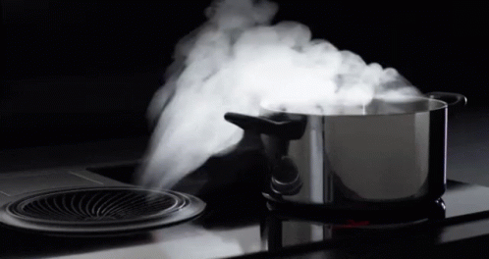

Slide 32
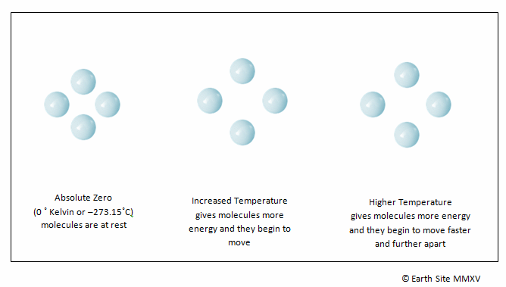

Slide 33
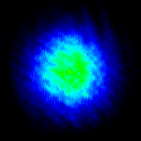
Hotter to colder
Imaging
Of
Atomic gas
Temperature of atomic gas is reduced as a function of time

Slide 34
What is Temperature?
From Kinetic Theory of gases
Will deal with gases now

Slide 35
Huge number of particles

Slide 36
Necessity of Kinetic Theory and Thermodynamics
What is “Kinetic Theory”?
What is “Thermodynamics”?

Slide 37
Approach of “Kinetic Theory”
Distribution
Gas molecules
Microscopic theory

Slide 38
Approach of “Thermodynamics”
Macroscopic level
Measurable quantities
Extensive and Intensive variables

Slide 39
Equilibrium
Approach of “Kinetic Theory”
Approach of “Thermodynamics”

Slide 40
What is Equilibrium?
“Nothing depends on time”

Slide 41
Equilibrium
Ideal Gas Equation

Slide 42
What is an “Ideal Gas”?
Point particles
Non-interaction
Only Kinetic energy
Only Elastic collisions
Is there an ideal gas in practice?

Slide 43
Ideal gas and Real gas
Classical gas
The Approximation
Quantum gas
Larger T
Lower density

Slide 44
Ideal gas and Real gas
Classical gas
The Approximation
Quantum gas
Larger T
Lower density

Slide 45
Kinetic Theory of Gases
Avagrado and Loschmidt – 19th century
“Kinetic theory of gas is a microscopic theory which concerns itself with the average motion of
atoms and their collisions with wall and other objects in order to calculate the equation of the
state for the ideal gas”
Kinetic theory of gas is limited to monoatomic gas with many assumption’s made on the
behavior of ideal gas

Slide 46
Maxwell’s velocity distribution function and assumption’s

Slide 47
Maxwell-Boltzmann Distribution: Kinetic Theory
y
Random motion in all directions
N molecules
V container volume
x
z
How many molecules are moving between velocities v and v + dv?

Slide 48
For convenience
Position space to Velocity space

Slide 49
Let us consider a small region of space

Slide 50
Let us consider a small infinitesimal region of space
“N” molecules
in container
how many molecules are moving between
velocities v and v + dv?

Slide 51
Maxwell’s velocity distribution function and assumption’s

Slide 52
Maxwell’s velocity distribution function and assumption’s
A

Slide 55
2

Slide 56
Recollect eqn (1)
3

Slide 57
Laplace’s method of undetermined multiplier (Mathematics)

Slide 58
Recollecting (A) and substituting

Slide 59
A
B

Slide 62
Maxwell’s distribution law

Slide 64
Maxwell Boltzmann
distribution law

Slide 65
Concept of Mean free path

Slide 66
Free paths
…………………
Target Molecule
Assumption: All other molecules are static

Slide 67
Mean free path: Definition
“Average distance travelled by a gas molecule between two successive collisions”

Slide 68
Assumption: All identical
d

Slide 69
=d
Greater than d
lesser than d

Slide 70
How to calculate the mean free path?
d
d

Slide 71
How to calculate the mean free path?
Assumption: All other molecules are static
d
d

Slide 72
How to calculate the mean free path?
Assumption: All other molecules are static
d
d

Slide 74
Maxwell’s correction when molecules are moving

Slide 75
Average relative speed

Slide 76
0

Slide 77
Applying on both sides

Slide 79
Assumption: Isotropic situation

Slide 80
Equipartition of energy

Slide 81
Mean free path, Pressure, Temperature

Slide 82
Concept of Diffusion and Effusion: Kinetic theory of gases

Slide 83
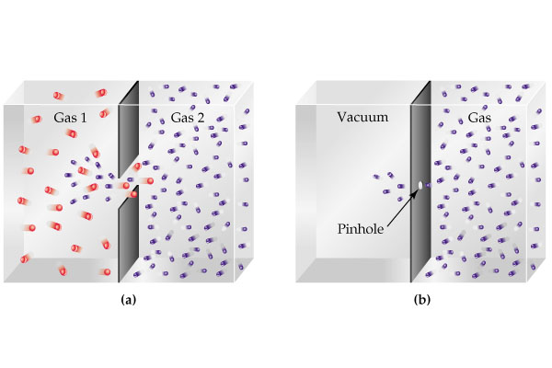

Slide 84
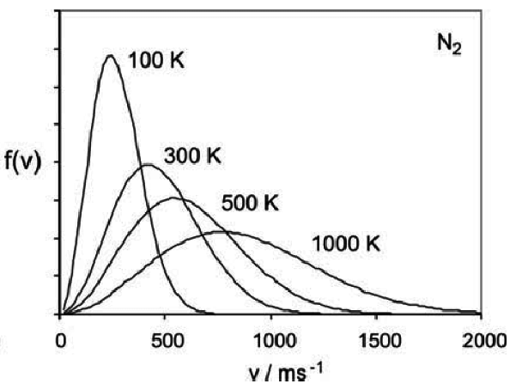
Temperature

Slide 85
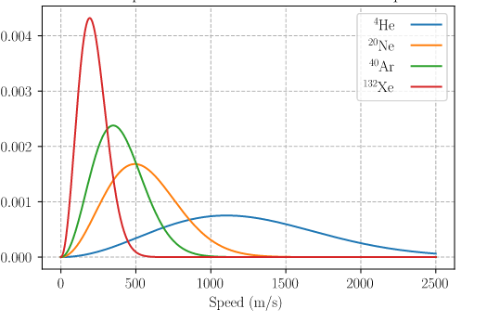
T = 300K
Mass decrease

Slide 86
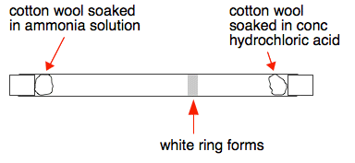

Slide 87
Graham’s Law of Diffusion

Slide 88
Thermal Diffusion equation: Fick’s Law
Kinetic theory

Slide 89
Area A

Slide 90
Heat Flow
Charge Flow
Gas/mass Flow
Flux
Heat Flux q
Charge Flux J
Molecular/mass Flux J
Gradient
Law
Material Property
Thermal conductivity K
Electrical conductivity
Diffusion Coefficient

Slide 91
effect
cause
Flux
Concentration
gradient

Slide 92
Time dependency of concentration
Area =A
C
x

Slide 93
How much concentration inside
this volume change with time?
Apply
Fick’s
Law
C
x

Slide 95
Fick’s second law

Slide 96
Fick’s second law

Slide 97
Thermal Diffusion equation: Fick’s Law
Fick’s second law

Slide 98
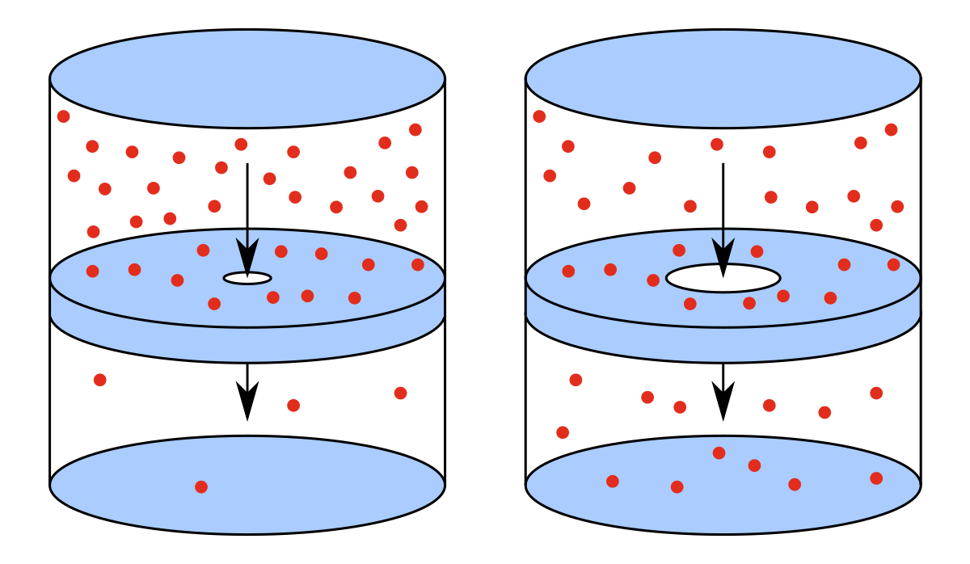
Effusion
Effusion
Diffusion
Effusion occurs through an orifice smaller than the mean free path of the particles in motion

Slide 99
Thermal Diffusion equations: Fick’s Law
Fick’s second law

Slide 100
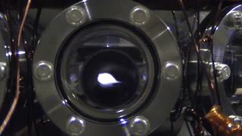
Atomic cloud diffusion in Quantum Technology

Slide 101
v
v

Slide 103
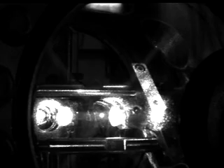

Slide 104
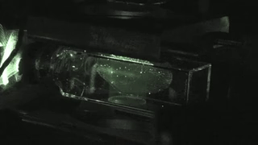

Slide 106
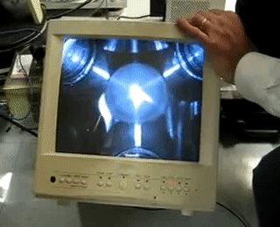

Slide 108
v
a
Non invasive temperature
measurement
a+vt
a+vt’

Slide 109
Effusion
Effusion
Effusion occurs through an orifice smaller than the mean free path of the particles in motion

Slide 110
Gas in left chamber is under equilibrium

Slide 111
To maintain gas in left chamber is under equilibrium
Ensures little or no collisions near the opening hence the equilibrium is maintained

Slide 112
Equilibrium is not disturbed
Under the above condition escape of molecules through hole is called as EFFUSION
OR
EFFUSION occurs through an orifice smaller than the mean free path of the particles in motion

Slide 113
Introduction to Thermodynamics
A revision

Slide 114
Macroscopic approach
Does not probe system at molecular level
Thermodynamic variables P,V,T
System and rest of universe (reservoir: Infinite heat capacity)
System is separated by a wall

Slide 115
Macroscopic approach
Does not probe system at molecular level
Thermodynamic variables P,V,T etc
System and rest of universe (reservoir: Infinite heat capacity)
System is separated by a wall

Slide 116
Zeroth Law of Thermodynamics
R. H. Fowler :1931

Slide 117
Statement
If two systems are in thermal equilibrium with a third system then those two are in thermal equilibrium with each other
A
B

Slide 118
Statement
If two systems are in thermal equilibrium with a third system then those two are in thermal equilibrium with each other
B
C

Slide 119
Statement
If two systems are in thermal equilibrium with a third system then those two are in thermal equilibrium with each other
A
C

Slide 120
Statement
Same Temperature
A
C

Slide 121
Statement
No Heat Flow
A
C

Slide 122
B
DIATHERMIC (CONDUCTING)
A
ADIABATIC
(NON
CONDUCTING)
C

Slide 123
B
ADIABATIC
A
DIATHERMIC (CONDUCTING)
C
No heat flow

Slide 124
First Law of Thermodynamics
Law of Conservation of Energy

Slide 125
Statement
Energy is conserved and heat and work are both forms of energy.

Slide 126
Second Law of Thermodynamics
Revision

Slide 127
Clausius statement
Clausius’ statement of the second law of thermodynamics: ‘No process is possible whose sole result is the transfer of heat from a colder to a hotter body.’

Slide 128
Kelvin’s statement
Kelvin’s statement of the second law of thermodynamics: ‘No process is possible whose sole result is the complete conversion of heat into work.’

Slide 129
Engine
We define an engine as a system operating a cyclic process that converts heat into work. It has to be cyclic so that it can be continuously operated, producing a steady power.
One such engine is the Carnot engine, which is based upon a process called a Carnot cycle

Slide 130
Carnot Cycle

Slide 131
Second Law and Entropy Introduction
Concepts through Problems: B.Sc/M.Sc Level
Application “Engineering real life problems and solution” B.Tech Level

Slide 132
Second Law of Thermodynamics
Revision

Slide 133
Kelvin-Planck’s statement
Kelvin’s statement of the second law of thermodynamics: ‘No process is possible whose sole result is the complete conversion of heat into work.’
Heat
Work

Slide 134
Engine
We define an engine as a system operating a cyclic process that converts heat into work. It has to be cyclic so that it can be continuously operated, producing a steady power.
One such engine is the Carnot engine, which is based upon a process called a
Carnot cycle

Slide 137
Kelvin’s statement
Kelvin’s statement of the second law of thermodynamics: ‘It is impossible to construct an
Engine that operating in a cycle, will produce no effect other than the extraction of heat from a reservoir and the performance of an equivalent amount of work.’

Slide 138
Carnot Cycle

Slide 139
Clausius statement
Clausius’ statement of the second law of thermodynamics: ‘No process is possible whose sole result is the transfer of heat from a colder to a hotter body.’

Slide 141
ASYMMETRY

Slide 142
Refrigerator

Slide 143
Clausius statement
Clausius statement of the second law of thermodynamics: ‘It is impossible to construct a refrigerator that, operating in cycle, will produce no effect other than the transfer of heat from a lower-temperature reservoir to a higher temperature reservoir.’

Slide 144
Equivalence of Kelvin-Planck’s and Clausius statements

Slide 145
Kelvin-Planck’s statement of the second law of thermodynamics: ‘No process is possible whose sole result is the complete conversion of heat into work.’
Clausius’ statement of the second law of thermodynamics: ‘No process is possible whose sole result is the transfer of heat from a colder to a hotter body.’

Slide 146
If Kelvin’s statement is violated, what happens?
R

Slide 147
R
R

Slide 148
R
R

Slide 149
R
R
Violating
Kelvin’s
Violated
Clausius

Slide 150
Violating Kelvin’s Statement Violated Clausius Statement
Let us check the reverse

Slide 151
Violating
Clausius

Slide 152
R
E
W
W
Violating
Clausius
Violated
Kelvin

Slide 153
Violating Clausius Statement Violated Kelvin’s Statement

Slide 154
Re-visit Carnot Cycle

Slide 155
Carnot Efficiency

Slide 156
Definition of Entropy from Carnot Cycle

Slide 157
Definition of Entropy
For a Cyclic Process
State function

Slide 158
Definition of Entropy
For a Cyclic Process
State function

Slide 159
Entropy for an arbit cycle

Slide 160
A
P
B
V

Slide 161
For an arbit cycle
A
P
B
V

Slide 162
For an arbit cycle
A
P
B
V

Slide 166
State function

Slide 167
Entropy and irreversibility
Clausius Inequality
“Entropy of the Universe always increases”

Slide 173
Clausius
inequality

Slide 177
One example……

Slide 185
Now what happens for an irreversible process?

Slide 188
The second law of thermodynamics states that the total entropy of the universe always increases for a spontaneous process.
Clausius inequality helped us to understand this…..

Slide 189
B
A

Slide 190
B
A

Slide 191
B
A

Slide 192
B
A

Slide 193
B
A

Slide 194
B
A

Slide 195
Entropy increases and reached a maximum at equilibrium
No more change in Entropy occurs

Slide 196
Heat cannot be transferred from low temperature to high temperature
In a cyclic process, total heat cannot be converted to work
Efficiency of an engine cannot be 1
One cannot reach T=0K
Entropy of the Universe is always increasing

Slide 197
MID SEM EXAM (Next week)
TOTAL MARKS : 30
Problems approx 15 Marks
Conceptual approx 5 marks
Descriptive approx 5 Marks
Tough Question’s (could be any of above types) approx 5 Marks

Slide 198
Practice Problem/Home Work

Slide 201
Reservoir
300ºc
System
2m³
Q
H₂

Slide 202
Change in Entropy of Hydrogen/System

Slide 203
Error in my solution: Corrected in class
Change in Entropy of Reservoir

Slide 204
Quiz 1 Answer copies displayed…
Many where absent………………

Slide 205
MID SEM EXAM (Next week)
TOTAL MARKS : 30
Problems approx 15 Marks
Conceptual approx 5 marks
Descriptive approx 5 Marks
Tough Question’s (could be any of above types) approx 5 Marks

Slide 206
Quiz Type

Slide 207
State True or False
True

Slide 208
State True or False
True

Slide 209
State True or False
False

Slide 210
State True or False
False

Slide 211
MCQ type
Entropy can be transferred to or from the system in which of the
following forms?
Heat Transfer
Volume change
Both the above
None

Slide 212
MCQ type
Which of the following statement is false?
For a reversible process total change in the Entropy is 0
Entropy does not depend on the path
For an irreversible Process total Change in Entropy is greater than 0
None

Slide 213
MCQ type
Which of the following statement is correct?
ds>dq_{rev}
dS is greater than equal to dq_{rev}/T
dS= dq_{rev}/T
ds<dq_{rev}

Slide 214
MCQ type
How do we calculate change in Entropy of an irreversible process?
We cannot
By knowing KE and PE of particles
By creating a reversible path between initial and final states
B
None

Slide 215
MCQ type
The second law of thermodynamics restricts
A ship could be driven by extracting heat from the ocean
B
An engine which take heat from colder reservoir to hotter reservoir by doing some work
Working of a Power Plant
A reversed heat engine

Slide 216
MID SEM EXAM (Next week)
TOTAL MARKS : 30
Problems approx 15 Marks
Conceptual approx 5 marks
Descriptive approx 5 Marks
Tough Question’s (could be any of above types) approx 5 Marks

