Slide 1
Highlights of the course
Co-ordinate Systems
Introduction to Vector Operators
Work , Energy and Conservation laws
Rigid body in motion
Oscillations and Waves
Quantum Physics

Slide 2
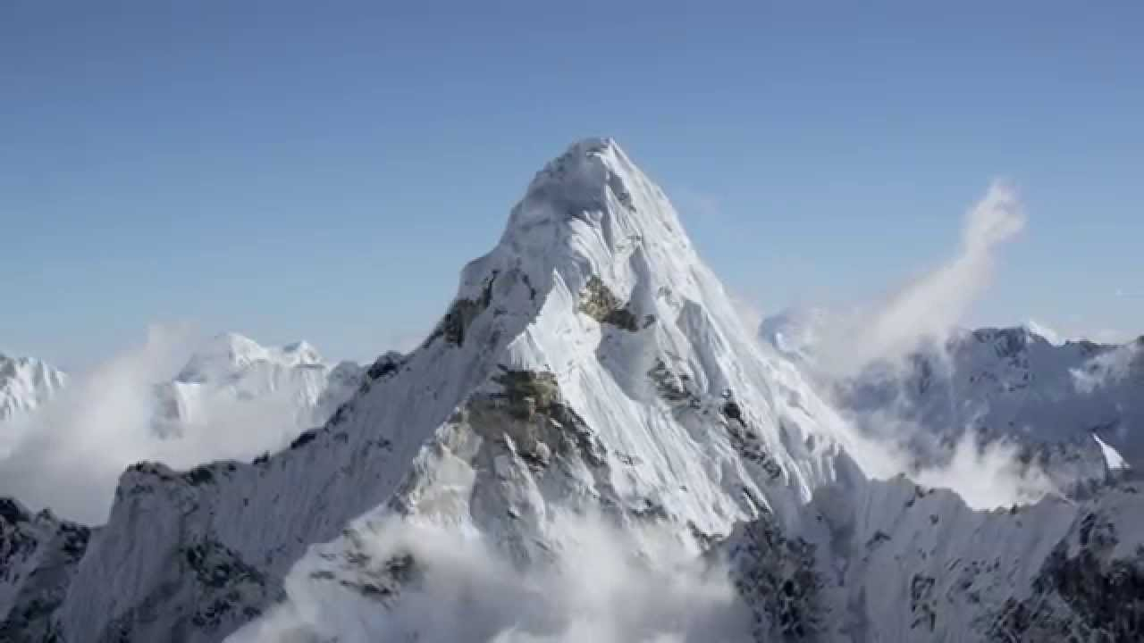
Chapter-2: Introduction to Vector Operators
Gradient, Divergence and Curl

Slide 3
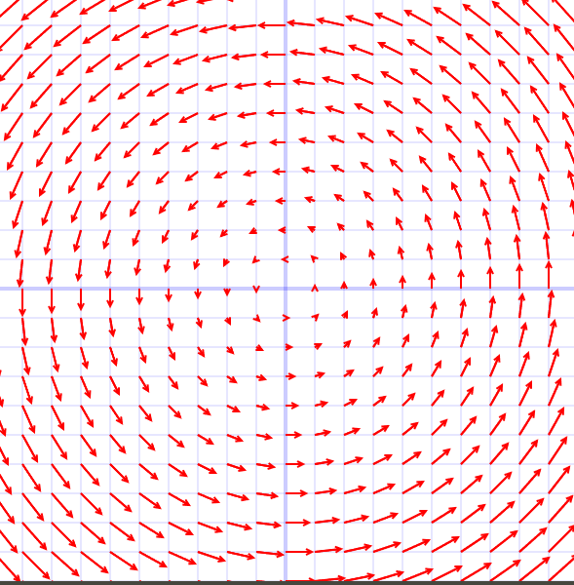
Chapter-2: Introduction to Vector Operators
Gradient, Divergence and Curl (Lecture 8)
Scalar field Vs Vector field
RECAP
The gradient points in the direction of maximum increase of the T.

Slide 4
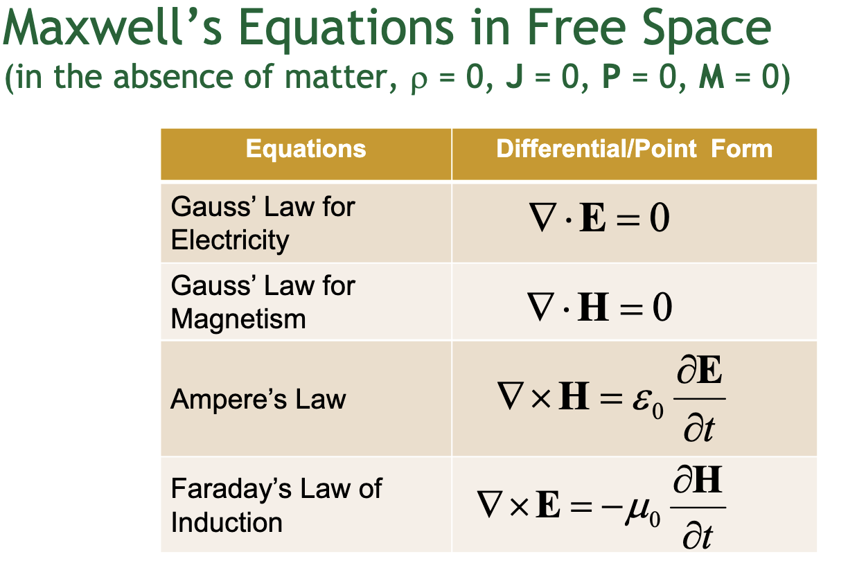
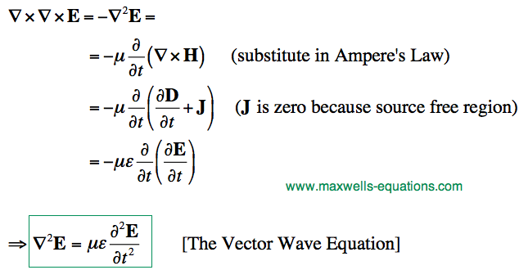
Many many more to learn in Science and Engineering ………

Slide 5
Vector Field
A vector field in the plane is an assignment of a vector to every point (x,y) in the plane.
Algebraically a vector field is a function of (x, y) whose value is a vector
i.e. F(x, y) is a vector field if
We saw some examples in last class……………

Slide 6
Vector Field

Slide 7
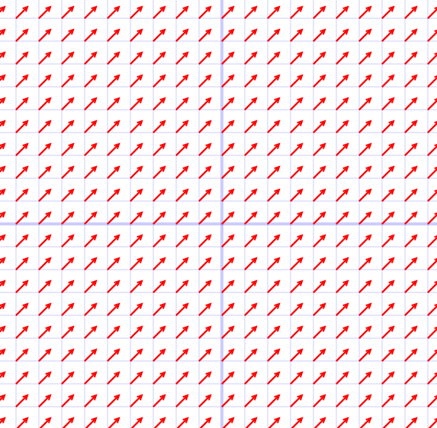
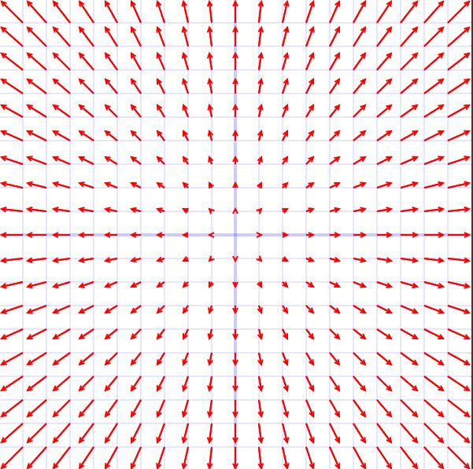
Vector Field

Slide 8
Vector Field
(4,0)
(4,4)
(0,4)

Slide 9
GRADIENT IS A VECTOR FIELD

Slide 11
The divergence: Geometrical interpretation
Net outward/inward flow
Will try to understand it through some examples

Slide 13
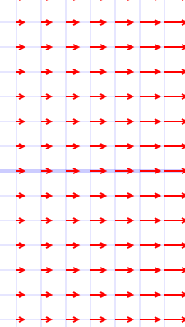

Slide 17
Measure of rotation

Slide 18
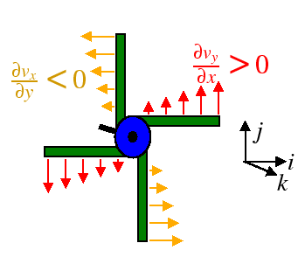
The curl: Geometrical interpretation
Measure of rotation

Slide 19
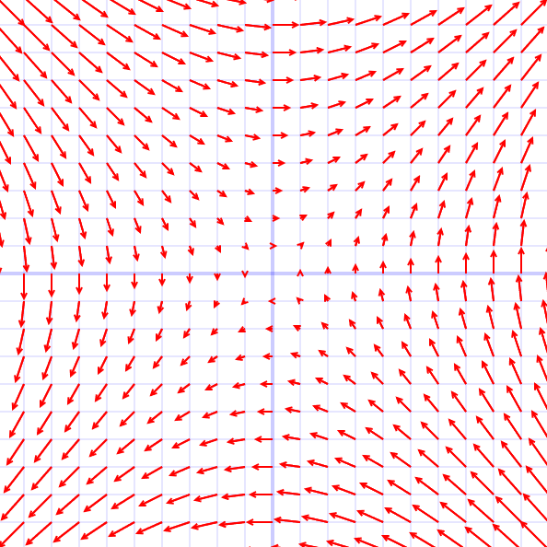
The curl: Geometrical interpretation
Measure of rotation

Slide 20
Gradient of a scalar function in different coordinate system
This definition is independent of the coordinate system used

Slide 21
Gradient in cylindrical polar coordinate system
Gradient

Slide 22
Gradient in cylindrical polar coordinate system
Gradient

Slide 23
Gradient in spherical polar coordinate system
Gradient

Slide 24
Gradient in spherical polar coordinate system

Slide 25
Gradient in different coordinate system
Cartesian Coordinate system
Cylindrical polar Coordinate system
Spherical polar Coordinate system

Slide 26
Divergence and curl in different coordinate system
Spherical polar Coordinate system

Slide 27
Divergence and curl in Spherical polar Coordinate system

Slide 28
Derivatives of Unit Vectors

Slide 29
Divergence and curl in Spherical polar Coordinate system
and proceeding further…..

Slide 30
Divergence and curl in Spherical polar Coordinate system

Slide 31
Divergence and curl in different coordinate system
Spherical polar Coordinate system

Slide 32
Divergence and curl in Spherical polar Coordinate system

Slide 33
Laplacian – a scalar operator
Laplacian – In Cartesian coordinate system

Slide 34
Laplacian – Spherical polar Coordinate system

Slide 35
Divergence and curl in Cylindrical polar Coordinate system

Slide 36
Easy way to remember

