Slide 1

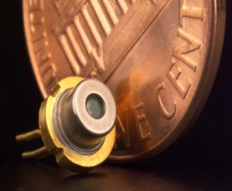
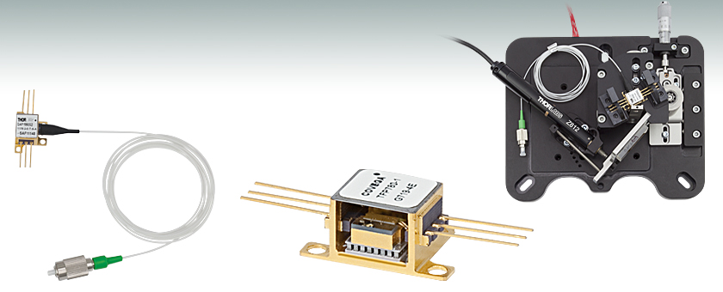
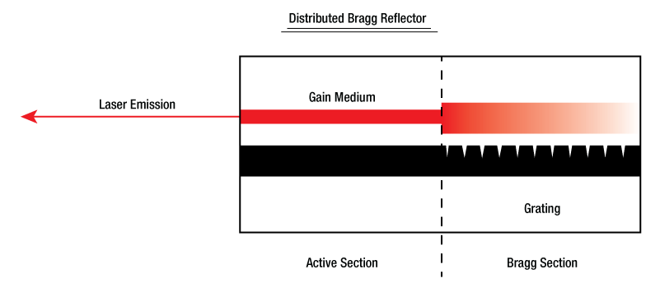
Semiconductor Laser

Slide 2
Semiconductor Laser
Optical communication
Broad areas of Physics and chemistry
Applications in Gas sensors, Interferometer
Atomic clocks
Wide range of applications

Slide 3
Optical communication
Attenuation/Loss in Optical Fiber
3.0
First
Window
2.5
Second
Window
2.0
1.5
Third
Window
ATTENUATION (dB/km)
1.0
0.5
800
900
1000
1100
1200
1300
1400
1500
1600
1700
WAVELENGTH (nm)
850nm
1310nm
1550nm
First window, second window, third window correspond (roughly) to first, second and third generation optic network technology
First Window @ 850nm
  High loss; First-gen. semiconductor diodes (GaAs)
Second Window @ 1310nm
  Lower Loss; good dispersion; second gen. InGaAsP
Third Window @ 1550nm, InGaAsNSb
  Lowest Loss; Erbium Amplification possible

Slide 4
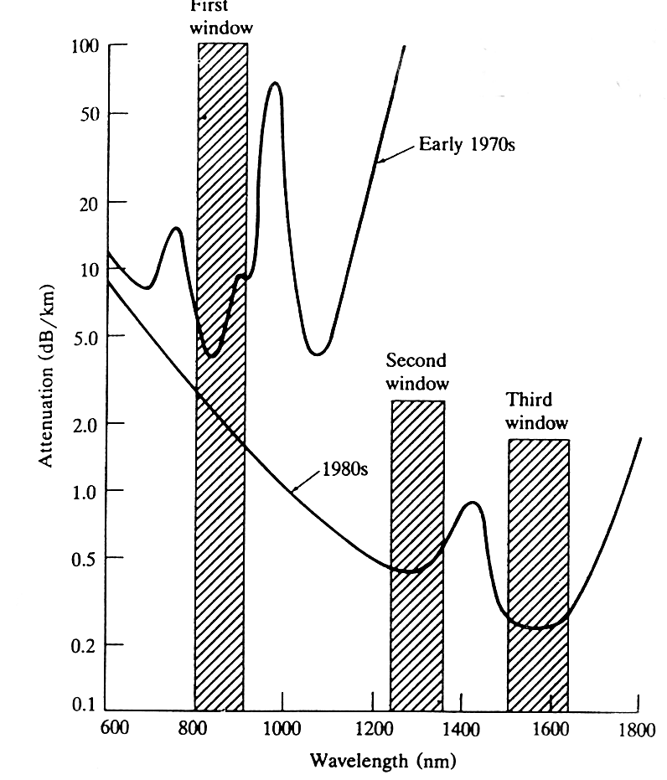
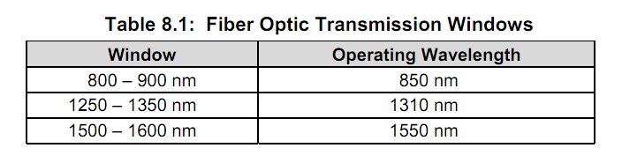

Slide 5
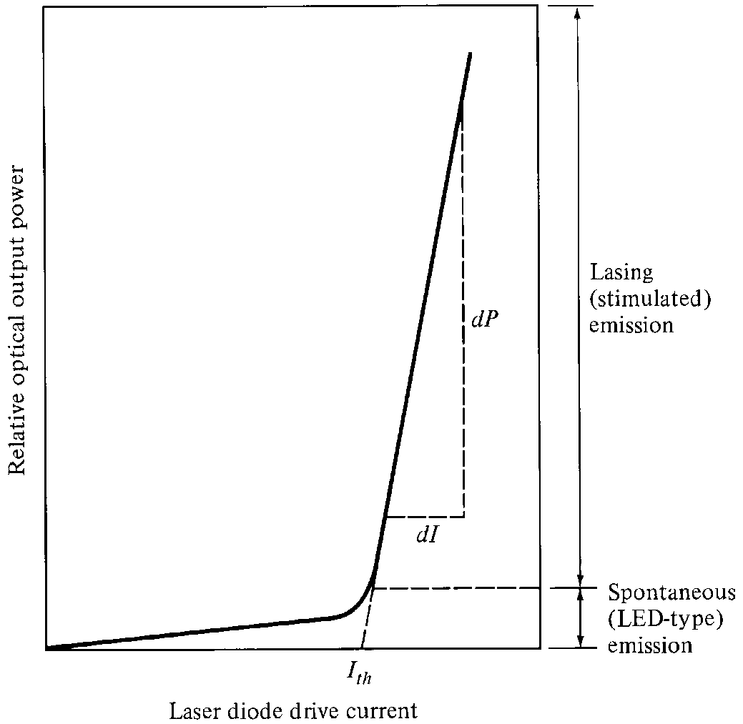
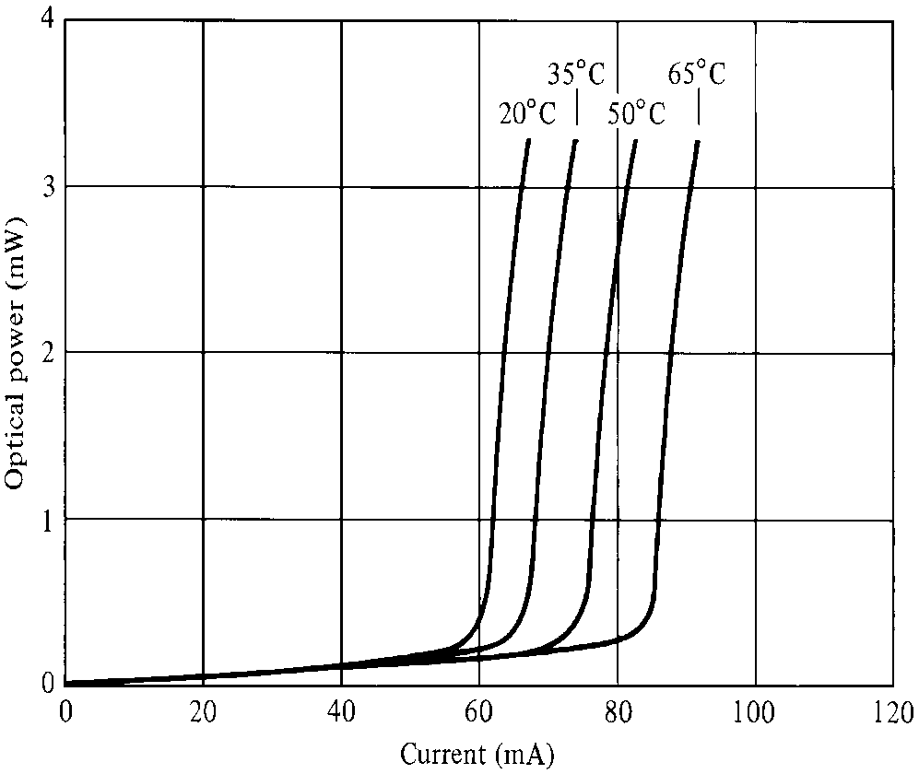
Laser Diode Characteristics

Slide 11
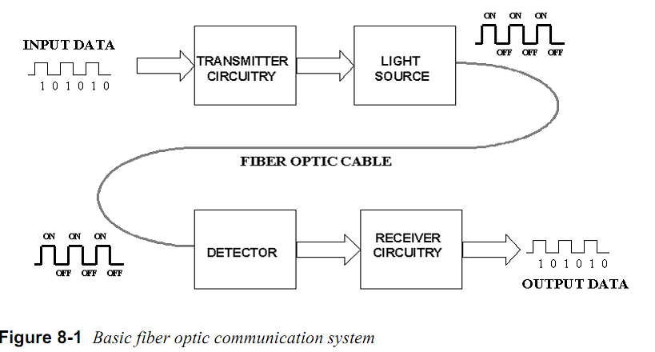
Basic optical communication

Slide 12
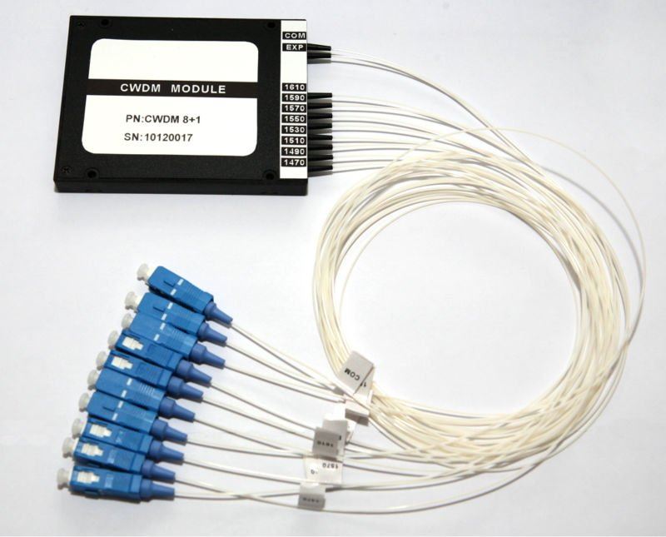
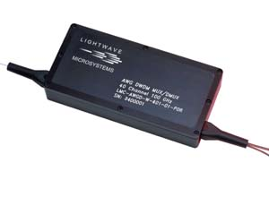
WDM MUX

