Slide 1
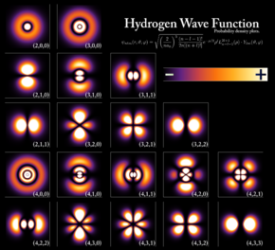
Chapter 6 Quantum Physics

Slide 2
All these experiments confirm dual nature of sub atomic particles and light
Light as PHOTON and electron as MATTER WAVES
Classical or Newtonian Mechanics could not explain all these
New field called Quantum Physics emerged
What is “Quantum” here?

Slide 3
Quantum
Discrete or fixed or allowed entity
Photon picture of light defines energy as
quantized entity: E = hν
Quantum Nature of Light
Some experiments showed energy of matter is also quantized

Slide 4
A thought experiment
Throwing a ball
One can throw ball
to any height
K.E is converted to P.E
Classical Experiment

Slide 5
Quantum nature of energy of matter

Slide 6
Shining light to a matter
LIGHT
SOURCE
Only
Discrete Energies
are absorbed
Something Quantum inside Matter?

Slide 7
What happens Inside?
Matter
is
Quantized
P.E. of atom is increased for a selective frequency by absorption
RECOLLECT HARMONIC OSCILLATOR: RESONANT FREQUENCY

Slide 8
Emission by spontaneous decay

Slide 9
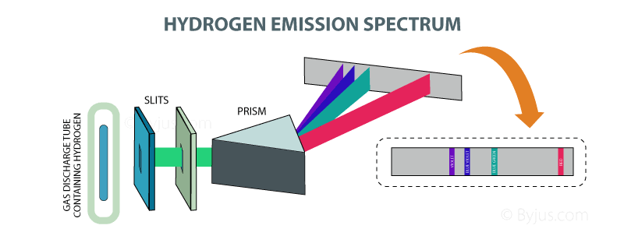
Hydrogen Spectra: Emission lines

Slide 10
Frank Hertz Experiment
Quantum nature of energy of atoms

Slide 11
Bohr atom model

Slide 12
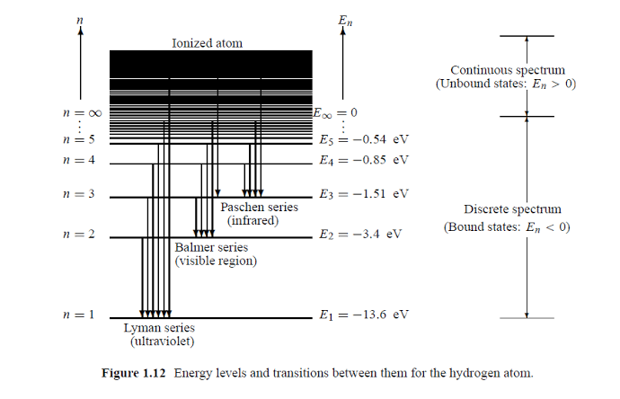
Energy Levels of Hydrogen atom
Bohr’s Correspondence Principle: States that in the limit of n
Quantum physics must agree to Classical physics
$$∞$$

Slide 13
Failure of Bohr Model
Energy spectra of multi electron atoms it could not explain
This theory could not explain the splitting of spectral lines in magnetic field (Zeeman effect) and in electric field (Stark effect). The intensity of these spectral lines was also not explained by the Bohr atomic model.

Slide 14
Failure of other models
Rutherford atom model
Somerfield model predicted elliptical orbit,
also failed to explain Stark and Zeeman splitting

Slide 15
New mathematical framework is needed!

Slide 16
New frame work to understand Quantum Physics
Set of Postulates are made, first we need to believe them
They worked and could predict correctly many results

Slide 17
State of physical system
In classical mechanics how do you specify a state of a system or gain complete knowledge about the system?
Ans: by knowing x and P
Energy, Angular momentum etc could be known

Slide 18
State of physical system
In Quantum Physics this does not work. Why?
Ans: Uncertainty relation
This leads to first postulate in Quantum Physics

Slide 19
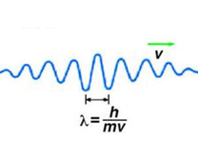
Postulate 1
The state of a quantum mechanical system is completely specified
by the wavefunction ψ(x).
Wavefunction gives a mathematical description of shape of the matter wave. This can be complex also.
ψ(x) and ψ’(x) must be single valued and continuous everywhere.

Slide 20
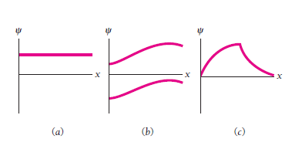
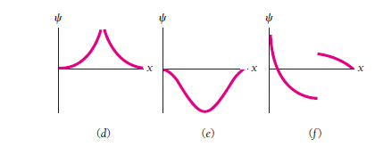
Lets See Some Examples….

Slide 21
Postulate 2
ψ*(x)ψ(x) is the probability density that the particle can be found at x.

Slide 22
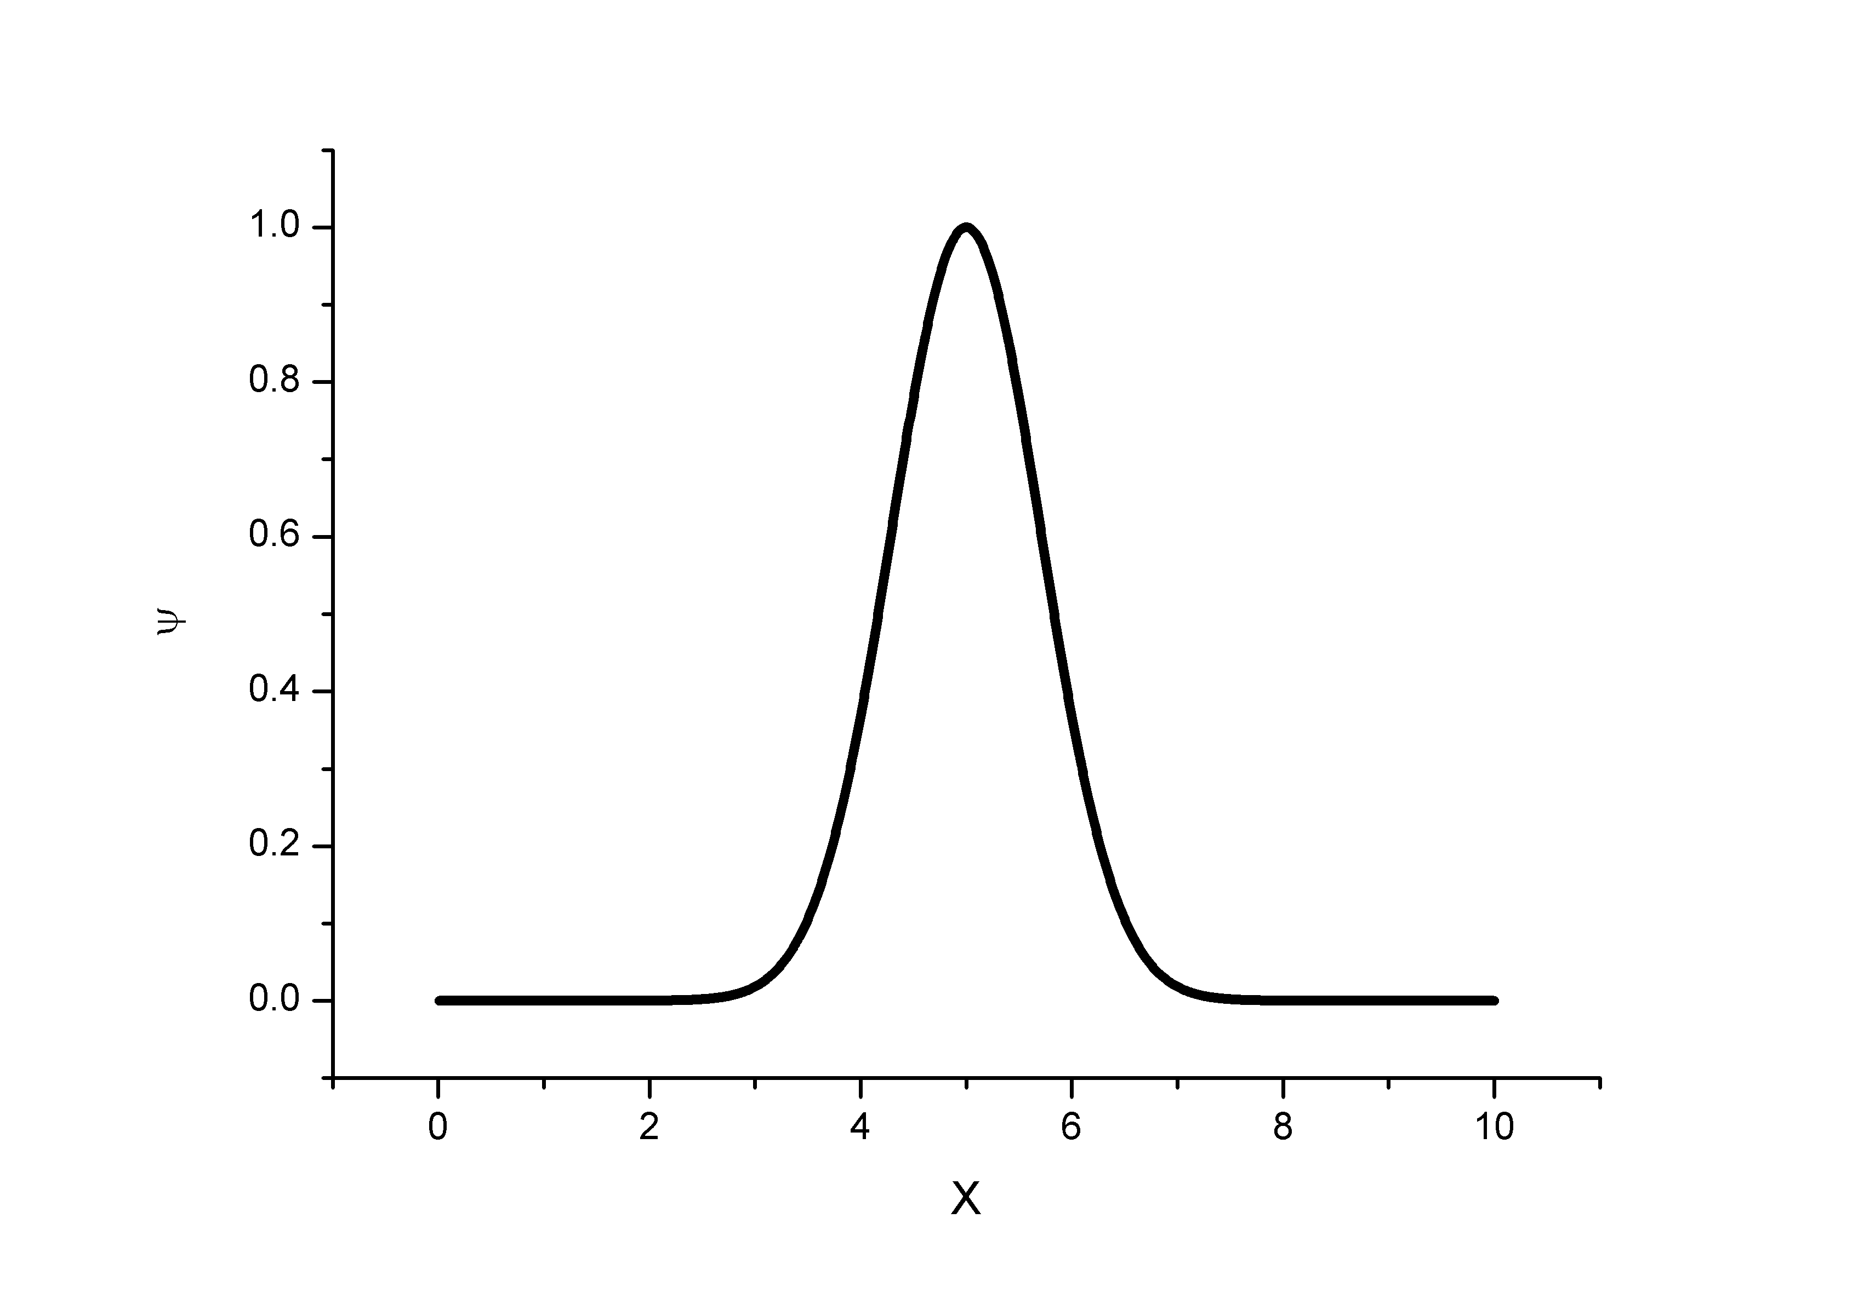
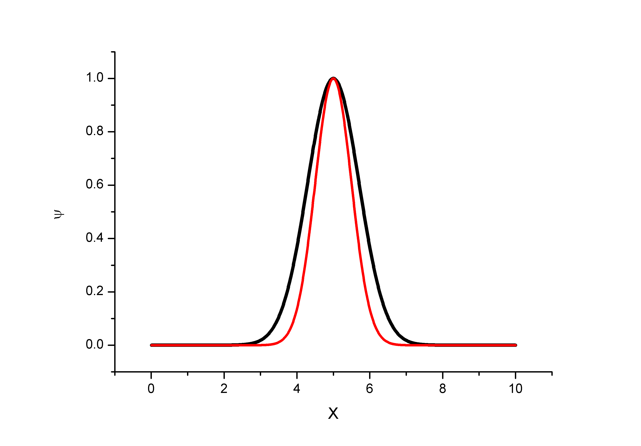
Lets See Some Examples….
ψ*(x)ψ(x)

Slide 23
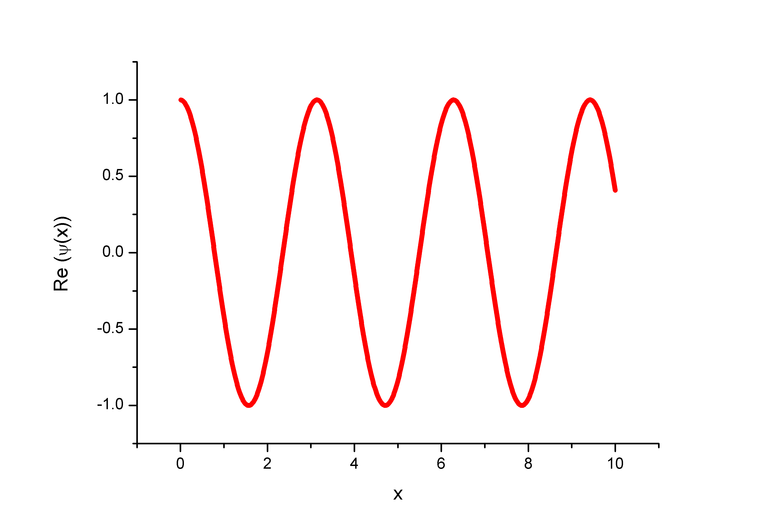
Lets See Some Examples….

Slide 24
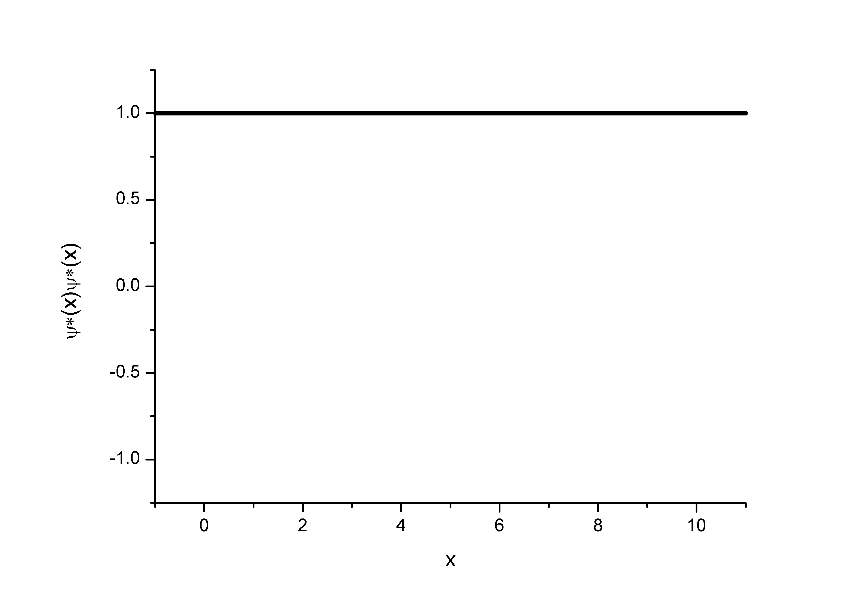
How about ψ*(x)ψ(x)?

Slide 25
Normalization
What is the total probability possible?
Probability that the particle can be found in the interval dx
Adds another quality:
ψ(x) has to be finite everywhere

Slide 26
Guess the dimension of wavefunction!

Slide 27
A particle is limited to the x axis has the wavefunction ψ(x) =Ax between x=0 and x=1; ψ(x) =0 elsewhere.
Find the probability that the particle can be found between x=0.45 and x=0.55
For what value of A the wavefunction will be normalized?

Slide 28
(b) For what value of A the wavefunction will be normalized?

Slide 29
Postulate 3
Linearity and Superposition
Let ψ₁(x) and ψ₂(x) represents the two wavefunctions of a quantum system, then the linear superposition will also be a valid wavefunction for the same quantum system.

Slide 30
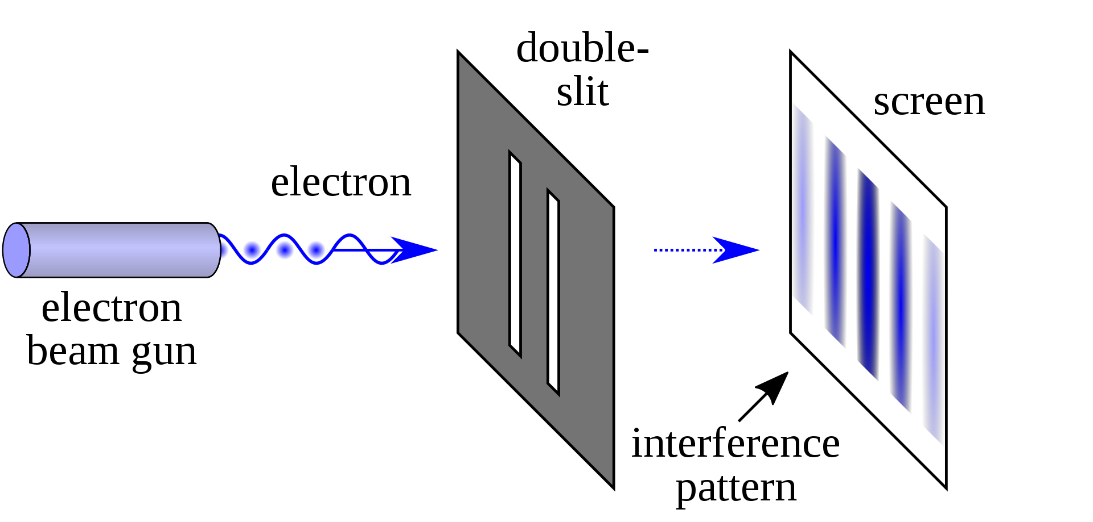
Demonstration of superposition

Slide 31
ANNOUNCEMENTS
Quiz-2 on 22nd November (Friday) 2019.
Portion for End-Sem and Quiz-2(Post Mid-sem Syllabus)
Reference for Quantum Mechanics: Concepts of Modern
Physics by Arthur Beiser.

