Slide 1

PH5101 Atomic and Molecular Physics
Orientation with Instructor

Slide 2

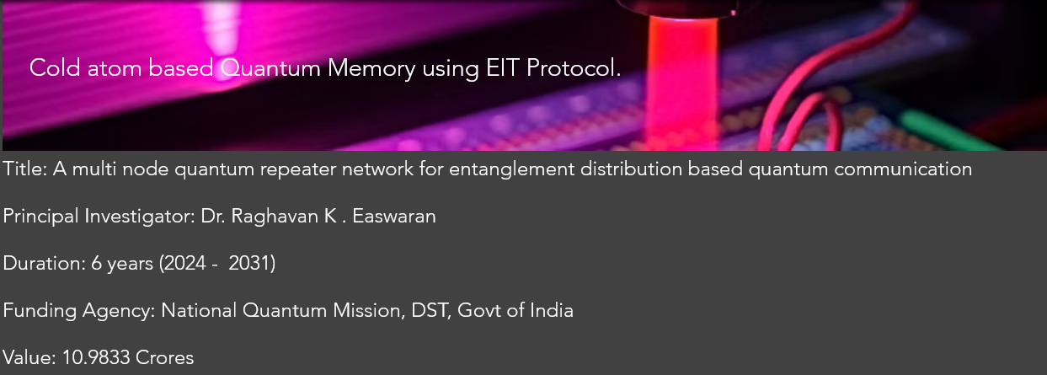

Course Instructor
Dr. Raghavan K Easwaran
PhD (France, Paris) PDF(Nottingham, UK), UG (IIT Madras)
Marie Curie Fellow (PhD) European Union (EU), IFRAF, Paris
Associate Professor and Former Head of the department
Department of Physics
MPI, National Quantum Mission
Quantum Communication HUB,
Indian Institute of Technology Madras
Indian Institute of Technology Patna
www.raghavanke.com

Slide 3
PH5101 Atomic and Molecular Physics
3-1-0-4
Syllabus
Recap of Atomic physics experiments: a historical overview and recap of Quantum Physics, One electron atom and its representation example Alkali atoms: Rubidium as a case study, Zeeman effect ,Interaction of one electron atoms with electromagnetic radiation and stark effect, Transition rates, The dipole approximation, Selection rules, Spectrum of one electron atoms like alkali gas, , Fine structure and Hyperfine structure of alkali atoms and atomic spectroscopy, Line intensities and the life time of the excited states, Line shapes and widths. Many electron atoms: L-S coupling and j-j coupling, Thomas Fermi model, Hartree- Fock method and the SCF.
Molecular structure, Born -Oppenheimer approximation, Electronic structure of diatomic molecule, Electronic, Rotational, Vibrational and Vibration-Rotation Spectra of diatomic molecules, Electronic spectra of diatomic molecules, The Franck-Condon principle. Introduction to the Density functional theory
Additional Topics: Atomic Physics and Quantum Memory for Quantum Communication.
Suggested Readings:
Textbooks: • B.H. Bransden and C.J. Joachain, Physics of Atoms and Molecules,
Longman Scientific and Technical, 1983.
• Gordon W and F. Drake, Springer Handbook of Atomic, Molecular,
and Optical Physics, Springer, 2006.
• W. Demtroder, Atoms, Molecules and Photons, Springer, 2010.
• H. Haken and H.C. Wolf, Physics of Atoms and Quanta, Springer, 2005.
• H. E. White, Introduction to Atomic Spectra, McGraw Hill, 2019
• G. K. Woodgate, Elementary Atomic Structure, 2nd Ed., Clerenton Press, Oxford, 2002
• M. Karplus and R. N. Porter, Atoms and Molecules: An Introduction for Students of Physical Chemistry
References:
• Ira N. Levine, Quantum Chemistry, 6th Edition, PHI Learning Private Limited, New Delhi, 2009.
• John P. Lowe and Kirk A. Peterson, Quantum Chemistry, 3rd Edition, Academic Press, 2009.
• Peter Atkins and Ronald Friedman, 4thEdition, Oxford Univ. Press, 2012. • Collin N. Banwell and Elain M. Mc Cash, Fundamentals of Molecular Spectroscopy, 4thEdition, Tata McGraw Hills, 2008.

Slide 4
Time | 10:11 | 10-11 | 11-12 | 11-12 | 4-5
Day
Monday | R103
Tuesday |  | R103
Wednesday |  |  | R103
Thursday |  |  |  | R304
Friday |  |  |  | 103

Slide 5
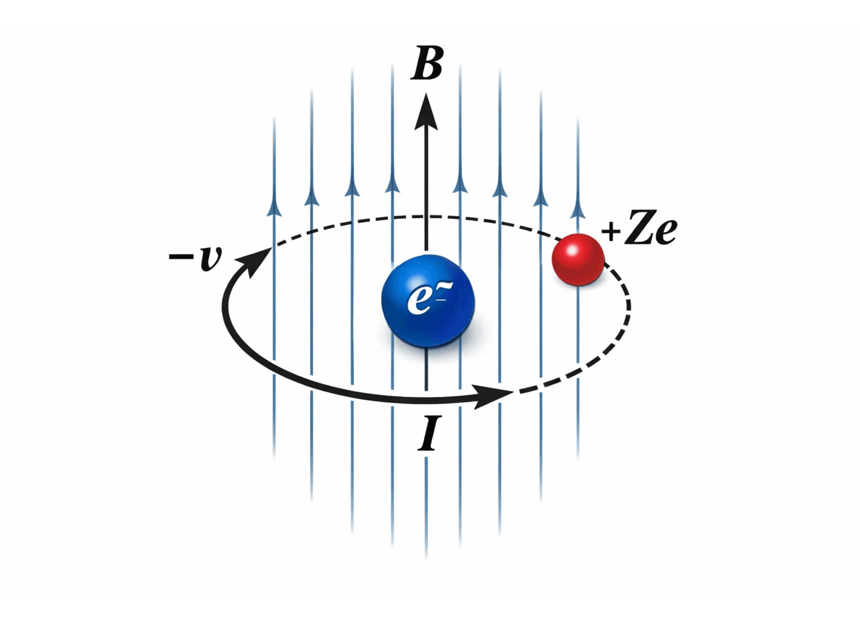
Spin Orbit Coupling

Slide 6
 |  | L1 | L2 | L3 | L4 | L5 | L6 | L7 | L8 | L9 | L10 | L11 | L12 | L13 | L14
 | Ankita | p | p | p | P
2. | Divya | p | p | p | P
3. | Dixita | p | p | p | P
4. | Abdul | p | p | p | P
5. | Nikhilkumar | p | p | p
6. | Ritik | a | p | p | P
7. | Arnab | p | p | p | P
8. | Upamanyu | p | p | p | P
9. | Antar | p | p |  | P
10. | Arun | a | p | p | P

Slide 7
 |  | L1 | L2 | L3 | L4 | L5 | L6 | L7 | L8 | L9 | L10 | L11 | L12 | L13 | L14
11 | Naman | p | p | p | P
12 | Narashingh | a | p | p | P
13 | Ratnanabh | a | p | p
14 | Umacharan | a | p | p | P
15 | Mangal | a | p | p | P
16 | Shubham | p | p | p | P
17 | Ardhra | p | p | p
18 | Rahul | p | p | p | P
19 | Rabindra | p | p | p | P
20 | Aoura | p | p | p | P
21 | Sourav | p | p | p | P
22 | Akansha | p | p | p | P

Slide 8
Start in the nucleus/laboratory frame.
Transform the electromagnetic field to the electron’s instantaneous rest frame.
Calculate the magnetic interaction of the electron’s spin in that frame.
Include Thomas precession because the instantaneous rest frame is accelerating.
Express the final result in terms of the laboratory-frame operators $L$and $S$.
Thus, we use the electron rest frame as an intermediate calculation frame, but the final Hamiltonian is written as an effective Hamiltonian for the atom in the laboratory frame.
The mass is $m_{e}$because $L=m_{e}r×v$is the electron’s orbital angular momentum in the fixed-nucleus approximation.

Slide 9
Semi-Classical approach
Electron trajectory $r\left(t\right),v\left(t\right)$ | Classical approximation
$p=m_{e}v$along that trajectory | Classical approximation
Coulomb force $m_{e}a=qE$ | Classical approximation
Lorentz transformation of $E,B$ | Classical relativistic electrodynamics
Thomas rotation of successive rest frames | Classical relativistic kinematics
Spin $S$ | Quantum
$$μ_{s}=−g_{s}eS/\left(2m_{e}\right)$$ | Quantum input
$L⋅S$coupling and J values | Quantum
Final Hamiltonian | Quantum effective operator

Slide 10
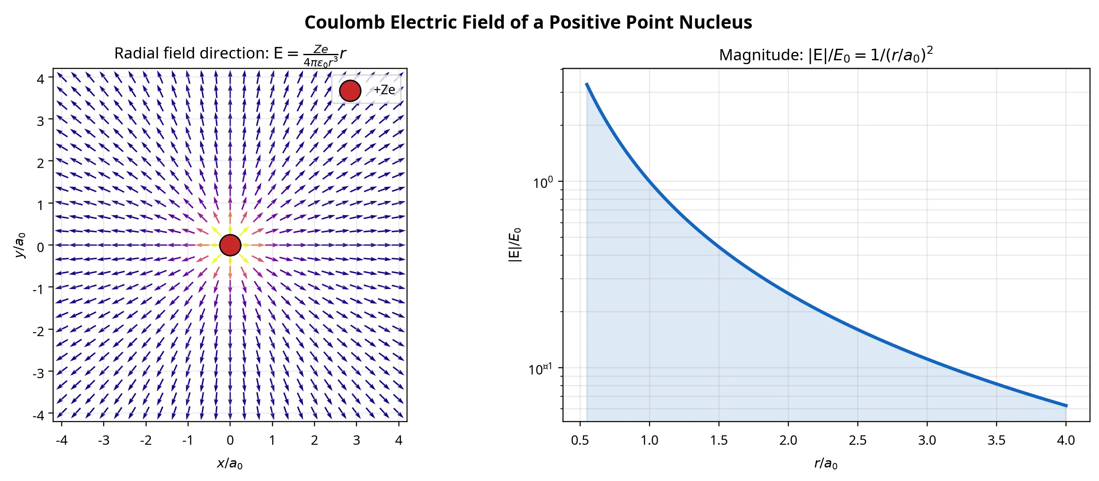

Slide 11
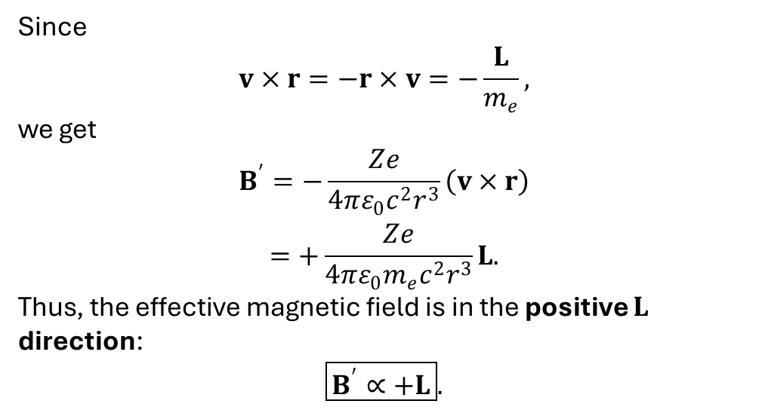
2. Transform to the electron’s instantaneous rest frame
The electron’s rest frame sees a magnetic field due to its motion through the nuclear electric field:
$$B^{′}=−\frac{1}{c^{2}}v×E.$$
comes from the Lorentz transformation of electromagnetic fields.
v is the electron’s velocity in the laboratory/nucleus frame
Since
$$v×r=−r×v=−\frac{L}{m_{e}},$$
we get
$$\begin{aligned}B^{′}=−\frac{Ze}{4πε_{0}c^{2}r^{3}}\left(v×r\right) \\ =+\frac{Ze}{4πε_{0}m_{e}c^{2}r^{3}}L.\end{aligned}$$
Thus, the effective magnetic field is in the positive $L$ direction:
$$\boxed{B^{′}∝+L}.$$

Slide 16
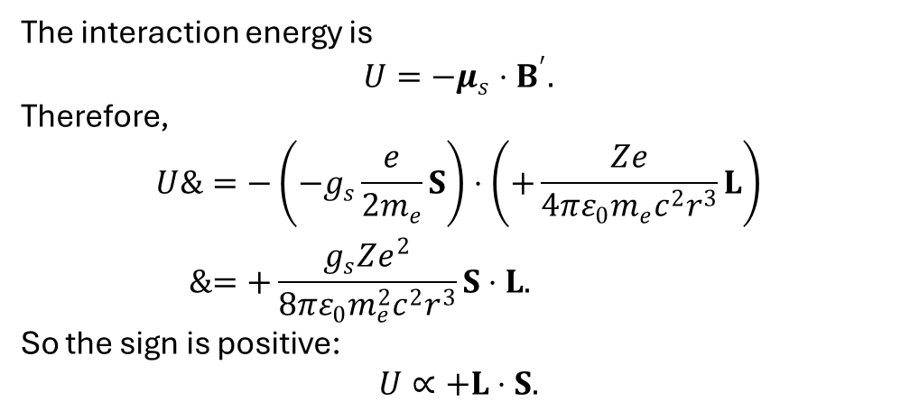
The interaction energy is
$$U=−μ_{s}⋅B^{′}.$$
Therefore,
$$\begin{aligned}U&=−\left(−g_{s}\frac{e}{2m_{e}}S\right)⋅\left(+\frac{Ze}{4πε_{0}m_{e}c^{2}r^{3}}L\right) \\ &=+\frac{g_{s}Ze^{2}}{8πε_{0}m_{e}^{2}c^{2}r^{3}}S⋅L.\end{aligned}$$
So the sign is positive:
$$U∝+L⋅S.$$

Slide 17
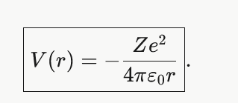
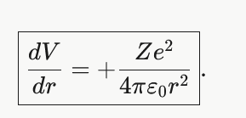
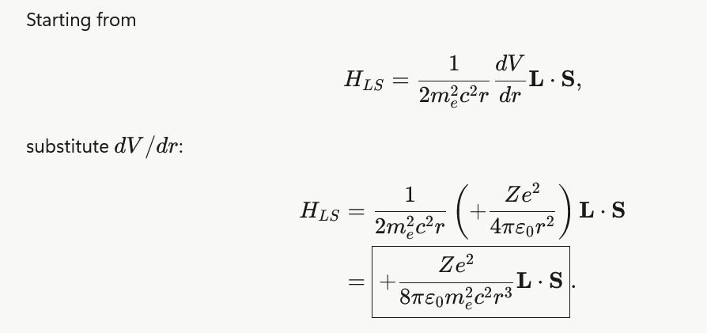
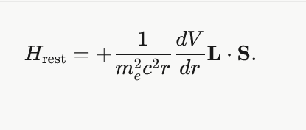
$g_{s}$ = 2

Slide 18
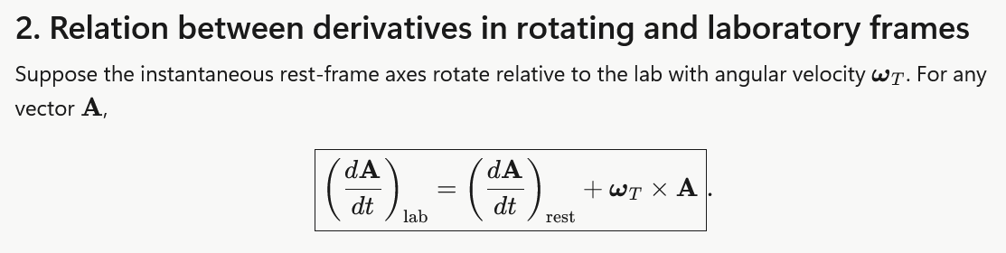
Include Thomas precession
The electron’s instantaneous rest frame is not an inertial frame because the electron is accelerating in its orbit. The Thomas-precession correction reduces the naive result by a factor of $1/2$. With $g_{s}≈2$, the standard spin–orbit Hamiltonian becomes
$$\boxed{H_{SO}=\frac{Ze^{2}}{8πε_{0}m_{e}^{2}c^{2}r^{3}}L⋅S}.$$

Slide 19
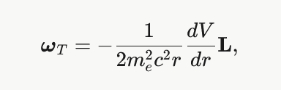

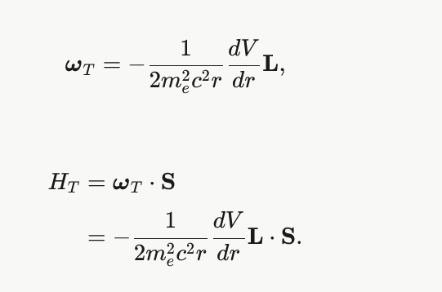

Slide 20
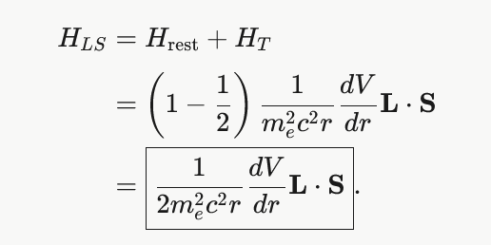

Slide 21

The Thomas Precession Correction
Non-Inertial Frame
The electron's rest frame is accelerating
due to its orbital motion, making it a
non-inertial reference frame.
Correction Factor
1 / 2
Kinematic Effect
Relativistic rotation of the coordinate
system occurs, known as Thomas
U_{SO} = ½ U_{naive}
Precession, which adds an energy term.
The Correction
Corrected Interaction
H_{SO} ∝ ½ (L · S)
This effect reduces the effective
magnetic field by exactly a factor of 2,
resolving the "factor of 2" discrepancy.

Slide 22
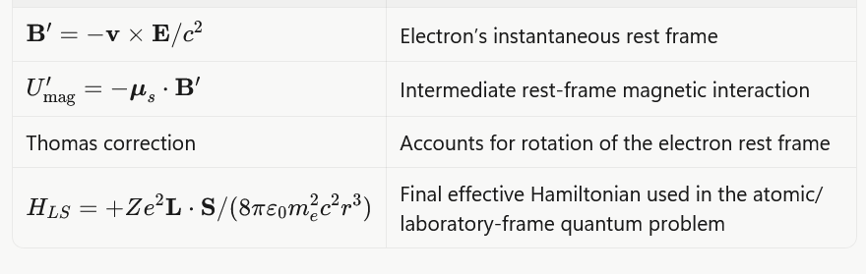

Slide 23

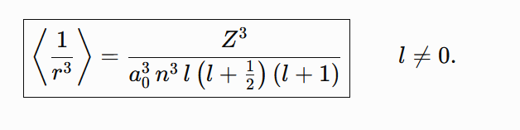
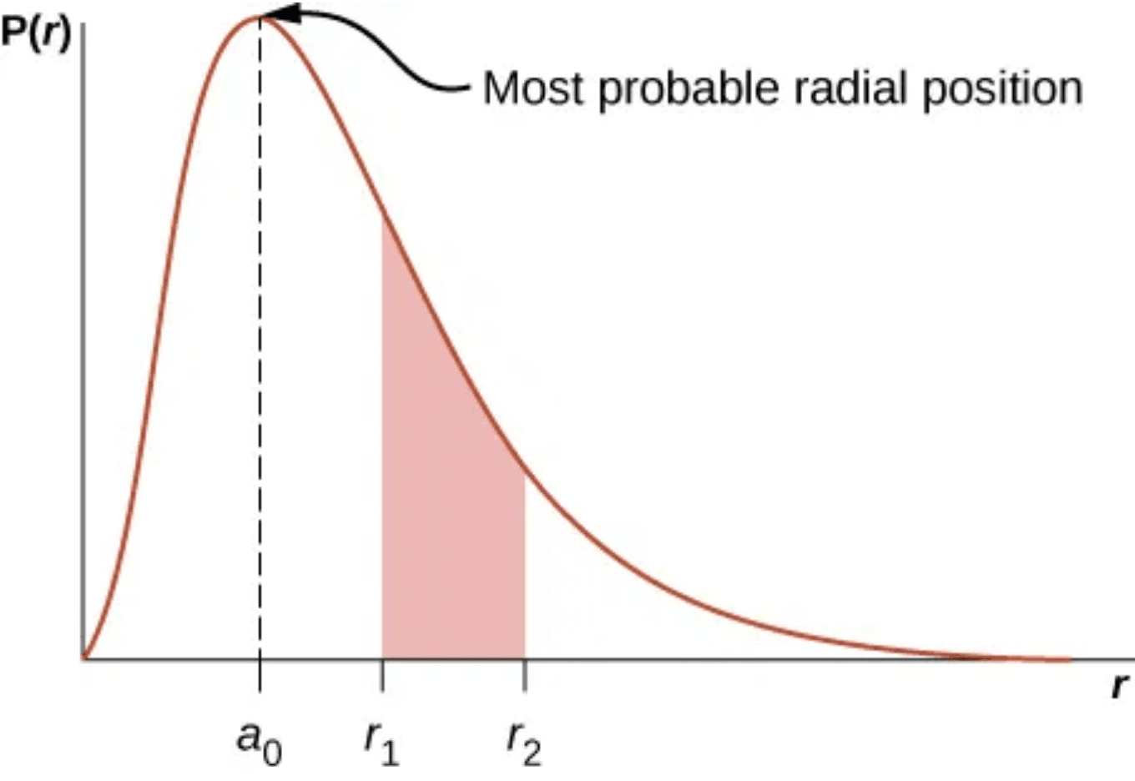
Expectation Value of 1/r³
⟨1/r³⟩ = Z³ / [n³a₀³ l(l+1/2)(l+1)]
Atomic Number (Z³)
Principal Quantum (n⁻³)
The interaction strength increases cubically with Z, making it dominant in heavy elements.
As n increases, the electron is further from the nucleus, rapidly weakening the coupling.
Angular Momentum (l)
Physical Origin
Radial probability distribution P(r) determines the spatial average of the interaction.
The term depends heavily on l. Note that for l=0, the formula formally diverges.
Derived from the radial wave functions R_{nl}(r) of the hydrogen-like atom.

Slide 24

Evaluating the L · S Term
01
J = L + S
Define the Total Angular Momentum as the sum of orbital and spin components.
02
J² = (L + S)² = L² + S² + 2(L · S)
Square the operator to isolate the coupling term.
03
L · S = ½(J² - L² - S²)
The expectation value is determined by the quantum numbers j, l, and s:
⟨L · S⟩ = (ħ²/2) [j(j+1) - l(l+1) - s(s+1)]

Slide 25
Calculating the Energy Shift (ΔE_{SO})
General Expression
ΔE_{SO} = ⟨H_{SO}⟩ = [Ze² / (8πε₀m_{e}²c²)] ⟨1/r³⟩ ⟨L · S⟩
Defining Constant A
A = [Ze² / (8πε₀m_{e}²c²)] [Z³ / (n³a₀³l(l+1/2)(l+1))]
We group the radial part and constants into A to simplify the energy level expressions.
The total energy shift is the product of the radial expectation value and the angular momentum coupling term.
Energy Levels
The fine-structure energy is
$$E_{FS}=\frac{A}{2}\left[J\left(J+1\right)−L\left(L+1\right)−S\left(S+1\right)\right],$$
where $A$ is the spin-orbit coupling constant

Slide 26
Final Energy Gap Formula
The fine-structure energy is
$$E_{FS}=\frac{A}{2}\left[J\left(J+1\right)−L\left(L+1\right)−S\left(S+1\right)\right],$$
where $A$ is the spin-orbit coupling constant
Interval Rule
The gap between consecutive J levels:
$$ΔE_{J}=E_{J}−E_{J−1}=AJ.$$
For example, in a ${}^{3}P$ term ($L=1,S=1$), the $J=1$ to $J=2$ gap is $2A$, twice the $J=0$ to $J=1$ gap of $A$.
Energy levels for sodium. The 3p level splitting is a direct application of this Z⁴ scaling formula.
Fine Structure Constant Scaling
ΔE = [Z⁴α⁴mₑc²] / [2n³l(l+1)]
Where α = e² / (4πε₀ħc) ≈ 1/137

Slide 27
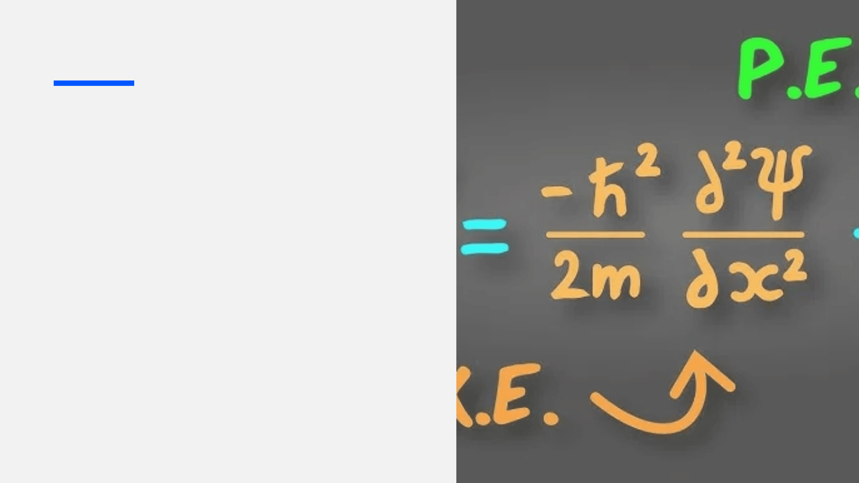
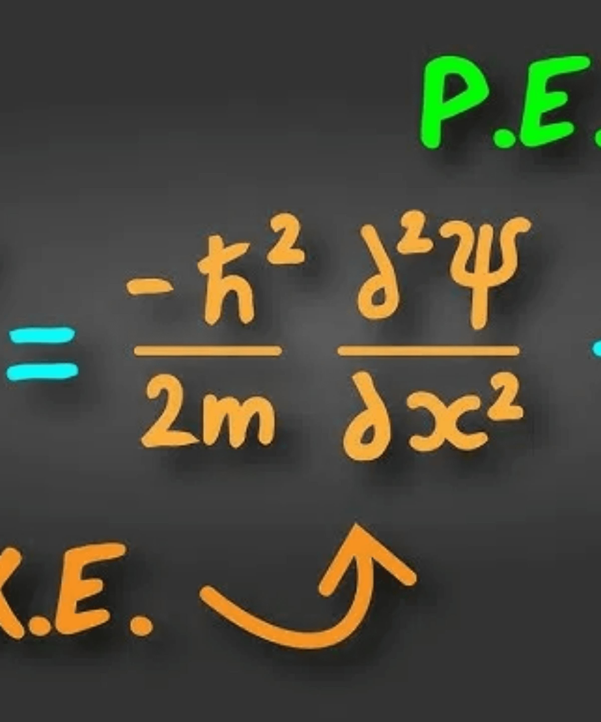
Relativistic
Correction
Detailed Derivation of
Expectation Values

Slide 28
Deriving Kinetic Energy from Special Relativity
The Unified Energy Relation
E = T + mc²
E = √(p²c² + m²c⁴)
Total energy = kinetic + rest energy.
The Fundamental Definition
Factoring for Analysis
1. Defining Kinetic Energy (T)
3. Factoring out Rest Energy (mc²)
T = E - mc²
T = mc² [ √(1 + p²/m²c²) - 1 ]
Kinetic energy is the energy added to a system by virtue of its motion.
This form enables a binomial expansion at low velocities.
2. Substituting Total Energy (E)
T = √(p²c² + m²c⁴) - mc²

Slide 29

Relativistic Kinetic Energy
from Special Relativity
E = √(p²c² + m²c⁴)
Einstein's Relation
T = E - mc²
Kinetic Energy Definition
T = √(p²c² + m²c⁴) - mc²
Substitution
T = mc² [ √(1 + p²/m²c²) - 1 ]
Factoring out mc²

Slide 30

Binomial Expansion
for Kinetic Energy
√(1 + p²/m²c²) ≈ 1 + p²/2m²c² - p⁴/8m⁴c⁴
Approximation (p ≪ mc)
T ≈ mc² [ 1 + p²/2m²c² - p⁴/8m⁴c⁴ - 1 ]
Substitute into T
T ≈ mc² [ p²/2m²c² - p⁴/8m⁴c⁴ ]
Simplify Terms
T ≈ p²/2m - p⁴/8m³c²
Final Expansion

Slide 31

Obtaining the
Correction Hamiltonian
Non-Relativistic Term
Ĥ₀ = p̂² / 2m
The standard kinetic energy term used in the unperturbed Schrödinger equation.
Relativistic Correction (Perturbation)
Ĥ'ᵣₑₗ = - p̂⁴ / 8m³c²
This term is responsible for the relativistic shift in energy levels, contributing to the fine structure splitting.

Slide 32

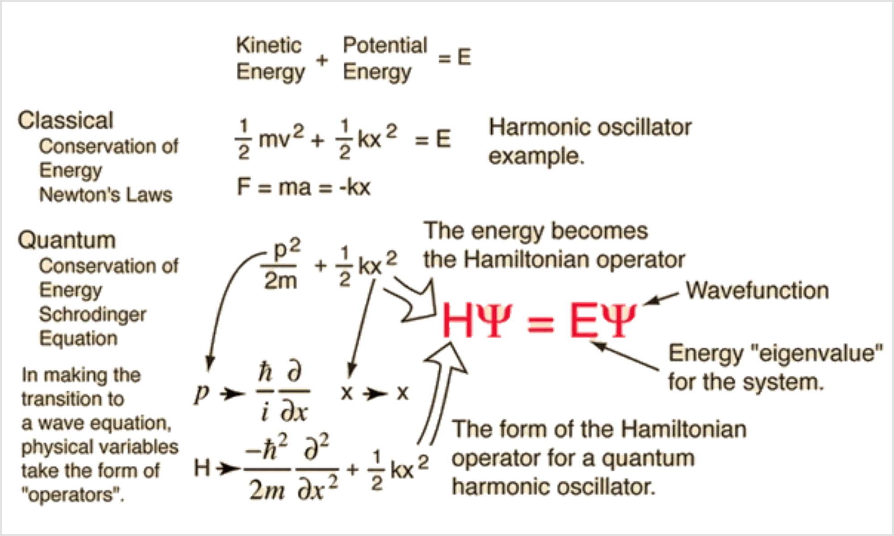
Introduction
Objective
Provide a detailed, step-by-step evaluation of the expectation values for the momentum operators p² and p⁴.
Significance
These values are essential for calculating the first-order relativistic correction to the energy levels of the hydrogen atom.
Methodology
We utilize the unperturbed Schrödinger equation to substitute for the momentum operators, simplifying the derivation.

Slide 33

The Unperturbed
Schrödinger Equation
Unperturbed Hamiltonian
Ĥ₀ = p̂² / 2m + V̂(r)
Time-Independent Schrödinger Equation
Ĥ₀ |ψₙₗₘ⟩ = Eₙ |ψₙₗₘ⟩
(p̂² / 2m + V̂) |ψₙₗₘ⟩ = Eₙ |ψₙₗₘ⟩

Slide 34
Isolating the
p̂² Operator
01
Start with the Schrödinger Equation
(p̂² / 2m + V̂) |ψₙₗₘ⟩ = Eₙ |ψₙₗₘ⟩
02
Subtract the Potential Term
p̂² / 2m |ψₙₗₘ⟩ = (Eₙ - V̂) |ψₙₗₘ⟩
03
Multiply by 2m
p̂² |ψₙₗₘ⟩ = 2m(Eₙ - V̂) |ψₙₗₘ⟩

Slide 35
Evaluating the
Expectation Value ⟨p̂²⟩
⟨p̂²⟩ = ⟨ψₙₗₘ | p̂² | ψₙₗₘ⟩
Definition
⟨p̂²⟩ = ⟨ψₙₗₘ | 2m(Eₙ - V̂) | ψₙₗₘ⟩
Substitution
⟨p̂²⟩ = 2m [ Eₙ⟨ψₙₗₘ|ψₙₗₘ⟩ - ⟨ψₙₗₘ|V̂|ψₙₗₘ⟩ ]
Linearity
⟨ψₙₗₘ|ψₙₗₘ⟩ = 1
Normalization
⟨p̂²⟩ = 2m(Eₙ - ⟨V⟩)
Final Result
where ⟨V⟩ is the expectation value of potential energy.

Slide 36
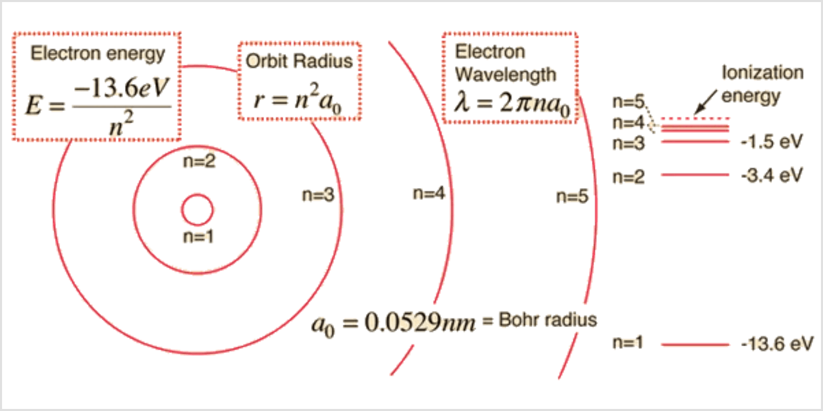
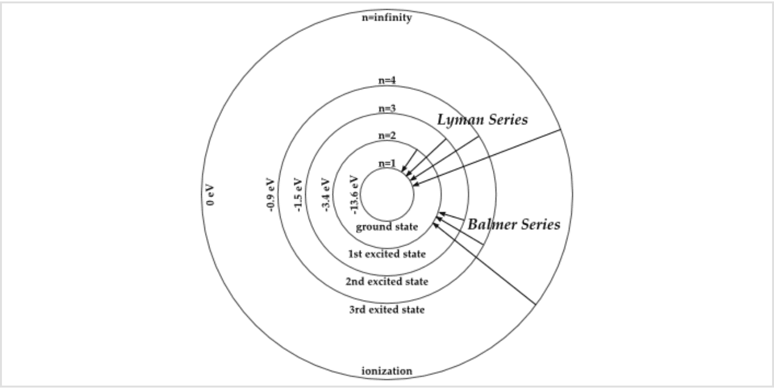
Evaluating the
Expectation Value ⟨p⁴⟩
Step 1: Definition & Hermiticity
⟨p⁴⟩ = ⟨ψ | p̂² p̂² | ψ⟩ = ⟨p̂² ψ | p̂² ψ⟩
Hydrogen Energy Spectrum
Step 2: Operator Substitution
⟨p⁴⟩ = ⟨2m(Eₙ - V̂)ψ | 2m(Eₙ - V̂)ψ⟩
Step 3: Factoring Constants
⟨p⁴⟩ = 4m² ⟨ψ | (Eₙ - V̂)† (Eₙ - V̂) | ψ⟩
Bohr Model Transitions

Slide 37

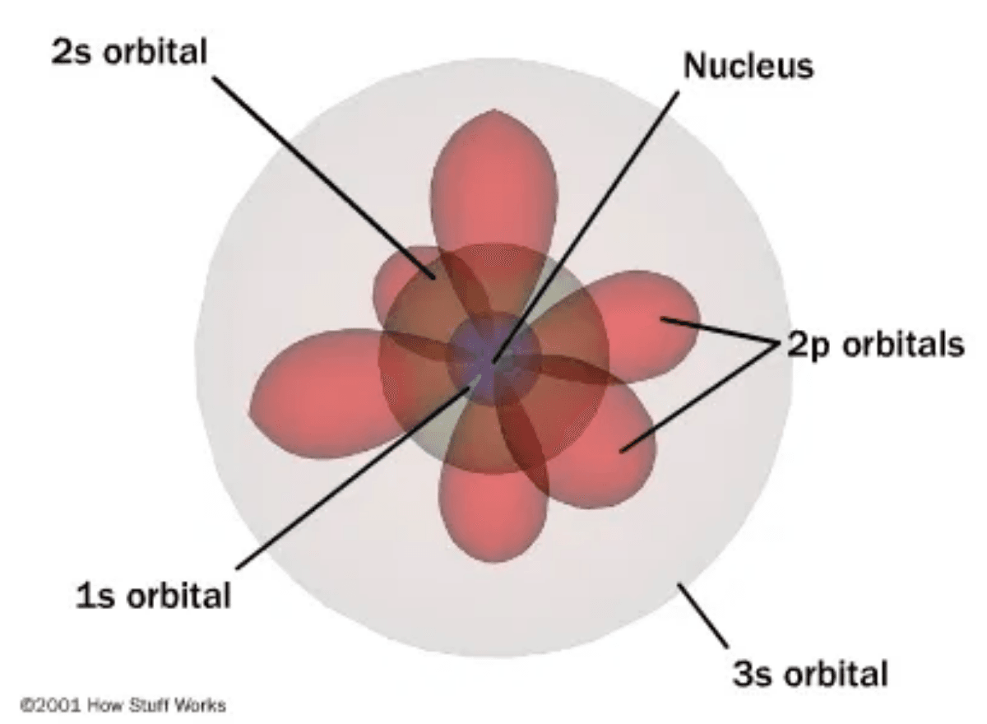
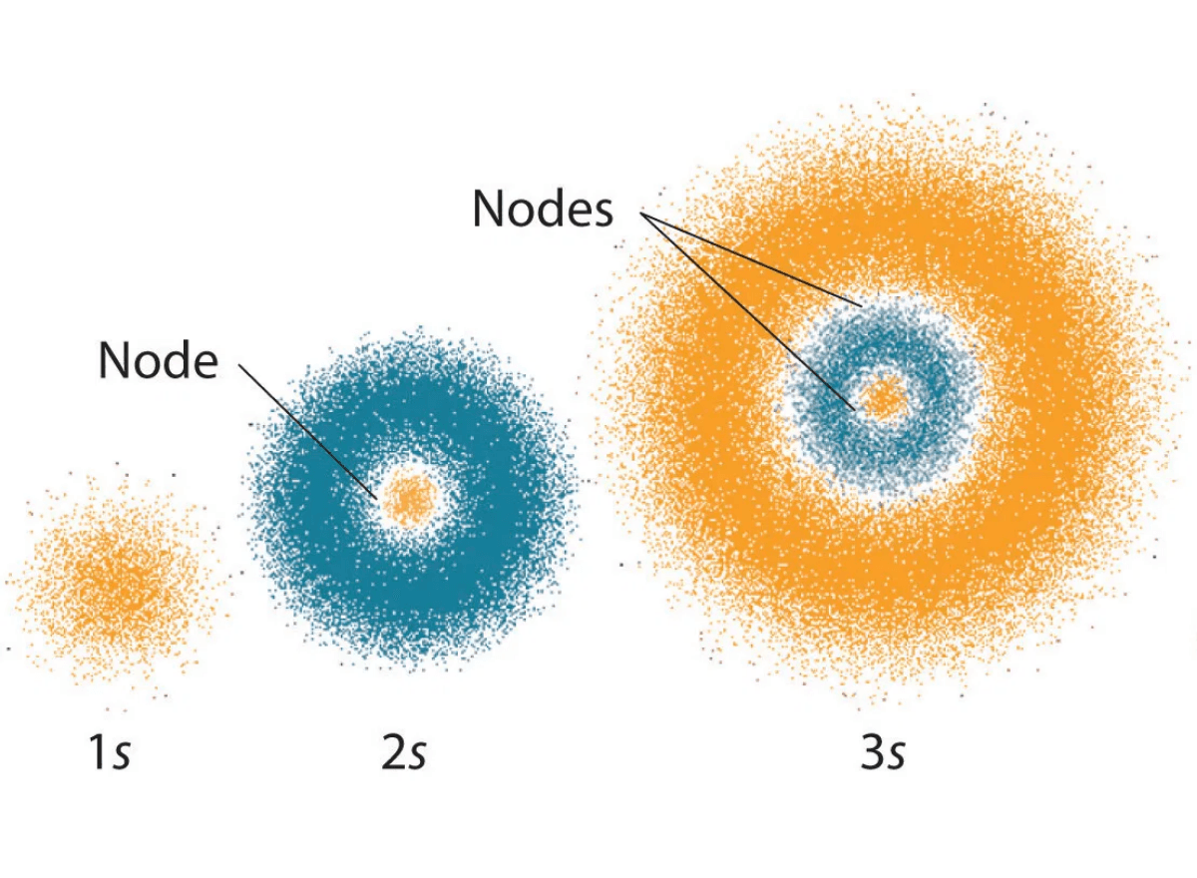
Expanding the
⟨p⁴⟩ Expression
Final Result
Step 1: Hermiticity
⟨p⁴⟩ = 4m² (Eₙ² - 2Eₙ⟨V⟩ + ⟨V²⟩)
⟨p⁴⟩ = 4m² ⟨ψ | (Eₙ - V̂)† (Eₙ - V̂) | ψ⟩
Since V̂ is Hermitian: (Eₙ - V̂)† = (Eₙ - V̂)
Eigenstates |ψₙₗₘ⟩
Step 2: Binomial Expansion
(Eₙ - V̂)² = Eₙ² - 2EₙV̂ + V̂²
Step 3: Distribution
⟨p⁴⟩ = 4m² [ Eₙ²⟨ψ|ψ⟩ - 2Eₙ⟨ψ|V̂|ψ⟩ + ⟨ψ|V̂²|ψ⟩ ]
Probability Distributions

Slide 38
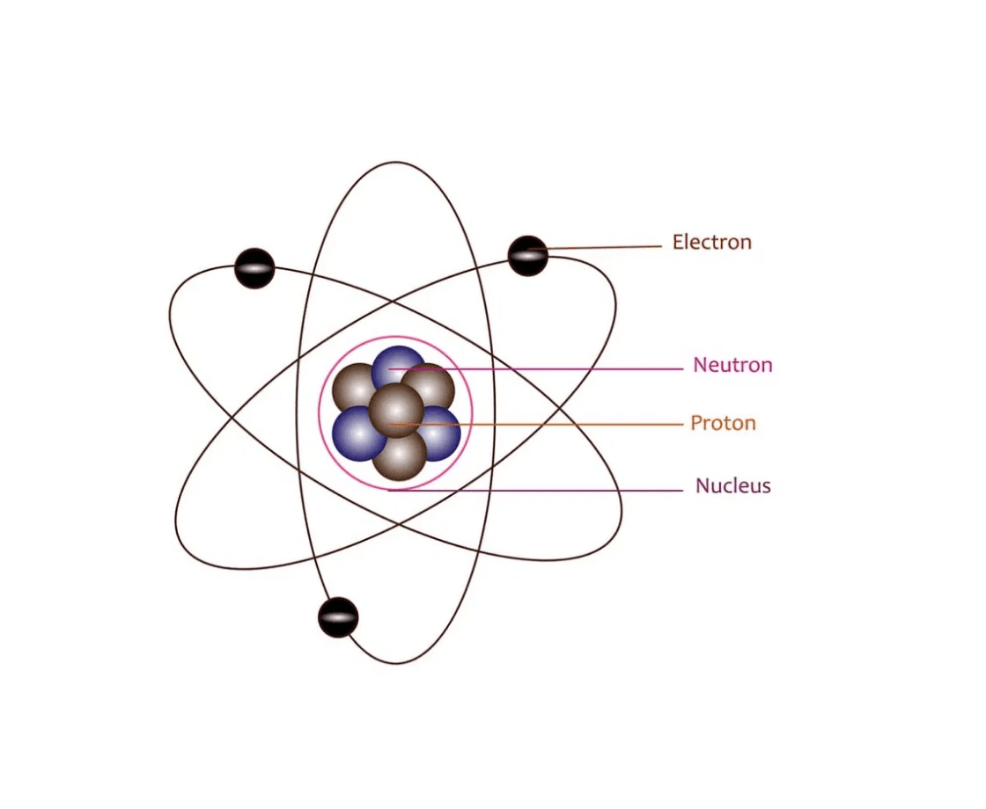
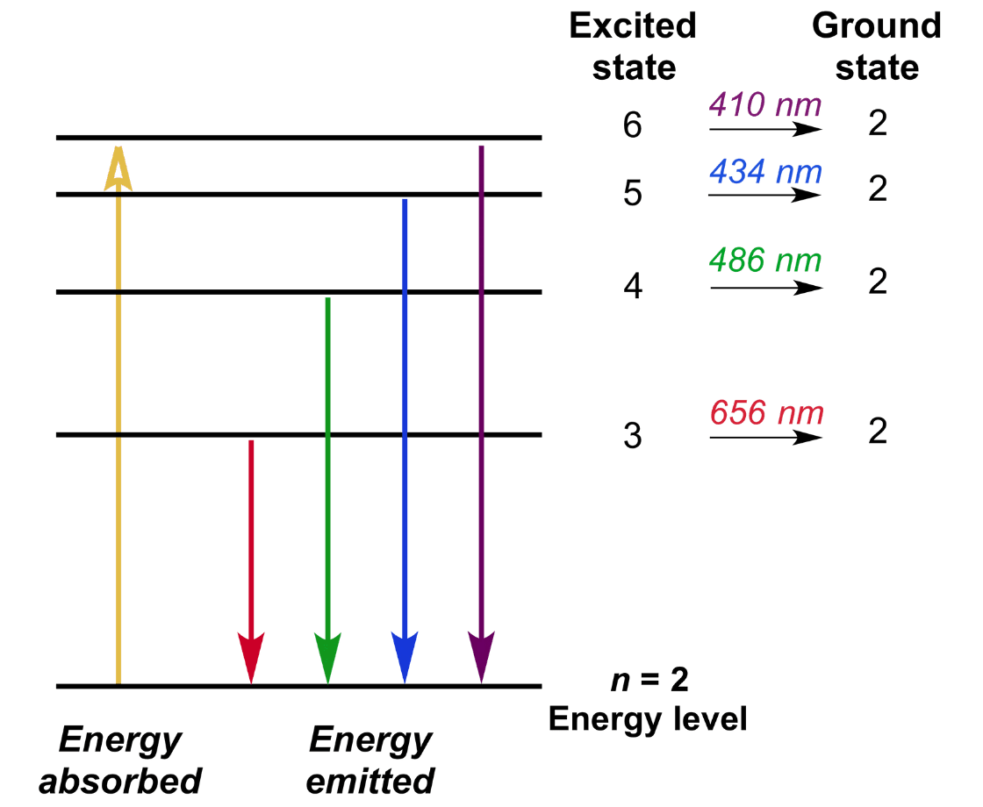
Summary of Results
Expectation Value of p²
⟨p̂²⟩ = 2m(Eₙ - ⟨V⟩)
The relativistic correction to the energy levels is obtained by evaluating the expectation value of the perturbation Hamiltonian.
Expectation Value of p⁴
⟨p̂⁴⟩ = 4m²(Eₙ² - 2Eₙ⟨V⟩ + ⟨V²⟩)
Final Relativistic Correction
Fine Structure: This correction removes the l-degeneracy in the hydrogen atom spectrum.
ΔEᵣₑₗ = - (1 / 2mc²) (Eₙ² - 2Eₙ⟨V⟩ + ⟨V²⟩)
Responsible for Fine Splitting

Slide 39
Derivation Step 1: Expectation of p⁴
Initial Hamiltonian
Squaring for p⁴
H⁰ = p² / 2m + V
p⁴ = [2m(H⁰ - V)]²
p⁴ = 4m²(H⁰² - H⁰V - VH⁰ + V²)
To evaluate ⟨p⁴⟩, we first express p² in terms of the unperturbed Hamiltonian and the potential.
Expectation Value
Rearranging for p²
⟨p⁴⟩ = 4m² ⟨E_{n}² - 2E_{n}V + V²⟩
p² = 2m(H⁰ - V)
Since H⁰ is Hermitian and acts on its eigenstates ψ_{n}, we substitute H⁰ ψ_{n} = E_{n} ψ_{n}.

Slide 40
Derivation Step 2: Final Formula
Substitution into Perturbation Hamiltonian
ΔE_{rel} = ⟨H_{rel}⟩ = - (1 / 8m³c²) ⟨p⁴⟩
Simplification of Constants
ΔE_{rel} = - (1 / 8m³c²) · 4m² (E_{n}² - 2E_{n}⟨V⟩ + ⟨V²⟩)
Final Correction Expression
ΔE_{rel} = - (1 / 2mc²) (E_{n}² - 2E_{n}⟨V⟩ + ⟨V²⟩)
This elegant result allows for the calculation of relativistic energy shifts by evaluating the expectation values of the potential V and its square V² for any given atomic state.

Slide 41
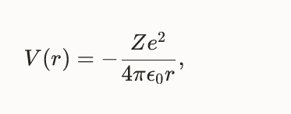
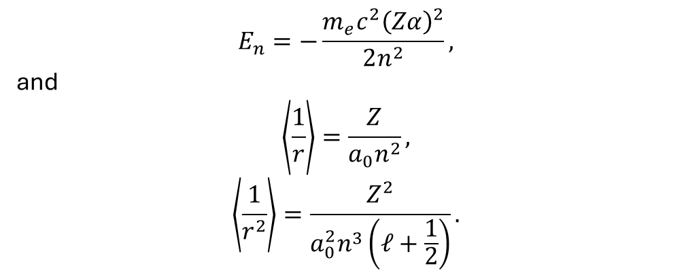
Hydrogen-like Substitution
$$E_{n}=−\frac{m_{e}c^{2}{\left(Zα\right)}^{2}}{2n^{2}},$$
and
$$\left\langle \frac{1}{r}\right\rangle =\frac{Z}{a_{0}n^{2}},$$
$$\left\langle \frac{1}{r^{2}}\right\rangle =\frac{Z^{2}}{a_{0}^{2}n^{3}\left(ℓ+\frac{1}{2}\right)}.$$

Slide 42
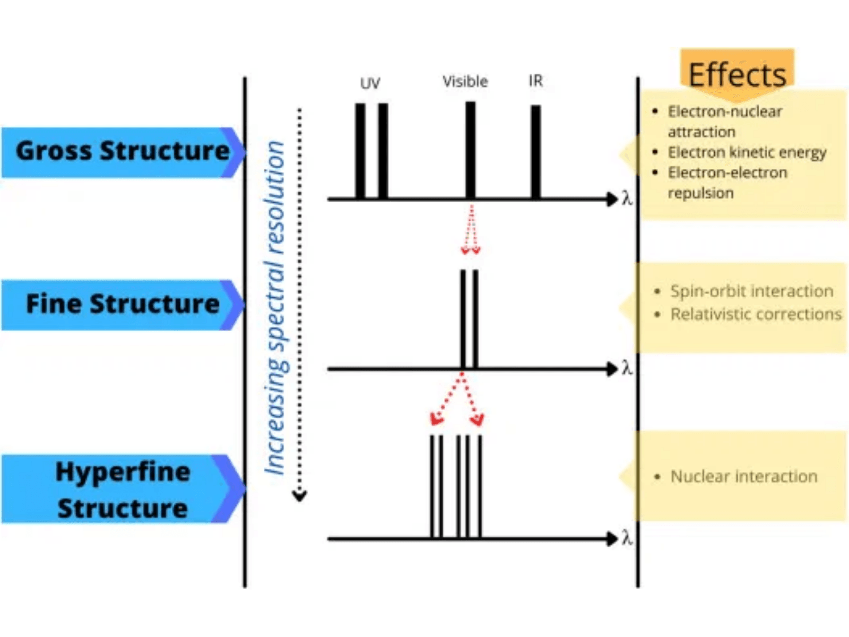
The Darwin
Correction Term
A correction arising from Zitterbewegung (trembling motion), leading to the smearing of the electron's effective potential.

Slide 43
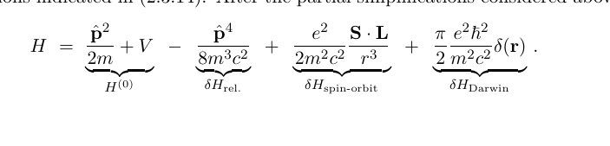
Fine Splitting Energy
λH _{darwin}

Slide 44
A case study on Rb atomic gas
“connecting to the lab”

Slide 45
