Slide 1
Oscillations to Waves

Slide 2
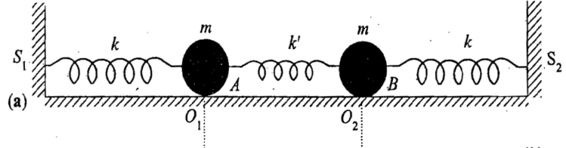
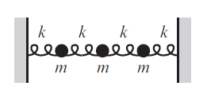
2
D
I
S
C
R
E
T
E
TO
C
O
N
T
I
N
O
U
S
3
.
.
.
N
∞

Slide 4
3-masses coupled oscillator

Slide 5
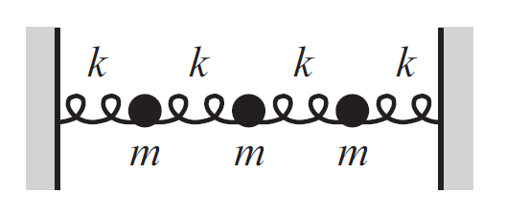
3-masses coupled oscillator
x₁
x₂
x₃

Slide 6
3-masses coupled oscillator

Slide 7
3
EIGEN VALUES = 3 NORMAL MODES
&
3
EIGEN VETORS
Characteristic equation
Eigen values and Eigen vectors
Normal modes and Normal co-ordinates

Slide 9
Finding Eigen values
Home Work

Slide 10
4-masses coupled oscillator
4
EIGEN VALUES = 4 NORMAL MODES
&
4
EIGEN VETORS
Characteristic equation
Eigen values and Eigen vectors
Normal modes and Normal co-ordinates

Slide 11
Solving eigen values and eigen vectors for n-Coupled mass system

Slide 12
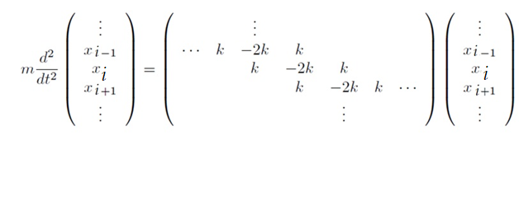
n-masses coupled oscillator
What will be the equation of motion for i^{th} mass?
Recollect

Slide 13
N-masses coupled oscillator
What will be the equation of motion for i^{th} mass?

Slide 14
Solving n coupled masses equation
will have n values
hence n normal modes will be present
ω
will
Have
n
values

Slide 15
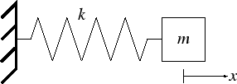
Few scattered thoughts on oscillations leading to waves
One Normal mode & One resonance frequency
Two Normal modes and therefore two resonance frequency
Any motion of the masses can be represented by a linear combination of two modes!

Slide 16
Few scattered thoughts on oscillations leading to waves
N Normal modes and therefore
N resonance frequencies
Any oscillatory motion of the masses can be represented by a linear combination of N orthogonal modes!

Slide 17
Oscillations to Waves
How are they related?

Slide 18
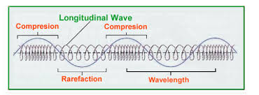
Oscillations to Waves
How are they related?
A wave can be thought of as a disturbance or oscillation that travels through space-time, accompanied by a transfer of energy.
If the direction of wave propagation is parallel to the direction it oscillates then its called as Longitudinal waves.
Longitudinal waves generated in a coupled oscillator
A wave does not move mass in the direction of propagation; it transfers energy.

Slide 19
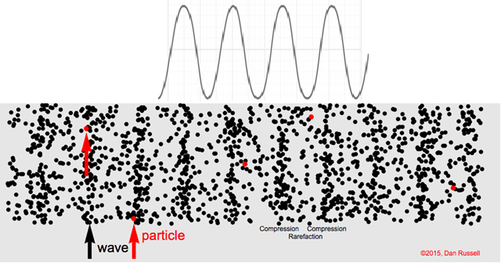
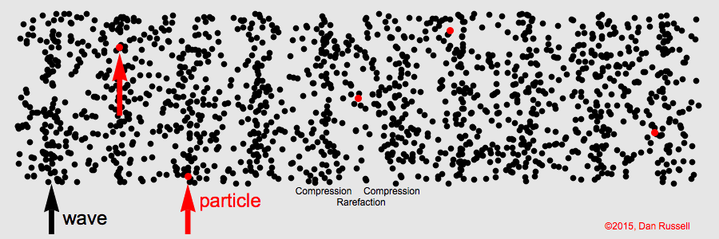
Longitudinal waves

Slide 20
This equation solve ONLY for time dependence of displacements S_{i} around its equilibrium position
Need to invent a differential equation which gives spatial dependence also S(x,t)

Slide 21
Derivation of wave equation from n-coupled masses oscillators

Slide 22
N-masses coupled oscillator
ΔX
x₀
x₁
x₂
x₃
x₄
S₀
S₁
S₂
S₃
What will be the equation of motion for i^{th} mass?

Slide 23
Derivation of Wave Equation
Need to bring spatial derivatives for
understanding wave propagation
Rate of rate of change of displacement with respect
to SPATIAL CO-ORDINATE x need to be known

Slide 24
Derivation of wave equation from n-couple masses oscillators
Dividing by Δx throughout

Slide 25
In the limit Δx tending to 0 i.e. N→∞
Wave equation
How to solve this wave equation? We need to find S(x,t)

Slide 26
The trial Solution:
Let ω corresponds to any of the normal mode frequency
Wave equation

Slide 28
General solution of Wave equation
Thus the general solution is:
Let’s recapitulate……

Slide 29
Thus the general solution of a wave equation is:
For conventional reason, let us replace with k in the coming slides

Slide 30
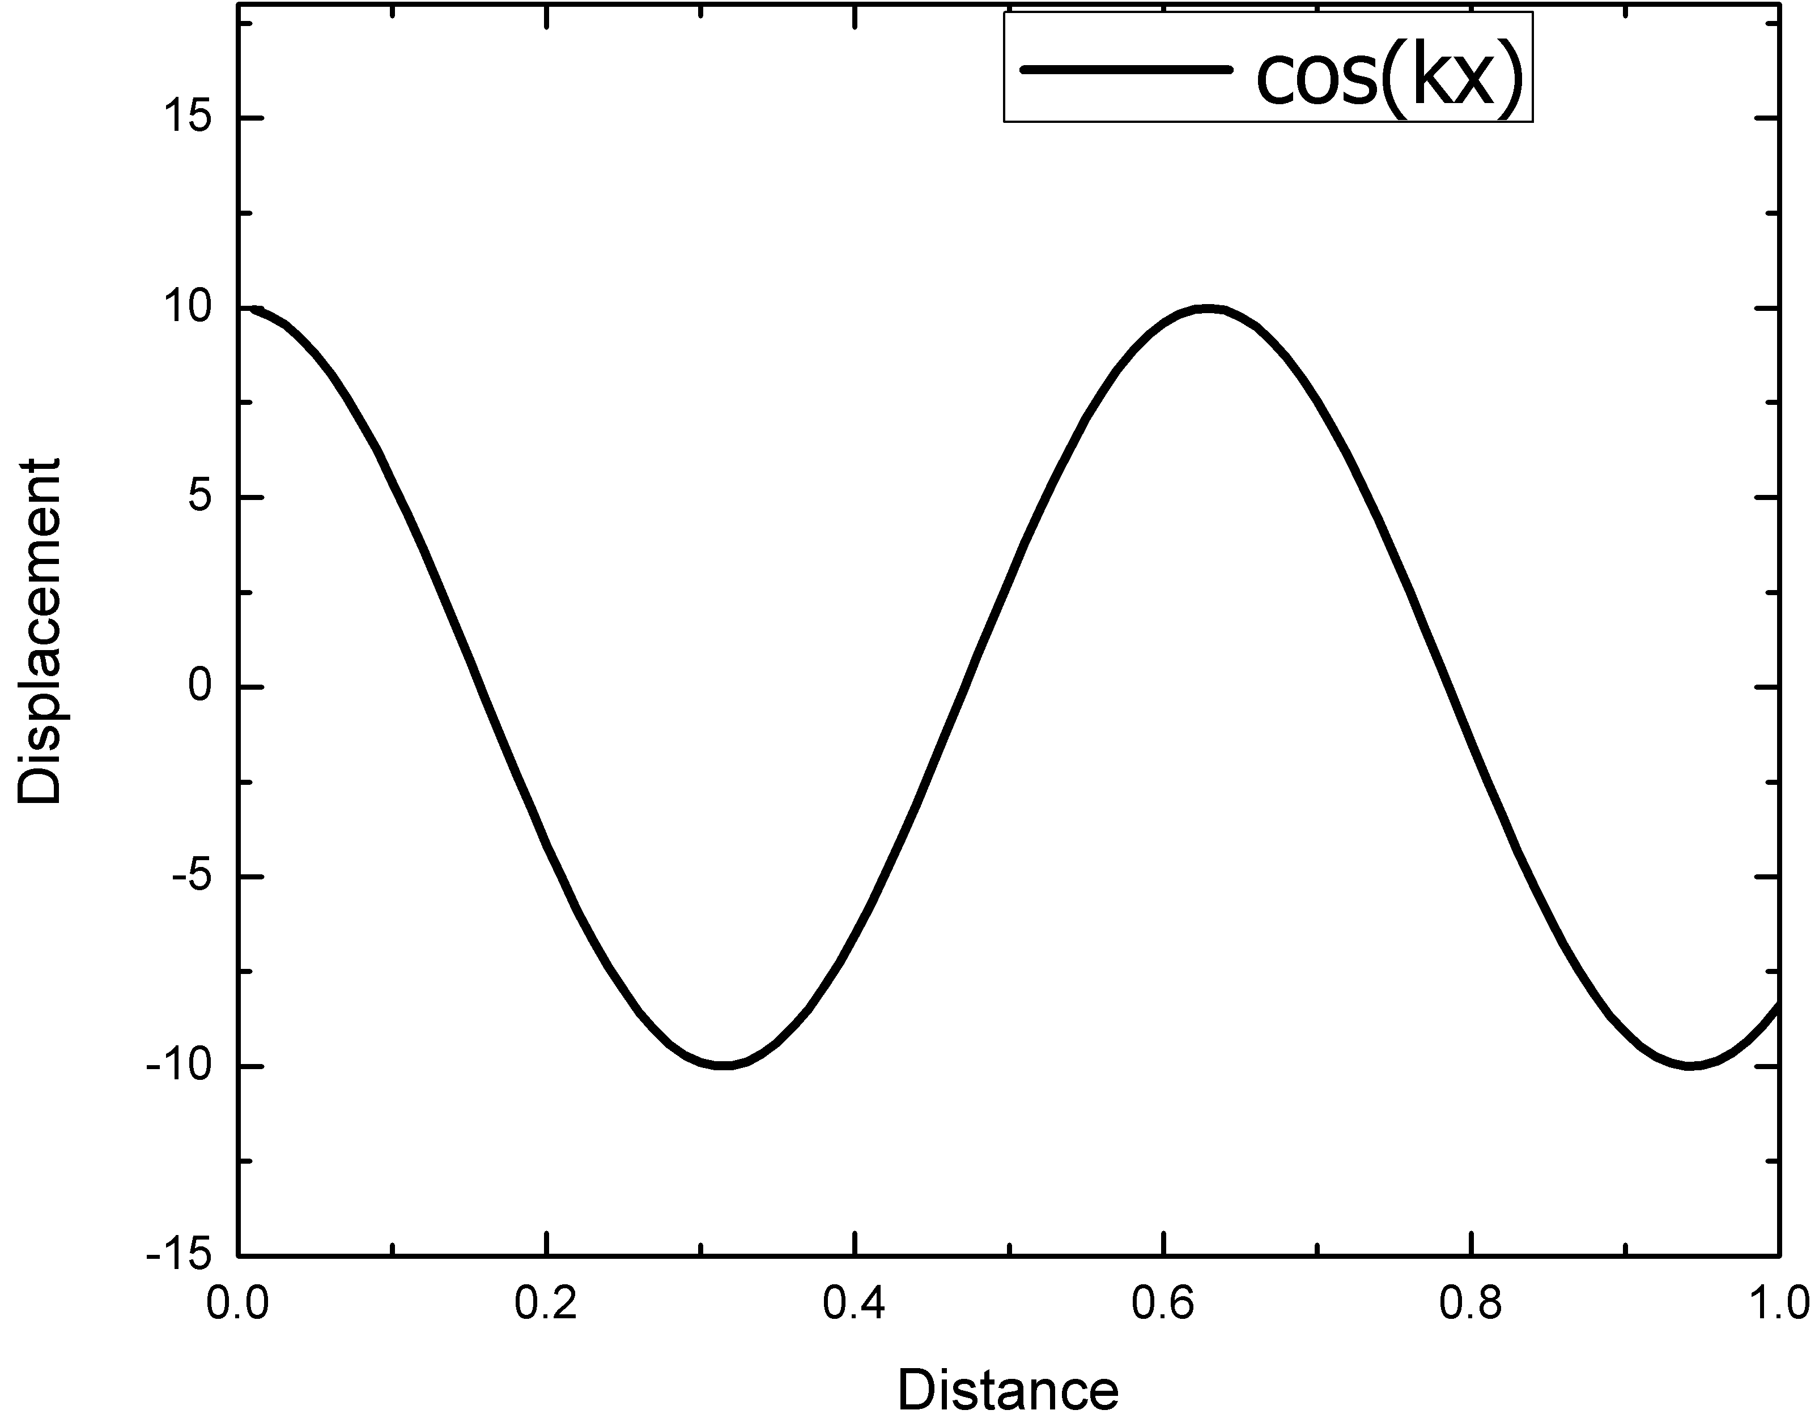
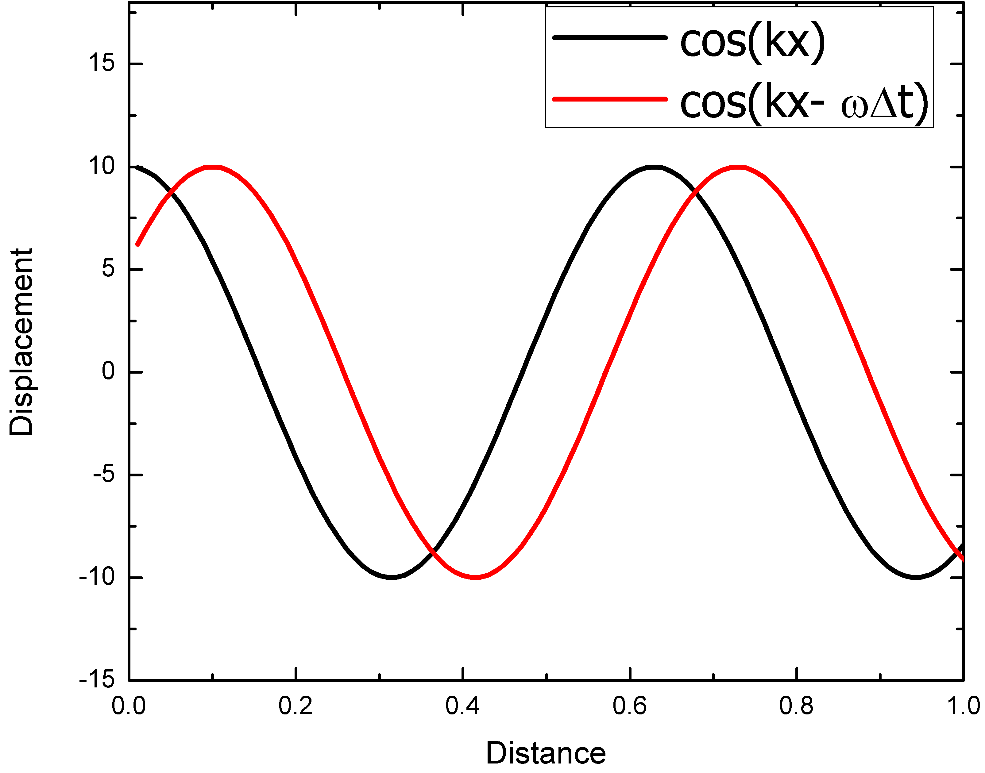
Plot of cos(kx –ωt)
x=0 and t = 0, cosine has
Max value hence kx = 0
ΔX
After t = Δt, cosine has max value and wave has moved a distance Δx, hence kΔx –ωΔt = 0
v = Δx/Δt = ω/k

Slide 31
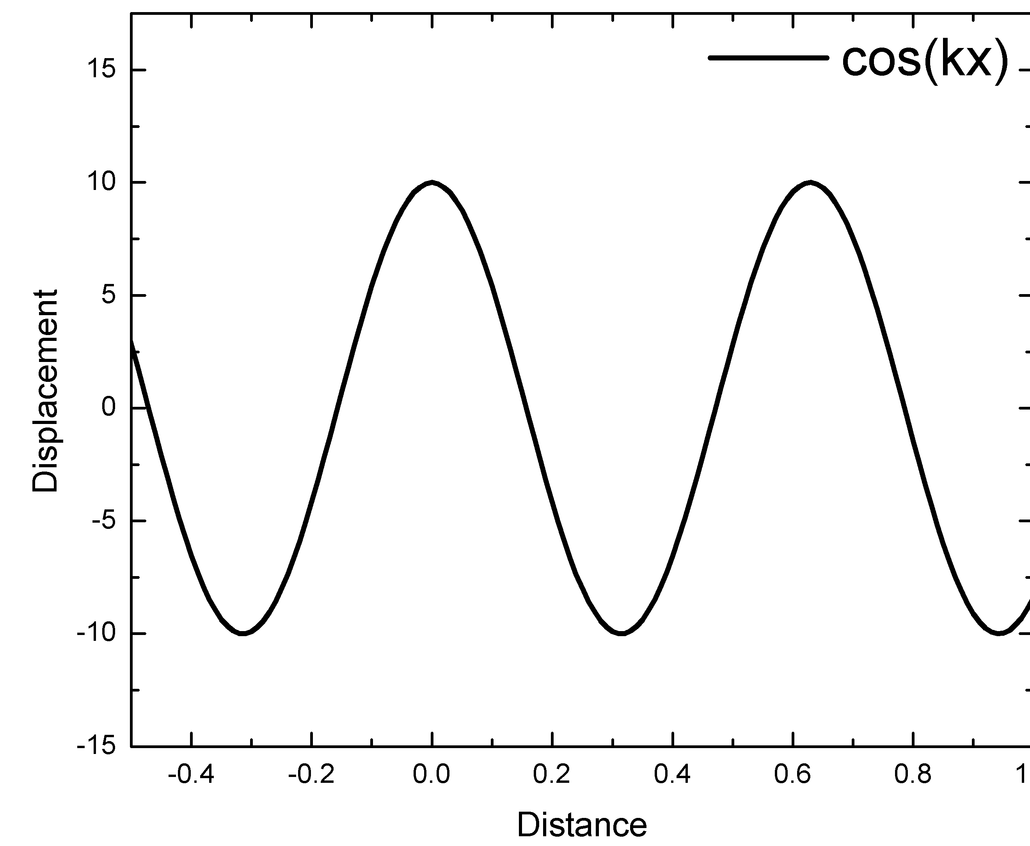
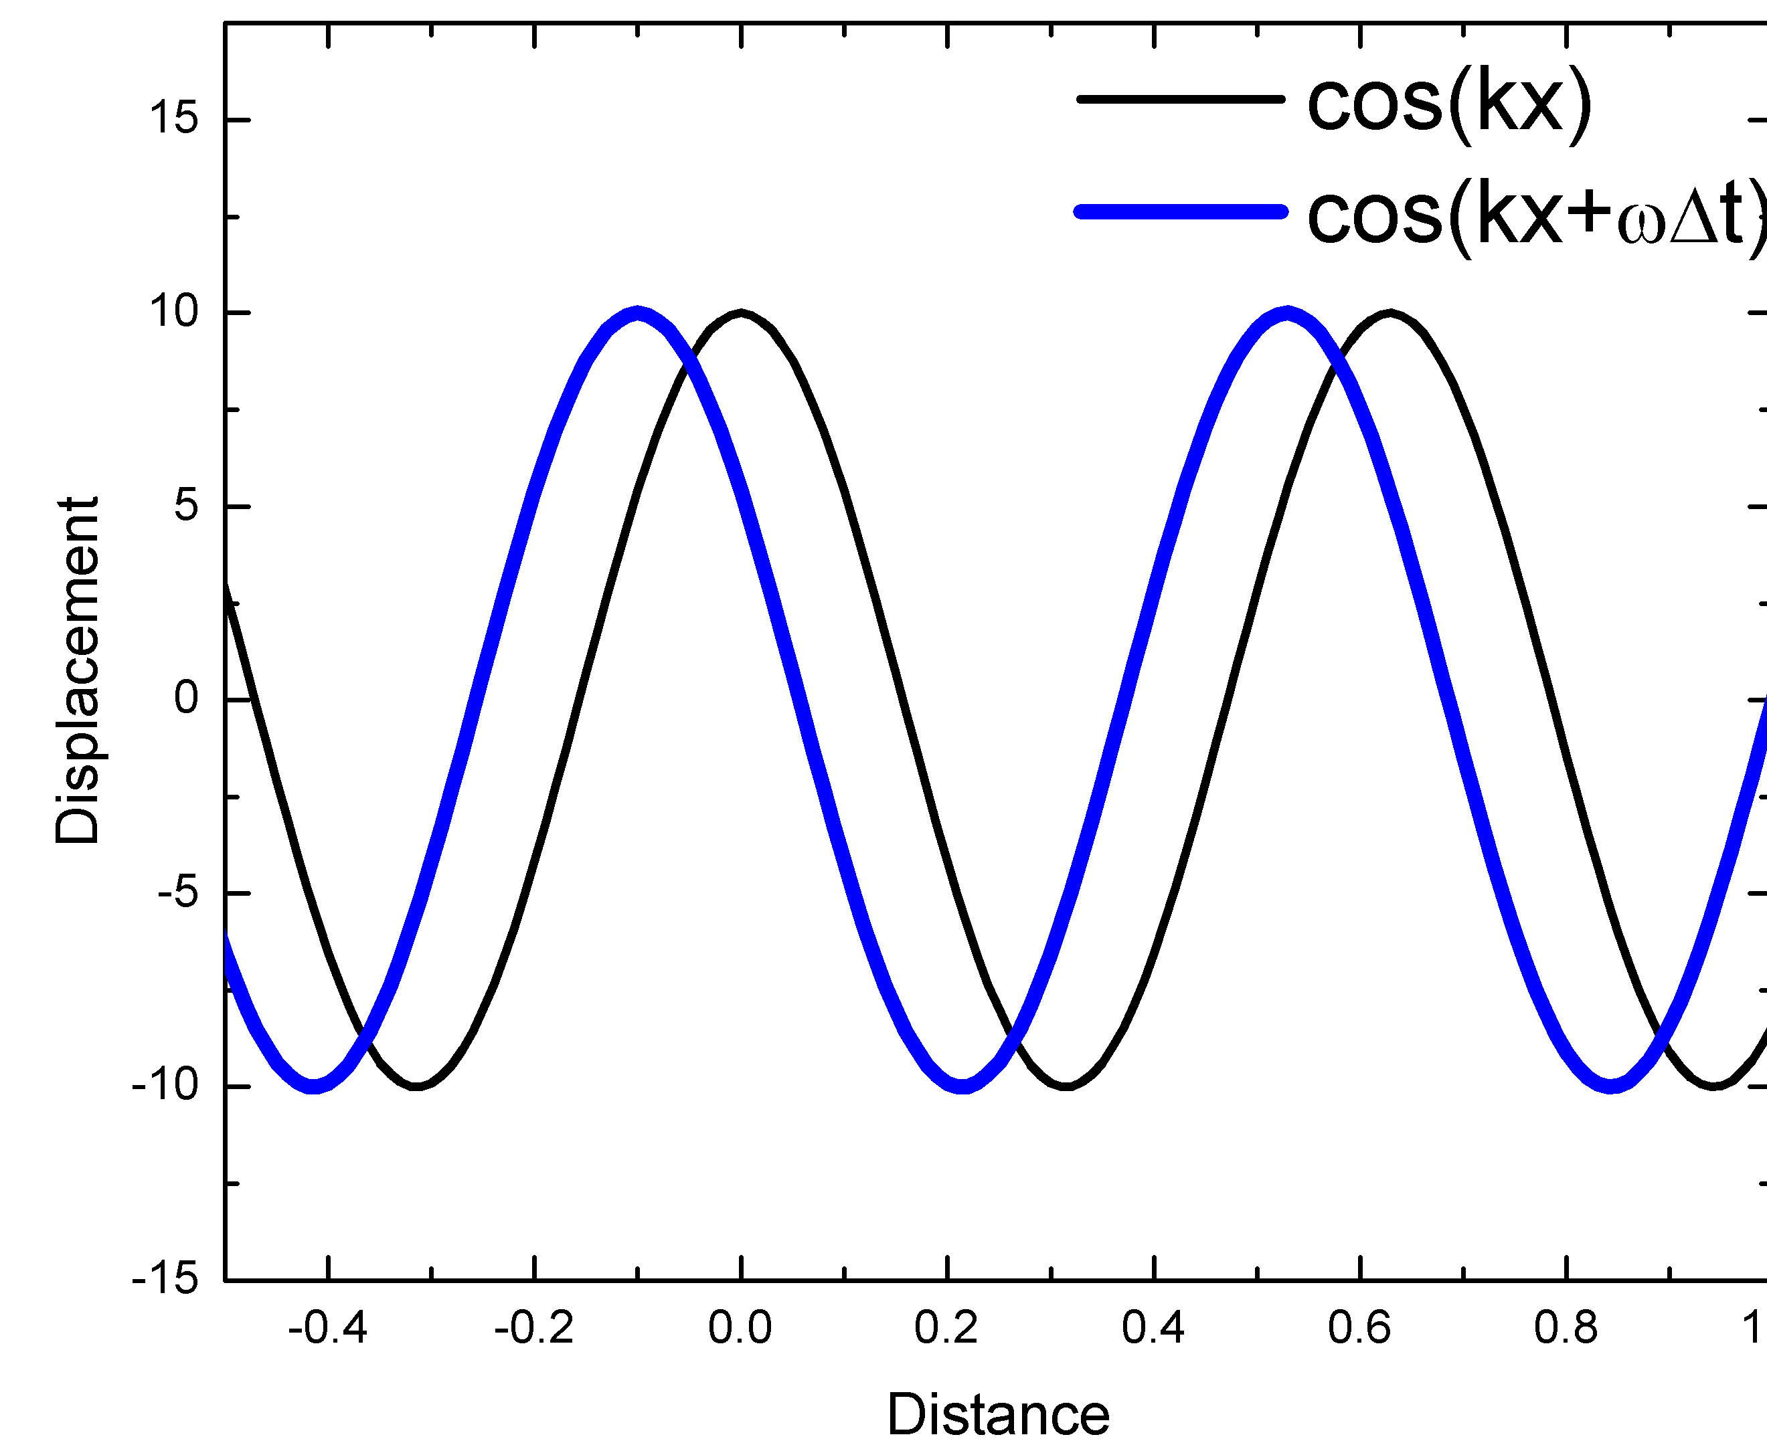
Plot of cos(kx +ωt)
x=0 and t = 0, cosine has
Max value hence kx –ωt = 0
ΔX
After t = Δt, the wave has moved a distance Δx, hence kΔx +ωΔt = 0 v = Δx/Δt = -ω/k

Slide 32
Thus the general solution of a wave equation is:
Left going
Right going
Constants are determined by initial conditions

Slide 33
Displacement as function of position and time

Slide 34
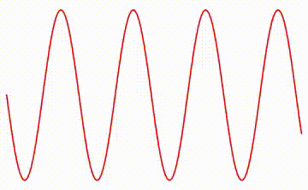
Wave moving
S(x,t)
x

Slide 35
Longitudinal Waves

Slide 36
Transverse Waves
Transverse waves also follow the same treatment
Similar analysis

Slide 37
Wave in 3 dimension

Slide 38
Electro-Magnetic Wave

Slide 39
Waves to Quantum Physics

Slide 40
Particle
Wave
Optics
Mechanics

Slide 41
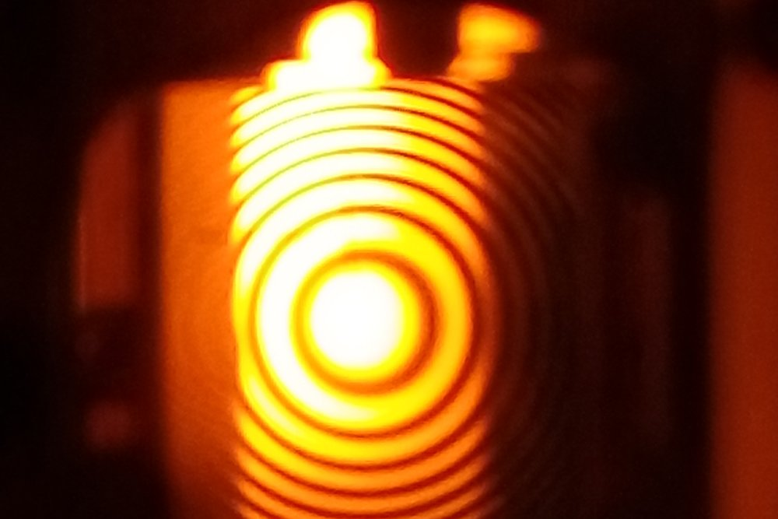
Wave nature of light

Slide 42
Few surprises/Contradictions in the beginning of 19th Century!
Particle nature of light

Slide 43
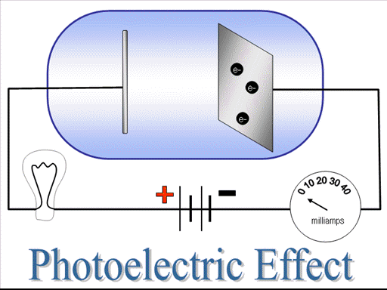
Photoelectric Effect

Slide 44
Quantum Physics
Wave
Particle
Particle
Wave

Slide 45
Highlights of the course
Co-ordinate Systems
Introduction to Vector Operators
Work , Energy and Conservation laws
Rigid body in motion
Oscillations and Waves
Quantum Physics

