Slide 1
Season 2, Lecture 10 (S2,L10):
Tutorial 3: Thermal Diffusion

Slide 2
Name | L9 | L10
"2201ph34_dolly" <2201ph34_dolly@iitp.ac.in>; | p | P
"Adhila Aslam" <2201ph01_adhila@iitp.ac.in>; | p | P
"Aditi Baghel" <2201ph31_aditi@iitp.ac.in>; | p | P
"Aditya Kumar" <2201ph02_aditya@iitp.ac.in>; | p | A
"Aditya Singh" <2201ph03_aditya@iitp.ac.in>; | p | P
"Anil Ram" <2201ph04_anil@iitp.ac.in>; | a | A
"Animesh Sharma" <2201ph05_animesh@iitp.ac.in>; | p | P
"Arun Mishra" <2201ph06_arun@iitp.ac.in>; | a | P
"Aryan Raj" <2201ph32_aryan@iitp.ac.in>; | p | P
"Ayush Gautam" <2201ph07_ayush@iitp.ac.in>; | a | P
"Boda Vishnuwardhan" <2201ph08_boda@iitp.ac.in>; | p | A
"Chanchal Tolani" <2201ph09_chanchal@iitp.ac.in>; | p | P
"Devansh Srivastava" <2201ph33_devansh@iitp.ac.in>; | a | A
"Gaurav Verma" <2201ph10_gaurav@iitp.ac.in>; | p | P

Slide 3
Name | L9 | L10
"Gourav Jha" <2201ph11_gourav@iitp.ac.in>; | a | P
"Gurinder Dhillon" <2201ph12_gurinder@iitp.ac.in>; | p | P
"Harsh Joshi" <2201ph13_harsh@iitp.ac.in>; | p | P
"Himanshu Patel" <2201ph35_himanshu@iitp.ac.in>; | p | P
"Jigyasa Agrawal" <2201ph36_jigyasa@iitp.ac.in>; | a | A
"Khushal Yadav" <2201ph14_khushal@iitp.ac.in>; | p | P
"Krishnakant Chourey" <2201ph15_krishnakant@iitp.ac.in>; | p | A
"Manas Gupta" <2201ph16_manas@iitp.ac.in>; | a | P
"Mohit Saini" <2201ph17_mohit@iitp.ac.in>; | a | P
"Mude Naik" <2201ph18_mude@iitp.ac.in>; | p | P
"Murari Kumar" <2201ph19_murari@iitp.ac.in>; | p | P
"Nishant Yadav" <2201ph20_nishant@iitp.ac.in>; | p | P
"Pranitha Moluguri" <2201ph21_pranitha@iitp.ac.in>; | p | P

Slide 4
Name | L9 | L10
"Premanandh Sigamala" <2201ph22_premanandh@iitp.ac.in>; | p | P
"Ruchi Thakur" <2201ph23_ruchi@iitp.ac.in>; | p | P
"Satyam Sahoo" <2201ph25_satyam@iitp.ac.in>; | p | P
"Satyam Shandilya" <2201ph24_satyam@iitp.ac.in>; | p | P
"Shyam Hembram" <2201ph26_shyam@iitp.ac.in>; “ | p | P
Sougata Saha" <2201ph27_sougata@iitp.ac.in>; | a | A
"Sumit Rajpoot" <2201ph28_sumit@iitp.ac.in>; | p | P
"Suprajit Dewanji" <2201ph29_suprajit@iitp.ac.in>; | a | P
"Yepuri Subhash" <2201ph30_yepuri@iitp.ac.in> | p | A
Attendance: 75% mandatory

Slide 6
Thermal Diffusion equations: Fick’s Law
Fick’s second law

Slide 7
Tutorial 3: Thermal Diffusion

Slide 9
Direction of diffusion
Pd membrane
0.005 mm

Slide 12
Flux increases

Slide 13
This is called as a “steady state” condition
Plot concentration as a function of x

Slide 15
Plot

Slide 16
Note:
Using variable separable method one can find the solution as

Slide 17
Plot

Slide 19
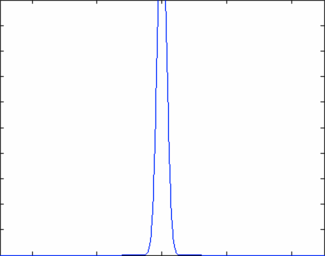

Slide 20
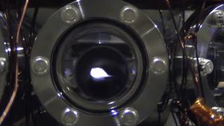
Atomic cloud diffusion in Quantum Technology

Slide 21
v
v

Slide 23
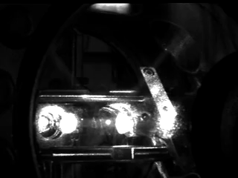

Slide 24
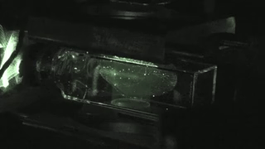

Slide 26
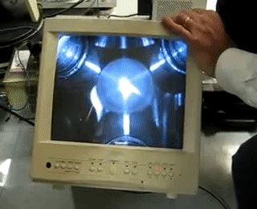

Slide 28
v
a
Non invasive temperature
measurement
a+vt
a+vt’

Slide 29
Size
t
From the fit V is calculated, then T

