Slide 1
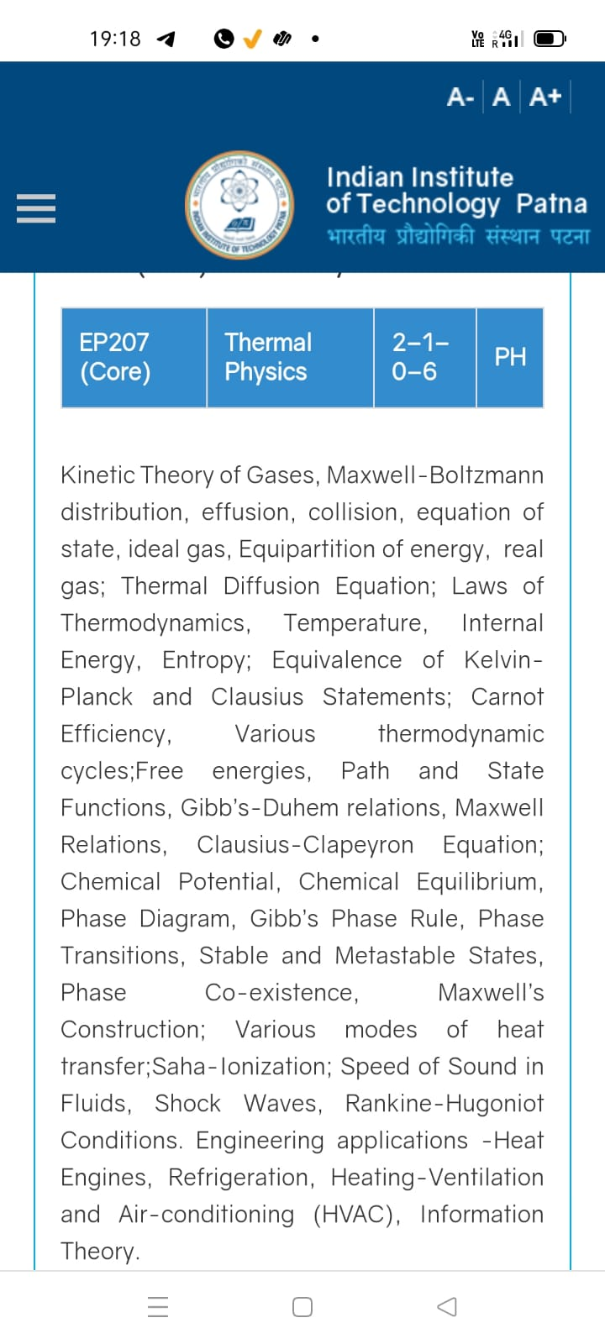
Season 4, Lecture 7 (S4,L7):
Tutorial 1
EP2104 Thermal physics with engineering applications
3-1-0-4

Slide 2
Time | 11:11:55 | 12-12:55 | 3-3:55 | 4- 4:55 | 02-02:55
Day
Monday |  | R103
Tuesday |  |  | R102
Wednesday |  |  |  | R103
Thursday | R103

Slide 3
 | firstname | lastname | roll_no |  | L1 | L2 | L3 | L4 | L5 | L6 | L7 | L8 | L9 | L10
1 | Jatin | . | 2401PH04 |  | P | P | P | P | p | p | P | P | P | P
2 | Prince | . | 2401PH24 |  | P | P | P | A | a | p | A | A | A | A
3 | Rayatuwar | Aditya Potanna | 2401PH11 |  | P | P | P | P | p | p | P | P | P | P
4 | Kota | Anantha Akash | 2401PH23 |  | P | P | P | P | p | p | P | P | P | P
5 | Tushar | Bharti | 2401PH03 |  | P | A | P | A | p | p | P | P | P | A
6 | Seshapu | Charan Sri Aditya Vardhan | 2401PH12 |  | P | P | P | P | p | a | P | P | P | A
7 | Riya | Chauhan | 2401PH26 |  | P | P | P | P | p | a | A | P | P | P
8 | Arijeet | Das | 2401PH32 |  | P | P | A | P | p | p | P | P | P | P
9 | Shrestha | Das | 2401PH27 |  | P | P | P | P | p | p | P | P | P | P
10 | Satyam | Gupta | 2403PH02 |  | P | P | P | P | p | p | P | P | P | P
11 | Sanskar | Kulshrestha | 2401PH05 |  | P | P | P | P | p | p | P | P | P | A
12 | Amit | Kumar | 2401PH02 |  | P | P | P | P | p | p | P | P | P | P
13 | Sanat | Kumar | 2401PH01 |  | P | P | P | A | p | p | A | P | A | P
14 | Vansh | Kumar | 2401PH18 |  | P | P | P | P | p | p | A | P | P | P
15 | Dhruv | Maheshwari | 2401PH19 |  | P | P | P | P | p | p | P | P | P | A
16 | Deepak | Nagar | 2401PH20 |  | P | P | P | P | p | p | A | P | P | P
17 | Satyam | Pandey | 2403PH01 |  | P | P | P | P | p | p | P | P | P | P
18 | Arvind | Prajapat | 2401PH31 |  | P | P | A | P | p | p | A | P | P | P
19 | Rathod | Rudra Amitbhai | 2403PH05 |  | P | P | P | P | p | p | P | P | P | A

Slide 4
20 | Jorvekar | Sahil Amit | 2401PH06 | P | P | P | P | a | p | A | P | P | A
21 | Lunavath | Sai Prem | 2401PH30 | P | P | P | P | p | p | P | P | P | P
22 | Manda | Sai Rithvik | 2401PH09 | P | P | A | P | p | a | P | A | C | C
23 | Vaddamani | Santhosh Kumar | 2403PH04 | A | P | P | P | p | p | P | A | P | P
24 | Apoorva | Singh | 2401PH13 | P | P | P | P | p | p | P | P | P | P
25 | Harshit | Singh | 2401PH08 | P | A | P | P | p | p | P | P | P | A
26 | Kushagra | Singh | 2401PH07 | P | P | P | P | p | p | P | P | P | P
27 | Srishti | Singh | 2401PH15 | P | A | P | P | p | p | A | P | A | A
28 | Harsh | Singh Baghel | 2401PH17 | P | P | P | P | p | p | A | P | P | P
29 | Satyam | Sinha | 2401PH21 | P | P | P | P | p | a | P | P | P | P
30 | Konyala | Sri Charan Reddy | 2401PH14 | P | P | A | P | p | a | A | C | C
31 | Chittedi | Srinidhi Reddy | 2401PH28 | P | P | P | A | p | a | P | A | P | P
32 | Seshu | Srinivas | 2403PH03 | P | P | P | P | p | p | P | P | P | P
33 | Tanushkumar | Upendrakumar Yadav | 2401PH25 | P | P | P | A | p | p | A | P | P | P
34 | Sanskriti | Verma | 2401PH16 | P | P | P | A | p | p | P | P | P | A
35 | Sanvidhan | Vijay Lonare | 2401PH10 | P | P | P | P | p | p | P | P | P | P
36 | Kalidindi | Yashwanth Varma | 2401PH29 | A | P | A | A | a | a | A | C | C
Attendance: 75% mandatory

Slide 5
RECAP AND SUMMARY

Slide 6
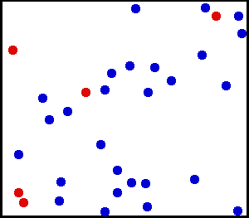
A theoretical model is required for a dilute gas enclosed in a container

Slide 7
Introduction to
Kinetic theory of gases

Slide 8
Kinetic Theory of Gases
Avagrado and Loschmidt – 19th century
“Kinetic theory of gas is a microscopic theory which concerns itself with the average motion of
atoms and their collisions with wall and other objects in order to calculate the equation of the
state for the ideal gas”
Kinetic theory of gas is limited to monoatomic gas with many assumption’s made on the
behavior of ideal gas

Slide 9
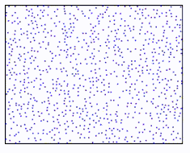
Kinetic Theory of Gas: It’s assumptions
Molecules/particles are moving in all random directions
Treat molecules/particles as point classical particles, since size of molecules are much smaller compared to their intermolecular
distance
No interaction between the molecules
No forces of attraction or repulsion
between molecules
N
Gas is under equilibrium condition
V
No gravity
Only elastic collisions
Uniform distribution of atoms such that N/V is a constant (homogenous)
dV is very small compared to V, still it can have large number of molecules in dN

Slide 10
Maxwell-Boltzmann Distribution: Kinetic Theory
how many molecules are moving between velocities v and v + dv
y
Random motion in all directions
N molecules/particles
x
z
Velocity components are completely independent
And completely Isotropic
Collisions with wall is always
Perpendicular and only linear

Slide 11
Kinetic Theory of Gas: It’s assumptions
Molecules can have any speed’s between 0 to infinity
V
N
Velocity distribution and distribution function
Kinetic theory help us to find Maxwell-Boltzmann distribution function which is used to determine
Probability of molecules/particles are moving between velocities v and v + dv

Slide 12
Approach of “Kinetic Theory”
Finding a Distribution Function
Microscopic theory

Slide 13
Finding a distribution function

Slide 14
Expectation or average: no of students v/s height
20
No of students
10
5
4
4.5
5
Height

Slide 15

Expectation or average position
Probability
0.6
0.4
1m
2m
Distance (x)

Slide 17
What type of distribution function?
Will it be a classical one or Quantum mechanical one?

Slide 18

De Broglie wave length of a man at room temperature
Velocity 5m/s
Mass=70 kg
Find the De-broglie wavelength!

Slide 19
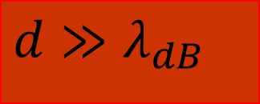
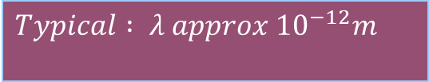
De Broglie wave length of atoms/molecules at room temperature
$$Typical : λ approx {10}^{−12}m$$
$$d≫λ_{dB}$$

Slide 20
At room temperature
Classical Theory holds good for atoms/
Molecules
Quantum effects
Are negligible

Slide 21
De Broglie hypothesis for an electron
Velocity 5m/s
Mass=9.1X10⁻³¹ kg
e
Find the De-broglie wavelength!

Slide 22
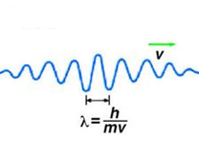
How do we understand the motion?
e

Slide 23
Expectation value of position of a quantum particle
Probability that the particle can be found in the interval dx
What is the expectation value of the position of the particle ?

Slide 24
For classical particles
Kinetic Theory is “good model”
Finding Distribution function
Microscopic theory

Slide 25
For convenience
Position space to Velocity space

Slide 26
Let us consider a small region of space

Slide 27
Let us consider a small infinitesimal region of space
“N” molecules
in container
Probability of molecules which are moving between
velocities v and v + dv?

Slide 28
Maxwell’s velocity distribution function and assumption’s

Slide 29
Maxwell’s velocity distribution function and assumption’s
A

Slide 32
2

Slide 33
Recollect eqn (1)
3

Slide 34
Langrangian method of undetermined multiplier
(Mathematics)

Slide 35
Recollecting (A) and substituting

Slide 36
A
B

Slide 39
Maxwell’s distribution law

Slide 40
Maxwell Boltzmann
distribution law

Slide 41
Tutorial 1

Slide 42
Problem 1

Slide 43
Solution

Slide 50
Using Law of Equipartition of energy

Slide 51
Distribution function
Maxwell Boltzmann speed distribution

Slide 52
Problem 2

Slide 53
Distribution function
Maxwell Boltzmann speed distribution

Slide 54
Problem 2

Slide 55
(a) Complete Analysis of distribution function

Slide 56

Complete Analysis of distribution function

Slide 57
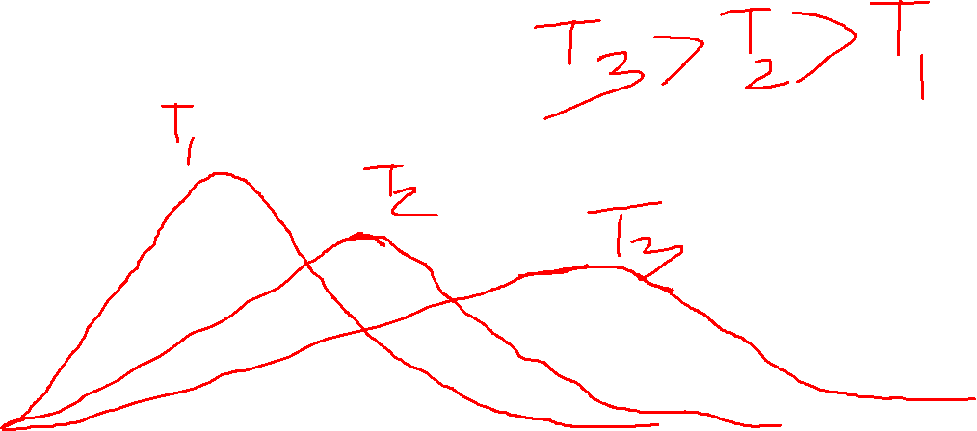
(b) With temperature

Slide 58
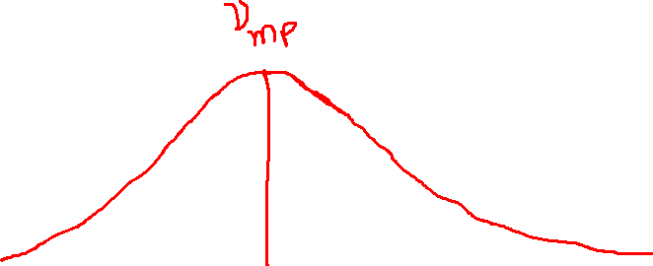
(c) Most Probable speed
Most probable speed

Slide 59
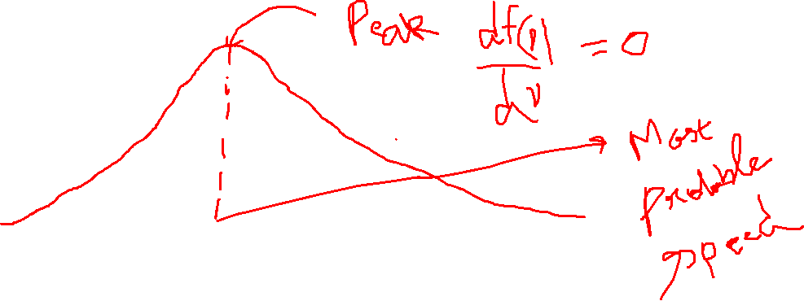
Complete Analysis of distribution function

Slide 60
Average speed
(d)
Root mean square speed (RMS)

Slide 61
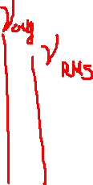
(e) A comparison

Slide 62
Problem 3

Slide 63
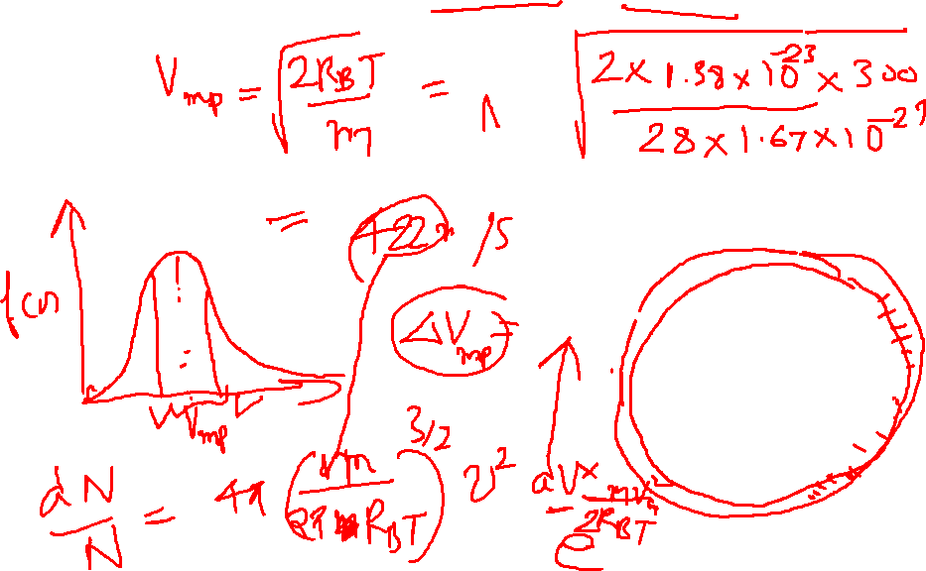
Solution:

Slide 64
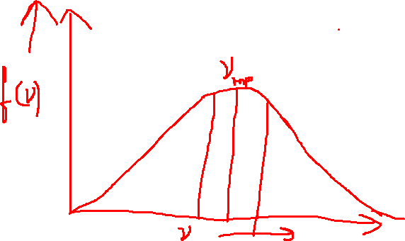
Solution:

Slide 65
Problem 4

Slide 66
Solution

Slide 68
Problem 5

Slide 69
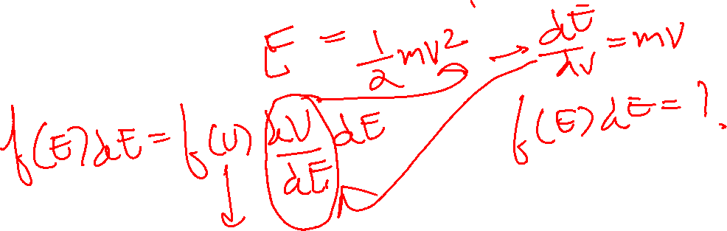
Problem 5

Slide 70
Solution
1

Slide 71
Solution

Slide 72
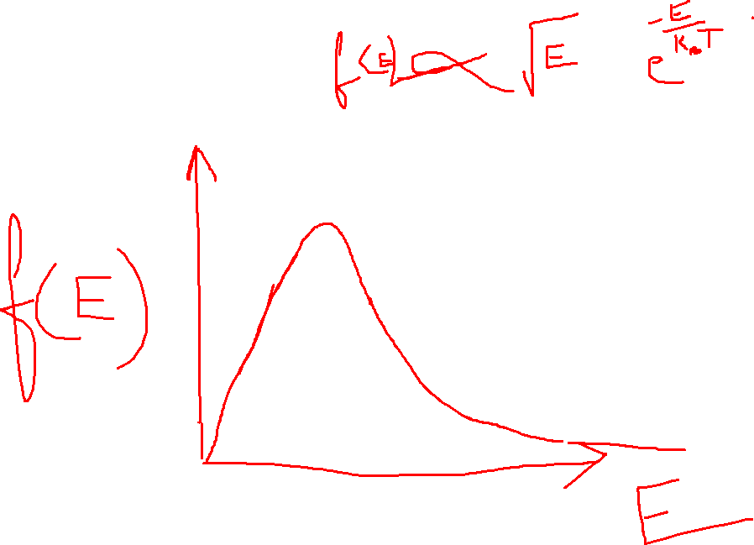

Slide 73
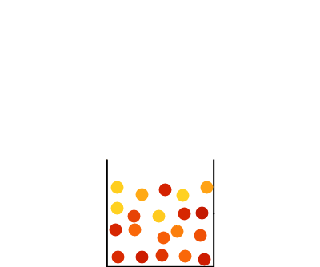

Slide 74
Problem 6

Slide 75
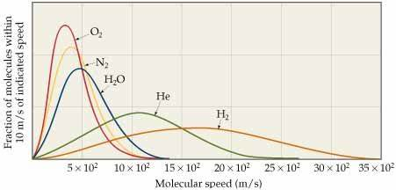
Solution

Slide 76
Concept of Mean free path

Slide 78
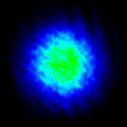
Hotter to colder
Imaging
Of
Atomic gas
Temperature of atomic gas is reduced as a function of time

Slide 79
Knowledge of mean free path in engineering:
Gas transport:
Determines how gases flow and diffuse, which is crucial in designing piping, ventilation, and combustion systems.
Heat transfer:
Used to calculate the rate of heat transfer between surfaces, impacting heat exchanger and insulation performance.
Thermal conductivity:
Influences the efficiency of conductivity
Vacuum technology and Vacuum design:
Dictates the behavior of gases at low pressures, affecting the operation of pumps and the design of vacuum chambers

Slide 80
Free paths
…………………
Target Molecule
Assumption: All other molecules are static

Slide 81
Mean free path: Definition
“Average distance travelled by a gas molecule between two successive collisions”

Slide 82
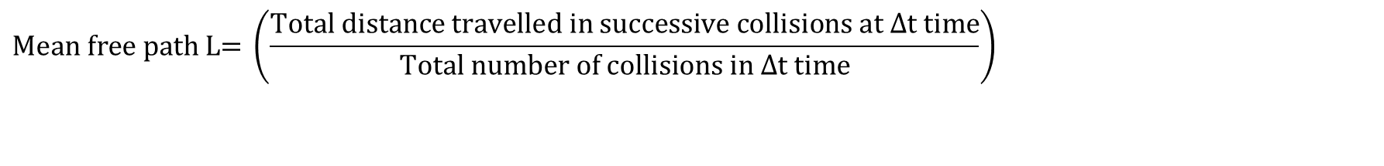
Mean free path: Definition
$$\text{Mean} \text{free} \text{path} \text{L}\text{= }\left(\frac{\text{Total} \text{distance} \text{travelled} \text{in} \text{successive} \text{collisions} \text{at} Δ\text{t} \text{time}}{\text{Total} \text{number} \text{of} \text{collisions} \text{in} Δ\text{t} \text{time}}\right)$$

Slide 83
Assumption: All identical
d

Slide 84
=2d
Greater than d
lesser than d

Slide 85
How to calculate the mean free path?
d
d

Slide 86
How to calculate the mean free path?
Assumption: All other molecules are static
d
d

Slide 87
How to calculate the mean free path?
Assumption: All other molecules are static
d
d

Slide 89
Maxwell’s correction when molecules are moving

Slide 90
Average relative speed

Slide 92
0

Slide 93
Applying on both sides

Slide 96
Pressure of an ideal gas inside a container- Kinetic theory approach

Slide 97
Pressure inside a container- Kinetic theory approach

Slide 98
Pressure inside a container- Kinetic theory approach

Slide 99
Assumptions: very dilute ideal gas
Velocity remains the same throughout
: only elastic collision take place
No other collisions takes place
For this i^{th} particle

Slide 100
Velocity remains the same throughout
: only elastic collision take place

Slide 102
Assumption: Isotropic situation

Slide 103
Equipartition of energy

Slide 104
Mean free path, Pressure, Temperature

Slide 105
Tutorial 2

Slide 106
Problem 1

Slide 107
Solution:

Slide 108
Problem 2

Slide 109
Solution

Slide 111
Problem 3

Slide 113
Solution

Slide 114
Problem 4

Slide 115
Solution

Slide 117
Problem 5

Slide 119
Problem 6

Slide 121
Concept of Diffusion: Kinetic theory of gases

Slide 122
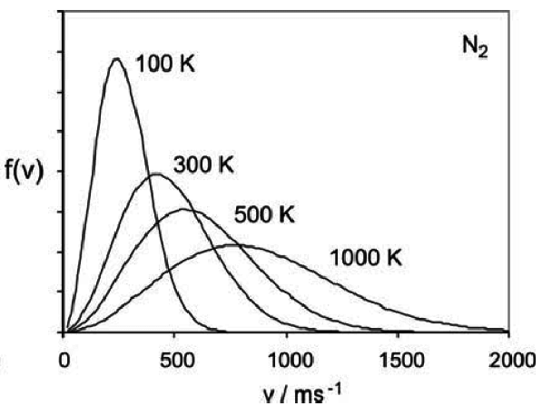
Temperature

Slide 123
Concept of Radiation Pressure, Laser cooling and Diffusion

Slide 124
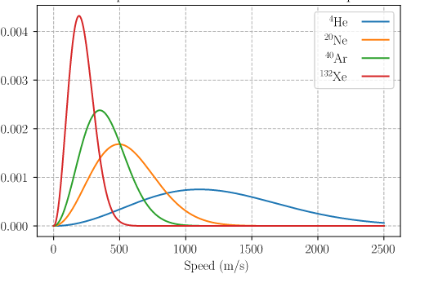
T = 300K
Mass decrease

Slide 125
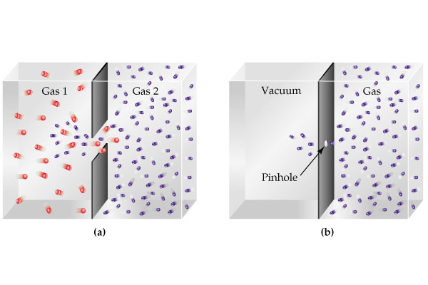

Slide 126
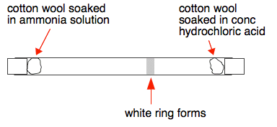

Slide 127
Graham’s Law of Diffusion

Slide 128
Thermal Diffusion equation: Fick’s Laws
(Kinetic theory)

Slide 129
Heat Flow
Charge Flow
Gas/mass Flow
Flux
Heat Flux q
Charge Flux J
Molecular/mass Flux J
Gradient
Law
Material Property
Thermal conductivity K
Electrical conductivity
Diffusion Coefficient

Slide 131
Area A

Slide 132
effect
cause
Flux
Concentration
gradient

Slide 136
Time dependency of concentration (Fick’s second law)
Area =A
C
x

Slide 137
How much concentration inside
this volume change with time?
Apply
Fick’s
Law
C
x

Slide 139
Fick’s second law

Slide 140
Fick’s second law

Slide 141
Thermal Diffusion equation: Fick’s Law
Fick’s second law

Slide 142
Thermal Diffusion equations: Fick’s Law
Fick’s second law

Slide 143
Tutorial 3: Thermal Diffusion

Slide 144
Problem 1
“A diffusing spherical cloud”

Slide 149
Problem 2
“Medicine storage ”

