Slide 1
Roll No. | Name
2301PH01 | Aditya Chandra | p | p | p | p | p | p
2301PH02 | Aditya Mittal | p | p | a | p | p | a
2301PH03 | Aditya Prakash Gupta | p | p | p | p | p | p
2301PH04 | Amit Kumar | a | a | p | p | p | p |  |  | p
2301PH05 | Angaanba Ningthoujam | p | p | p | p | p | p |  |  | p
2301PH06 | Arunvishal Palanisamy | a | p | p | p | p | p | p |  | p
2301PH07 | Ashmit Verma | p | p | p | p | p | a | p
2301PH08 | Azariah Peter | p | p | p | p | p | a | p | p | p

Slide 2
2301PH10 | Muskan Singh | p | p | p | p | p | p | p
2301PH11 | Naveen Saini | a | a | p | p | p | p |  | p
2301PH12 | Nishanth Kumaran | p | p | a | p | p | a | p
2301PH13 | Nived Krishna M | p | a | a | p | a | p |  | p
2301PH14 | Ratan Deep Prasad | p | p | p | a | p | p
2301PH16 | Shivam Kumar Kannojia | p | a | p | a | a | a
2301PH17 | Shivang Rayat | p | p | p | p | p | p
2301PH18 | Yashraj Singh Thakur | p | p | p | p | p | a
2301PH19 | Aekampreet Singh Dhir | a | p | p | p | p | a
2301PH20 | Banoth Naveen | p | p | a | p | a | p | p

Slide 3
2301PH21 | Neerati Pranay | p | p | p | p | p | a
2301PH22 | Tanish Dhankhar | a | p | a | a | a | a
2301PH23 | Farhan Farhan | p | p | p | p | a | a
2301PH24 | Utpal Raj Ambastha | p | p | p | p | p | p | p
2301PH25 | Riya Singh | p | p | p | a | p | a |  |  | p
2301PH27 | Rahul Katravath | p | p | p | a | p | p | p | p | p
2301PH28 | Shivani | p | p | p | p | p | p | p
2301PH29 | Rakesh Bairwa | a | p | p | p | p | p
2301PH30 | Nikhil Pratap Singh | a | p | p | p | p | a
2301PH31 | Sridutt Rugada | a | p | p | p | a | p |  | p
2301PH32 | Anmisha Jadi | p | p | p | p | a | p
Attendance: 75% mandatory

Slide 4
Maxwells equations
New variable “N”

Slide 5
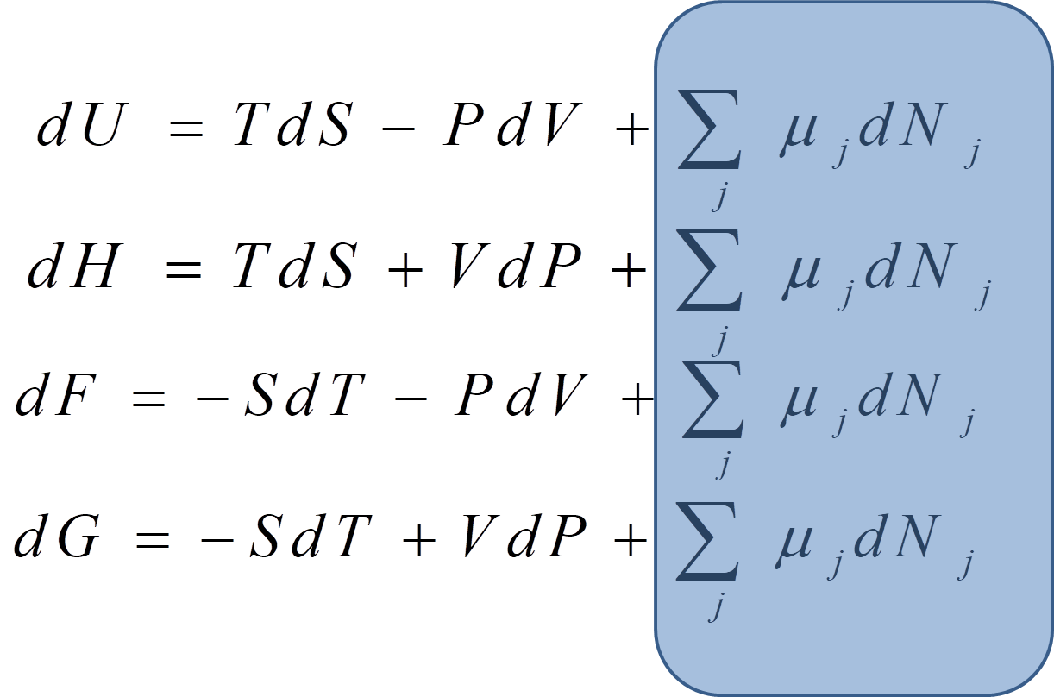

Slide 6
Extensive and Intensive variables
3 pairs of variables we formed
Conjugate variables
T
P
V
S
Intensive
variables
Extensive variable (depends on quantity of the substance)

Slide 7
$$dG−d(\sum_{j}{μ_{j}N_{j}})=−SdT+VdP+\sum_{j}{μ_{j}dN_{j}}−d(\sum_{j}{μ_{j}N_{j}}) \\ dX=−SdT+VdP−\sum_{j}{N_{j}dμ_{j}}$$

Slide 8
Can we write like
?
All are intensive variables
System specification is incomplete

Slide 10
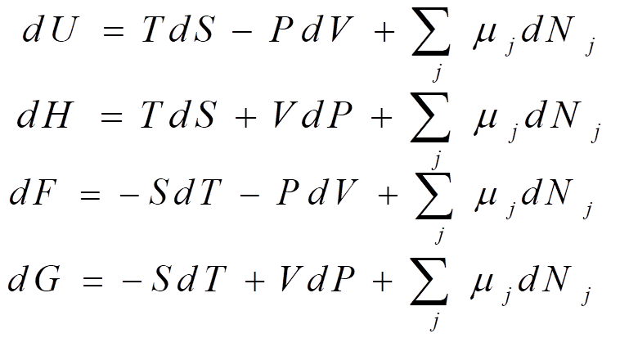
At least one extensive variable was present

Slide 11
We cannot define such Thermodynamic function
Gibbs -Duhem relation

Slide 12
$0=SdT−VdP+\sum_{j}{N_{j}dμ_{j}} (\text{Multiplied} \text{by}\text{ −1}$)

Slide 13
Using Gibbs Duhem relation we could find an absolute value of U

Slide 14
Thermal energy
Mechanical energy
chemical energy

Slide 15
Finding other thermodynamic functions using this relation

Slide 16
Gibbs -Duhem relation

Slide 17
$$\text{The} \text{temperature} \text{of}\text{ 1 }\text{mole} \text{of} {\text{N}}_{2} \text{gas} \text{at}\text{ 2 }\text{atm} \text{pressure} \text{is} \text{raised} \text{from} \\ \text{300}\text{K} \text{to}\text{ 400}\text{K} \text{isobarically}\text{. }\text{Calculate} ΔG \text{for} \text{the} \text{process} \text{if} \text{entropy} \text{of} {\text{N}}_{\text{2 }}\text{gas} \text{is} \\ \text{given} \text{by} S=A+B\ln{T},A=25J/K \text{and} B=29J/K$$

Slide 18
$$\text{The} \text{temperature} \text{of}\text{ 1 }\text{mole} \text{of} {\text{N}}_{2} \text{gas} \text{at}\text{ 2 }\text{atm} \text{pressure} \text{is} \text{raised} \text{from} \\ \text{300}\text{K} \text{to}\text{ 400}\text{K} \text{isobarically}\text{. }\text{Calculate} ΔG \text{for} \text{the} \text{process} \text{if} \text{entropy} \text{of} {\text{N}}_{\text{2 }}\text{gas} \text{is} \\ \text{given} \text{by} S=A+B\ln{T},A=25J/K \text{and} B=29J/K$$

Slide 22
Phase transition
Water to steam

Slide 23
https://www.youtube.com/watch?v=Juz9pVVsmQQ

Slide 25
Chemical Potential and Phase changes
At constant P and T
At equilibrium

Slide 28
We know from Gibbs-Duhem relations,

Slide 30
Clausius-Clapeyron Equation

Slide 31
Practice Problems

Slide 34
$$\text{Consider} \text{a} \text{carnot} \text{cycle} \text{operating} \text{as} \text{shown} \text{in} \\ \text{diagram} \text{below} \text{and} \text{compute} \frac{dP_{saturation}}{dT}$$
B
C
P
D
A
V
Saturation Pressure = The pressure of a vapor which is in equilibrium with its liquid
Example steam and water co-existing under equilibrium at phase boundary

Slide 38
$$2.It is found that a certain liquid boils at a temperature of 95 C at the top of a hill, \\ whereas it boils at a temperature of 105 C at the bottom. The latent heat is 1000 cal/mol. \\ What is the approximate height of the hill?$$
Use MW of air = 0.0288 Kg/mol (constant)

Slide 41
MW of air at 25C = 0.0288 Kg/mol

Slide 42
$$3.The boiling point of Li is 1620 K \text{at} \text{pressure} \text{of}\text{ 1 }\text{atm}. \\ What is the vapor pressure of liquid Li at 1000 K?$$ $$Data:ΔH of evaporation is 156 kJ/mol$$

Slide 43
$$3.The boiling point of Li is 1620 K \text{at} \text{pressure} \text{of}\text{ 1 }\text{atm}. \\ What is the vapor pressure of liquid Li at 1000 K?$$ $$Data:ΔH of evaporation is 156 kJ/mol$$

Slide 44
$$3.The boiling point of Li is 1620 K \text{at} \text{pressure} \text{of}\text{ 1 }\text{atm}. \\ What is the vapor pressure of liquid Li at 1000 K?$$ $$Data:ΔH of evaporation is 156 kJ/mol$$

Slide 48
T-V diagram during a “Phase Transition”

Slide 49
A thought experiment

Slide 54
A thought experiment

Slide 55
A thought experiment
T
Specific volume v

Slide 56
A thought experiment
T
Specific volume v

Slide 57
A thought experiment

Slide 58
A thought experiment
T
Specific volume v

Slide 60
A thought experiment

Slide 61
A thought experiment
T
Specific volume v

Slide 63
Water contained in a const pressure device is heated slowly
Volume changes continuously, the change is less for liquid more for vapour
T increase’s for pure liquid, after reaching at boiling point T remains constant, T further increases for pure vapor
- T increases only when system is in single phase
During phase change, T and p remains constant
- Heat transfer without temperature increase

Slide 64
What happens at different pressure’s?

Slide 65
A thought experiment
T
Specific volume v

Slide 67
At low pressures, latent heat of vaporization is high
At high pressures, latent heat of vaporization is lower
At critical pressure, latent heat is 0: critical temperature, critical volume
Above critical pressure, both V and T increase with heating

Slide 68
P-v diagram

Slide 71
P
Specific volume v

Slide 72
P-V-T Surface

Slide 74
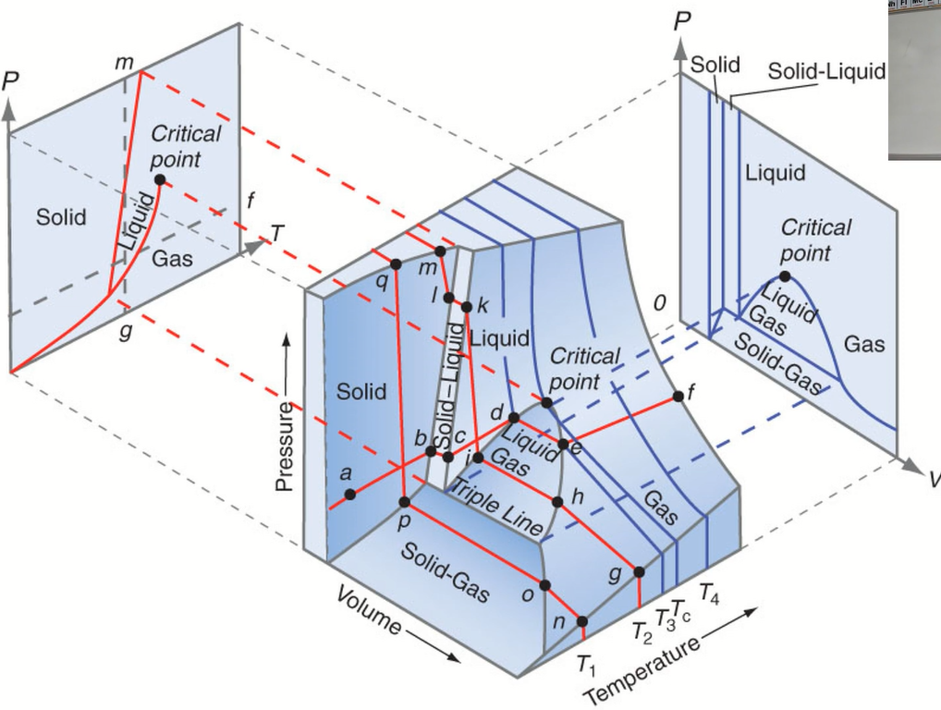

Slide 75
P-T diagram

Slide 76
https://www.youtube.com/watch?v=Juz9pVVsmQQ

Slide 78
Application Engineering Problems

Slide 81
Definition of “dryness fraction”

Slide 109
Engineering application 1: Thermal Power Plant using Vapor Cycle

Slide 110
Recollect….
1
isothermal
2
Q_{in}
1
2
T
P
Q=0
T_{hot}
Q=0
adiabatic
adiabatic
T_{cold}
4
3
Q_{out}
isothermal
4
3
S
V

Slide 111
Carnot Efficiency

