Slide 1
Quiz 1 solution
Held on 31-Dec-2021

Slide 2
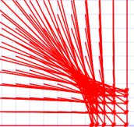
z

Slide 3
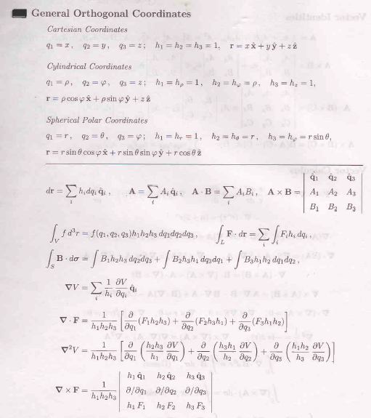

Slide 4
= 2πR²H

Slide 5
Evaluation of Surface Integral
$$dρ$$
$$ρdφ$$
a$dφ$
$$dz$$
= 2πR²H
z

Slide 6
This means sum of all sources within an enclosed volume
gives the net flux out of a region. Hence volume integral of divergence of a vector field coming from an enclosed volume (here cylinder) will be equal to the surface integral of the vector field on the surface.

Slide 7
z

Slide 9
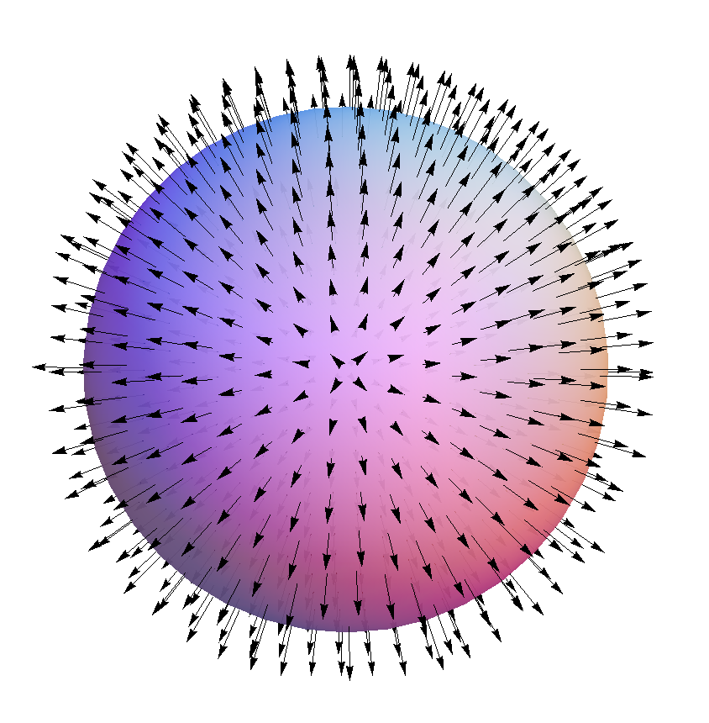
The sum of diverging field
Lines coming from inside
Of the spherical volume
=
Sum of the field lines
In the surface of the sphere
Divergence Theorem

Slide 10
Which of the following vector fields corresponds to the gradient of the function $T\left(x,y\right)=x^{2}−y^{2}$.
T(x,y)=x²-y²

Slide 11
T(x,y)=x²-y²
-y
+y
T(x,y)
T(x,y)
-x
+x

Slide 12
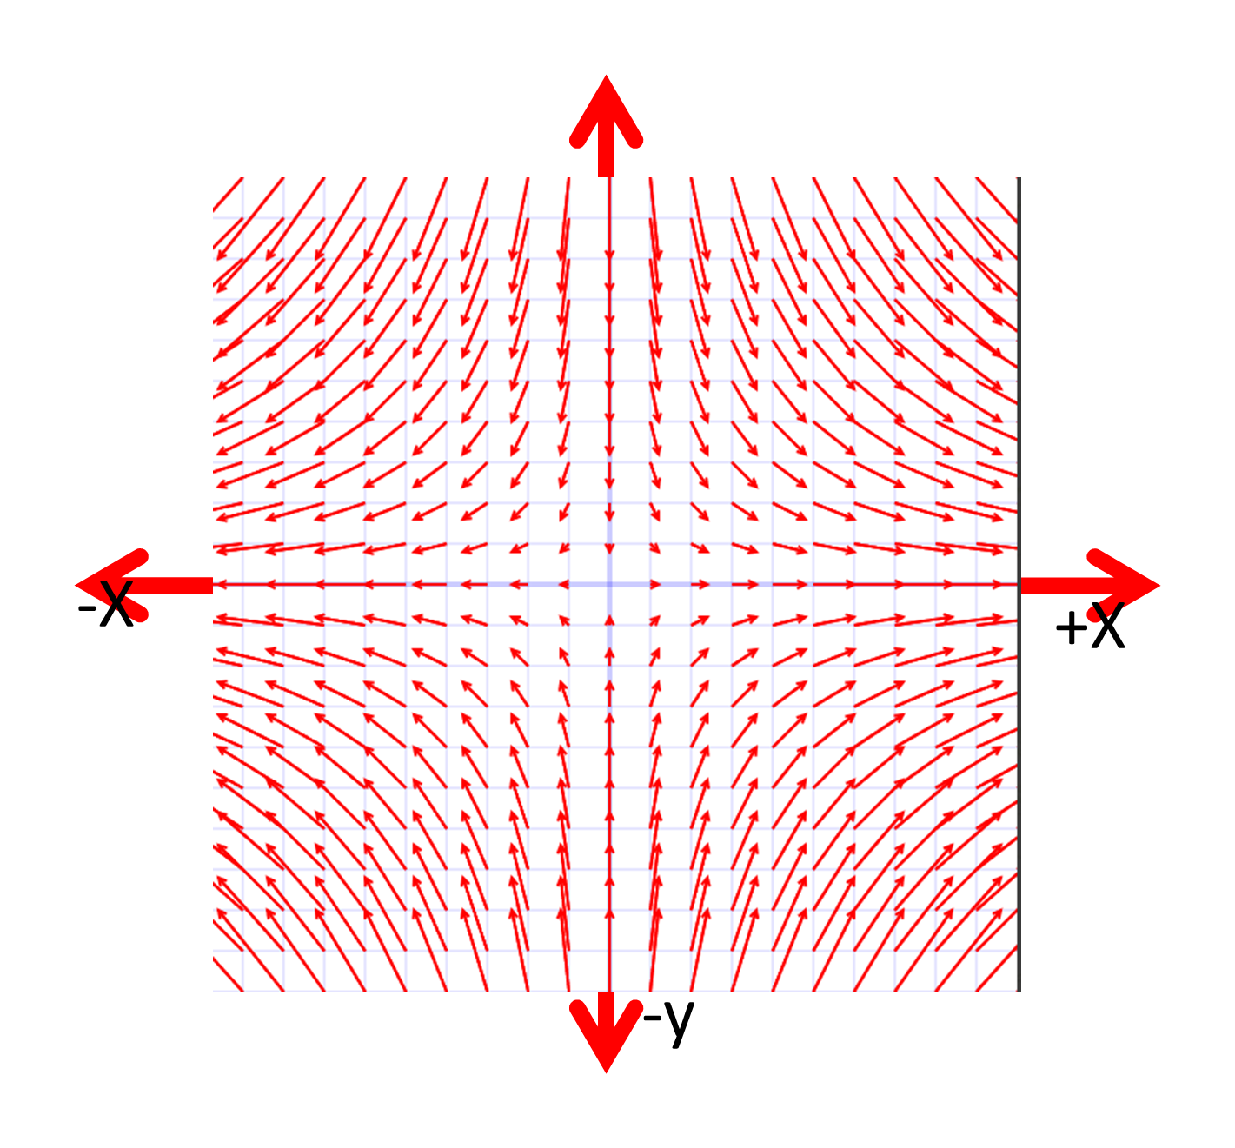
Gradiant is
T(x,y)
x
y

Slide 13
What is the curl of the vector field

Slide 14
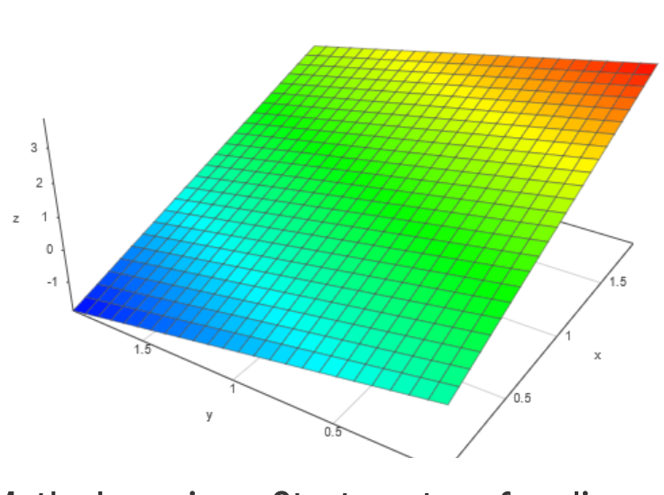
What is the volume enclosed by surface $z=2x−y$ and the rectangle in the xy plane defined by $0≤x≤2 and 0≤y≤2$?

Slide 18
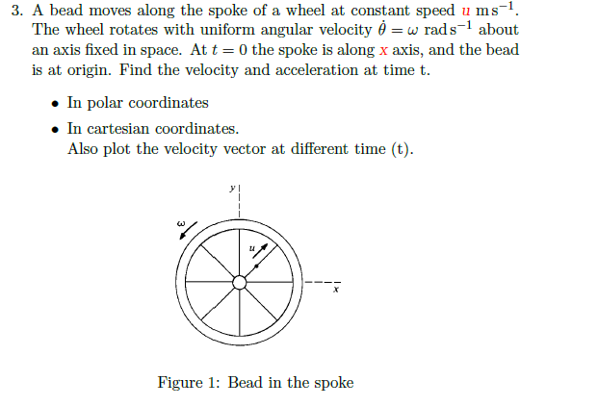

Slide 19
