Slide 1
1 | 1921PH19 | SAUMYASHREE BARAL
2 | 2321PH02 | ARYA KUMAR SIDDHARTH
3 | 2321PH07 | NAINCY SHRIVASTAVA
4 | 2321PH09 | PRITAM SAMANTA
5 | 2321PH10 | REETU SAINI
6 | 2321PH13 | SOUBHIK MUKHERJEE
7 | 2321PH14 | NEHA CHOUDHARY
8 | 2321PH15 | RABI DAS
9 | 2321PH19 | SHRUTI SARSWAT
10 | 2212PH02 | AMAN KUMAR
11 | 2212PH10 | BINAYAK ROUT
12 | 2212PH11 | DARPAN SARKAR
13 | 2212PH13 | GAURAV JAISWAL
14 | 2212PH17 | KAUSHIP SAHA
15 | 2212PH20 | NEELLOHIT KARMAKAR
16 | 2212PH23 | RITIK PAL
17 | 2212PH26 | SOUMIK KARMAKAR
18 | 2212PH32 | KAUSTAB BHARASA

Slide 2
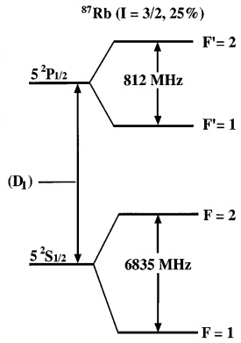
MOT
-B Location
-2
+2
For emission
ΔmF = 0, +/-1
ΔF=0, +/-1
Repump,
Π POLARIZED
+2
+1
mF
σ+Light, ΔmF = +1
-1
+1

Slide 3
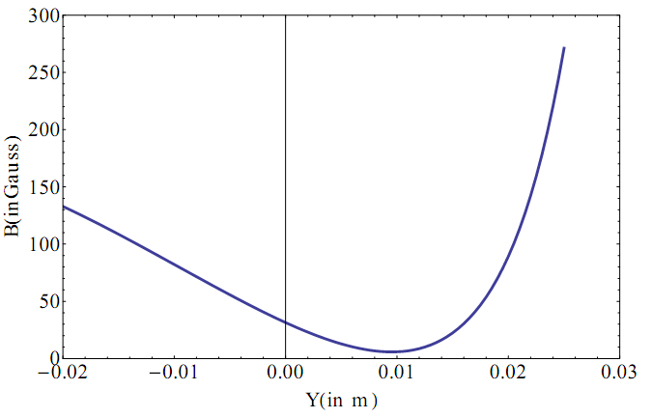
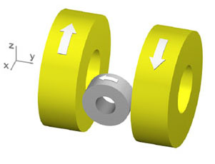
Technique to reach ultra low temperatures
Laser cooling and trapping
MOT
Temperature in a MOT is limited to Doppler Temperature T_{D} ≈ 200 µK
Magnetic trap - Quadrupole Ioffe trap
Z
X
O

Slide 4
MOT Coil
+
Ioffe Coil
Z
X
O

Slide 5
MAGNETIC TRAPPING
A conservative Trap/ Potential for laser cooled atoms
No Laser Cooling Lights, they are off

Slide 6
How to use this as a Conservative Trap?
Loading from MOT to Magnetic TRAP

Slide 7
Cooling phases
Doppler
Cooling
Milli Kelvin range
MOT
Atomic density
Increased
Cooling is limited
Upto Doppler Temp due to light
Magnetic Trapping
Need
Multi-Level
Treatment.
2 level model fails…
Cooling Beyond Doppler Limit
Quantum nature of atoms observed
Evaporative Cooling

Slide 8
MOT
-B Location
-2
+2
For emission
ΔmF = 0, +/-1
ΔF=0, +/-1
Repump,
Π POLARIZED
+2
+1
mF
σ+Light, ΔmF = +1
-1
+1

Slide 9
MOT
+B
VICE VERSA

Slide 11
MOT to MAGNETIC TRAP
LIGHT FIELD IS OFF
ATOMS REMAIN IN mF = +1 STATE

Slide 12
-B Location
a
-2
+2
Atom has electron in mF = +1 state
+2
+1
mF
-1
+1

Slide 13
What happens in +B location?

Slide 14
MOT
+B Location
+2
-2
For emission
ΔmF = 0, +/-1
ΔF=0, +/-1
Repump,
Π POLARIZED
-2
-1
mF
σ-Light, ΔmF = -1
+1
-1

Slide 15
MOT to MAGNETIC TRAP
LIGHT FIELD IS OFF
ATOMS REMAIN IN mF = -1 STATE

Slide 16
+B Location
a
-2
+2
Atom has electron in mF = -1 state
+2
+1
mF
+1
-1

Slide 18
Potential seen by the atom in different mF states
1/2 kx²
mF = +1
mF = 0
-1/2 kx²
mF = -1

Slide 20
Restoring Force
Hence, restoring force is experienced for atoms having electron in mF =+1 state only (F=-Kx form)
Only those toms will ‘feel’ a trapping potential
This is like a trap for atoms having electron in mF =+1 inside this region
where +1g_{F}µ_{B}B(x) >>> ½ mv_{D}²

Slide 24
MAGNETIC TRAP
IMMEDIATELY AS LIGHT GETS OFF MAGNETIC COILS FOR
MAGNETIC TRAP GETS ON
Nearly Harmonic

Slide 25
Doppler
Cooling
MOT
Magnetic
Trap
Laser
Power
ω₀-kv_{d}
Laser
Frequency
Cooling+
Repump
ω₀ - ω_{zeeman} - kv
MOT COIL
IOFFE
COIL

Slide 26
Atomic cloud
½ mv_{D}²
mF = +1
+1g_{F}µ_{B}B(x)
+1g_{F}µ_{B}B(x) >>> ½ mv_{D}²
Atoms who has ½ mv²>>> +1g_{F}µ_{B}B(x) will escape the trap leaving
Colder ones behind and they thermalize
Evaporation Process……

Slide 27
Coffee cup!

Slide 28
Self Evaporation
mF = +1
Overall temperature goes down

Slide 31
Magnetic trapping

Slide 33
Potential seen by the atom in different mF states
1/2 kx²
mF = +1
mF = 0
-1/2 kx²
mF = -1

Slide 34
Restoring Force
Hence, restoring force is experienced for atoms having electron in mF =+1 state only (F=-Kx form)
Only those toms will ‘feel’ a trapping potential
This is like a trap for atoms having electron in mF =+1 inside this region
where +1g_{F}µ_{B}B(x) >>> ½ mv_{D}²

Slide 35
Atomic cloud
½ mv_{D}²
mF = +1
+1g_{F}µ_{B}B(x)
+1g_{F}µ_{B}B(x) >>> ½ mv_{D}²
Atoms who has ½ mv²>>> +1g_{F}µ_{B}B(x) will escape the trap leaving
Colder ones behind and they thermalize
Evaporation Process……

Slide 36
Self Evaporation
mF = +1
Overall temperature goes down

Slide 37
How to cool further in conservative trap such that de Broglie wave length becomes significant and atoms start to show quantum nature?

Slide 38
Keep on reducing the potential Barrier?
Such that self evaporation gets promoted?

Slide 43
TECHNICAL PROBLEM ARISES! GETTING STABLE LOW MAGNETIC
FIELDS ARE DIFFICULT IN MAGNETIC TRAP COILS……………
Field value jitters……

Slide 44
Forced Evaporation is the method!

Slide 45
How it works?
Force fully remove the higher energetic atoms in the trap
This will lead to a loss in atom number but overall a reduction occurs in temperature after thermalisation

Slide 46
We know atoms move randomly in the trap
Overall atomic cloud will have average speed of v for a given T
Lets look at this situation in Energy diagram where these atoms are?
Energy
v
How to
Remove them?
Distance

Slide 47
How to do it??

Slide 48
Lets C how it works?......
Lets look at a hotter atom with average speed v in the energy v/s x
These
Atoms move
In this height
On Energy scale
Off course there are many atoms
Doing the same…

Slide 49
Important
Note that ATOMS ARE not actually under uniform circular motion, this is SYMBOLIC
Actual motion is different from the Energy Scale
Picture
Energy Picture is an easy way to understand Forced
Evaporation, compared to actual motion in position space

Slide 50
How to remove those hotter ones?
Think on why we remove them?......
This leads to overall reduction in speed and temperature due to thermalisation effects from elastic collision…………
Recollect the CUT in Boltzmann distribution……..

Slide 51
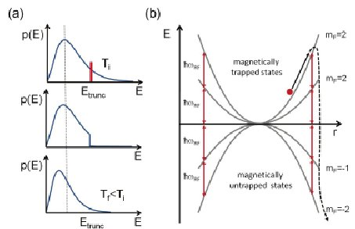
E

Slide 52
Lets C how it works?......
How to remove?

Slide 53
How is the internal structure?
Atoms with higher energy remains in the periphery at farther away distance, hence
They have larger energy
1/2 kx²
mF = +1
mF = 0
-1/2 kx²
mF = -1

Slide 54
How is the internal structure?
mF = +1
mF = 0
mF = -1

Slide 55
How to remove them?
mF = +1
mF = 0
mF = -1

Slide 56
De-excite using light to mF=0
mF = +1
Rf resonant radiation
mF = 0
mF = -1

Slide 57
De-excite using light to mF=0
No Force
On atoms anymore
They escape
mF = +1
Rf resonant radiation
mF = 0
mF = -1

Slide 58
This gets thermalised….. Recollect Distribution

Slide 59
E

Slide 60
This process repeated for lower speed/lower energetic atoms as well
mF = +1
mF = 0
mF = -1

Slide 61
Lets now Summarize the Forced Evaporation

Slide 62
Forced evaporative cooling
H(r) = μ.B_{dc}(r)
E(r) = m_{F}g_{F}µ_{B}B_{dc}
+1
+1
E
=0

Slide 63
Forced evaporative cooling
+1
E
f₁
=0

Slide 64
Forced evaporative cooling
+1
E
f₂
=0

Slide 65
Forced evaporative cooling
+1
E
f₃
=0

Slide 66
Forced evaporative cooling
+1
E
f₄
=0

Slide 69
Temperature measurement
Trap off
Cloud expands
camera
Atom
cloud
Resonant light is shone on to atoms

Slide 70
RECAP

Slide 71
Temperature measurement
Trap off
Cloud expands
camera
Atom
cloud
Resonant light is shone on to atoms

Slide 72
Frequency of detection light?
+2
-2
-2
-1
mF
σ+Light, ΔmF = +1
+1
-1

Slide 73
As seen on Camera: Absorption imaging
Atom
cloud

Slide 74
How it looks in camera?
False
Color
a

Slide 75
Absorption Imaging Sequence
Step 1
Doppler Cooling+ MOT + Magnetic trap
ALL OFF
Expansion
Of atomic cloud
Atomic sample destroyed
t₁ s
Detection light
CCD Camera

Slide 76
Again the sequence starts from beginning! Why? Because atoms are destroyed by detection light
Note: Absorption imaging is a destructive method

Slide 77
Absorption Imaging Sequence
Step 1
Doppler Cooling+ MOT + Magnetic trap
ALL OFF
Expansion
Of atomic cloud
Atomic sample destroyed
It is
Difficult
To get
A ultra short
Light
Pulse
As our laser
Is CW
t₁ s
Detection light
CCD Camera

Slide 78
Absorption Imaging Sequence
Step 2
Doppler Cooling+ MOT + Magnetic trap
ALL OFF
Expansion
Of atomic cloud
Atomic sample destroyed
later
t₂ s
Detection light
CCD Camera

Slide 79
Absorption Imaging Sequence
Step 3
Doppler Cooling+ MOT + Magnetic trap
ALL OFF
Expansion
Of atomic cloud
Atomic sample destroyed
t₃ s
Detection light
CCD Camera

Slide 80
Doppler Cooling+ MOT + Magnetic trap
ALL OFF
Expansion
Of atomic cloud

Slide 82
v
a
a+vt
a+vt’

Slide 83
Size
t
From the fit V is calculated, then T

Slide 84
How to cool further in conservative trap such that de Broglie wave length becomes significant and atoms start to show quantum nature?

Slide 85
Keep on reducing the potential Barrier?
Such that self evaporation gets promoted?

Slide 90
Forced Evaporation is the method!

Slide 91
How it works?
Force fully remove the higher energetic atoms in the trap
This will lead to a loss in atom number but overall a reduction occurs in temperature after thermalisation

Slide 92
We know atoms move randomly in the trap
Overall atomic cloud will have average speed of v for a given T
Lets look at this situation in Energy diagram where these atoms are?
Energy
v
How to
Remove them?
Distance

Slide 93
How to do it??

Slide 94
Lets C how it works?......
Lets look at a hotter atom with average speed v in the energy v/s x
These
Atoms move
In this height
On Energy scale
Off course there are many atoms
Doing the same…

Slide 95
Important
Note that ATOMS ARE not actually under uniform circular motion, this is SYMBOLIC
Actual motion is different from the Energy Scale
Picture
Energy Picture is an easy way to understand Forced
Evaporation, compared to actual motion in position space

Slide 96
How to remove those hotter ones?
Think on why we remove them?......
This leads to overall reduction in speed and temperature due to thermalisation effects from elastic collision…………
Recollect the CUT in Boltzmann distribution……..

Slide 97
E

Slide 98
Lets C how it works?......
How to remove?

Slide 99
How is the internal structure?
Atoms with higher energy remains in the periphery at farther away distance, hence
They have larger energy
1/2 kx²
mF = +1
mF = 0
-1/2 kx²
mF = -1

Slide 100
How is the internal structure?
mF = +1
mF = 0
mF = -1

Slide 101
How to remove them?
mF = +1
mF = 0
mF = -1

Slide 102
De-excite using light to mF=0
mF = +1
Rf resonant radiation
mF = 0
mF = -1

Slide 103
De-excite using light to mF=0
No Force
On atoms anymore
They escape
mF = +1
Rf resonant radiation
mF = 0
mF = -1

Slide 104
This gets thermalised….. Recollect Distribution

Slide 105
E

Slide 106
This process repeated for lower speed/lower energetic atoms as well
mF = +1
mF = 0
mF = -1

Slide 107
Lets now Summarize the Forced Evaporation

Slide 108
Forced evaporative cooling
H(r) = μ.B_{dc}(r)
E(r) = m_{F}g_{F}µ_{B}B_{dc}
+1
+1
E
=0

Slide 109
Forced evaporative cooling
+1
E
f₁
=0

Slide 110
Forced evaporative cooling
+1
E
f₂
=0

Slide 111
Forced evaporative cooling
+1
E
f₃
=0

Slide 112
Forced evaporative cooling
+1
E
f₄
=0

Slide 113
Steps: RF evaporation
Step 1
Image Analysis
Doppler Cooling+ MOT + Magnetic trap
RF
Evaporation
Frequency f₁
ALL OFF
Expansion
For temperature
Detection light
CCD Camera

Slide 114
Steps: RF evaporation
Step 2
Image Analysis
Doppler Cooling+ MOT + Magnetic trap
RF
Evaporation
Frequency f₁
To f₂
ALL OFF
Expansion
For temperature
Detection light
CCD Camera

Slide 115
Steps: RF evaporation
Step 3
Image Analysis
Doppler Cooling+ MOT + Magnetic trap
RF
Evaporation
Frequency f₁
To f₃
ALL OFF
Expansion
For temperature
Detection light
CCD Camera

Slide 116
Steps: RF evaporation
Distribution
changes
Step 4
Image Analysis
Doppler Cooling+ MOT + Magnetic trap
RF
Evaporation
Frequency f₁
To f₄
ALL OFF
Expansion
For temperature
Detection light
CCD Camera

Slide 117
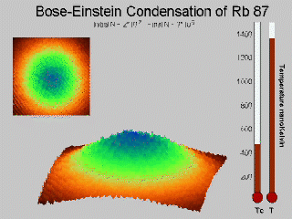
Till how much you do evaporation?

Slide 118
Quantized levels start appearing… Once atoms become quantum particle….

Slide 119
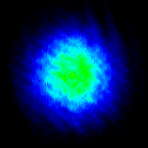
Quantum degeneracy
BEC

Slide 120
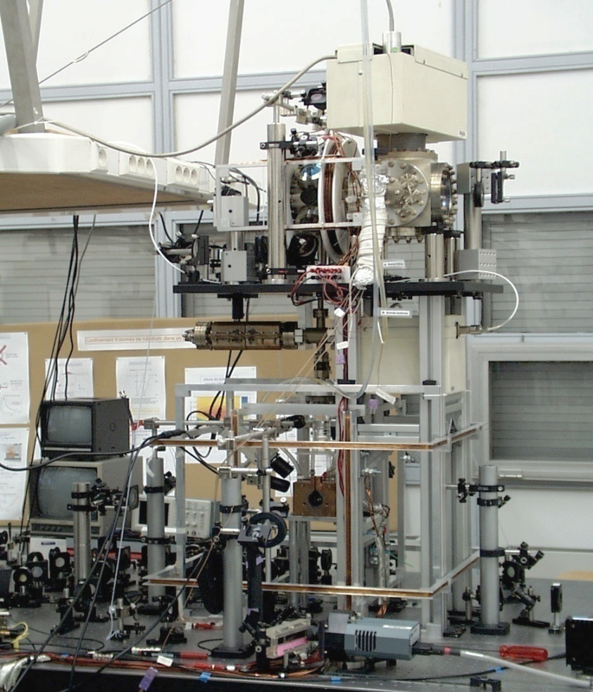
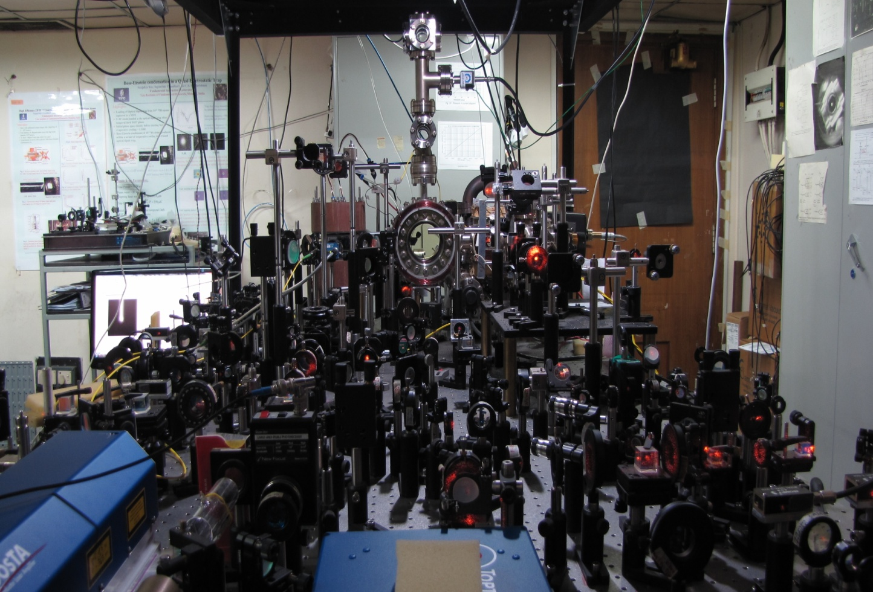
Experimental set up
Paris
TIFR Mumbai

Slide 135
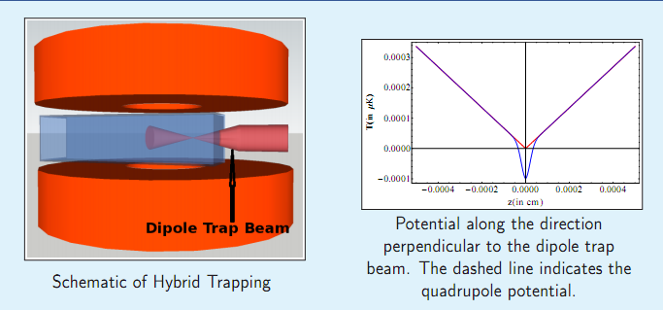
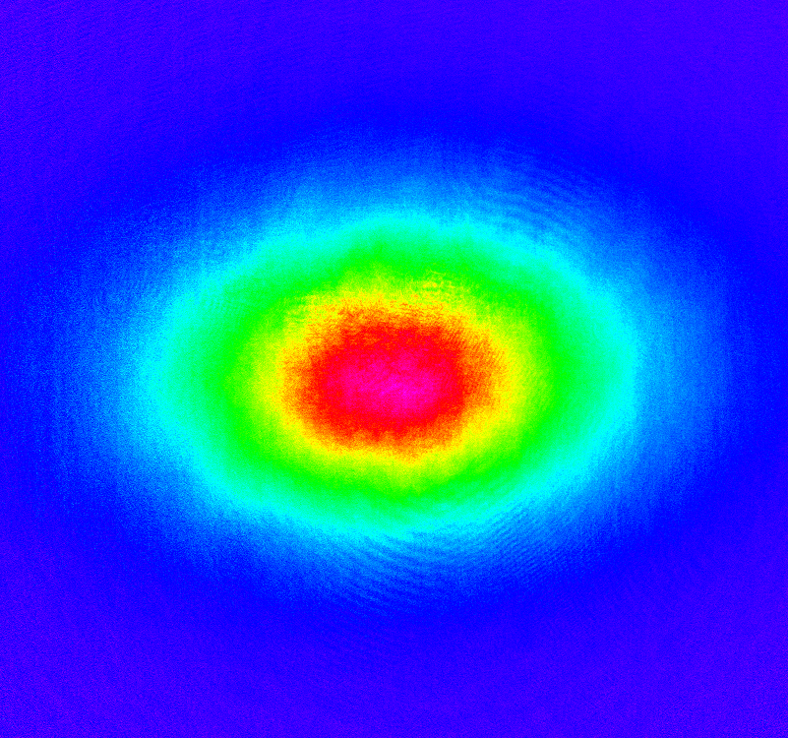
Optical Trap
Optical Dipole trap
w₀
Hybrid trap =
Magnetic + Optical field

Slide 136
Find out the Single-photon recoil velocity and recoil temperature for Sodium atom [Mass of Na atom is 22.98 a.m.u, Resonant wavelength = 589.3 nm]

Slide 137
An ensemble of two level atoms moving at a room temperature of 300K needs to be laser cooled and trapped in an experiment. Assume average atomic speed inside the Vacuum chamber as 300m/s. Being an experimentalist in Quantum Optics, think of implementing this in a set up
How will you achieve the appropriate detuning for the laser experimentally for cooling process? (a)What will be the experimental parameters you need to set for laser cooling stage and MOT stage given the Magnetic field numerical value changes from +0.5G to -0.5G along the periphery of the laser cooling beam in an anti-Helmholtz configuration. Magnetic field gradient is very small and negligible (Band gap Wavelength for this atom 750 nm)
Sketch the Experimental sequence of laser cooling stage and MOT stage assuming optimum time scales of frequency ramp as 5 ms for laser cooling and 10 ms for MOT stage. {Use F = 0 to F = 1 as ground and excited states, for simplicity choose gf = 1 for F = 1 level of the hypothetical atom}

Slide 145
Potential seen by the atom in different mF states
1/2 kx²
mF = +1
mF = 0
-1/2 kx²
mF = -1

Slide 146
Restoring Force
Hence, restoring force is experienced for atoms having electron in mF =+1 state only (F=-Kx form)
Only those toms will ‘feel’ a trapping potential
This is like a trap for atoms having electron in mF =+1 inside this region
where +1g_{F}µ_{B}B(x) >>> ½ mv_{D}²

Slide 147
Atomic cloud
½ mv_{D}²
mF = +1
+1g_{F}µ_{B}B(x)
+1g_{F}µ_{B}B(x) >>> ½ mv_{D}²
Atoms who has ½ mv²>>> +1g_{F}µ_{B}B(x) will escape the trap leaving
Colder ones behind and they thermalize
Evaporation Process……

Slide 148
Self Evaporation
mF = +1
Overall temperature goes down

Slide 149
Temperature measurement
Trap off
Cloud expands
camera
Atom
cloud
Resonant light is shone on to atoms

Slide 150
Frequency of detection light?
+2
-2
-2
-1
mF
σ+Light, ΔmF = +1
+1
-1

Slide 151
As seen on Camera: Absorption imaging
Atom
cloud

Slide 152
How it looks in camera?
False
Color
a

Slide 153
Absorption Imaging Sequence
Step 1
Doppler Cooling+ MOT + Magnetic trap
ALL OFF
Expansion
Of atomic cloud
Atomic sample destroyed
t₁ s
Detection light
CCD Camera

Slide 154
Again the sequence starts from beginning! Why? Because atoms are destroyed by detection light
Note: Absorption imaging is a destructive method

Slide 155
Absorption Imaging Sequence
Step 1
Doppler Cooling+ MOT + Magnetic trap
ALL OFF
Expansion
Of atomic cloud
Atomic sample destroyed
It is
Difficult
To get
A ultra short
Light
Pulse
As our laser
Is CW
t₁ s
Detection light
CCD Camera

Slide 156
Absorption Imaging Sequence
Step 2
Doppler Cooling+ MOT + Magnetic trap
ALL OFF
Expansion
Of atomic cloud
Atomic sample destroyed
later
t₂ s
Detection light
CCD Camera

Slide 157
Absorption Imaging Sequence
Step 3
Doppler Cooling+ MOT + Magnetic trap
ALL OFF
Expansion
Of atomic cloud
Atomic sample destroyed
t₃ s
Detection light
CCD Camera

Slide 158
Doppler Cooling+ MOT + Magnetic trap
ALL OFF
Expansion
Of atomic cloud

Slide 159
Steps: RF evaporation
Step 1
Image Analysis
Doppler Cooling+ MOT + Magnetic trap
RF
Evaporation
Frequency f₁
ALL OFF
Expansion
For temperature
Detection light
CCD Camera

Slide 160
Steps: RF evaporation
Step 2
Image Analysis
Doppler Cooling+ MOT + Magnetic trap
RF
Evaporation
Frequency f₁
To f₂
ALL OFF
Expansion
For temperature
Detection light
CCD Camera

Slide 161
Steps: RF evaporation
Step 3
Image Analysis
Doppler Cooling+ MOT + Magnetic trap
RF
Evaporation
Frequency f₁
To f₃
ALL OFF
Expansion
For temperature
Detection light
CCD Camera

Slide 162
Steps: RF evaporation
Distribution
changes
Step 4
Image Analysis
Doppler Cooling+ MOT + Magnetic trap
RF
Evaporation
Frequency f₁
To f₄
ALL OFF
Expansion
For temperature
Detection light
CCD Camera

Slide 163
Till how much you do evaporation?

Slide 164
Quantum degeneracy
BEC

