Slide 1
Season 2, Lecture 1 (S2,L1): Orientation
and
Introduction

Slide 2
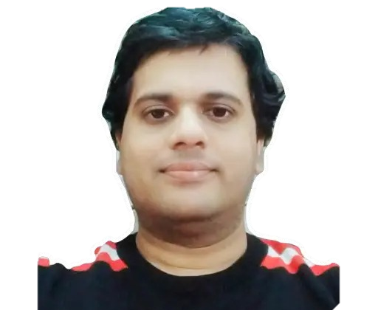
Course Instructor for Thermal Physics
Dr. Raghavan K Easwaran
PhD (France, Paris) PDF(Nottingham, UK), UG (IIT Madras)
Marie Curie Fellow (PhD) European Union (EU), IFRAF, Paris
Associate Professor
Department of Physics
Indian Institute of Technology Patna
www.raghavanke.com
Season2: EP207 Thermal Physics

Slide 4
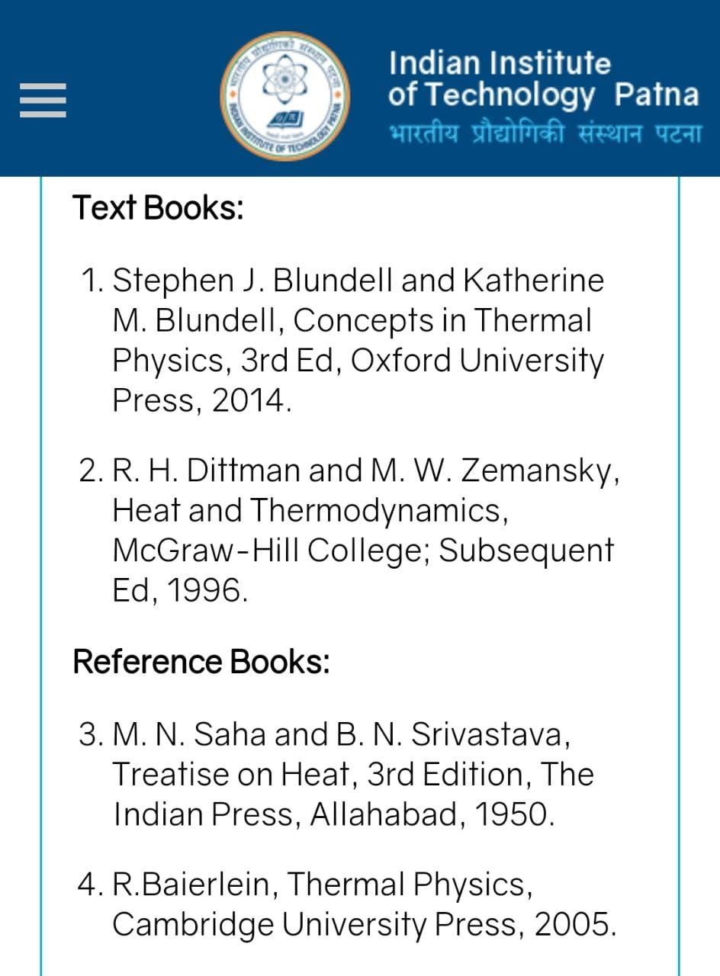

Slide 5
Time |  | 02-02:55 | 03-03:55 | 04-04:55
Day
Tuesday |  | EP207(304)(RKE)
Thursday |  |  | EP207(104)(RKE)
Friday |  |  |  | EP207(304)(RKE)

Slide 6
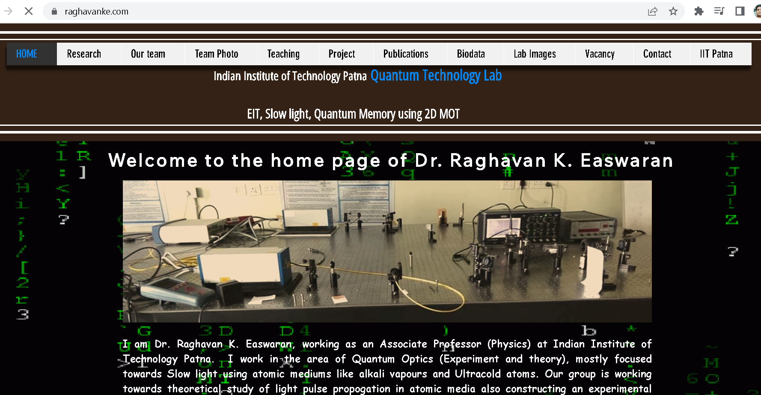

Slide 7
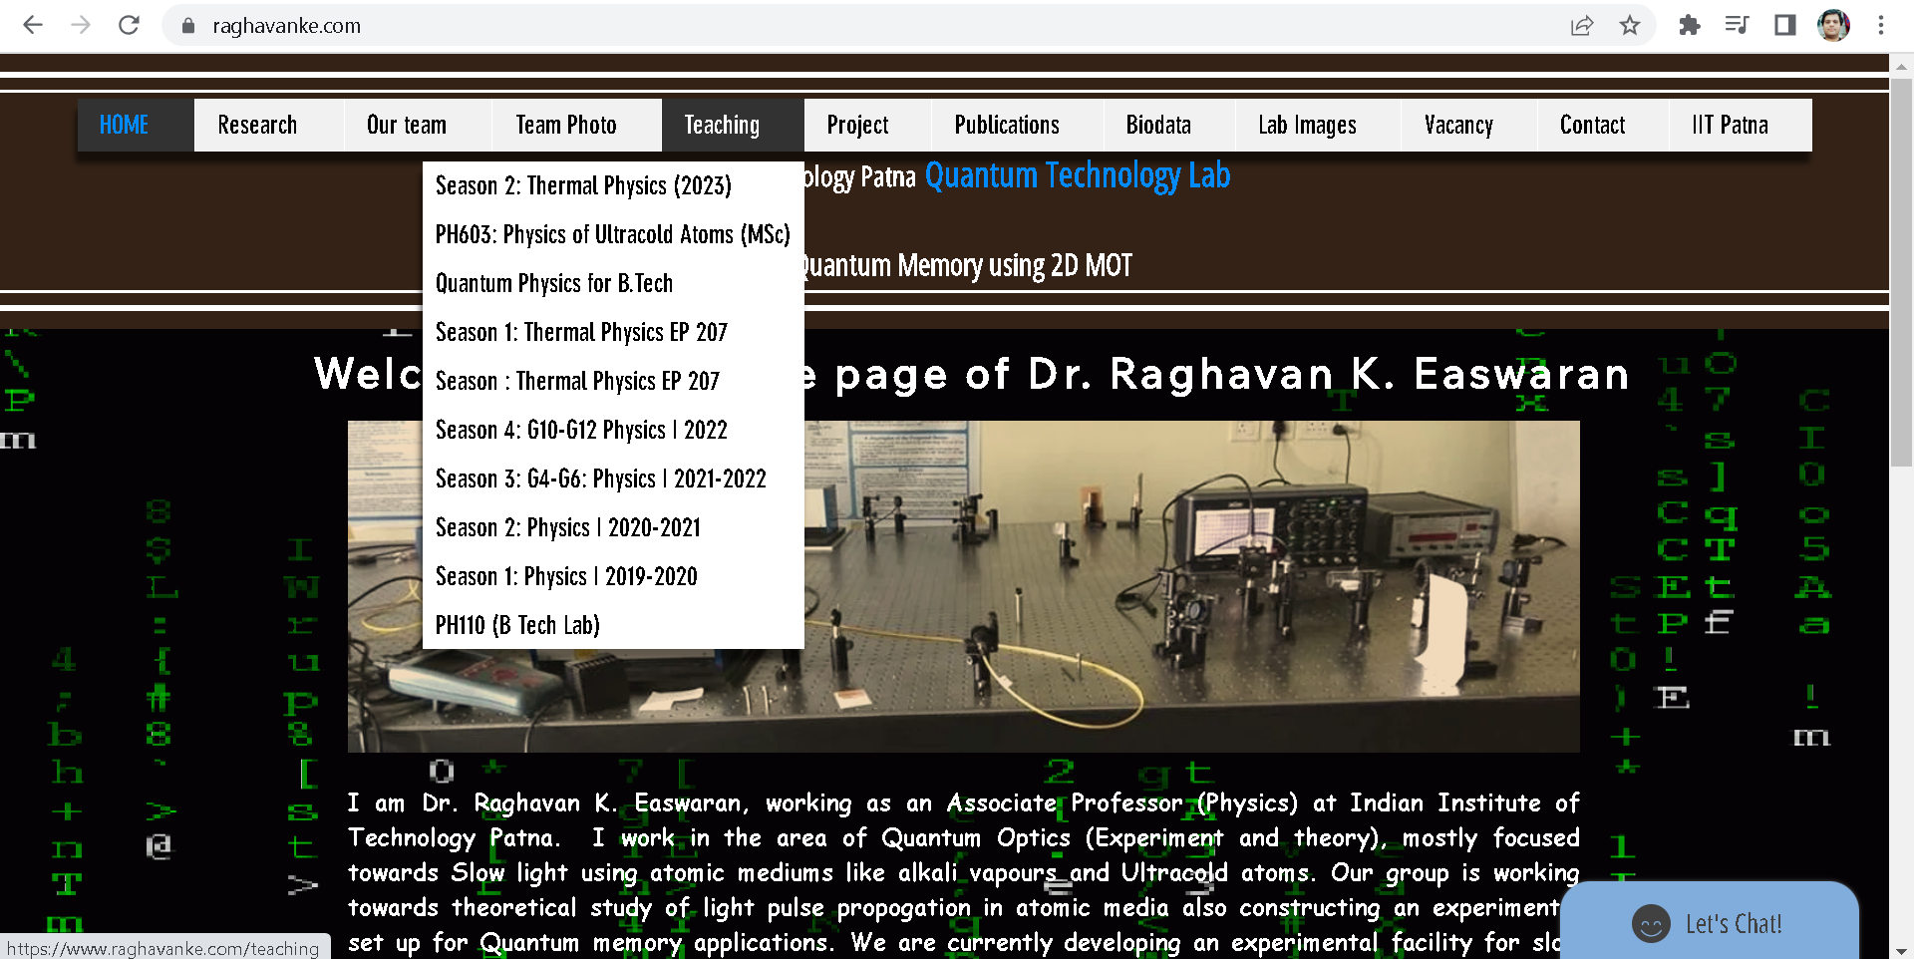

Slide 9
Name | L1
"2201ph34_dolly" <2201ph34_dolly@iitp.ac.in>; | p
"Adhila Aslam" <2201ph01_adhila@iitp.ac.in>; | p
"Aditi Baghel" <2201ph31_aditi@iitp.ac.in>; | p
"Aditya Kumar" <2201ph02_aditya@iitp.ac.in>; | a
"Aditya Singh" <2201ph03_aditya@iitp.ac.in>; | p
"Anil Ram" <2201ph04_anil@iitp.ac.in>; | a
"Animesh Sharma" <2201ph05_animesh@iitp.ac.in>; | p
"Arun Mishra" <2201ph06_arun@iitp.ac.in>; | p
"Aryan Raj" <2201ph32_aryan@iitp.ac.in>; | p
"Ayush Gautam" <2201ph07_ayush@iitp.ac.in>; | p
"Boda Vishnuwardhan" <2201ph08_boda@iitp.ac.in>; | p
"Chanchal Tolani" <2201ph09_chanchal@iitp.ac.in>; | p
"Devansh Srivastava" <2201ph33_devansh@iitp.ac.in>; | p
"Gaurav Verma" <2201ph10_gaurav@iitp.ac.in>; | p

Slide 10
Name | L1
"Gourav Jha" <2201ph11_gourav@iitp.ac.in>; | a
"Gurinder Dhillon" <2201ph12_gurinder@iitp.ac.in>; | p
"Harsh Joshi" <2201ph13_harsh@iitp.ac.in>; | a
"Himanshu Patel" <2201ph35_himanshu@iitp.ac.in>; | p
"Jigyasa Agrawal" <2201ph36_jigyasa@iitp.ac.in>; | a
"Khushal Yadav" <2201ph14_khushal@iitp.ac.in>; | p
"Krishnakant Chourey" <2201ph15_krishnakant@iitp.ac.in>; | p
"Manas Gupta" <2201ph16_manas@iitp.ac.in>; | a
"Mohit Saini" <2201ph17_mohit@iitp.ac.in>; | p
"Mude Naik" <2201ph18_mude@iitp.ac.in>; | a
"Murari Kumar" <2201ph19_murari@iitp.ac.in>; | a
"Nishant Yadav" <2201ph20_nishant@iitp.ac.in>; | p
"Pranitha Moluguri" <2201ph21_pranitha@iitp.ac.in>; | p

Slide 11
Name | L1
"Premanandh Sigamala" <2201ph22_premanandh@iitp.ac.in>; | a
"Ruchi Thakur" <2201ph23_ruchi@iitp.ac.in>; | a
"Satyam Sahoo" <2201ph25_satyam@iitp.ac.in>; | p
"Satyam Shandilya" <2201ph24_satyam@iitp.ac.in>; | p
"Shyam Hembram" <2201ph26_shyam@iitp.ac.in>; “ | p
Sougata Saha" <2201ph27_sougata@iitp.ac.in>; | p
"Sumit Rajpoot" <2201ph28_sumit@iitp.ac.in>; | p
"Suprajit Dewanji" <2201ph29_suprajit@iitp.ac.in>; | p
"Yepuri Subhash" <2201ph30_yepuri@iitp.ac.in> | a
Attendance: 75% mandatory

Slide 12
Evaluation Scheme
Exam | Marks (100)
Quiz 1 | 10
Mid semester | 30
Quiz 2 | 10
End Semester | 50

Slide 13
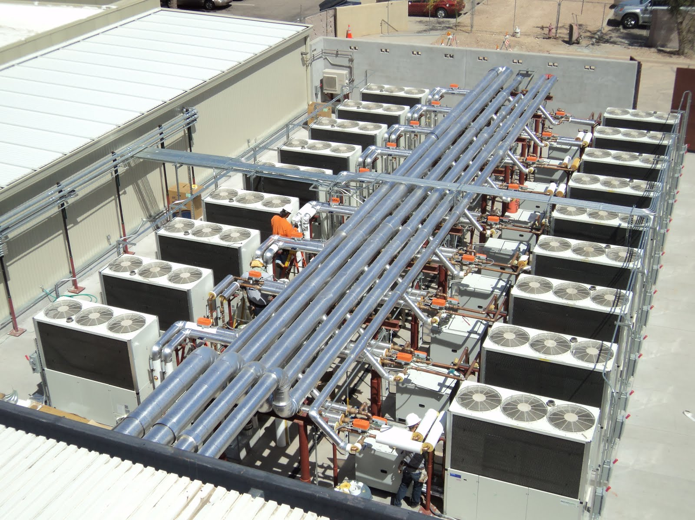
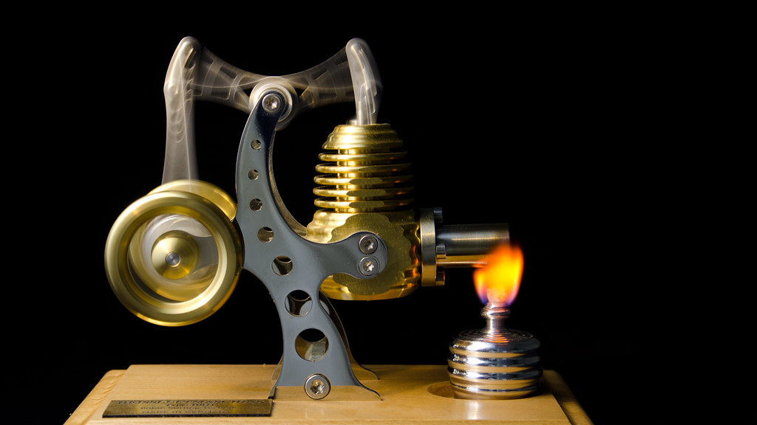
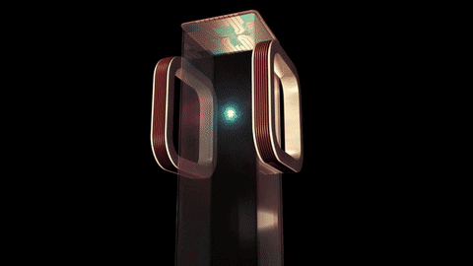
Focus on concepts and Cutting edge engineering Applications

Slide 14
Plan
Kinetic Theory of gases
Thermodynamics
Engineering applications

Slide 15
What is heat?
What is Temperature?

Slide 16
What is heat?
Mechanical energy converted

Slide 17
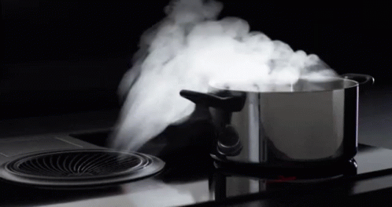

Slide 18
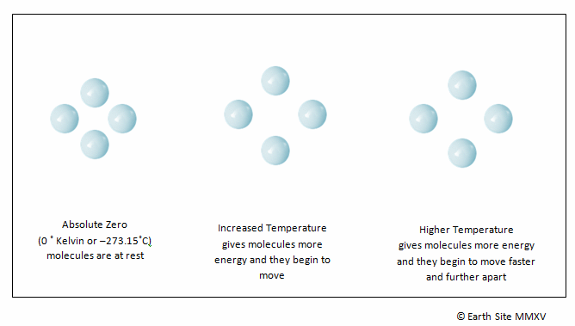

Slide 19
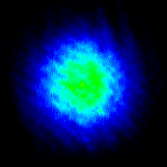
Hotter to colder
Imaging
Of
Atomic gas
Temperature of atomic gas is reduced as a function of time

Slide 20
Will deal with only gases now
What is Temperature?
From Kinetic Theory of gases

Slide 21
Huge number of particles

Slide 22
Necessity of Kinetic Theory and Thermodynamics
What is “Kinetic Theory”?
What is “Thermodynamics”?

Slide 23
Approach of “Kinetic Theory”
Distribution
Gas molecules
Microscopic theory

Slide 24
Approach of “Thermodynamics”
Macroscopic level
Measurable quantities
Extensive and Intensive variables

Slide 25
Equilibrium
Approach of “Kinetic Theory”
Approach of “Thermodynamics”

Slide 26
What is Equilibrium?
“Nothing depends on time”

Slide 27
Equilibrium
Ideal Gas Equation

Slide 28
What is an “Ideal Gas”?
Point particles
Non-interaction
Only Kinetic energy
Only Elastic collisions
Is there an ideal gas in practice?

Slide 29
Ideal gas and Real gas
Classical gas
The Approximation
Quantum gas
Larger T
Lower density

