Slide 1
Highlights of the course
Co-ordinate Systems
Introduction to Vector Operators
Work , Energy and Conservation laws
Rigid body in motion
Oscillations and Waves
Quantum Physics

Slide 2
Chapter-3:Work , Energy and Conservation laws (contd….)

Slide 3
Recap
The change in kinetic energy equals work done on the particle

Slide 4
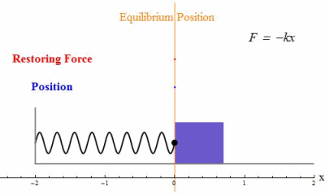
Solving the equation of Simple Harmonic Motion using Work-Energy Theorem
x=0, v=v_{max}
x=x_{0,} v=0
x=x_{1,} v=v₁
Case I
Choose Initial conditions: at t=0, v=0, x=x₀
Case II
Choose Initial conditions: at t=0, V=V_{max}, x=0
Case III
Choose Initial conditions: at t=0, V=V₁ , x=x₁

Slide 5
Solving the equation of Simple Harmonic Motion
x=x₀
Case I
Choose Initial conditions: at t=0, v=0, x=x₀
Integrating again after separating variables

Slide 7
Solving the equation of Simple Harmonic Motion
x₀=0, v=v_{max}
Case II
Choose Initial conditions: at t=0, V=V_{max}, x₀=0
Integrating again after separating variables

Slide 9
Solving the equation of Simple Harmonic Motion
Case III
Choose Initial conditions: at t=0, V=V₁ , x=x₁
x=x_{1,} v=v₁
Integrating again after separating variables

Slide 13
Solving the equation of Simple Harmonic Motion
x=0, v=v_{max}
x=x_{0,} v=0
x=x_{1,} v=v₁
Case I
Choose Initial conditions: at t=0, v=0, x=x₀
Case II
Choose Initial conditions: at t=0, V=V_{max}, x=0
Case III
Choose Initial conditions: at t=0, V=V₁ , x=x₁

Slide 14
Vertical Motion in an inverse square field
What is the minimum value of velocity for escaping the earth?
Apply work energy theorem
At maximum height, v=0

Slide 15
Vertical Motion in an inverse square field
As
Escape velocity is the initial velocity needed to move r_{max} to inifinity

Slide 16
Work Energy Theorem in 3D
Work done on the particle by the total force

Slide 17
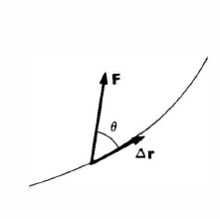
Work Energy Theorem- Physical interpretation
For infinitesimally small displacement
does no work!!
Work done on the particle by the total force
For a finite displacement, the work done on the particle is the sum of the contributions from each segment of the path, in the limit where the size of each segment approaches zero.

Slide 18
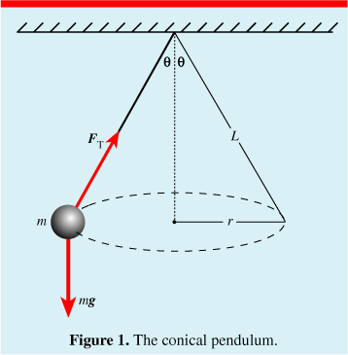
Conical Pendulum
Mass M is fixed to the end of a rod of length l and negligible mass that is pivoted to swing. The mass moves with constant speed in a circular path of constant radius. Find the work done by the string force and weight force.

Slide 19
Conical Pendulum
Since the kinetic energy is constant, the work energy theorem tells that no net work is being done on the mass.
String force and weight force separately do no work.

Slide 20
Work Energy Theorem- Physical interpretation
Work Energy Theorem- is a mathematical consequence of Newton’s second law.
Evaluation of this integral depends on knowing what path the particle actually follows
It needs to know the solution in order to apply the theorem.
Solution
Work-Energy Theorem
Work done on the particle by the total force
Constrained motion
Conservative forces

Slide 21
Conservative Forces
Definition:
The forces whose work integral does not depend on the
particular path but only on the end points are called as
Conservative Forces [Implications will be shown shortly]
Examples are work done by a uniform force, central force etc

Slide 22
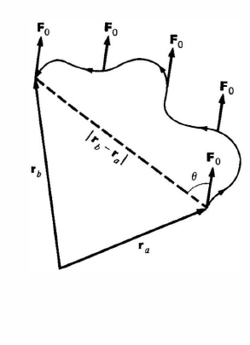
Work done by a uniform Force
For a constant force, work done only depends on the net displacement and not on the path followed.

Slide 23
Work Done by a Central Force
Central force is a radial force which depends only on the distance from the origin
Motion in a plane
It follows that
the work by a central force around a closed path is zero.
Note that work done only depends on initial and final radial distances, and not on the particular path.
Example of path dependent integral in tutorial session

Slide 24
Non- Conservative Force
The forces whose work is different for different paths between the initial and final points.
Example is Friction force
Different paths will offer different friction
(0,1)
(1,1)
D
C
A
B
(0,0)
(1,0)

Slide 25
Concept of Potential Energy
For a conservative force
V(r) is known as potential energy function
This proves that if Force is conservative Total Energy E of the system is independent of
Position of particle.
Position ‘a’ and ‘b’ are arbitrary, hence the above relation is true at any point.

