Slide 1
L23
Problems and solutions: Second Law Statements

Slide 2
Tutorials + Practice problems
Theoretical Concepts understood through Problems
Application “Engineering real life problems and solution”
Focused on Job Perspective
Clear differences between Physics Problems and Engineering Problems

Slide 3
Roll No. | Name | L1 | L2 | L3 | L4 | L5 | l6 | l7 | l8 | l9 | l10 | l11 | l12 | l13 | l14 | l15 | l16 | l17 | l18 | l19
2301PH01 | Aditya Chandra | p | P | p | p | P | p | a | p | a | p | a | p | p | a | p | a | p | p | p | a | p | p
2301PH02 | Aditya Mittal | p | P | a | p | P | p | p | p | a | a | a | p | a | a | p | a | p | p | a | a | p | p
2301PH03 | Aditya Prakash Gupta | p | P | p | p | P | p | p | p | p | a | p | p | a | p | p | a | p | p | a | p | p | a
2301PH04 | Amit Kumar | a | P | p | p | P | p | p | p | p | a | p | a | p | a | p | p | a | p | p | p | p | a
2301PH05 | Angaanba Ningthoujam | p | P | p | p | P | p | p | p | p | p | p | p | p | p | p | a | p | p | a | p | p | p
2301PH06 | Arunvishal Palanisamy | p | P | p | p | P | p | p | p | p | a | p | a | p | p | p | p | p | p | a | p | p | p
2301PH07 | Ashmit Verma | p | P | p | p | P | p | p | p | p | p | p | p | p | p | p | p | p | p | p | p | a | p
2301PH08 | Azariah Peter | a | A | p | p | P | p | p | p | a | p | a | p | p | p | p | a | p | a | a | a | p | p
2301PH09 | Deveshsingh Kuldeepsingh Tomar | p | P | p | p | P | p | c | c | c | c | c | c | c | c | c | c | c | c

Slide 4
 |  | L1 | L2 | L3 | L4 | l5 | l6 | l7 | l8 | l9 | l10 | l11 | l12 | l13 | l14 | l15 | l16 | l17 | l18 | l19
2301PH10 | Muskan Singh | p | P | a | p | P | p | p | p | p | p | p | p | p | p | p | p | p | p | p | p | p | p
2301PH11 | Naveen Saini | a | P | p | p | P | p | p | p | p | a | p | p | p | a | p | p | a | p | p | p | p | p
2301PH12 | Nishanth Kumaran | p | P | p | a | P | p | a | p | p | a | a | p | a | p | p | a | p | a | a | p | a | a
2301PH13 | Nived Krishna M | p | P | p | p | P | p | p | a | a | a | a | p | a | p | p | p | p | p | a | p | p | a
2301PH14 | Ratan Deep Prasad | p | P | p | p | P | p | p | p | a | a | a | p | p | p | p | a | a | p | p | p | p | p
2301PH15 | Ritesh | p | P | p | p | P | p | c | c | c | c | c | c | c | c | c | c | c
2301PH16 | Shivam Kumar Kannojia | p | P | p | p | P | p | p | a | a | p | a | p | p | p | p | a | p | p | a | p | p | p
2301PH17 | Shivang Rayat | p | P | p | p | P | p | p | p | p | p | p | p | a | p | p | a | p | a | a | p | p | a
2301PH18 | Yashraj Singh Thakur | p | P | p | p | P | p | p | a | p | p | p | p | a | p | p | a | p | p | a | p | p | p
2301PH19 | Aekampreet Singh Dhir | p | P | p | p | P | p | p | p | p | p | p | p | a | a | p | p | p | p | a | p | p | a
2301PH20 | Banoth Naveen | a | A | a | a | A | a | a | a | a | p | p | p | p | p | a | a | a | p | a | p | a

Slide 5
 |  | L1 | L2 | L3 | L4 | l5 | l6 | l7 | l8 | l9 | l10 | l11 | l12 | l13 | l14 | l15 | l16 | l17 | l18 | l19
2301PH21 | Neerati Pranay | p | P | p | p | P | p | p | p | a | p | a | p | p | p | p | p | a | p | p | p | p | p
2301PH22 | Tanish Dhankhar | p | P | p | p | P | p | p | p | p | a | a | p | a | a | p | a | p | p | a | p | a | a
2301PH23 | Farhan Farhan | p | P | p | a | P | p | p | p | p | a | p | a | a | p | p | p | p | a | a | p | a | a
2301PH24 | Utpal Raj Ambastha | p | P | p | p | P | p | p | p | p | p | p | p | p | p | p | p | p | p | a | p | a | p
2301PH25 | Riya Singh | p | P | p | p | P | p | p | p | p | p | a | p | p | p | p | p | p | p | a | p | p | p
2301PH26 | Aakarsh Sinha | a | P | p | p | P | p | c | c | c | c | c | c | c | c | c | c
2301PH27 | Rahul Katravath | a | A | p | p | P | p | p | p | p | a | p | p | a | p | p | p | p | p | p | p | p | p
2301PH28 | Shivani | p | P | p | p | P | p | p | p | p | p | p | p | p | p | p | p | p | p | p | p | p | p
2301PH29 | Rakesh Bairwa | p | P | a | p | P | p | p | p | p | a | p | p | p | a | p | p | p | p | p | p | p | p
2301PH30 | Nikhil Pratap Singh | a | P | p | p | P | p | p | p | p | p | p | p | p | p | p | p | p | p | p | p | p | p
2301PH31 | Sridutt Rugada | a | P | p | p | P | p | p | p | p | p | p | p | p | a | p | p | a | p | p | p | p | p
2301PH32 | Anmisha Jadi | p | P | p | p | P | p | p | p | p | p | a | a | p | p | p | p | p | p | p | p | p | p
Attendance: 75% mandatory

Slide 6
Tutorials + Practice problems
Theoretical Concepts understtod through Problems
Application “Engineering real life problems and solution”
Focused on Job Perspective
Clear differences between Physics Problems and Engineering Problems

Slide 7
A
isothermal
Q_{in}
B
P
Q=0
T_{hot}
Q=0
adiabatic
adiabatic
T_{cold}
D
C
Q_{out}
isothermal
V

Slide 8
A
isothermal
Q_{in}
B
P
Q=0
T_{hot}
Q=0
adiabatic
adiabatic
T_{cold}
D
C
Q_{out}
isothermal
V

Slide 9
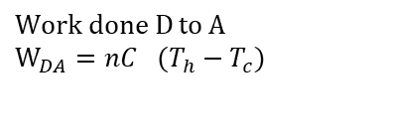
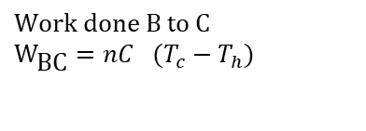
$$\text{Work} \text{done} \text{B} \text{to} \text{C} \\ W_{\text{BC}}=nC_{}(T_{c}−T_{h})$$
A
isothermal
Q_{in}
B
P
Q=0
T_{hot}
Q=0
adiabatic
adiabatic
T_{cold}
D
C
Q_{out}
isothermal
$$\text{Work} \text{done} \text{D} \text{to} \text{A} \\ W_{DA}=nC_{}(T_{h}−T_{c})$$
V

Slide 10
Total Work done
A
isothermal
Q_{in}
B
P
Q=0
T_{hot}
Q=0
adiabatic
adiabatic
T_{cold}
D
C
Q_{out}
isothermal
V

Slide 11
Total Work done-simplified form
A
isothermal
Q_{in}
B
P
Q=0
T_{hot}
Q=0
adiabatic
adiabatic
T_{cold}
D
C
Q_{out}
isothermal
V

Slide 12
Total Work done-simplified form
A
isothermal
Q_{in}
B
P
Q=0
T_{hot}
Q=0
adiabatic
adiabatic
T_{cold}
D
C
Q_{out}
isothermal
V

Slide 13
Total Work done-simplified form
A
isothermal
Q_{in}
B
P
Q=0
T_{hot}
Q=0
adiabatic
adiabatic
T_{cold}
D
C
Q_{out}
isothermal
V

Slide 14
Efficiency
A
isothermal
Q_{in}
B
P
Q=0
T_{hot}
Q=0
adiabatic
adiabatic
T_{cold}
D
C
Q_{out}
isothermal
V

Slide 15
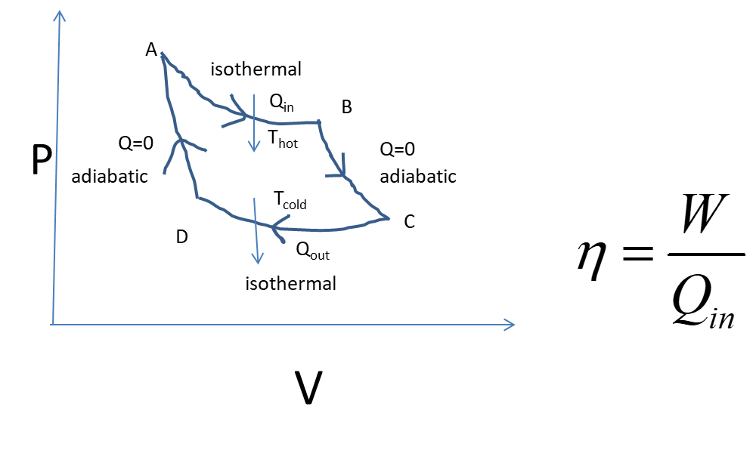

Slide 16
Second Law of Thermodynamics
Revision

Slide 17
Kelvin-Planck’s statement
Kelvin’s statement of the second law of thermodynamics: ‘No process is possible whose sole result is the complete conversion of heat into work.’
Heat
Work

Slide 18
Engine
We define an engine as a system operating a cyclic process that converts heat into work. It has to be cyclic so that it can be continuously operated, producing a steady power.
One such engine is the Carnot engine, which is based upon a process called a
Carnot cycle

Slide 20


Slide 21
Kelvin’s statement
Kelvin’s statement of the second law of thermodynamics: ‘It is impossible to construct an
Engine that operating in a cycle, will produce no effect other than the extraction of heat from a reservoir and the performance of an equivalent amount of work.’

Slide 22
Clausius statement
Clausius’ statement of the second law of thermodynamics: ‘No process is possible whose sole result is the transfer of heat from a colder to a hotter body.’

Slide 24

ASYMMETRY

Slide 25
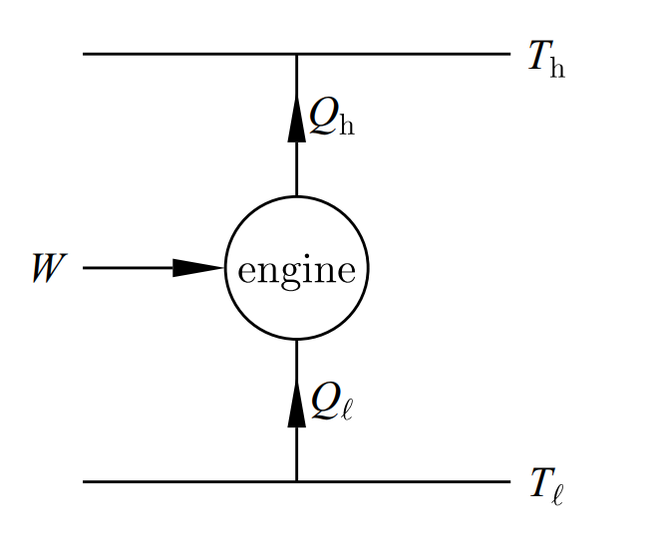

Refrigerator

Slide 26
Clausius statement
Clausius statement of the second law of thermodynamics: ‘It is impossible to construct a refrigerator that, operating in cycle, will produce no effect other than the transfer of heat from a lower-temperature reservoir to a higher temperature reservoir.’

Slide 27
Equivalence of Kelvin-Planck’s and Clausius statements

Slide 28
Kelvin-Planck’s statement of the second law of thermodynamics: ‘No process is possible whose sole result is the complete conversion of heat into work.’
Clausius’ statement of the second law of thermodynamics: ‘No process is possible whose sole result is the transfer of heat from a colder to a hotter body.’

Slide 29

If Kelvin’s statement is violated, what happens?
R

Slide 30

R
R

Slide 31
R
R

Slide 32
R
R
Violating
Kelvin’s
Violated
Clausius

Slide 33
Violating Kelvin’s Statement Violated Clausius Statement
Let us check the reverse

Slide 34
Violating
Clausius

Slide 35
R
E
W
W
Violating
Clausius
Violated
Kelvin

Slide 36
Violating Clausius Statement Violated Kelvin’s Statement

Slide 37
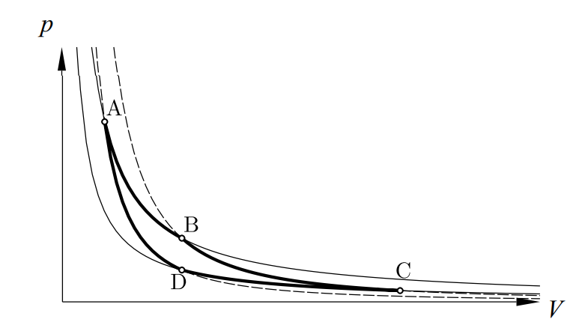
Re-visit Carnot Cycle

Slide 38
Carnot Efficiency

Slide 39
Definition of Entropy from Carnot Cycle

Slide 40
Let us re-visit Tutorial, Problem

Slide 41
Carnot Cycle
A
isothermal
Q_{in}
B
P
Q=0
T_{hot}
Q=0
adiabatic
adiabatic
T_{cold}
C
D
Q_{out}
isothermal
V

Slide 42
A
isothermal
Q_{in}
B
P
Q=0
T_{hot}
Q=0
adiabatic
adiabatic
T_{cold}
C
D
Q_{out}
isothermal
V

Slide 43
A
isothermal
Q_{in}
B
P
Q=0
T_{hot}
Q=0
adiabatic
adiabatic
T_{cold}
C
D
Q_{out}
isothermal
V

Slide 44
A
isothermal
Q_{in}
B
P
Q=0
T_{hot}
Q=0
adiabatic
adiabatic
T_{cold}
C
D
Q_{out}
isothermal
V

Slide 45
Definition of Entropy
For a Cyclic Process
State function

Slide 46
Tutorial 5
Second Law

Slide 47
Convert P-V diagram of Carnot Cycle to T-S diagram also calculate efficiency using T-S diagram
1
isothermal
2
Q_{in}
1
2
T
P
Q=0
T_{hot}
Q=0
adiabatic
adiabatic
T_{cold}
4
3
Q_{out}
isothermal
4
3
S
V

Slide 48
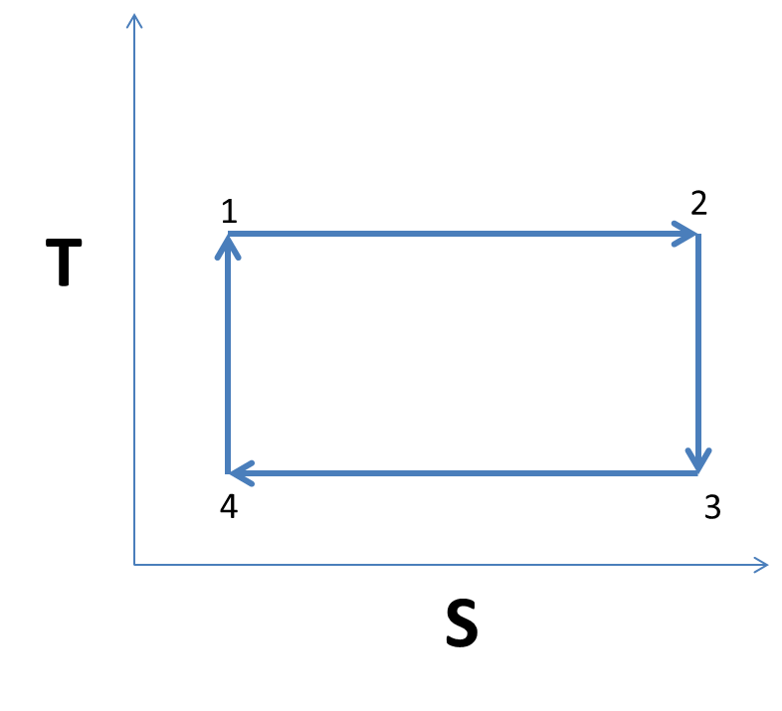

Slide 49
1 to 2 to 3 to 4 to 1
3
P
adiabatic
2
4
adiabatic
1
V

Slide 50
1 to 2 to 3 to 4 to 1
3
P
adiabatic
2
4
adiabatic
1
V
T
2
1 to 2
1
S

Slide 51
1 to 2 to 3 to 4 to 1
3
P
adiabatic
2
4
adiabatic
1
V
3
2 to 3
2
T
1
S

Slide 52
1 to 2 to 3 to 4 to 1
3
P
adiabatic
2
4
adiabatic
1
V
3
3 to 4
T
2
4
1
S

Slide 53
1 to 2 to 3 to 4 to 1
3
P
adiabatic
2
4
adiabatic
1
V
3
3 to 4
T
2
4
1
Using
S

Slide 54
1 to 2 to 3 to 4 to 1
3
P
adiabatic
2
4
adiabatic
1
V
3
3 to 4
T
2
4
1
S

Slide 55
1 to 2 to 3 to 4 to 1
3
P
adiabatic
2
4
adiabatic
1
V
3
3 to 4
T
2
4
1
S

Slide 56
1 to 2 to 3 to 4 to 1
3
P
adiabatic
2
4
adiabatic
1
V
3
3 to 4
T
2
4
1
S

Slide 57
1 to 2 to 3 to 4 to 1
3
P
adiabatic
2
4
adiabatic
1
V
3
4 to 1
T
2
4
1
S

Slide 58
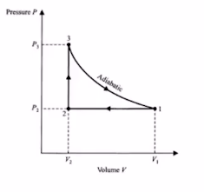
3
3
P₃
P
Adiabatic
P₂
1
2
V₂
V
V₁

Slide 59
3
3
P₃
P
Adiabatic
P₂
1
2
V₂
V
V₁

Slide 60
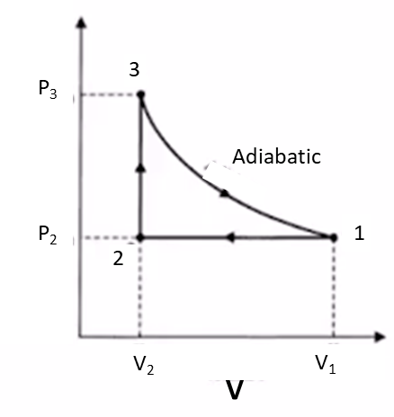
1 to 2
2 to 3

Slide 61
3 to 1
Adiabatic
Also

Slide 62
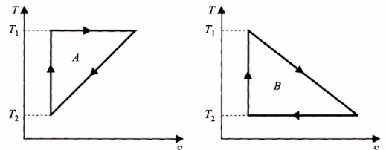
S

Slide 63
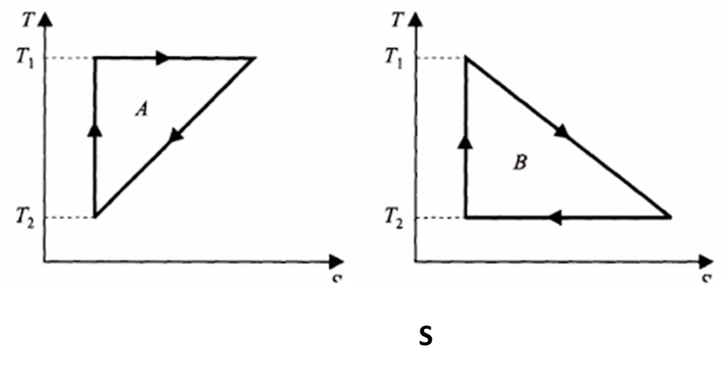
Isothermal expansion
3
2
Adiabatic
1
S1
S2

Slide 64

S1
S2

Slide 65
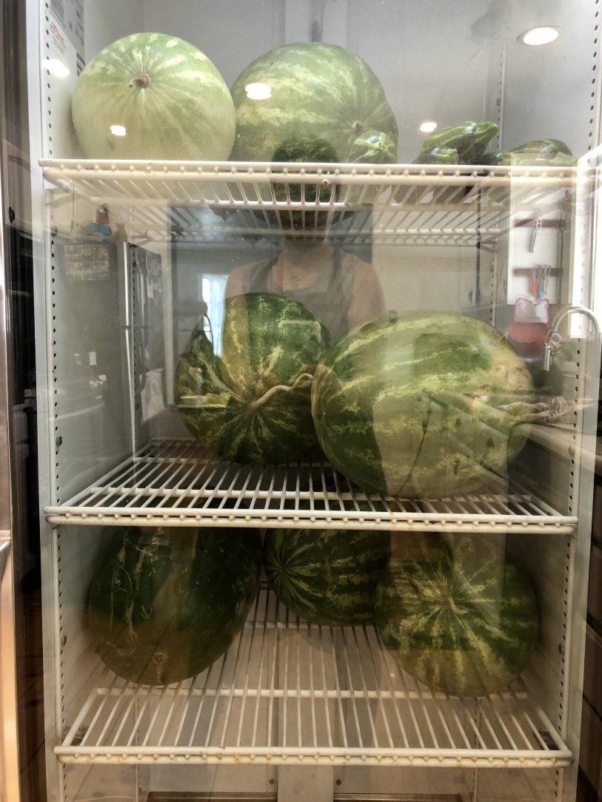
“Cooling Watermelons”

Slide 66
COP=2.5
500 W

Slide 67
COP=2.5
500 W

Slide 68
1000K
A
Air
20 Kg
E
W
Air
10 Kg
B
300 K

Slide 69
TA=1000K
A
Air
20 Kg
QA
E
W
QB
Air
10 Kg
B
TB=300 K

Slide 70
TA=1000K
A
Air
20 Kg
QA
E
W
QB
Air
10 Kg
B
TB=300 K

Slide 71
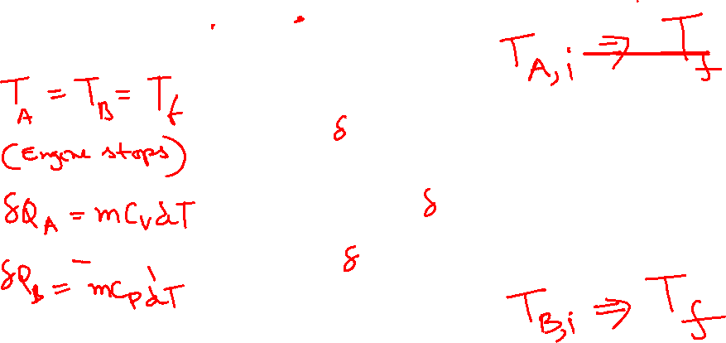
TA=1000K
A
Air
20 Kg
QA
E
W
QB
Air
10 Kg
B
TB=300 K

Slide 72
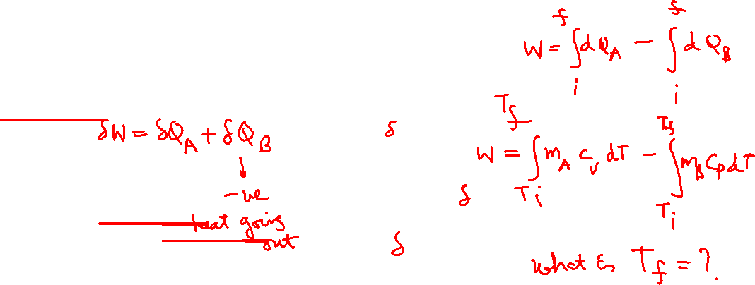
TA=1000K
A
Air
20 Kg
QA
E
W
QB
Air
10 Kg
B
TB=300 K

Slide 73
TA=1000K
A
Air
20 Kg
QA
E
W
QB
Air
10 Kg
B
Integrating on both sides
TB=300 K

Slide 74
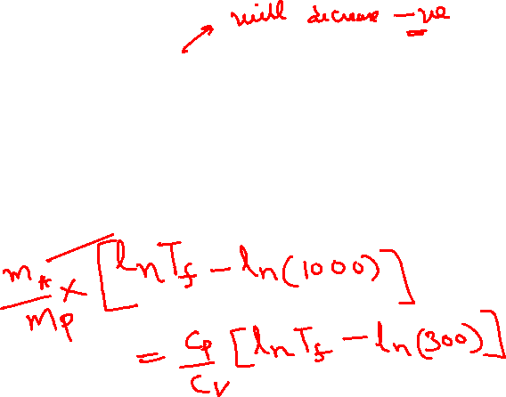
TA=1000K
A
Air
20 Kg
Integrating on both sides
QA
E
W
QB
Air
10 Kg
B
TB=300 K

Slide 75
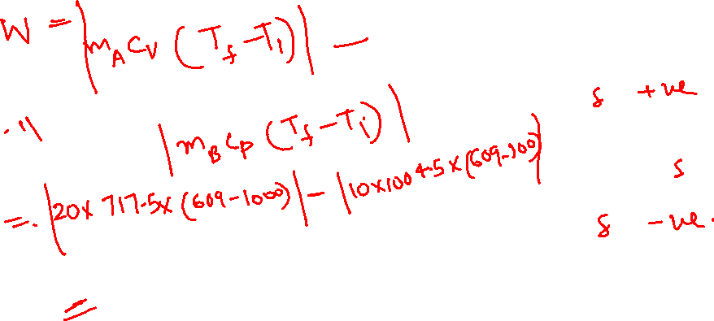
TA=1000K
A
Air
20 Kg
QA
E
W
QB
Air
10 Kg
B
TB=300 K

Slide 76
Solution

Slide 77
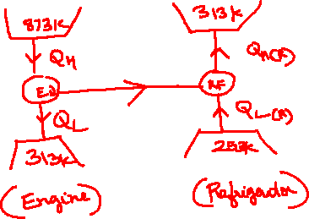

Slide 78
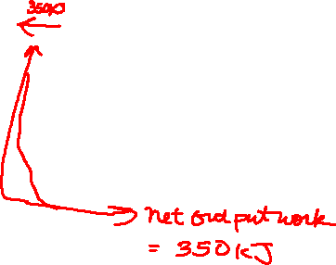
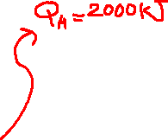


Slide 79

1 MARKS

Slide 80
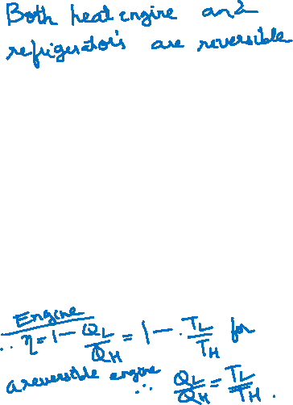

Slide 81
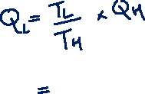

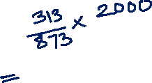
1 MARKS

Slide 82

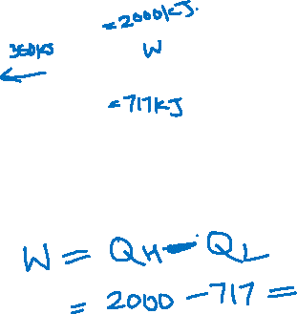

Slide 83
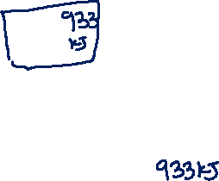
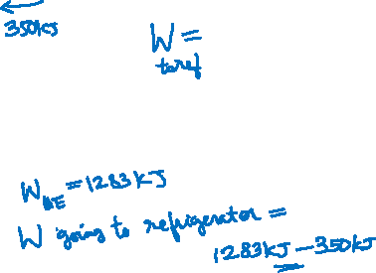
1 MARKS

Slide 84
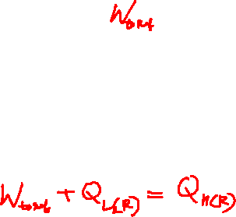
1 MARKS

Slide 85

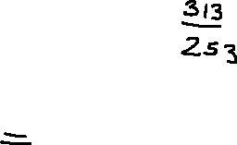

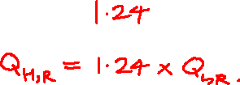

Slide 86

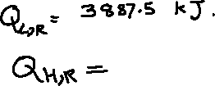


1 MARKS

