Slide 1
PH603 Physics of Ultra-cold Atoms
ULTRA COLD ATOMIC ALKALI GAS
LEVEL 6: ADVANCED AS WELL AS VERY FUNDMENTAL
Dr Raghavan K Easwaran
Faculty, Department of Physics
IIT P
Season 3, Lecture 1 (S3,L1)

Slide 2
SI | Roll Number | Name | P/A
1 | 2221PH23 | SONALI JANA
2 | 2112PH03 | ANUJ GUPTA
3 | 2112PH15 | NAYAN BISWAS
4 | 2112PH16 | NILESH TIWARI
5 | 2112PH17 | PEEYUSH SHARMA
6 | 2112PH19 | PRERNA JOSHI
7 | 2112PH23 | SOUNAK DUTTA
8 | 2112PH29 | VENU GOSWAMI

Slide 3
Plan for Today
Introduction
Syllabus
References and how to study?

Slide 4
Syllabus
Emphasis on Fundamentals of atoms and light,
Quantum Nature of atoms, Classical to Quantum nature of atoms……
Introduction to Utracold atoms,
Alkali metal gases,
Introduction to laser cooling,
Velocity dependent force,
Optical Molasses,
Magneto optical trapping (MOT),
Limitations of MOT, Different types of trapping,
Magnetic and optical trapping,
Evaporative cooling techniques in magnetic and optical trap,
Achieving Bose-Einstein Condensates in pure magnetic and optical traps, Hybrid trapping potentials; Various applications in experiments.

Slide 5
Pre- Mid-Sem
Bose-Einstein condensate (BEC), Critical temperature Basic Scattering theory; Second quantization, Mean field theory, Gross-Pitaevskii equation; 1D nonlinear Schrödinger equation; weak, strong and higher order interactions; BEC in a trap, trap engineering and condensate density; Bright & dark Solitons, exact solution; Applications & future technologies: BEC optical lattices; Faraday waves, phase transition, BEC in a chip, atomic beam splitter, atom lasers, Negative temperature etc.

Slide 6
Text Books/ References
First Pref: Class lecture notes/ Materials provided
Second Pref:
Textbooks:
C. J. Pethick & H. Smith, Bose-Einstein Condensation in Dilute Gases, Cambridge Univ. Press, Cambridge , 2008.
A. Griffin, D. W. Snoke & S. Stringari, Bose-Einstein Condensation, Cambridge Univ. Press, Cambridge, 1995.
Robert W. Boyd, Nonlinear Optics, Second edition, Academic press, 2003.
References
Scully, M. O., and M. S. Zubairy. Quantum Optics. Cambridge University Press, 1997.
Harold J. Metcalf, Peter van der Straten, Laser Cooling and Trapping, Springer, 1999.
Lambropoulos. P, Petrosyan. D, Fundamentals of Quantum Optics and Quantum Information, Springer 2007.
M. Lewenstein, A. Sanpera, and V. Ahufinger, Ultracold Atoms in Optical Lattices, Oxford University Press, 2012.

Slide 7
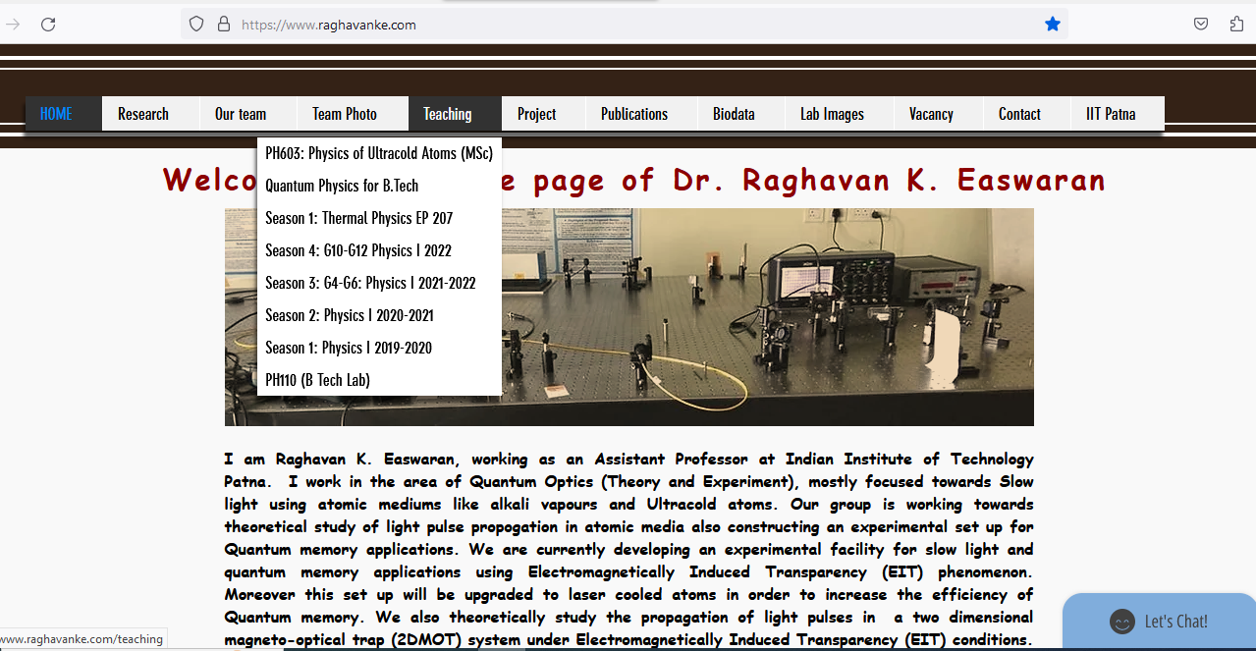
Course Webpage: https://www.raghavanke.com/

Slide 8
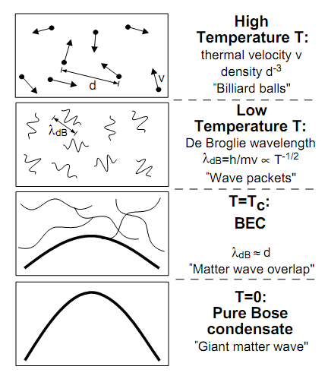
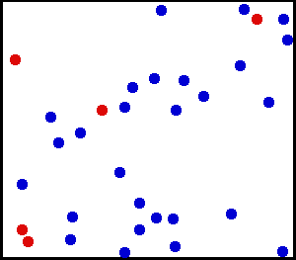
How Cold is Ultra Cold?
Kelvin
Celsius
300
26.8
Room Temperature
Water freezes
250
-23.2
200
-73.2
150
-123.2
100
-173.2
Air liquefies
50
-223.2
≈ 3K Deep space
0
-273.2
Absolute Zero
All motion stops
New state of Matter: Bose –Einstein Condensate
W.Ketterle, Cornell, C.Weimann, MIT
NOBEL PRIZE 2001
Laser Cooling and Evaporative cooling Technique

Slide 9
Ultracold atoms
Quantum Behaviour of Light
Quantum matter
Quantum gas

