Slide 1
Plan for the week
Finite number (N) of oscillators connected together (Normal modes and normal co-ordinates)
Case of N→∞ (Transverse and Longitudinal cases)
Propagation of disturbance (Wave equation)

Slide 2
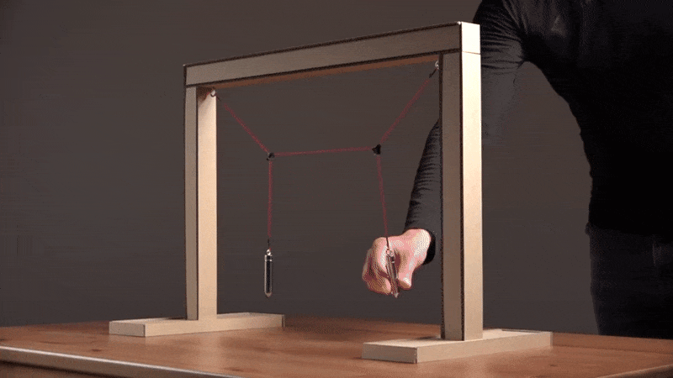
Coupled Oscillations

Slide 3
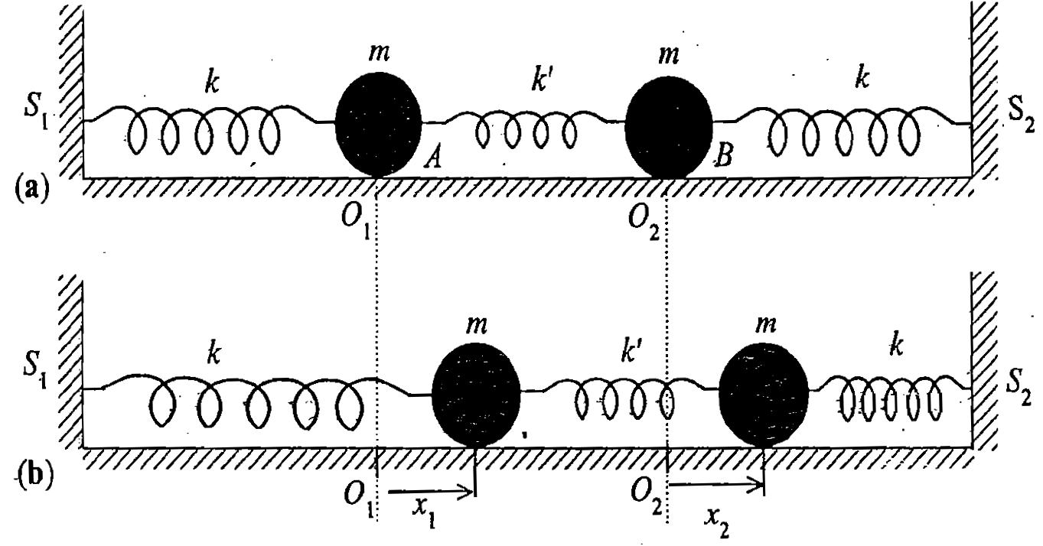
Coupled Oscillators
NON-INTITUTIVE!

Slide 4
Coupled Oscillators
Equations of motion are
Simultaneous coupled differential equation

Slide 5
Matrix equation of coupled oscillator

Slide 7
Following the procedure of getting Eigen values and Eigen vectors

Slide 8
Finding the energy eigen values λ of [A]

Slide 9
Finding Eigen values of [A]

Slide 10
Characteristic equation:
Eigen values of [A]

Slide 11
Find the eigen vectors of [A]

Slide 12
Finding Eigen vectors of [A]
Substitute each values of α² in the Eigen value equation
Putting α₁² in the Eigen value equation to get first set of
Eigen vectors

Slide 13
Substituting

Slide 14
Substituting

Slide 15
Finding Eigen vectors of [A]
Substitute each values of α₃² in the Eigen value equation
Putting α₃² =-(ω₀²+2ω_{c}² ) in the Eigen value equation

Slide 16
Substituting

