Slide 1
Highlights of the course
Co-ordinate Systems
Introduction to Vector Operators
Work , Energy and Conservation laws
Rigid body in motion
Oscillations and Waves
Quantum Physics

Slide 2
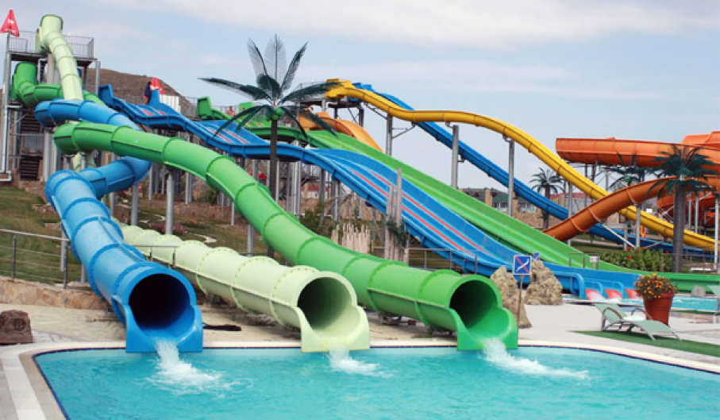
Chapter-3:Work , Energy and Conservation laws (contd….)

Slide 3
Work Energy Theorem- Physical interpretation
Work Energy Theorem- is a mathematical consequence of Newton’s second law.
Evaluation of this integral depends on knowing what path the particle actually follows
It needs to know the solution in order to apply the theorem.
Solution
Work-Energy Theorem
Work done on the particle by the total force
Constrained motion
Conservative forces

Slide 4
Conservative Forces
Definition:
The forces whose work integral does not depend on the
particular path but only on the end points are called as
Conservative Forces [Implications will be shown shortly]
Examples are work done by a uniform force, central force etc

Slide 5
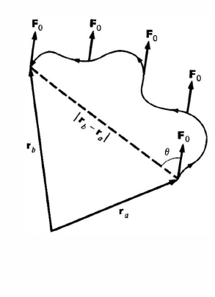
Work done by a uniform Force
For a constant force, work done only depends on the net displacement and not on the path followed.

Slide 6
Work Done by a Central Force
Central force is a radial force which depends only on the distance from the origin
Motion in a plane
It follows that
the work by a central force around a closed path is zero.
Note that work done only depends on initial and final radial distances, and not on the particular path.

Slide 7
Non- Conservative Force
The forces whose work is different for different paths between the initial and final points.
Example is Friction force
Different paths will offer different friction
(0,1)
(1,1)
D
C
A
B
(0,0)
(1,0)

Slide 8
Concept of Potential Energy
For a conservative force
V(r) is known as potential energy function
This proves that if Force is conservative Total Energy E of the system is independent of
Position of particle.
Position ‘a’ and ‘b’ are arbitrary, hence the above relation is true at any point.

Slide 9
Necessary conditions for Conservative Force
Curl of F is zero?
If V(r) is path independent,
Alternatively,
Curl of F is

Slide 10
Necessary conditions for Conservative Force
Curl of F is zero?
Curl of F is

Slide 11
Examples
Find potential energy of Spring Force
Since the central force is conservative,
r
r₀
Choosing potential energy to be zero at equilibrium,,

Slide 12
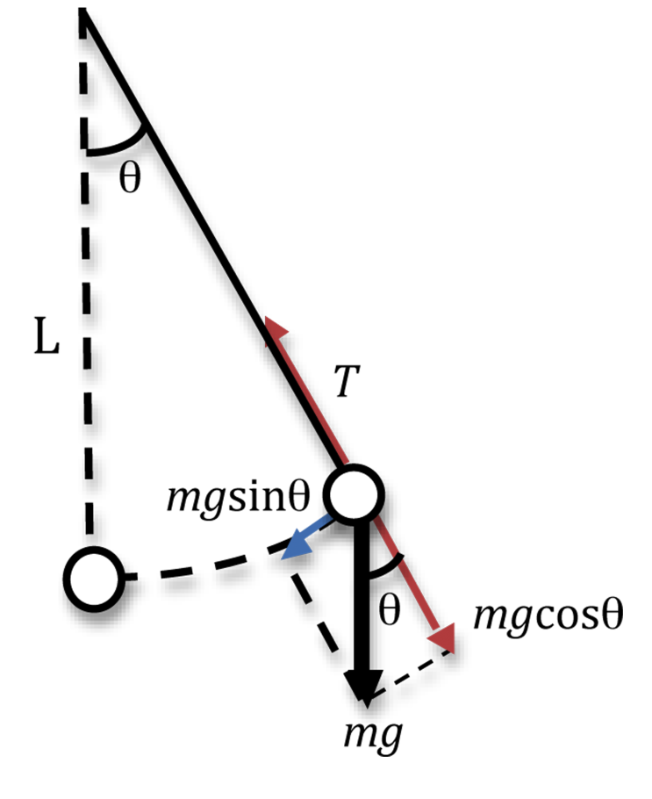
Examples
Find potential energy of Simple pendulum
Since the central force is conservative,
Choosing potential energy to be zero at equilibrium,,

Slide 13
Examples
Central force is conservative by showing that curl F=0

Slide 15
Examples
Central force is conservative by showing that curl F=0

Slide 16
Examples
Central force is conservative by showing that curl F=0

Slide 17
Examples
Central force is conservative by showing that curl F=0

Slide 18
Likewise for the x and y components

