Slide 1
Experiment Sequence (MOT)

Slide 2
Doppler
Cooling
MOT
Laser
Power
ω₀-kv_{d}
Laser
frequency
ω₀ - ω_{zeeman} + kv
Magnetic
field

Slide 3
Cooling phases
Doppler
Cooling
Milli Kelvin to Micro Kelvin range
MOT
Atomic is density
Increased
Temperature decreased
Magnetic Trapping
Need
Multi-Level
Treatment.
2 level model fails…
Quantum nature of atoms observed
Evaporative Cooling

Slide 4
Force equation in a MOT

Slide 5
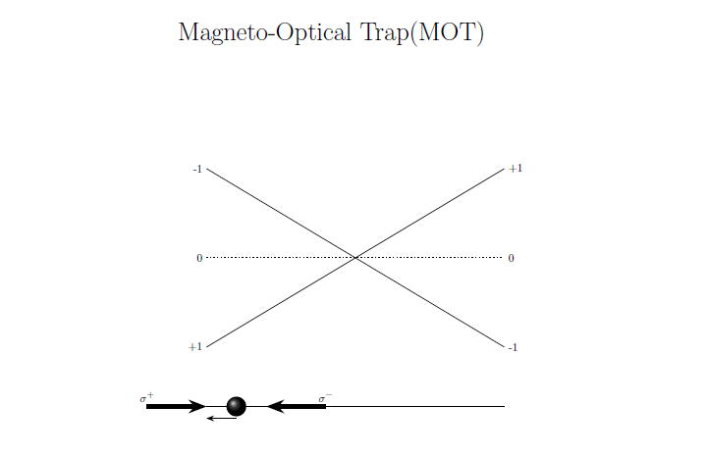
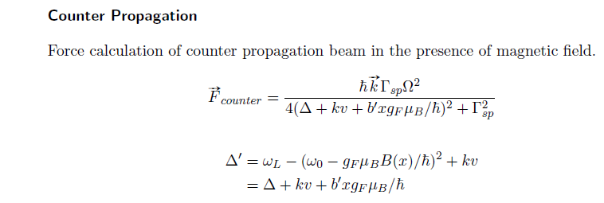

Slide 6
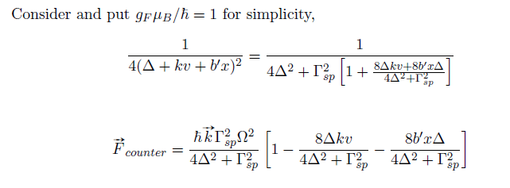
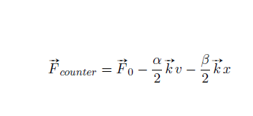

Slide 7
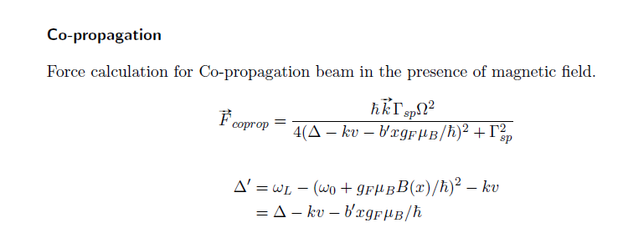
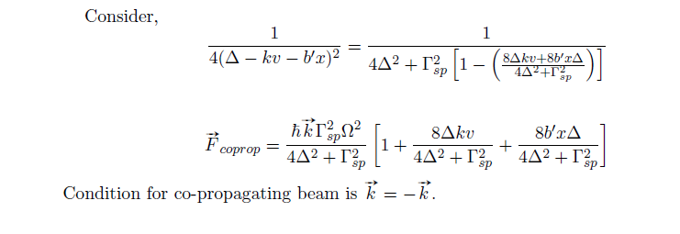

Slide 9
Multi-Level atom – A case study on Rb

Slide 10
Rb
Two ISOTOPES 85 AND 87
Mass number = 85
Mass number = no of protons +no of nuetrons
37 protons + 48 nuetrons = 85
Mass number = 87
Mass number = no of protons +no of nuetrons
37 protons + 50 nuetrons = 87
Number of electrons = 37
[…………………] 5S¹

Slide 11
Is it a Bosonic Atom or Fermionic Atom?

Slide 12
Atomic Spin of Rb⁸⁵
= [Proton spin + Neutron spin + Electron spin]X$\frac{1}{2}$
=[37(odd) + 48(even)+37(odd)] X$\frac{1}{2}$
= Even number, Hence Boson……
What about Rb⁸⁷?

Slide 13
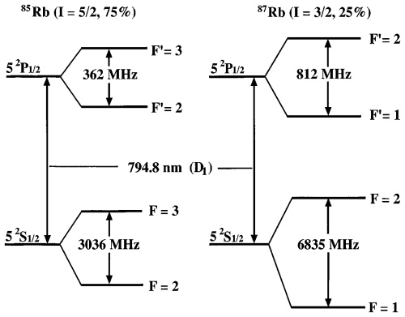
Hyperfine splitting

Slide 14
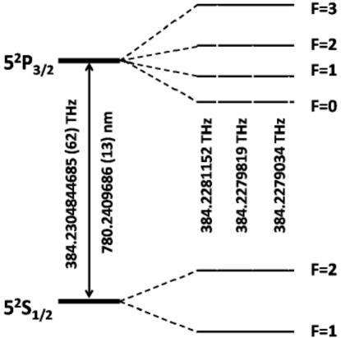
Hyperfine splitting

Slide 15
Laser Cooling in Rb87
Cooling
repump

Slide 16
MOT for Rb

Slide 17
MOT
-B Location
-2
+2
For emission
ΔmF = 0, +/-1
ΔF=0, +/-1
Repump,
Π POLARIZED
+2
+1
mF
σ+Light, ΔmF = +1
-1
+1

Slide 18
MOT
+B
VICE VERSA

Slide 19
MAGNETIC TRAPPING
A conservative Trap/ Potential for laser cooled atoms
No Laser Cooling Lights, they are off

Slide 20
Doppler
Cooling
MOT
Laser
Power
ω₀-kv_{d}
Laser
Frequency
Cooling+
Repump
ω₀ - ω_{zeeman} + kv
Magnetic
field

Slide 21
Rb
Two ISOTOPES 85 AND 87
Mass number = 85
Mass number = no of protons +no of nuetrons
37 protons + 48 nuetrons = 85
Mass number = 87
Mass number = no of protons +no of nuetrons
37 protons + 50 nuetrons = 87
Number of electrons = 37
[…………………] 5S¹

Slide 22
Is it a Bosonic Atom or Fermionic Atom?

Slide 23
Atomic Spin of Rb⁸⁵
= [Proton spin + Neutron spin + Electron spin]X$\frac{1}{2}$
=[37(odd) + 48(even)+37(odd)] X$\frac{1}{2}$
= Even number, Hence Boson……
What about Rb⁸⁷?

Slide 24
Hyperfine splitting

Slide 27
Hyperfine splitting

Slide 28
MOT
-B Location
-2
+2
For emission
ΔmF = 0, +/-1
ΔF=0, +/-1
Repump,
Π POLARIZED
+2
+1
mF
σ+Light, ΔmF = +1
-1
+1

Slide 29
MOT
+B
VICE VERSA

Slide 30
Cooling phases
Doppler
Cooling
Milli Kelvin range
MOT
Atomic density
Increased
Cooling is limited
Upto Doppler Temp due to light
Magnetic Trapping
Need
Multi-Level
Treatment.
2 level model fails…
Cooling Beyond Doppler Limit
Quantum nature of atoms observed
Evaporative Cooling

Slide 31
MAGNETIC TRAPPING
A conservative Trap/ Potential for laser cooled atoms
No Laser Cooling Lights, they are off

Slide 32
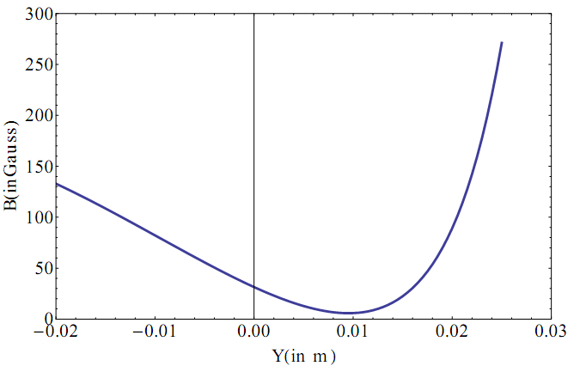
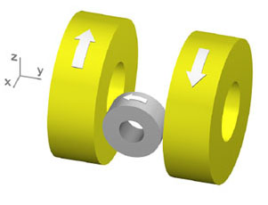
Technique to reach ultra low temperatures
Laser cooling and trapping
MOT
Temperature in a MOT is limited to Doppler Temperature T_{D} ≈ 200 µK
Magnetic trap - Quadrupole Ioffe trap
Z
X
O

Slide 33
MOT Coil
+
Ioffe Coil
Z
X
O

Slide 34
How to use this as a Conservative Trap?
Loading from MOT to Magnetic TRAP

Slide 35
MOT
-B Location
-2
+2
For emission
ΔmF = 0, +/-1
ΔF=0, +/-1
Repump,
Π POLARIZED
+2
+1
mF
σ+Light, ΔmF = +1
-1
+1

Slide 38
MOT to MAGNETIC TRAP
LIGHT FIELD IS OFF
ATOMS REMAIN IN mF = +1 STATE

Slide 39
-B Location
a
-2
+2
Atom has electron in mF = +1 state
+2
+1
mF
-1
+1

Slide 40
What happens in +B location?

Slide 41
MOT
+B Location
+2
-2
For emission
ΔmF = 0, +/-1
ΔF=0, +/-1
Repump,
Π POLARIZED
-2
-1
mF
σ-Light, ΔmF = -1
+1
-1

Slide 42
MOT to MAGNETIC TRAP
LIGHT FIELD IS OFF
ATOMS REMAIN IN mF = -1 STATE

Slide 43
+B Location
a
-2
+2
Atom has electron in mF = -1 state
+2
+1
mF
+1
-1

Slide 44
MAGNETIC TRAP
IMMEDIATELY AS LIGHT GETS OFF MAGNETIC COILS FOR
MAGNETIC TRAP GETS ON
Nearly Harmonic

Slide 45
Doppler
Cooling
MOT
Magnetic
Trap
Laser
Power
Concept of Magneto Optical Trap (MOT) continued
ω₀-kv_{d}
Laser
Frequency
Cooling+
Repump
ω₀ - ω_{zeeman} + kv
MOT COIL
IOFFE
COIL

