Slide 1

EP3206 Laser Physics
Engineering Applications

Slide 2

I
N
S
P
I
R
ED
Q
U
O
T
E
“What counts, I found, is not what you “cover”, in a class, but what you “uncover”
covering subjects in a class can be a boring exercise, and students feel it
uncovering the laws of physics and making them see through the equations, with all its newness and excitement, and students love being part of it.”
― Dr. Walter Lewin, Professor, MIT, USA

Slide 3

PORTIONS TO BE “un-covered”

Slide 4
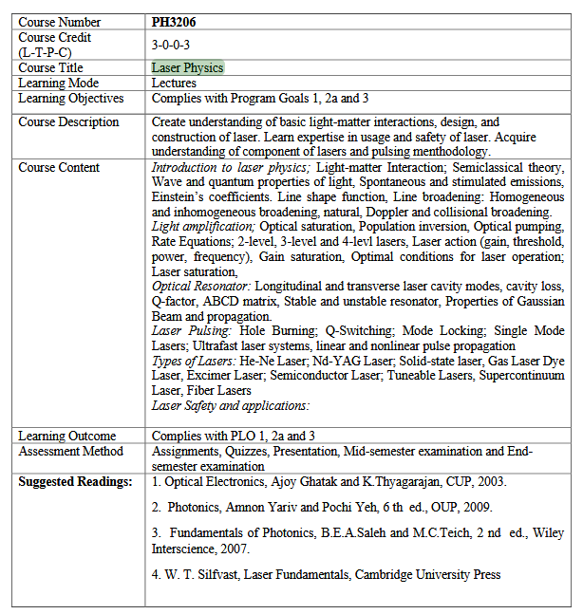

Slide 5
firstname | lastname | roll_no | L1
Rakesh | Bairwa | 2301PH29 |  |  |  | p |  | p |  | p | p | p
Aditya | Chandra | 2301PH01 |  |  | p | p | p | p |  |  | p | p
Anmisha | Jadi | 2301PH32 |  | p | p |  | p | p | p |  | p | p
Rahul | Katravath | 2301PH27 |  |  | p |  |  | p |  | p | p
Amit | Kumar | 2301PH04 |  |  |  | p | p | p | p | p | p
Arunvishal | Palanisamy | 2301PH06 |  | p | p | p |  |  | p |  | p
Neerati | Pranay | 2301PH21 |  | p | p | p | p | p |  | p | p
Nikhil | Pratap Singh | 2301PH30 |  | p | p | p | p | p | p | p | p | p
Utpal | Raj Ambastha | 2301PH24 |  | p | p | p | p | p | p | p | p | p
Naveen | Saini | 2301PH11 |  |  |  | p | p | p |  | p | p
Riya | Singh | 2301PH25 |  | p | p |  | p | p |  | p | p
Banoth Naveen |  |  |  |  |  |  |  |  |  | p | p

Slide 6
LASER: Fundamentals

Slide 7
Basic Concept of LASER using Einstein's Two level model
Spontaneous emission
Stimulated Absorption
Stimulated Emission

Slide 8
Stimulated absorption
E₂
Photon E₂ – E₁ = hf₁₂
E₁

Slide 9
Stimulated emission
E₂
Photon E₂ – E₁ = hf₁₂
Exactly Identical Photons
They have same frequency
And same wave vector K in
space
Coherent photons
E₁

Slide 10
Spontaneous emission
Quantum Theory
Vacuum Fluctuations/Vacuum noise
E₂
Vacuum fluctuations
Photon E₂ – E₁ = hf₁₂
Random wave vector
Frequency = f₁₂
E₁
Triggered by vacuum fluctuations out put photon has random direction
Because input fluctuations has random wave vector

Slide 11
STIMULATED EMISSION
POPULATION INVERSION
Photon E₂ – E₁ = hf₁₂
Many photons

Slide 12
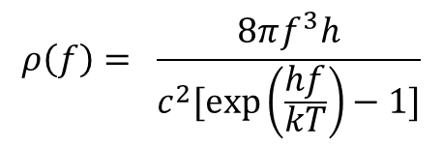

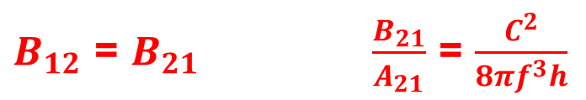

EINSTEIN’S MODEL
Absorption, Spontaneous emission and stimulated emission explained using a simple two level atom Model
Transition probabilities deﬁned as Einstein Coefﬁcients for the three process we introduced.
We wrote the Rate equations for this model
Einstein compared photon flux with Max planck’s Black body radiation formula
Einstein's formula for photon flux density
Max planck’s formula for Black body radiation
$$ρ\left(f\right)= \frac{\frac{A_{21}}{B_{21}}}{\frac{B_{12}N_{1}}{B_{21}N_{2}} −1}$$
$$ρ\left(f\right)= \frac{8πf^{3}h}{c^{2}[\exp\left(\frac{hf}{kT}\right)−1]}$$
Boltzmann distribution was utilized
$\frac{N_{1}}{N_{2}}$ = $\exp\left(\frac{hf}{kT}\right)$
After comparison
$B_{12}$ = $B_{21} \frac{B_{21}}{A_{21}}$ = $\frac{C^{2}}{8πf^{3}h}$

Slide 13
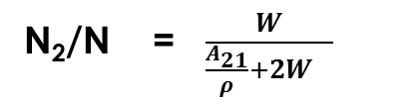
Population inversion not possible in 2 level picture
NATURAL SITUATION
BEST POSSIBLE IS N/2 IN E₁ AND N/2 IN E₂ ( hypothetical situation)
N₂/N = $\frac{W}{{\frac{A_{21}}{ρ}+2W}_{}}$
For ρ tending to infinity , N₂/N = 1/2

Slide 14
Multi-level scheme
OPTICAL PUMPING TECHNIQUE FOR ACHIEVING POPULATION INERSION
3
Very fast decay
NOTE: PUMP LIGHT
NEED NOT BE A LASER
AN INEXPENSIVE FLASH
LAMP WILL WORK
Population Inversion
f₀₃
2
Long life time
Metastable state
f₂₁
f₂₁
Excitation (Pumping)
Stimulus photons
Laser transition
1
0
Very fast decay

Slide 15
Mathematical treatment for photon flux
inside a Gain material
A material with population inversion using optical pumping
4-LEVEL SCHEME
Stimulus photons
f₂₁
f₀₃
f₂₁
Optical Pump
x
???
Photon flux ρ(f₂₁) will grow exponentially
How to make x large?
Origin of stimulus photon?
ρ(f_{21 ,} x) = ρ(f_{21 ,} 0) exp(Gx)

Slide 16
How to make x large?
Path fold by two mirrors
A material with population inversion using optical pumping
4-LEVEL SCHEME
f₀₃
Optical Pump
Laser
M1
M2

Slide 17
2. Origin of stimulus photon?
Spontaneously emitted photon is responsible to trigger stimulated emission
A material with population inversion using optical pumping
4-LEVEL SCHEME
Spontaneously emitted photon will see the population inversion between the
energy levels
Population emission is maintained with the help of Pump Photons
Thanks to the time constants for making population inversions

Slide 18
Spatial Coherence
ETC
Path fold by two mirrors
K2
K1
A material with population inversion using optical pumping
4-LEVEL SCHEME
f₀₃
f₂₁
K
Optical Pump
Laser
M1
M2
Only those photons oscillating perpendicular to the plane of mirrors will be
maintained.
Other photons leave the material

Slide 19
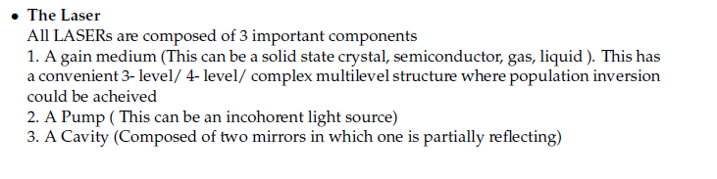
Condition for Sustained Oscillation
Essential components of LASER
A material with population inversion using optical pumping
4-LEVEL SCHEME
f₀₃
f₂₁

Slide 20
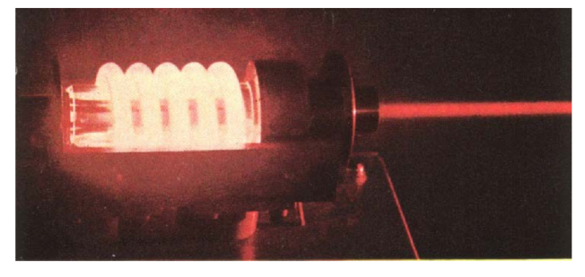
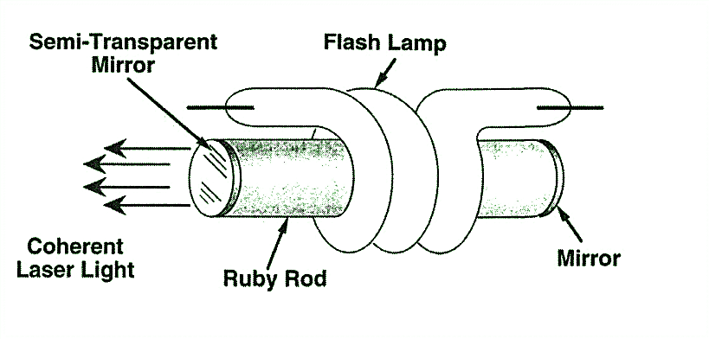

Solid State Lasers
1. Ruby Laser
First LASER: Ted Maiman (Hughes Research Labs, May 17, 1960)
Operates at 694.3 nm
Ruby rod : Sapphire crystal (Al₂O₃) with Cr³⁺doped
Optical Resonator + Gain Medium + Pump
Mirrors
Ruby rod
Xenon Flash Lamp
Operating with 3 Level Energy System

Slide 21
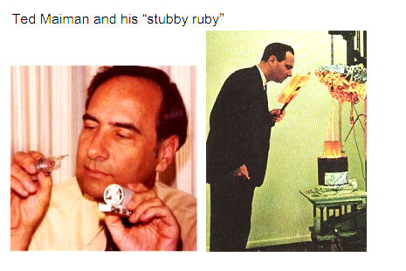
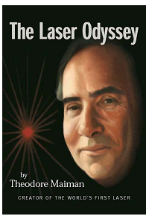
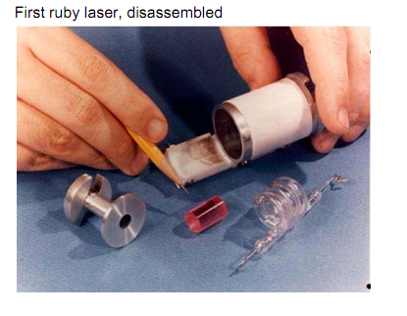
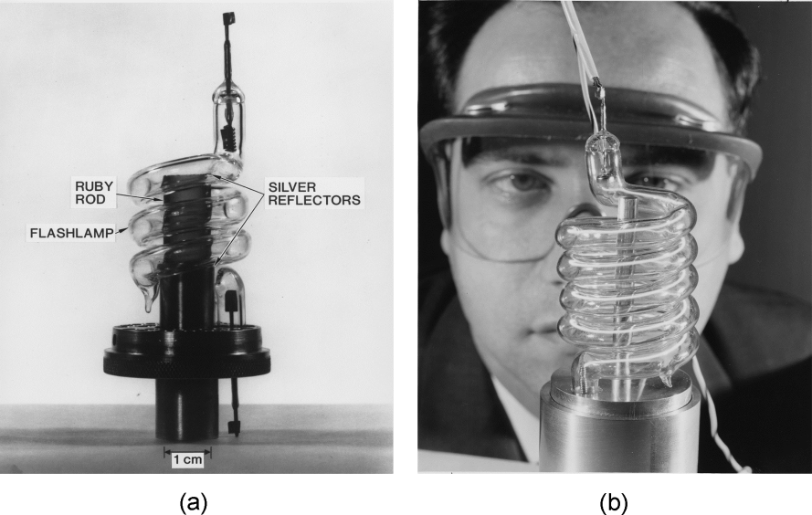
Some old pics…..

Slide 22
Basic Components
The ruby crystal is in the form of cylinder. Length of ruby crystal is usually 2 cm to 30 cm and diameter 0.5 cm to 2 cm. As very high temperature is produced during the operation of the laser, the rod is surrounded by liquid nitrogen to cool the apparatus.
Active medium or active center: Chromium ions act as active centers in ruby crystal. So it is the chromium ions that produce the laser.
Pumping source: A helical flash lamp filled with xenon is used as a pumping source. The ruby crystal is placed inside a xenon flash lamp. Thus, optical pumping is used to achieve population inversion in ruby laser.
Optical resonator system: The ends of ruby crystal are polished, grounded and made flat. The one of the ends is completely silvered while the other one is partially silvered to get the output. Thus the two polished ends act as optical resonator system.

Slide 23
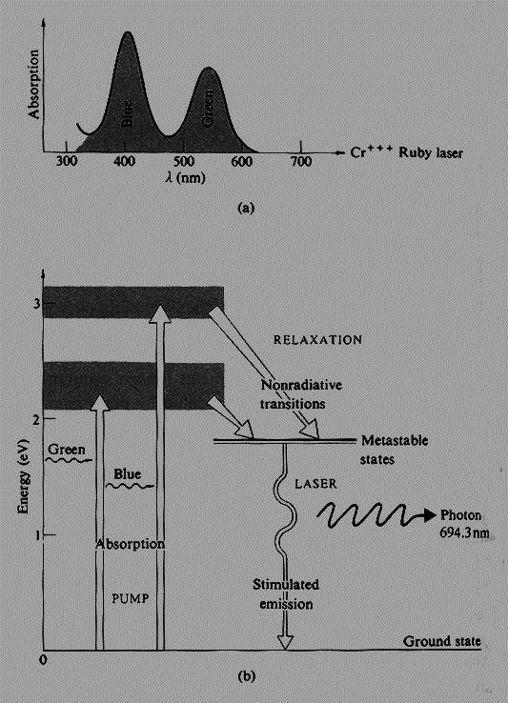
Energy Level Diagram

Slide 24
Typical Ruby Laser Parameters
Laser wavelength
Upper laser level lifetime
gain bandwidth
Laser gain-medium length (L)
Operating temperature
Thermal conductivity of laser rod
Pumping method
Pumping bands
Output power
694.3 nm
3.0 ms
0.53 nm
0.1m
Room temperature
42 W/m-K at 300 K
Flash lamp
404 nm and 554 nm
up to 100 J/pulse

Slide 25
Ruby Lasers
Drawbacks of ruby laser
As the terminus of laser action is the ground state, it is difficult to maintain the population
inversion. This fact results in ruby laser’s low efficiency
The ruby laser requires high power pumping source.
The laser output is not continuous but occurs in the form of pulses of microsecond
duration.
The defects due to crystalline imperfection are also present in ruby laser.
Uses of ruby laser
Ruby laser has very high output power of the order of 10⁴ Watts. It has wavelength
of 6943 Angstroms.
Ruby lasers are used for holography, industrial cutting and welding.

Slide 26
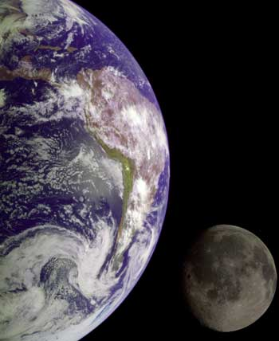
Historical Importance of Ruby Laser
First Lunar Laser Ranging Experiment [Light Detection And Ranging (LIDAR)]
Lunar Laser Ranging Experiment measures the distance between the Earth and the Moon using laser ranging.
A pulsed ruby laser was used for the famous laser ranging experiment which was conducted with a corner reflector placed on the Moon by the Apollo astronauts. This determined the distance to the Moon with an accuracy of about 15 cm

Slide 27
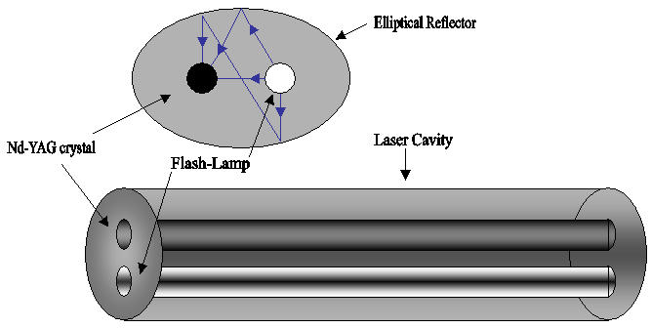
Nd YAG Laser
The host medium for this laser is Yttrium Aluminium Garnet (YAG = Y₃Al₅O₁₂) with 1.5% trivalent neodymium ions (Nd³⁺) present as impurities
The (Nd³⁺) ions occupy the lattice sites of yttrium ions as substitution impurities and provide the energy levels for both pumping and lasing transitions
Side view
Reflector
Nd YAG Crystal
Flash Lamp (Krypton)
Operates at 1064 nm
First demonstrated at Bell Labs , 1964, USA

Slide 28
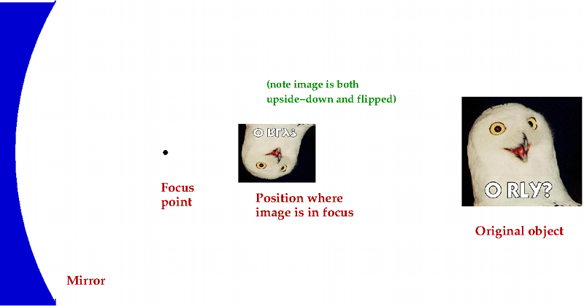
Nd YAG Basic Components
Nd YAG Crystal
Flash Lamp
Power Supply

Slide 29
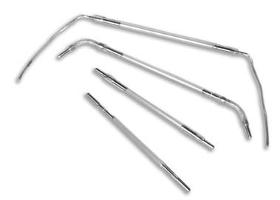
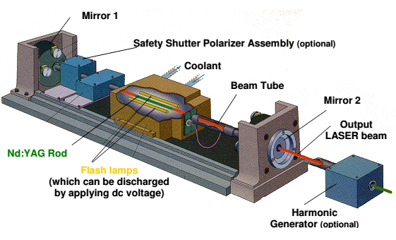
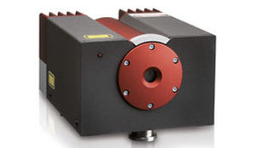
Nd YAG Schematic
Krypton Flash Lamp
A commercial Nd YAG

Slide 30
Energy Levels
Pumping bands
Non radiative decay
1064 nm
Excitation (Pumping)
730–760 nm and
790–820 nm
Laser transition
Non radiative decay

Slide 31
Typical Nd YAG Laser Parameters
Laser wavelength
Upper laser level lifetime
gain bandwidth
Laser gain-medium length (L)
Operating temperature
Thermal conductivity of laser rod
Pumping method
Pumping bands
Output power
1064 nm
0.23 ms
0.45 nm
0.1 to 0.15 m
Room temperature
14 W/m-K at 300 K
Flash lamp
730–760 nm and 790–820 nm
up to KW at CW operation and in MW at pulsed operation

Slide 32
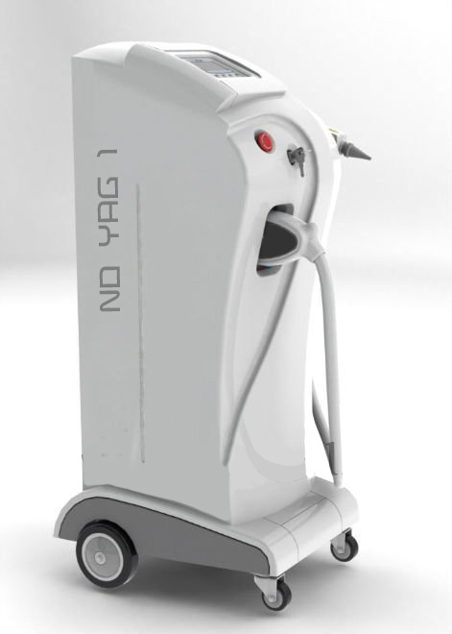
Wide Applications of Nd YAG Lasers
Physics and Engineering: NEW AREA developed due to High Powers
NON LINEAR OPTICS: We will discuss this important research area
Medicine: Ophthalmology, Oncology (In oncology, Nd:YAG
lasers can be used to remove skin cancers)
Cosmetic medicine
These lasers are also used extensively in the field of cosmetic
medicine for laser hair removal and the treatment of minor vascular
defects such as spider veins on the face and legs
Manufacturing
Nd:YAG lasers are extensively used in manufacturing for cutting
and welding steel and various alloys.
Fluid dynamics
Dentistry
Nd:YAG lasers are used for soft tissue surgeries in the oral cavity
Laser range finders
The Nd:YAG laser is the most common laser used in military laser rangefinders

