Slide 1
Oscillations to Waves

Slide 2
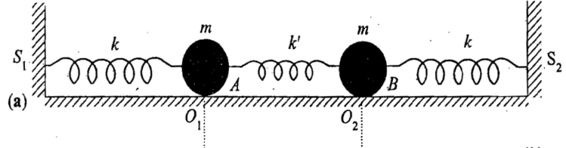
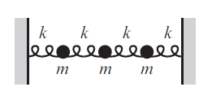
2
D
I
S
C
R
E
T
E
TO
C
O
N
T
I
N
O
U
S
P
L
A
N
3
.
.
.
N
ON
T
H
U
R
S
D
A
Y
∞

Slide 3
Recap

Slide 5
Let’s recapitulate……

Slide 6
We know
Let’s Choose A and B as

Slide 9
=
+

Slide 10
Plots: Amplitude v/s time
x₁(t) v/s t
x₂(t) v/s t

Slide 11
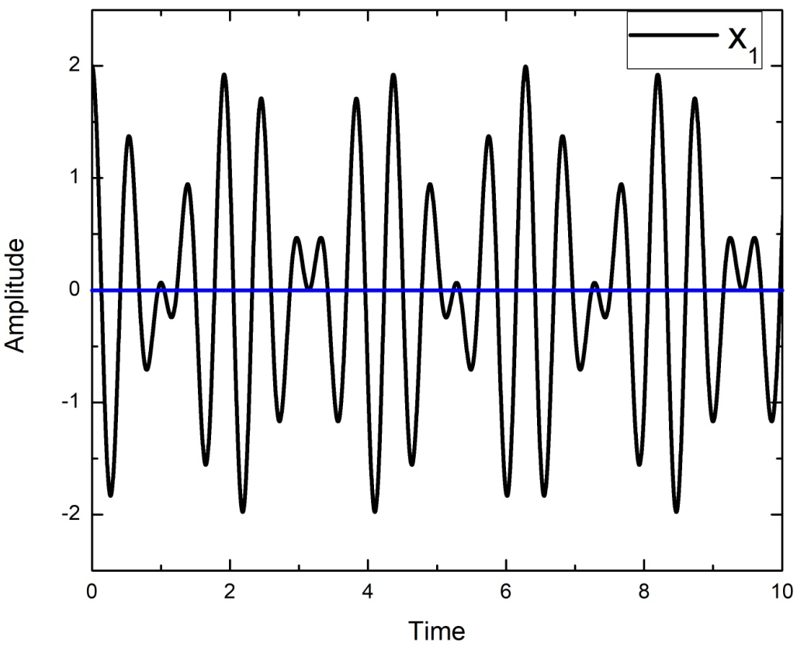
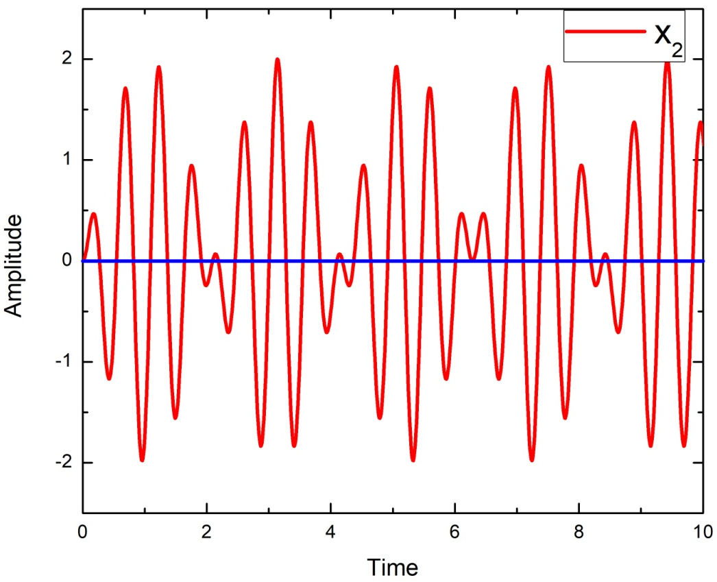

Slide 12
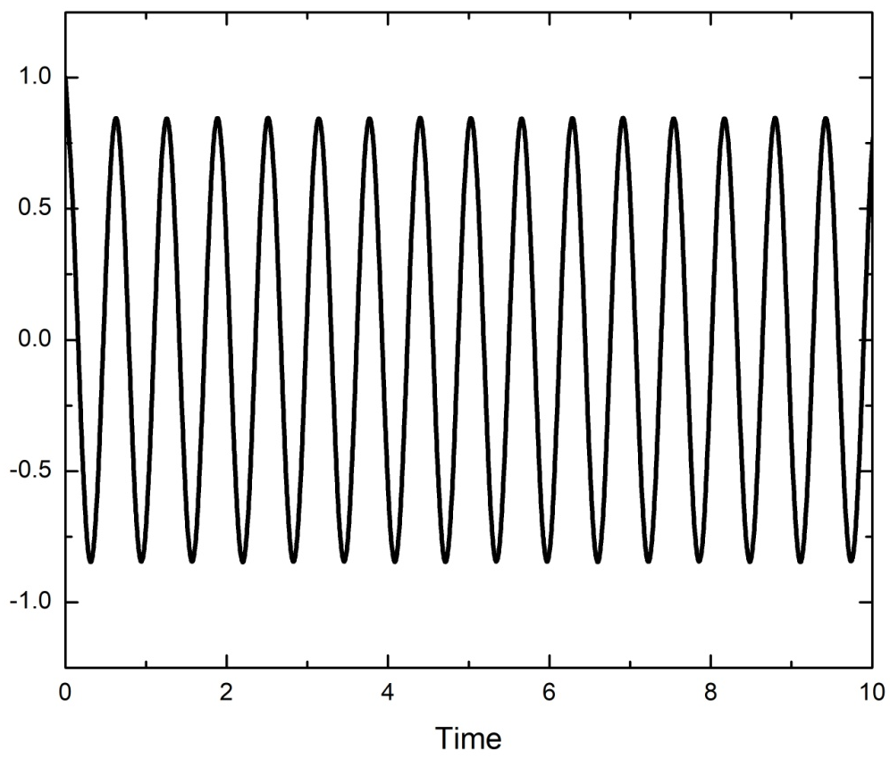
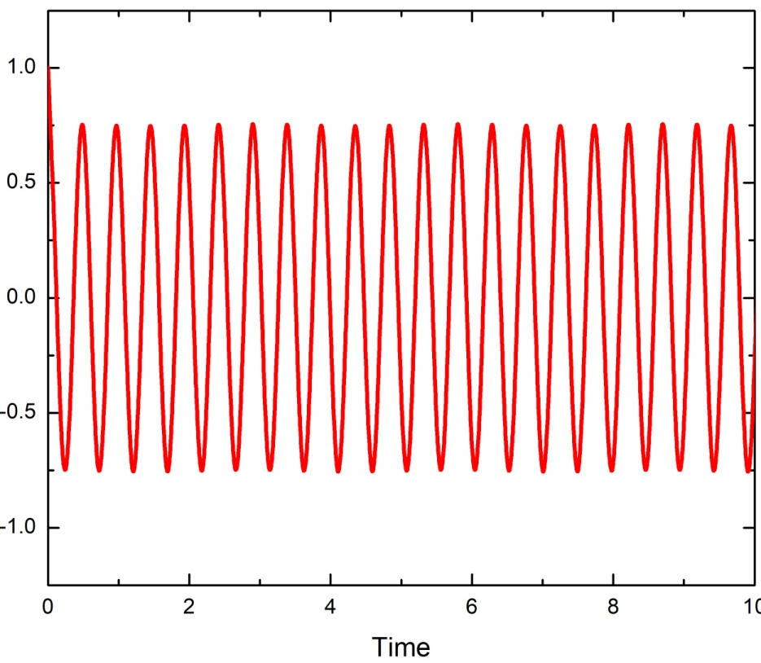

Slide 13
Normal Coordinates
Can we get some co-ordinates which will oscillate with one pure frequency??
Try by just adding x₁ and x₂ and subtracting
x₁ and x₂

Slide 14
Normal Coordinates
Inverse transformation

Slide 15
Why Normal Co-ordinates?
This will help in knowing 2 different frequencies independently
If you plot X₁(t) and X₂(t) v/s time you get nice cosine graph
x₁(t) and x₂(t) v/s time was erratic in nature
Out of phase and in-phase motion cannot get visualized though!

Slide 16
Is there any alternative way of solving the coupled differential equation?

Slide 17
Alternate way of deriving….
Equations of motion are
Simultaneous coupled differential equation

Slide 18
Equations of motion are
…….. (1)
…….. (2)
(1)+(2)
(1)-(2)

Slide 19
…….. (3)
…….. (4)
BACK TO NORMAL CO-ORDINATES AND NORMAL MODES

Slide 20
ALTERNATE METHOD
Quicker compared to first method for 2 mass 3 spring system
But gets complicated with more number of masses and spring system
First method using Matrix is more general

