Slide 1
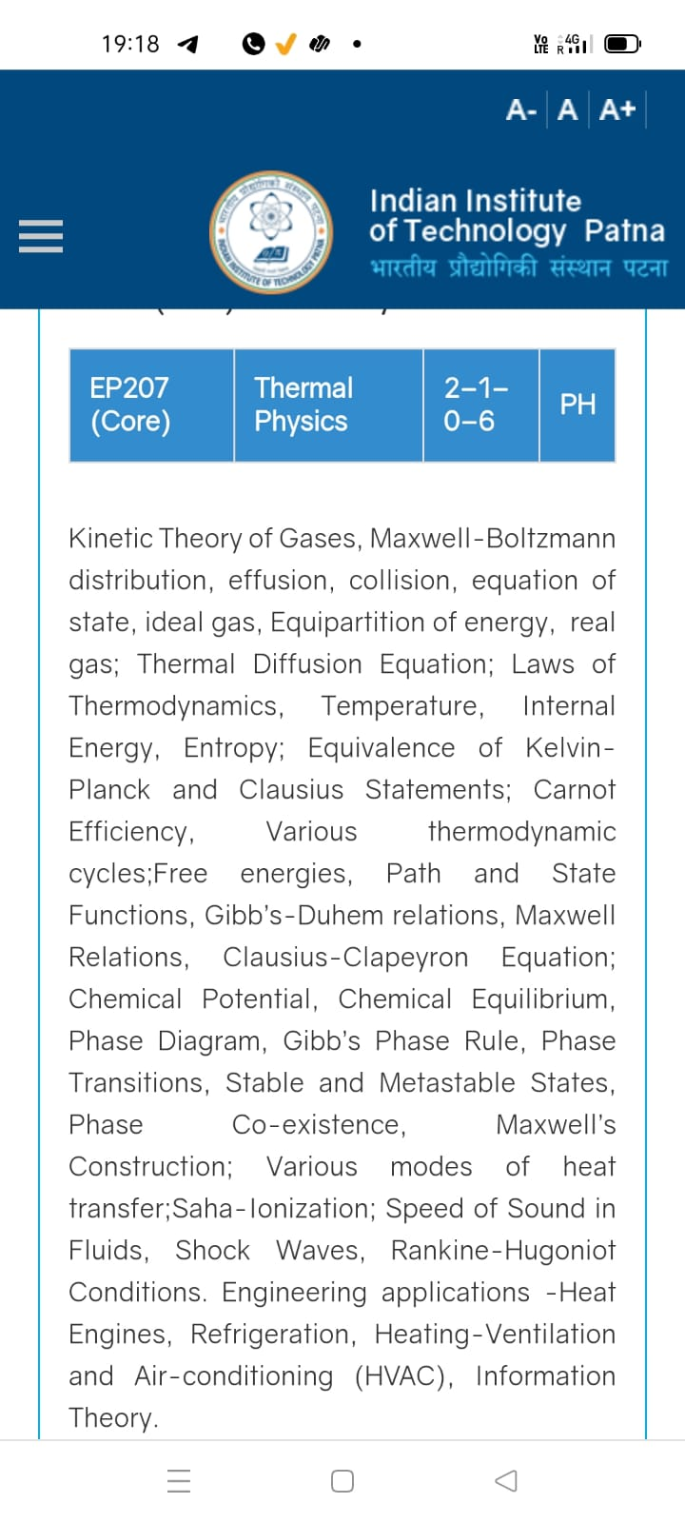
Season 3, Lecture 1 (S3,L1): Orientation
and
Introduction
EP2104 Thermal physics with engineering applications
3-1-0-4

Slide 2

Course Instructor for Thermal Physics
Dr. Raghavan K Easwaran
PhD (France, Paris) PDF(Nottingham, UK), UG (IIT Madras)
Marie Curie Fellow (PhD) European Union (EU), IFRAF, Paris
Associate Professor and Head of the department
Department of Physics
Indian Institute of Technology Patna
www.raghavanke.com
EP2104 Thermal physics with engineering applications
3-1-0-4

Slide 4
Time |  | 09-09:55 | 11-11:55 | 12-12:55 | 02-02:55
Day
Monday |  |  |  | R103
Wednesday |  |  |  |  | R103
Thursday |  | R103
Friday |  |  | R103

Slide 5
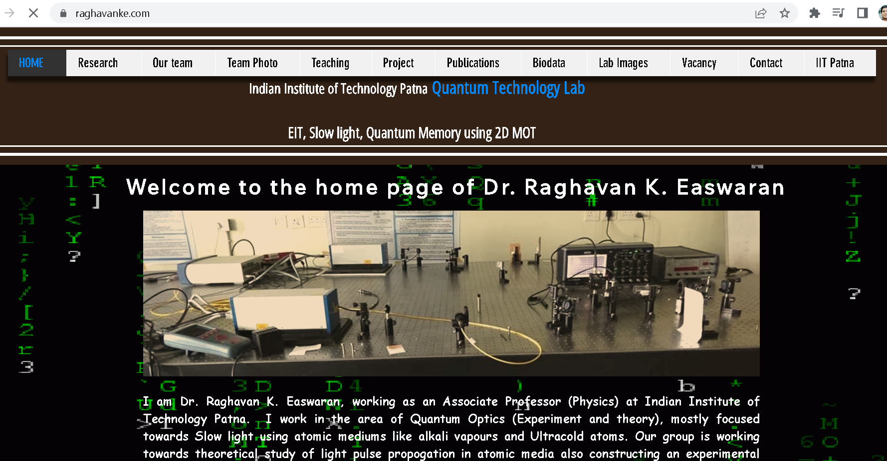

Slide 6
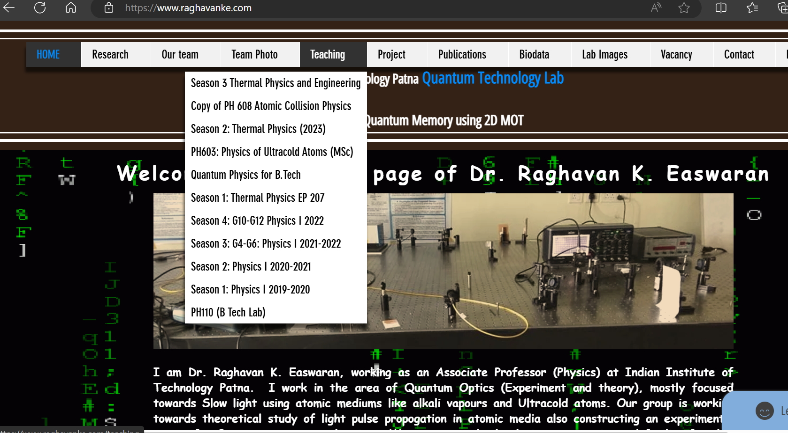

Slide 7
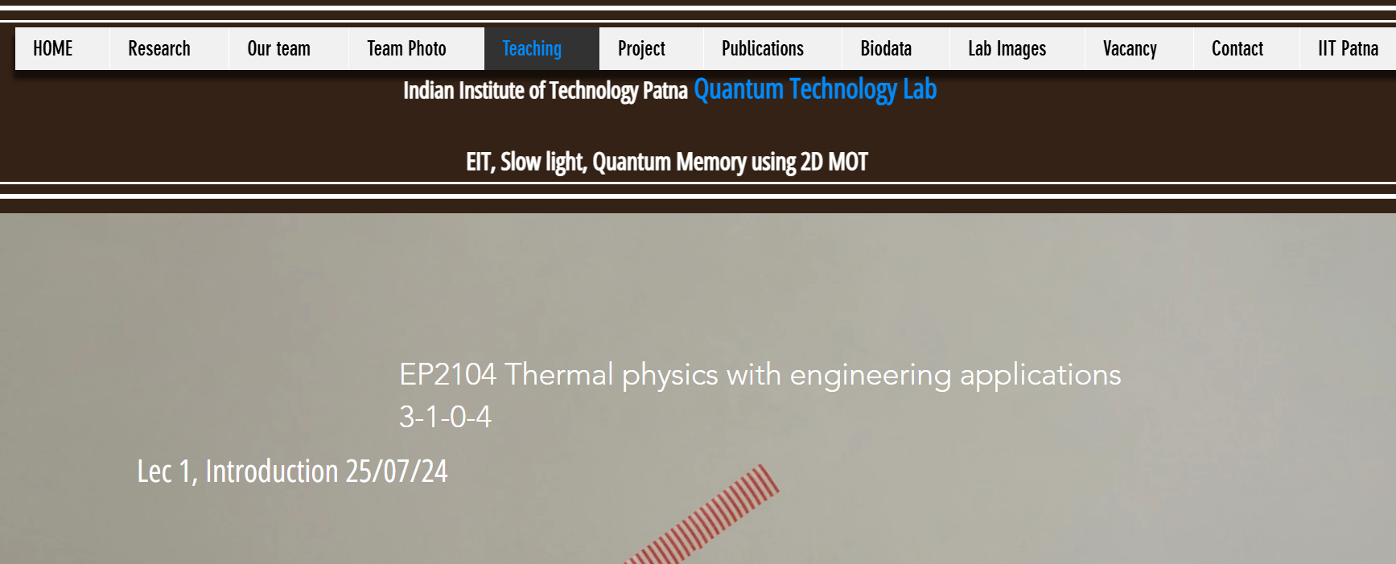

Slide 8
Roll No. | Name | L1
2301PH01 | Aditya Chandra | p
2301PH02 | Aditya Mittal | p
2301PH03 | Aditya Prakash Gupta | p
2301PH04 | Amit Kumar | a
2301PH05 | Angaanba Ningthoujam | p
2301PH06 | Arunvishal Palanisamy | p
2301PH07 | Ashmit Verma | p
2301PH08 | Azariah Peter | a
2301PH09 | Deveshsingh Kuldeepsingh Tomar | p

Slide 9
2301PH10 | Muskan Singh | p
2301PH11 | Naveen Saini | a
2301PH12 | Nishanth Kumaran | p
2301PH13 | Nived Krishna M | p
2301PH14 | Ratan Deep Prasad | p
2301PH15 | Ritesh | p
2301PH16 | Shivam Kumar Kannojia | p
2301PH17 | Shivang Rayat | p
2301PH18 | Yashraj Singh Thakur | p
2301PH19 | Aekampreet Singh Dhir | p
2301PH20 | Banoth Naveen | a

Slide 10
2301PH21 | Neerati Pranay | p
2301PH22 | Tanish Dhankhar | p
2301PH23 | Farhan Farhan | p
2301PH24 | Utpal Raj Ambastha | p
2301PH25 | Riya Singh | p
2301PH26 | Aakarsh Sinha | a
2301PH27 | Rahul Katravath | a
2301PH28 | Shivani | p
2301PH29 | Rakesh Bairwa | p
2301PH30 | Nikhil Pratap Singh | a
2301PH31 | Sridutt Rugada | a
2301PH32 | Anmisha Jadi | p
Attendance: 75% mandatory

Slide 11
Evaluation Scheme
Exam | Marks (100)
Quiz 1 | 10
Mid semester | 30
Quiz 2 | 10
End Semester | 50

Slide 12
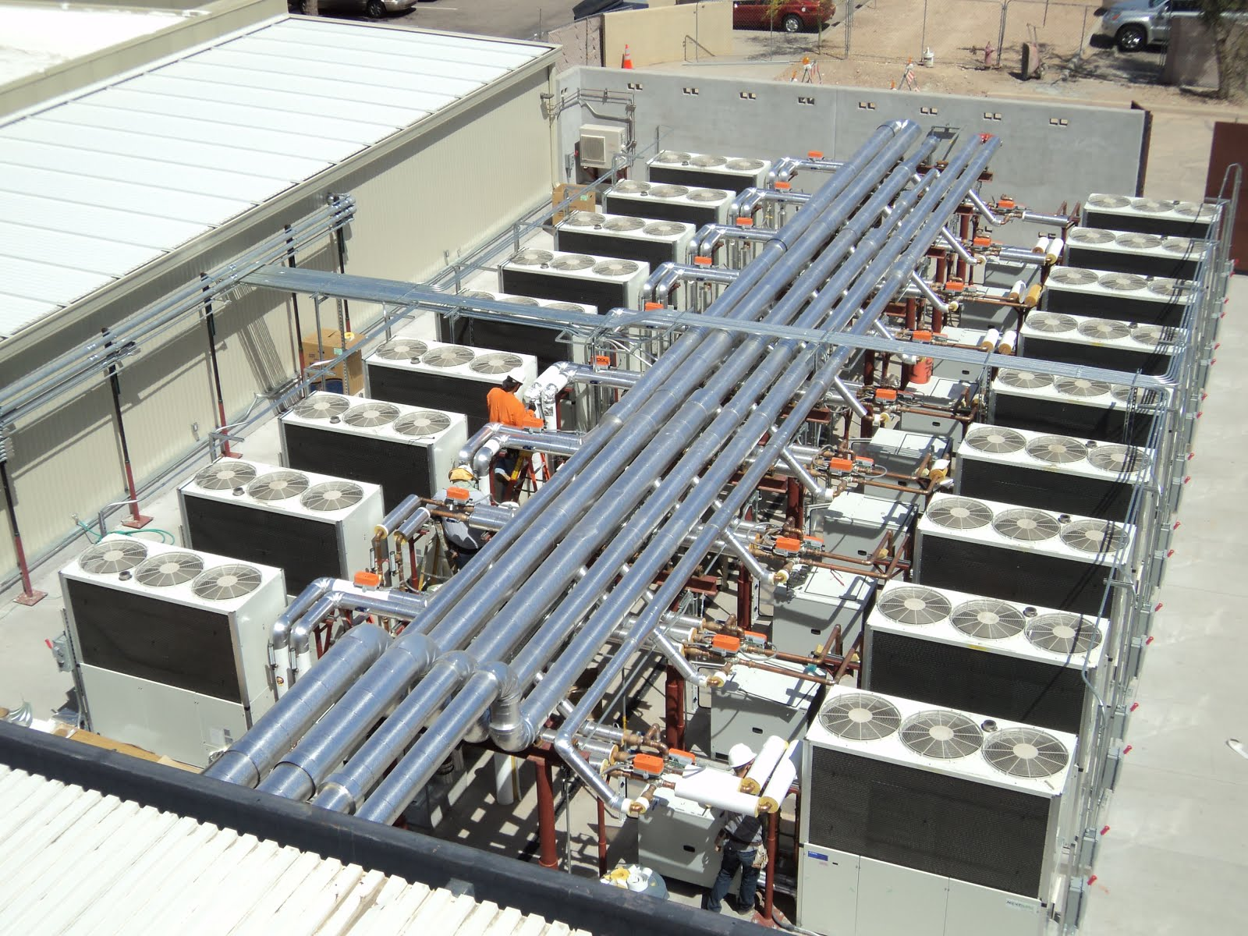
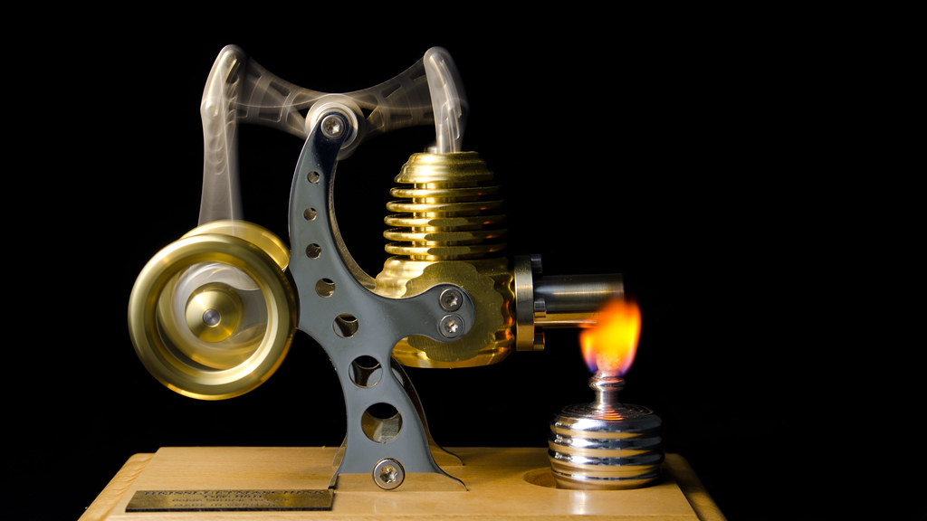

Focus on concepts and Cutting edge engineering Applications

Slide 13
Plan
Kinetic Theory of gases
Thermodynamics
Engineering applications

Slide 14
What is heat?
What is Temperature?

Slide 15
What is heat?
Mechanical energy converted

Slide 16
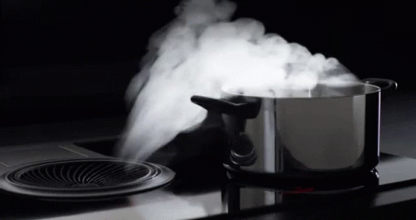

Slide 17
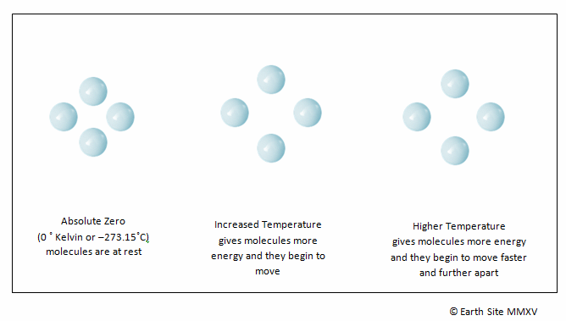

Slide 18
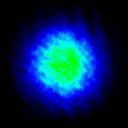
Hotter to colder
Imaging
Of
Atomic gas
Temperature of atomic gas is reduced as a function of time

Slide 19
Will deal with only gases now
What is Temperature?
From Kinetic Theory of gases

Slide 20
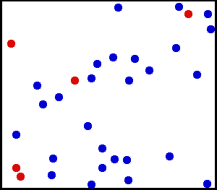
Huge number of particles

Slide 21
Necessity of Kinetic Theory and Thermodynamics
What is “Kinetic Theory”?
What is “Thermodynamics”?

Slide 22
Approach of “Kinetic Theory”
Distribution
Gas molecules
Microscopic theory

Slide 23
Approach of “Thermodynamics”
Macroscopic level
Measurable quantities
Extensive and Intensive variables

Slide 24
What is an “Ideal Gas”?
Point particles
Non-interaction
Only Kinetic energy
Only Elastic collisions
Is there an ideal gas in practice?

Slide 25
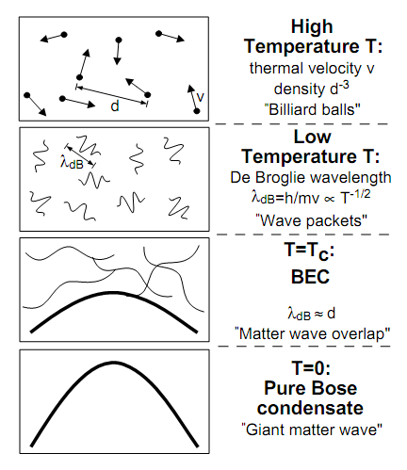

Ideal gas and Real gas
Classical gas
The Approximation
Quantum gas
Larger T
$$d≫λ_{dB}$$
Lower density

