Slide 1
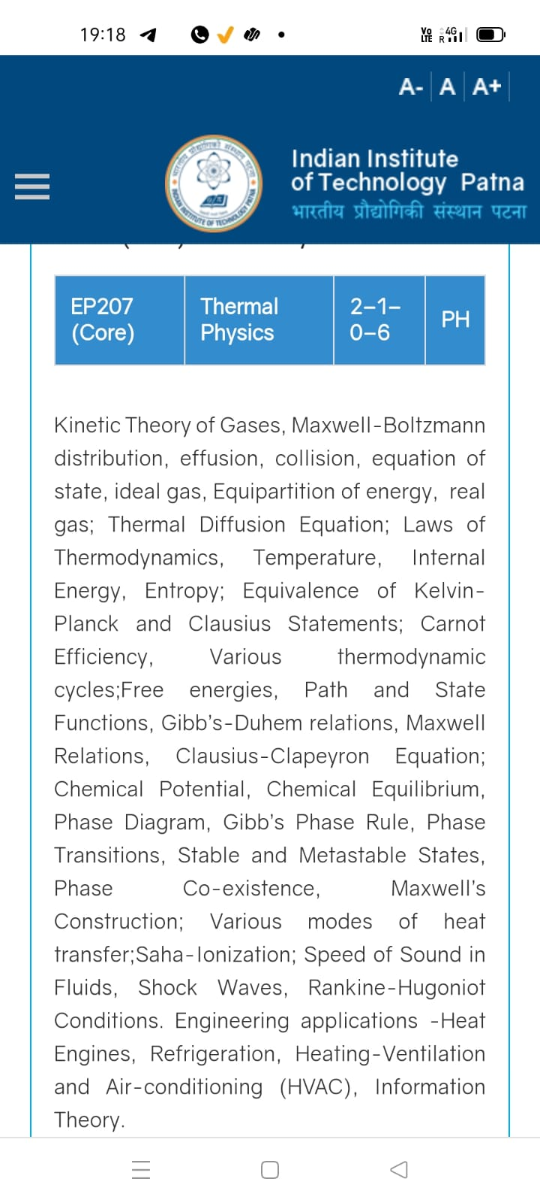
Season 4, Lecture 11 (S4,L11):
EP2104 Thermal physics with engineering applications
3-1-0-4

Slide 2
Time | 11:11:55 | 12-12:55 | 3-3:55 | 4- 4:55 | 02-02:55
Day
Monday |  | R103
Tuesday |  |  | R102
Wednesday |  |  |  | R103
Thursday | R103

Slide 3
 | firstname | lastname | roll_no |  | L1 | L2 | L3 | L4 | L5 | L6 | L7 | L8 | L9 | L10 | L11 | L12 | L13 | l14
1 | Jatin | . | 2401PH04 |  | P | P | P | P | p | p | P | P | P | P | P | A | P | p | p | a | p | a | p
2 | Prince | . | 2401PH24 |  | P | P | P | A | a | p | A | A | A | A | A | P | P | a | p | a | p | p | p
3 | Rayatuwar | Aditya Potanna | 2401PH11 |  | P | P | P | P | p | p | P | P | P | P | P | P | P | a | p | p | p | p | p
4 | Kota | Anantha Akash | 2401PH23 |  | P | P | P | P | p | p | P | P | P | P | P | A | P | p | p | p | p | p | p
5 | Tushar | Bharti | 2401PH03 |  | P | A | P | A | p | p | P | P | P | A | P | A | P | a | a | p | p | p | p
6 | Seshapu | Charan Sri Aditya Vardhan | 2401PH12 |  | P | P | P | P | p | a | P | P | P | A | P | A | P | p | a | a | p | p | p
7 | Riya | Chauhan | 2401PH26 |  | P | P | P | P | p | a | A | P | P | P | P | P | P | a | p | p | p | a | p
8 | Arijeet | Das | 2401PH32 |  | P | P | A | P | p | p | P | P | P | P | P | P | P | a | a | a | p | p | p
9 | Shrestha | Das | 2401PH27 |  | P | P | P | P | p | p | P | P | P | P | P | P | P | p | p | p | p | p | a
10 | Satyam | Gupta | 2403PH02 |  | P | P | P | P | p | p | P | P | P | P | P | P | P | p | p | p | p | p | p
11 | Sanskar | Kulshrestha | 2401PH05 |  | P | P | P | P | p | p | P | P | P | A | P | P | P | a | p | p | a | a | p
12 | Amit | Kumar | 2401PH02 |  | P | P | P | P | p | p | P | P | P | P | P | P | A | p | a | p | p | p | p
13 | Sanat | Kumar | 2401PH01 |  | P | P | P | A | p | p | A | P | A | P | P | P | A m | A m | p | p | p | p | p
14 | Vansh | Kumar | 2401PH18 |  | P | P | P | P | p | p | A | P | P | P | A | A | A | p | p | p | p | a | p
15 | Dhruv | Maheshwari | 2401PH19 |  | P | P | P | P | p | p | P | P | P | A | P | P | P | a | p | p | a | a | p
16 | Deepak | Nagar | 2401PH20 |  | P | P | P | P | p | p | A | P | P | P | P | P | A | p | a | p | p | p | p
17 | Satyam | Pandey | 2403PH01 |  | P | P | P | P | p | p | P | P | P | P | P | P | P | a | a | p | p | a | p
18 | Arvind | Prajapat | 2401PH31 |  | P | P | A | P | p | p | A | P | P | P | P | P | P | a | a | p | p | p | p
19 | Rathod | Rudra Amitbhai | 2403PH05 |  | P | P | P | P | p | p | P | P | P | A | P | P | P | a | p | p | a | a | p

Slide 4
20 | Jorvekar | Sahil Amit | 2401PH06 | P | P | P | P | a | p | A | P | P | A | P | P | A | a | p | p | p | p | p
21 | Lunavath | Sai Prem | 2401PH30 | P | P | P | P | p | p | P | P | P | P | P | P | P | a | a | p | p | a | p
22 | Manda | Sai Rithvik | 2401PH09 | P | P | A | P | p | a | P | A | C | C |  |  |  |  |  |  | a | a
23 | Vaddamani | Santhosh Kumar | 2403PH04 | A | P | P | P | p | p | P | A | P | P | P | A | A | p | p | p | a | p | p
24 | Apoorva | Singh | 2401PH13 | P | P | P | P | p | p | P | P | P | P | P | P | P | p | p | p | p | a | p
25 | Harshit | Singh | 2401PH08 | P | A | P | P | p | p | P | P | P | A | P | P | P | a | a | p | p | a | p
26 | Kushagra | Singh | 2401PH07 | P | P | P | P | p | p | P | P | P | P | P | P | P | p | p | p | p | p | p
27 | Srishti | Singh | 2401PH15 | P | A | P | P | p | p | A | P | A | A | A | P | P | p | a | p | p | p | p
28 | Harsh | Singh Baghel | 2401PH17 | P | P | P | P | p | p | A | P | P | P | P | P | P | a | a | p | p | p | p
29 | Satyam | Sinha | 2401PH21 | P | P | P | P | p | a | P | P | P | P | P | P | P | p | p | a | p | p | p
30 | Konyala | Sri Charan Reddy | 2401PH14 | P | P | A | P | p | a | A | C | C |  |  |  |  |  |  |  | a
31 | Chittedi | Srinidhi Reddy | 2401PH28 | P | P | P | A | p | a | P | A | P | P | P | A | P | p | p | a | p | a | p
32 | Seshu | Srinivas | 2403PH03 | P | P | P | P | p | p | P | P | P | P | P | P | P | p | p | p | p | p | p
33 | Tanushkumar | Upendrakumar Yadav | 2401PH25 | P | P | P | A | p | p | A | P | P | P | P | P | P | p | p | p | p | a | p
34 | Sanskriti | Verma | 2401PH16 | P | P | P | A | p | p | P | P | P | A | P | P | P | a | a | a | p | a | p
35 | Sanvidhan | Vijay Lonare | 2401PH10 | P | P | P | P | p | p | P | P | P | P | P | P | P | a | p | a | a | a | a
36 | Kalidindi | Yashwanth Varma | 2401PH29 | A | P | A | A | a | a | A | C | C
Attendance: 75% mandatory

Slide 5
Concept of Diffusion: Kinetic theory of gases

Slide 6
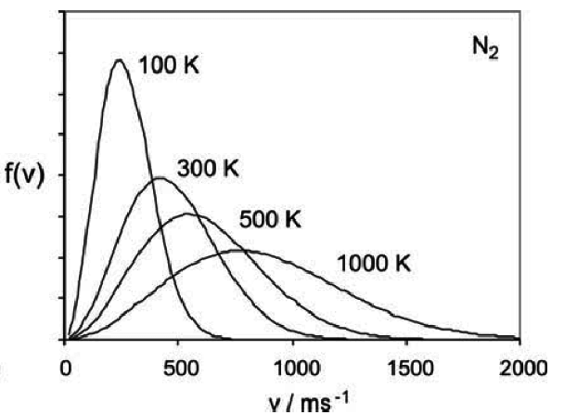
Temperature

Slide 8
Concept of Radiation Pressure, Laser cooling and Diffusion

Slide 9
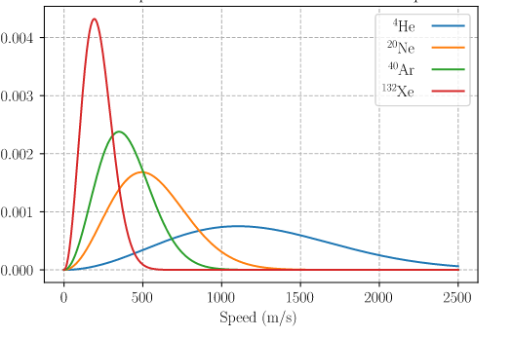
T = 300K
Mass decrease

Slide 10
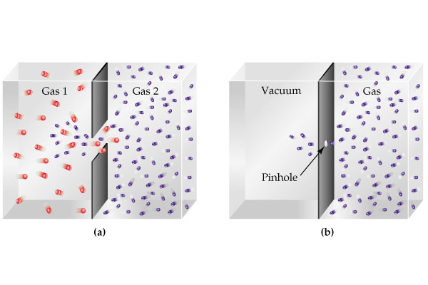

Slide 11
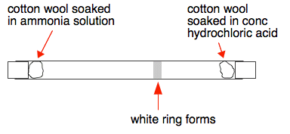

Slide 12
Graham’s Law of Diffusion

Slide 13
Thermal Diffusion equation: Fick’s Laws
(Kinetic theory)

Slide 14
Heat Flow
Charge Flow
Gas/mass Flow
Flux
Heat Flux q
Charge Flux J
Molecular/mass Flux J
Gradient
Law
Material Property
Thermal conductivity K
Electrical conductivity
Diffusion Coefficient

Slide 15
Area A

Slide 16
effect
cause
Flux
Concentration
gradient

Slide 17
Time dependency of concentration (Fick’s second law)
Area =A
C
x

Slide 18
How much concentration inside
this volume change with time?
Apply
Fick’s
Law
C
x

Slide 20
Fick’s second law

Slide 21
Fick’s second law

Slide 22
Thermal Diffusion equation: Fick’s Law
Fick’s second law

Slide 23
Thermal Diffusion equations: Fick’s Law
Fick’s second law

Slide 24
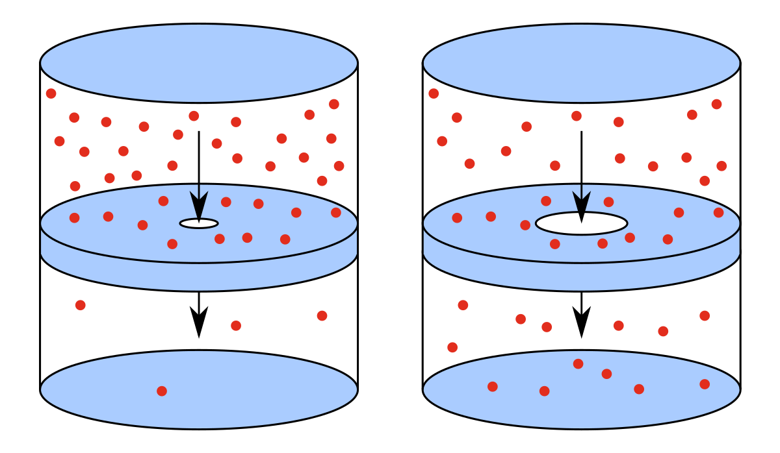
Effusion: A special Case
Effusion
Diffusion
Effusion occurs through an orifice smaller than the mean free path of the particles in motion

Slide 25
Effusion
Effusion
Effusion occurs through an orifice smaller than the mean free path of the particles in motion

Slide 26
Gas in left chamber is under equilibrium

Slide 27
To maintain gas in left chamber is under equilibrium
Ensures little or no collisions near the opening hence the equilibrium is maintained

Slide 28
Equilibrium is not disturbed
Under the above condition escape of molecules through hole is called as EFFUSION
OR
EFFUSION occurs through an orifice smaller than the mean free path of the particles in motion

Slide 29
Tutorial 3: Thermal Diffusion

Slide 30
Problem 1
“A diffusing spherical cloud”

Slide 35
Problem 2
“Medicine storage ”

Slide 38
Medicine remains safe

Slide 39
Direction of diffusion
Pd membrane
0.005 mm

Slide 40
Direction of diffusion
Pd membrane
0.005 mm

Slide 41
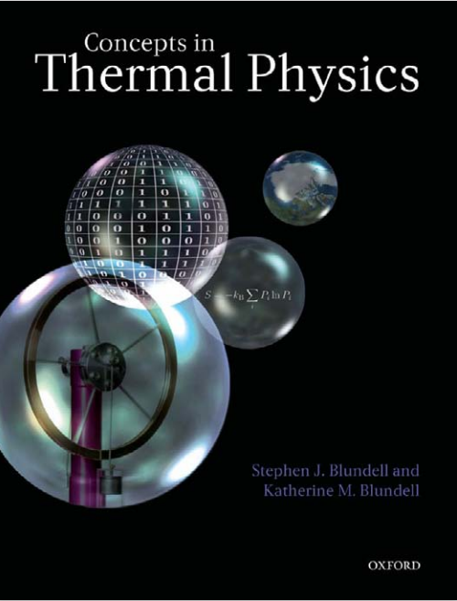

Slide 42
Thermal Diffusion equations: Fick’s Law
Fick’s second law

Slide 43
Tutorial 3: Thermal Diffusion

Slide 45
Direction of diffusion
Pd membrane
0.005 mm

Slide 48
Flux increases

Slide 49
This is called as a “steady state” condition
Plot concentration as a function of x

Slide 51
Plot

Slide 52
Note:
Using variable separable method one can find the solution as

Slide 53
Plot

Slide 54
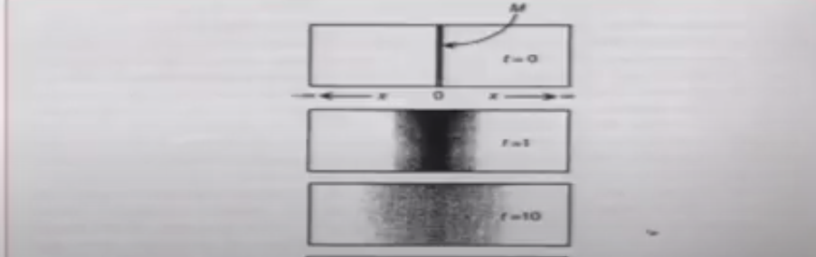

Slide 55
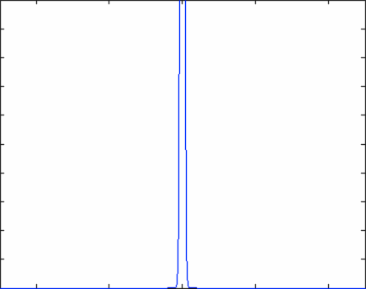
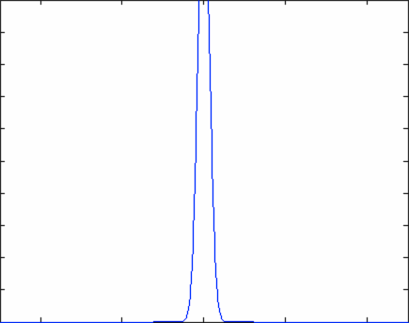

Slide 56
Effusion
Effusion
Diffusion
Effusion occurs through an orifice smaller than the mean free path of the particles in motion

Slide 57
Effusion
Effusion
Effusion occurs through an orifice smaller than the mean free path of the particles in motion

Slide 58
Gas in left chamber is under equilibrium

Slide 59
To maintain gas in left chamber is under equilibrium
Ensures little or no collisions near the opening hence the equilibrium is maintained

Slide 60
Equilibrium is not disturbed
Under the above condition escape of molecules through hole is called as EFFUSION
OR
EFFUSION occurs through an orifice smaller than the mean free path of the particles in motion

Slide 61
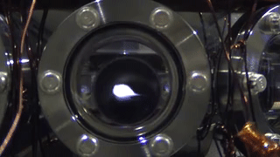
Atomic cloud diffusion in Quantum Technology

Slide 63
v
v

Slide 64


Slide 65
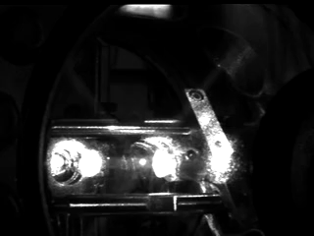

Slide 66
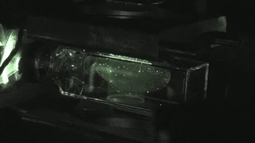

Slide 68
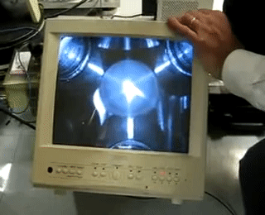

Slide 70
v
a
Non invasive temperature
measurement
a+vt
a+vt’

Slide 71
Size
t
From the fit V is calculated, then T

Slide 72
Stationary atoms and its engineeringapplications

Slide 73
Utracold atoms and modern cutting edge engineering technology
Metrology: Precise measurement of Energy levels, Time and Frequency standards
Quantum Communication
High precision sensors
Quantum Computers

Slide 74
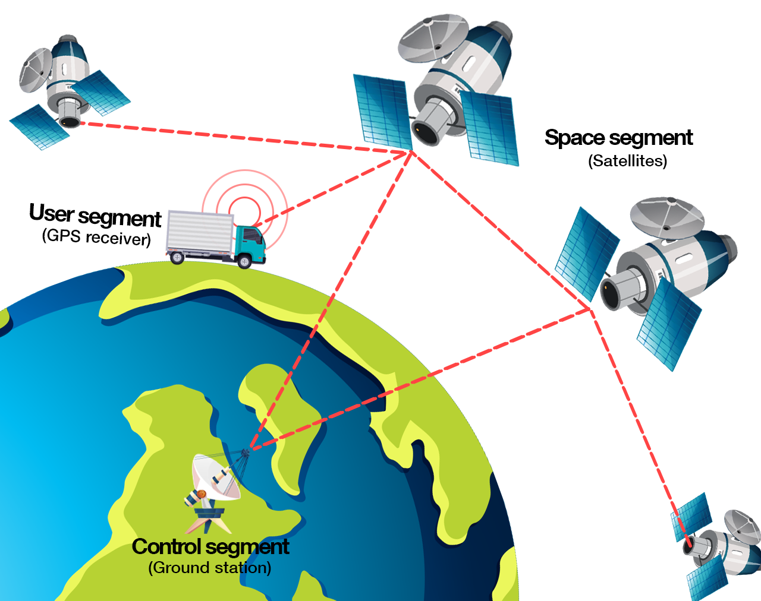

Slide 75
Introduction to Thermodynamics
A revision

Slide 76
Macroscopic approach
Does not probe system at molecular level
Thermodynamic variables P,V,T etc
System and rest of universe (reservoir: Infinite heat capacity)
System is separated by a wall

Slide 77
Zeroth Law of Thermodynamics
R. H. Fowler :1931

Slide 78
Statement
If two systems are in thermal equilibrium with a third system then those two are in thermal equilibrium with each other
A
B

Slide 79
Statement
If two systems are in thermal equilibrium with a third system then those two are in thermal equilibrium with each other
B
C

Slide 80
Statement
If two systems are in thermal equilibrium with a third system then those two are in thermal equilibrium with each other
A
C

Slide 81

Statement
Same Temperature
A
C

Slide 82
Statement
No Heat Flow
A
C

Slide 83
B
DIATHERMIC (CONDUCTING)
A
ADIABATIC
(NON
CONDUCTING)
C

Slide 84
B
ADIABATIC
A
DIATHERMIC (CONDUCTING)
C
No heat flow

Slide 85
First Law of Thermodynamics
Law of Conservation of Energy

Slide 86
First Law of Thermodynamics
Law of Conservation of Energy

Slide 87
Statement
Energy is conserved and heat and work are both forms of energy.

Slide 88
“Application engineering” problems
(First Law)
Practice problems

Slide 89
1. “Electric heater + Piston cylinder”

Slide 93
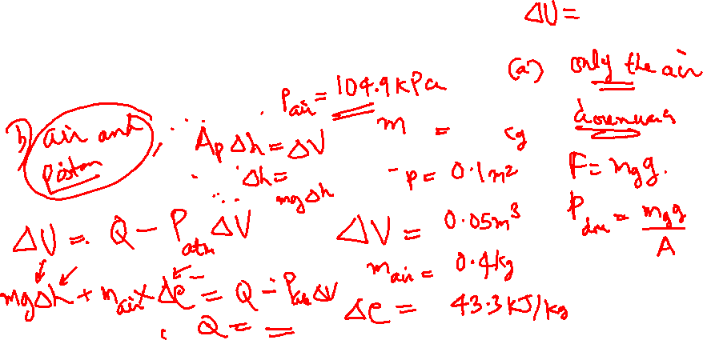

Slide 94
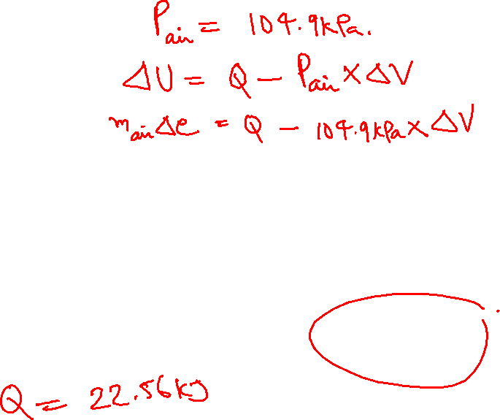
100 kPa

Slide 95
a) Only the air
100 kPa

Slide 96
100 kPa

Slide 97
a) Air and the Piston
100 kPa

Slide 98
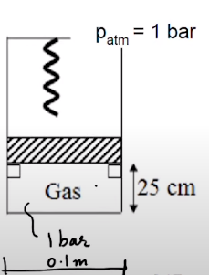
stops

Slide 99
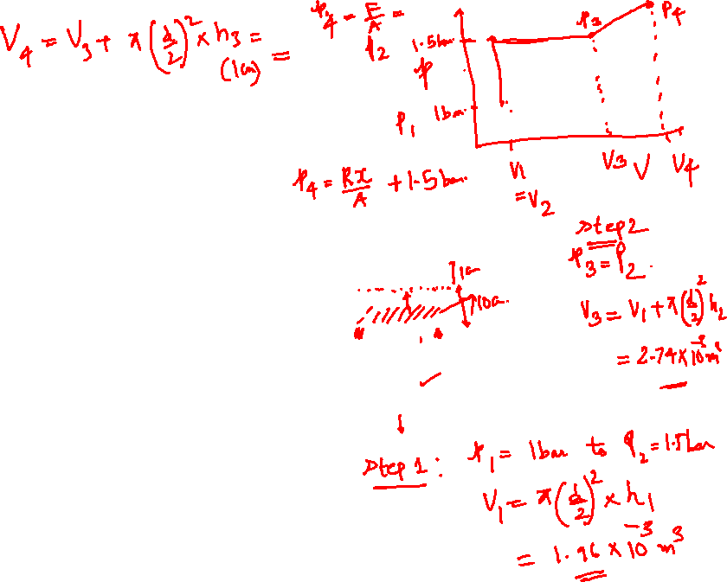
stops

Slide 100
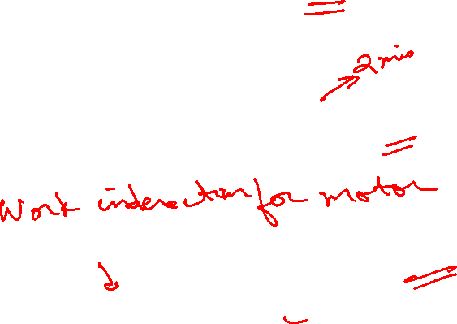
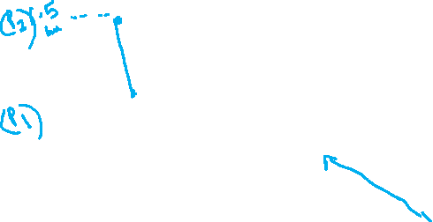

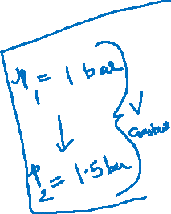
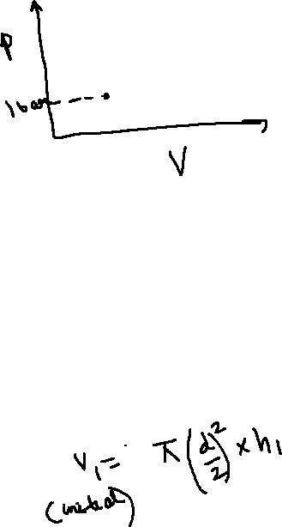

Slide 101
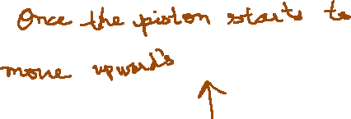
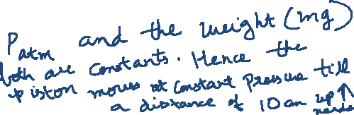
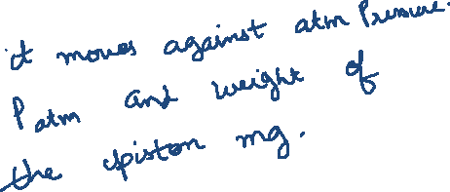

Slide 102

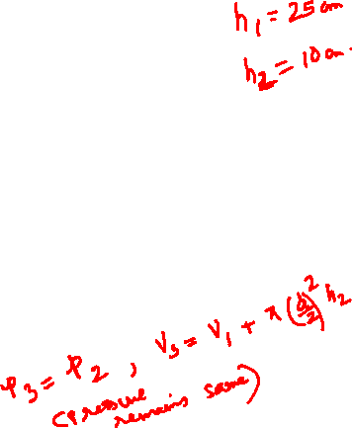
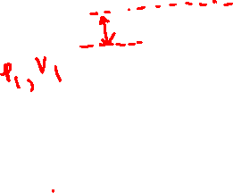
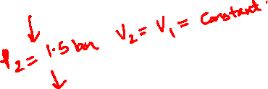

Slide 103
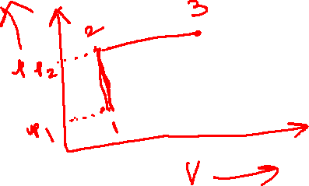
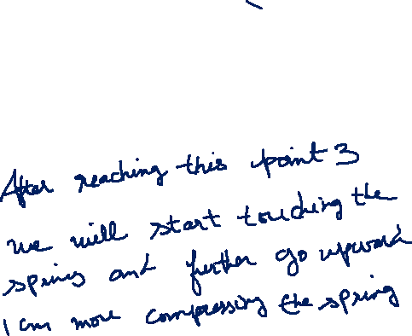

Slide 104
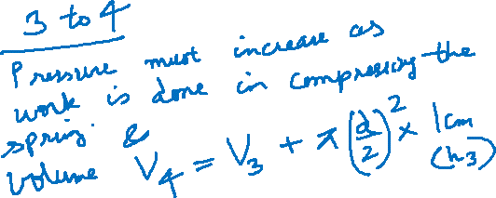

Slide 105
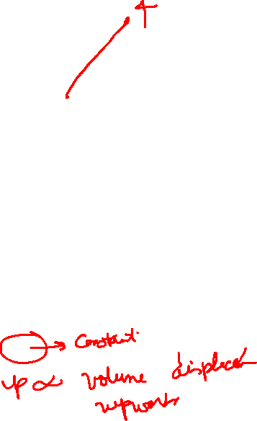
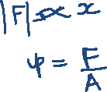

Slide 106
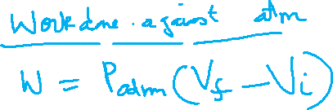


Slide 107
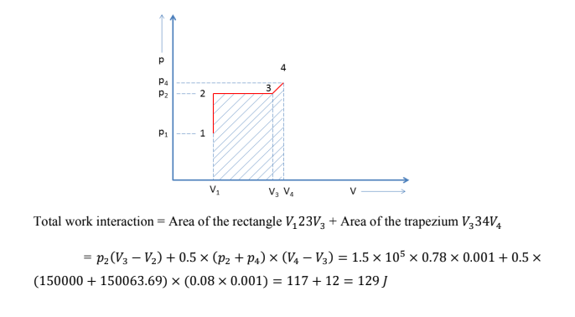
By calculating the different areas we can calculate
All the regions mentioned

Slide 108
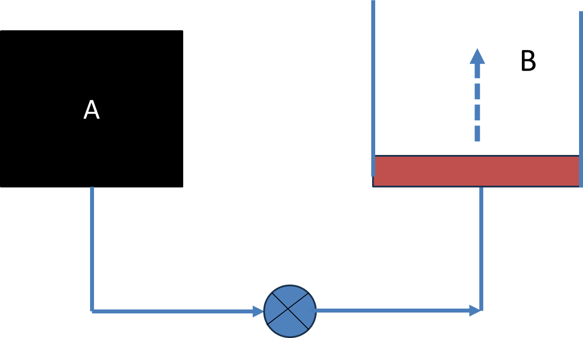
Tank A and a piston-cylinder arrangement B are connected through pipes as shown. The piston is frictionless. Tank A contains Nitrogen at 300 kPa and its volume is 0.4 m³. It requires 150 kPa to lift the piston. As the connecting valve opens, Nitrogen flows into the piston – cylinder arrangement B and attains a steady state after some time. What is the final pressure and work interaction for Nitrogen if the initial and final states are related by pV=C, where p and V represent pressure and volume of the gas and C represents a constant

Slide 109
Tank A and a piston-cylinder arrangement B are connected through pipes as shown. The piston is frictionless. Tank A contains Nitrogen at 300 kPa and its volume is 0.4 m³. It requires 150 kPa to lift the piston. As the connecting valve opens, Nitrogen flows into the piston – cylinder arrangement B and attains a steady state after some time. What is the final pressure and work interaction for Nitrogen if the initial and final states are related by pV=C, where p and V represent pressure and volume of the gas and C represents a constant. Assume the process is done in a quasi-static isobarically lifted in B.

Slide 110
“Cutting tool Lathe”

Slide 112
R = 40 mm

Slide 113
R = 40 mm
Cutting Torque
Work done by the Torque

Slide 114
R = 40 mm

Slide 115
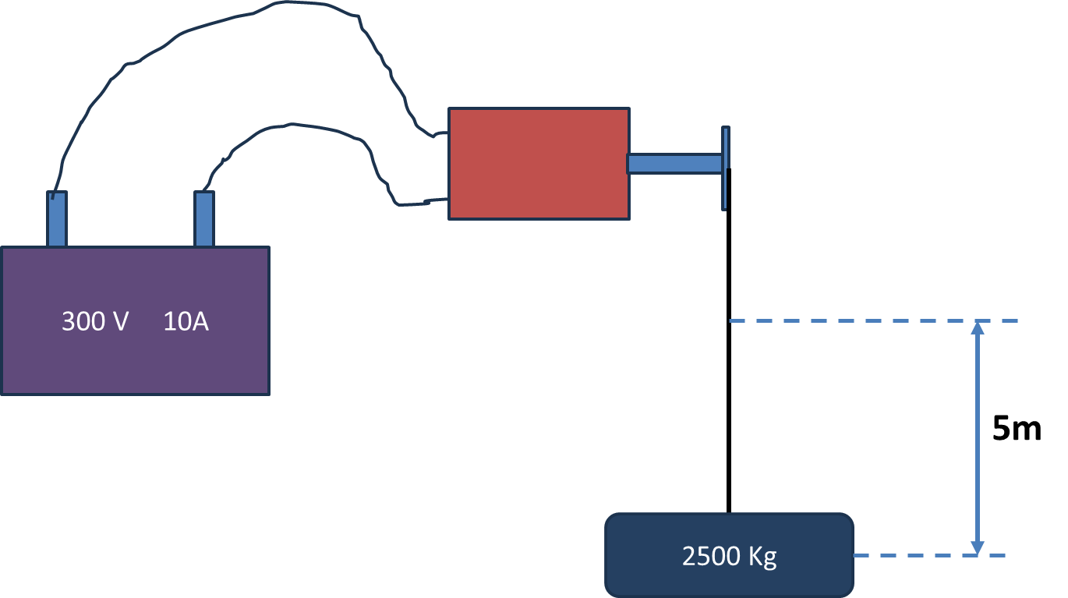
DC electrical motor is used to operate a hoist mechanism (which does lifting of objects) in a crane. The motor is supplied with 300 V and 10 Ampere from a DC source for a period of 2 min. The torque provided by the motor to the hoist shaft is 250 Nm at 50 rpm. The hoist mechanism lifts a mass of 2500 Kg through a height of 5m. Calculate the work interaction for the DC source, motor, hoist and the mass

Slide 116
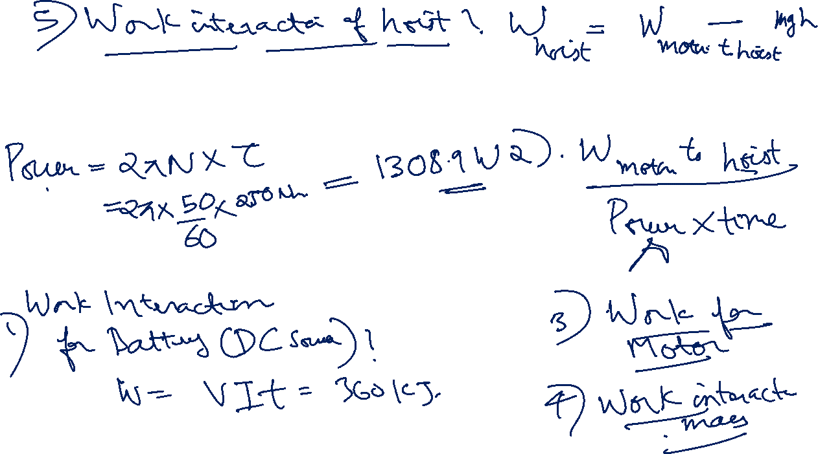
DC electrical motor is used to operate a hoist mechanism (which does lifting of objects) in a crane. The motor is supplied with 300 V and 10 Ampere from a DC source for a period of 2 min. The torque provided by the motor to the hoist shaft is 250 Nm at 50 rpm. The hoist mechanism lifts a mass of 2500 Kg through a height of 5m. Calculate the work interaction for the DC source, motor, hoist and the mass

Slide 119


Slide 120
“Application engineering” problems
(First Law)
Practice problems (contd…)

Slide 122

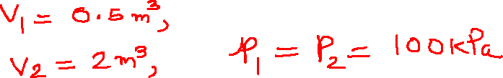

Step-wise Solution

Slide 124
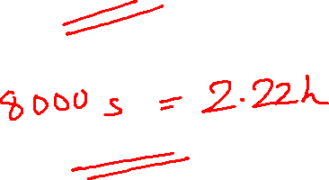
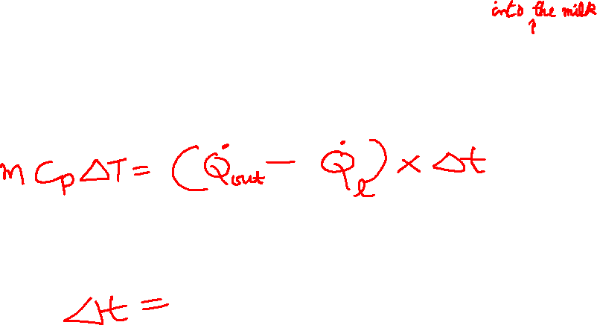
Step-wise Solution

Slide 125
Second Law and Entropy Introduction
Concepts through Problems: B.Sc/M.Sc Level
Application “Engineering real life problems and solution” B.Tech Level

Slide 126
Second Law of Thermodynamics
Revision

Slide 127
Kelvin-Planck’s statement
Kelvin’s statement of the second law of thermodynamics: ‘No process is possible whose sole result is the complete conversion of heat into work.’
Heat
Work

Slide 128
Engine
We define an engine as a system operating a cyclic process that converts heat into work. It has to be cyclic so that it can be continuously operated, producing a steady power.
One such engine is the Carnot engine, which is based upon a process called a
Carnot cycle

Slide 129


Slide 130



Slide 131
Kelvin’s statement
Kelvin’s statement of the second law of thermodynamics: ‘It is impossible to construct an
Engine that operating in a cycle, will produce no effect other than the extraction of heat from a reservoir and the performance of an equivalent amount of work.’

Slide 132
Clausius statement
Clausius’ statement of the second law of thermodynamics: ‘No process is possible whose sole result is the transfer of heat from a colder to a hotter body.’

Slide 133


Slide 134

ASYMMETRY

Slide 135
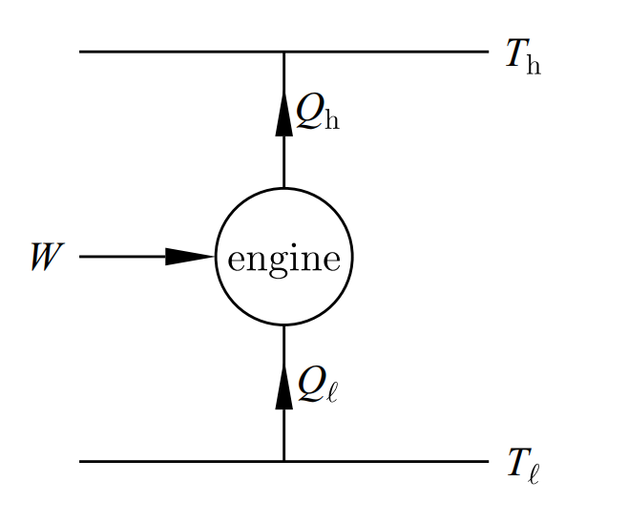

Refrigerator

Slide 136
Clausius statement
Clausius statement of the second law of thermodynamics: ‘It is impossible to construct a refrigerator that, operating in cycle, will produce no effect other than the transfer of heat from a lower-temperature reservoir to a higher temperature reservoir.’

Slide 137
Equivalence of Kelvin-Planck’s and Clausius statements

Slide 138
Kelvin-Planck’s statement of the second law of thermodynamics: ‘No process is possible whose sole result is the complete conversion of heat into work.’
Clausius’ statement of the second law of thermodynamics: ‘No process is possible whose sole result is the transfer of heat from a colder to a hotter body.’

Slide 140

If Kelvin’s statement is violated, what happens?
R

Slide 141

R
R

Slide 142
R
R

Slide 143
R
R
Violating
Kelvin’s
Violated
Clausius

Slide 144
Violating Kelvin’s Statement Violated Clausius Statement
Let us check the reverse

Slide 145
Violating
Clausius

Slide 146
R
E
W
W
Violating
Clausius
Violated
Kelvin

Slide 147
Violating Clausius Statement Violated Kelvin’s Statement

Slide 148
The second law of thermodynamics states that the total entropy of the universe always increases for a spontaneous process.
Clausius inequality helped us to understand this…..

Slide 149
Heat cannot be transferred from low temperature to high temperature
In a cyclic process, total heat cannot be converted to work
Efficiency of an engine cannot be 1
One cannot reach T=0K
Entropy of the Universe is always increasing

Slide 150
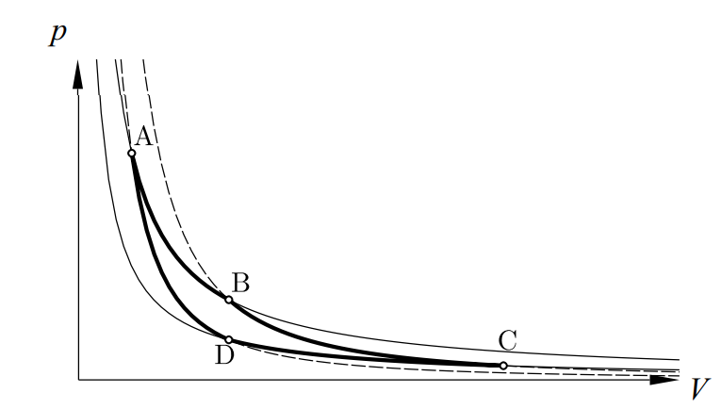
Re-visit Carnot Cycle

Slide 151
Definition of Entropy from Carnot Cycle

Slide 152
Carnot Cycle
A
isothermal
Q_{in}
B
P
Q=0
T_{hot}
Q=0
adiabatic
adiabatic
T_{cold}
C
D
Q_{out}
isothermal
V

Slide 153
A
isothermal
Q_{in}
B
P
Q=0
T_{hot}
Q=0
adiabatic
adiabatic
T_{cold}
C
D
Q_{out}
isothermal
V

Slide 154
A
isothermal
Q_{in}
B
P
Q=0
T_{hot}
Q=0
adiabatic
adiabatic
T_{cold}
C
D
Q_{out}
isothermal
V

Slide 155
A
isothermal
Q_{in}
B
P
Q=0
T_{hot}
Q=0
adiabatic
adiabatic
T_{cold}
C
D
Q_{out}
isothermal
V

Slide 156
Definition of Entropy
For a Cyclic Process
State function

