Slide 1

PH5101 Atomic and Molecular Physics

Slide 2

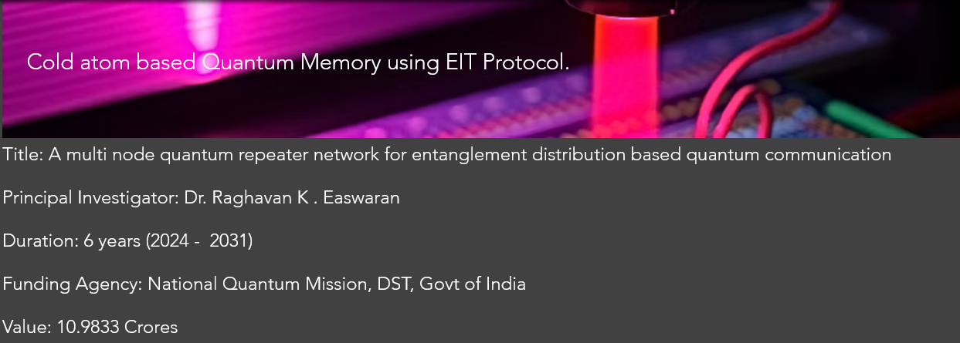

Course Instructor
Dr. Raghavan K Easwaran
PhD (France, Paris) PDF(Nottingham, UK), UG (IIT Madras)
Marie Curie Fellow (PhD) European Union (EU), IFRAF, Paris
Associate Professor and Former Head of the department
Department of Physics
MPI, National Quantum Mission
Quantum Communication HUB,
Indian Institute of Technology Madras
Indian Institute of Technology Patna
www.raghavanke.com

Slide 3
PH5101 Atomic and Molecular Physics
3-1-0-4
Syllabus
Recap of Atomic physics experiments: a historical overview and recap of Quantum Physics, One electron atom and its representation example Alkali atoms: Rubidium as a case study, Zeeman effect ,Interaction of one electron atoms with electromagnetic radiation and stark effect, Transition rates, The dipole approximation, Selection rules, Spectrum of one electron atoms like alkali gas, , Fine structure and Hyperfine structure of alkali atoms and atomic spectroscopy, Line intensities and the life time of the excited states, Line shapes and widths. Many electron atoms: L-S coupling and j-j coupling, Thomas Fermi model, Hartree- Fock method and the SCF.
Molecular structure, Born -Oppenheimer approximation, Electronic structure of diatomic molecule, Electronic, Rotational, Vibrational and Vibration-Rotation Spectra of diatomic molecules, Electronic spectra of diatomic molecules, The Franck-Condon principle. Introduction to the Density functional theory
Additional Topics: Atomic Physics and Quantum Memory for Quantum Communication.
Suggested Readings:
Textbooks: • B.H. Bransden and C.J. Joachain, Physics of Atoms and Molecules,
Longman Scientific and Technical, 1983.
• Gordon W and F. Drake, Springer Handbook of Atomic, Molecular,
and Optical Physics, Springer, 2006.
• W. Demtroder, Atoms, Molecules and Photons, Springer, 2010.
• H. Haken and H.C. Wolf, Physics of Atoms and Quanta, Springer, 2005.
• H. E. White, Introduction to Atomic Spectra, McGraw Hill, 2019
• G. K. Woodgate, Elementary Atomic Structure, 2nd Ed., Clerenton Press, Oxford, 2002
• M. Karplus and R. N. Porter, Atoms and Molecules: An Introduction for Students of Physical Chemistry
References:
• Ira N. Levine, Quantum Chemistry, 6th Edition, PHI Learning Private Limited, New Delhi, 2009.
• John P. Lowe and Kirk A. Peterson, Quantum Chemistry, 3rd Edition, Academic Press, 2009.
• Peter Atkins and Ronald Friedman, 4thEdition, Oxford Univ. Press, 2012. • Collin N. Banwell and Elain M. Mc Cash, Fundamentals of Molecular Spectroscopy, 4thEdition, Tata McGraw Hills, 2008.

Slide 4
Time | 10:11 | 10-11 | 11-12 | 11-12 | 4-5
Day
Monday | R103
Tuesday |  | R103
Wednesday |  |  | R103
Thursday |  |  |  | R304
Friday |  |  |  | 103

Slide 5
Spectrum of one electron atoms, Line intensities and the life time of the excited states, Line shapes and widths.

Slide 6
A case study on Rb atomic gas
“connecting to the lab”

Slide 7
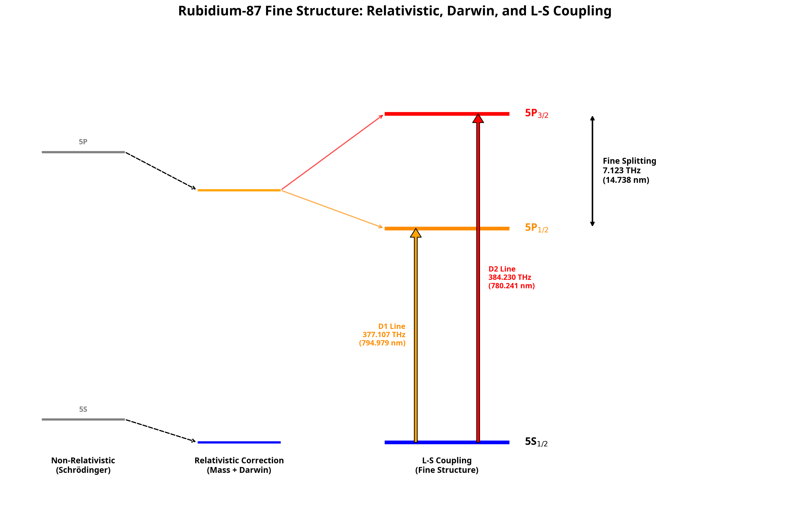

Slide 8
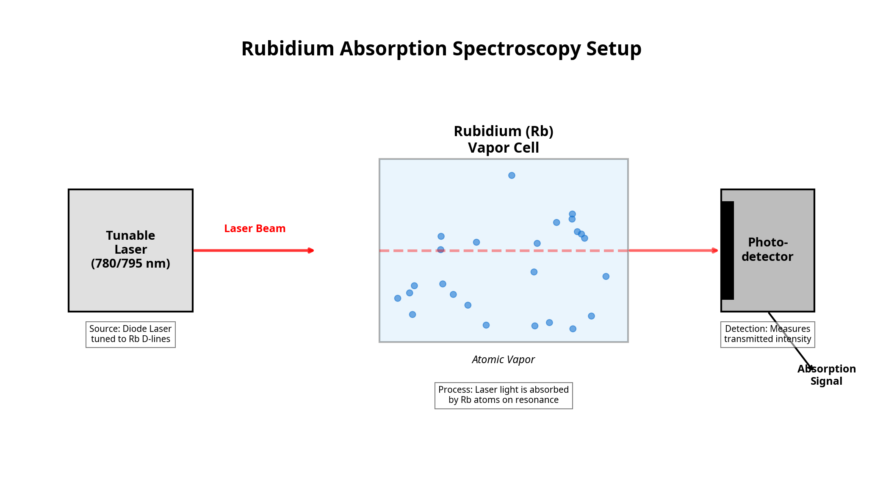

Slide 9
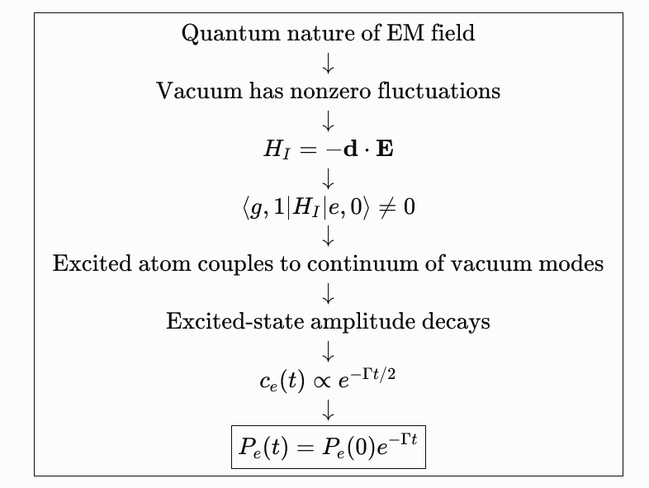

Slide 10



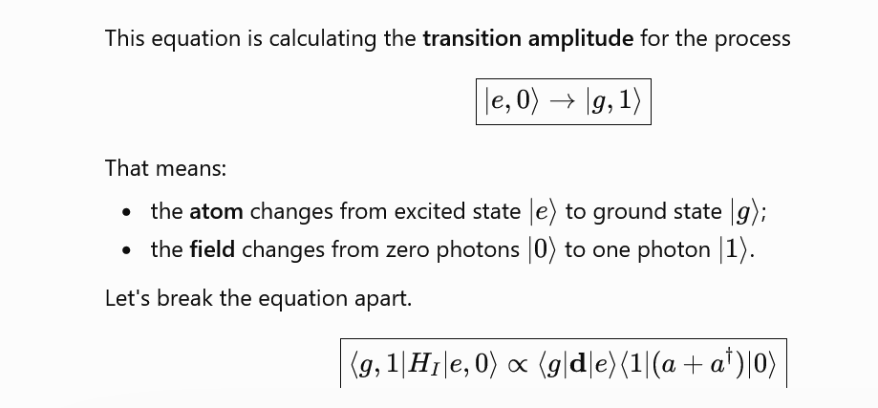

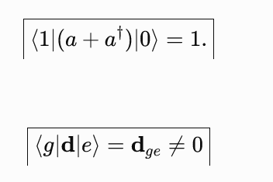
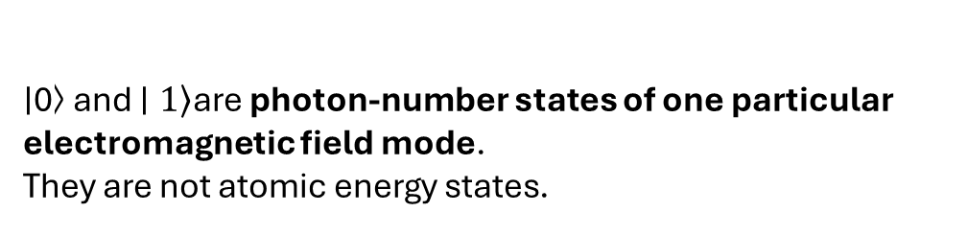
∣0⟩ and $\left.∣1\right\rangle$are photon-number states of one particular electromagnetic field mode.
They are not atomic energy states.

Slide 11
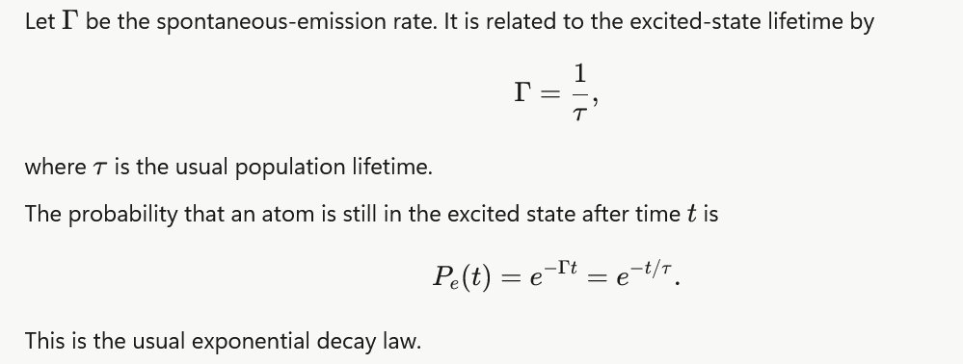
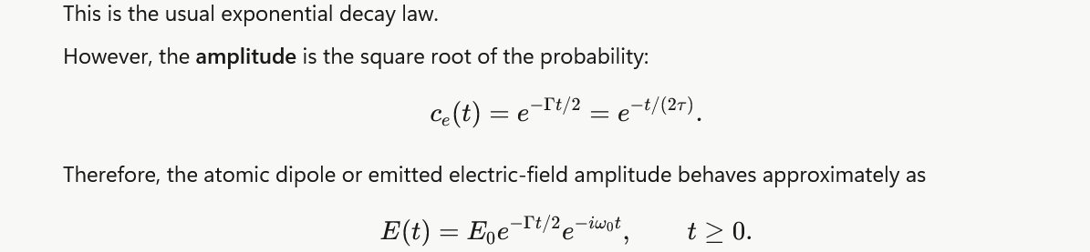

Slide 12
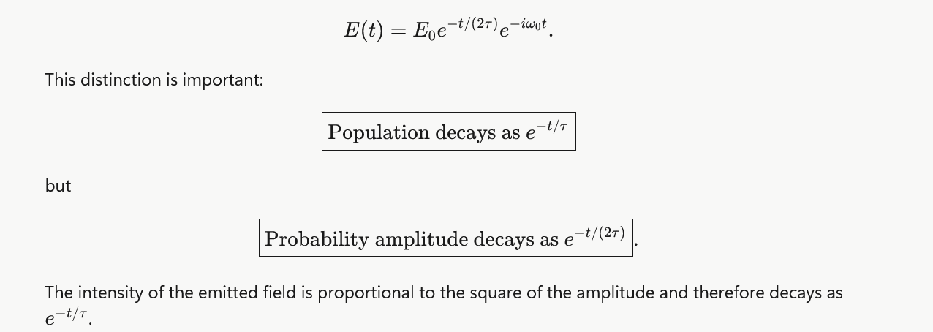

Slide 13
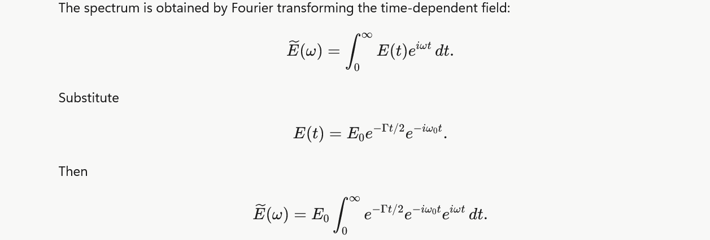

Slide 14
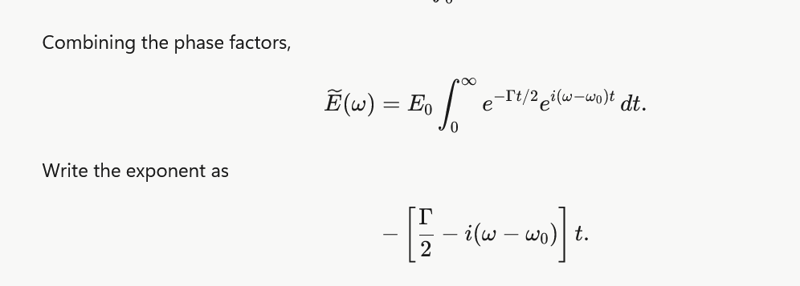
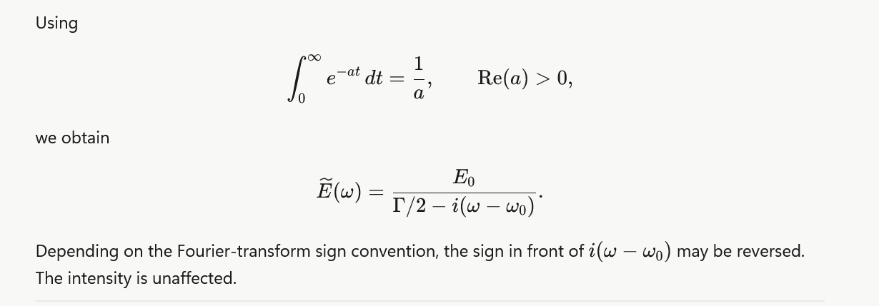

Slide 15
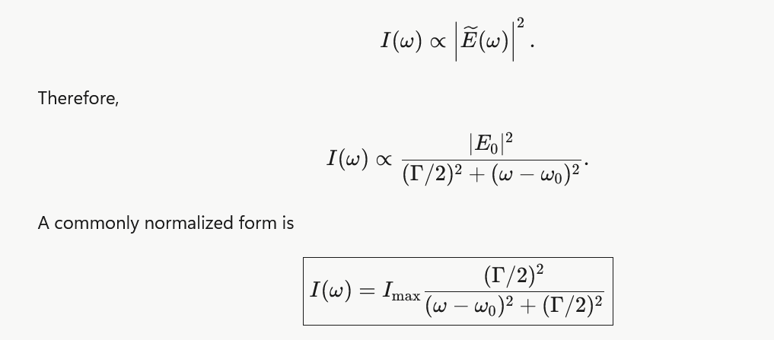

Slide 16
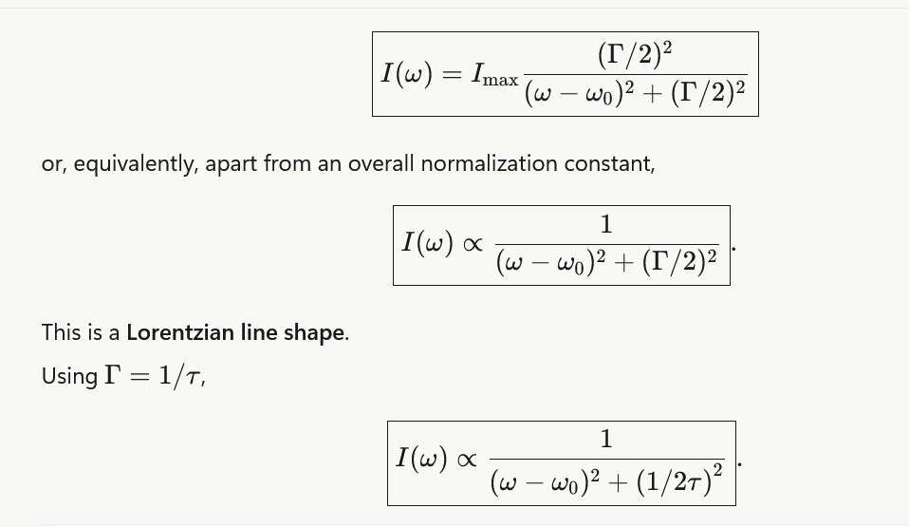

Slide 17
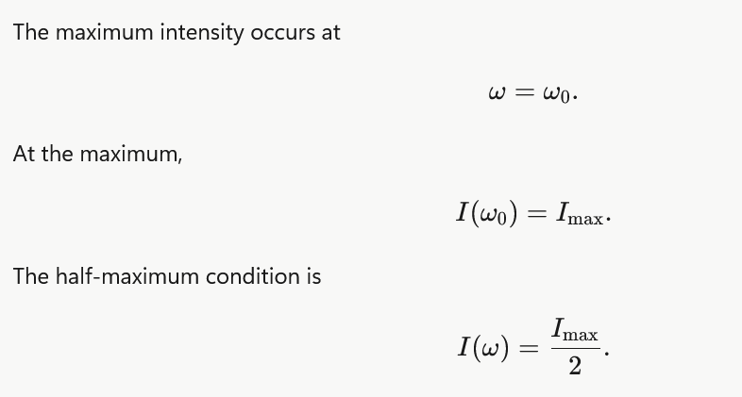
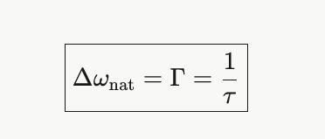

Slide 18
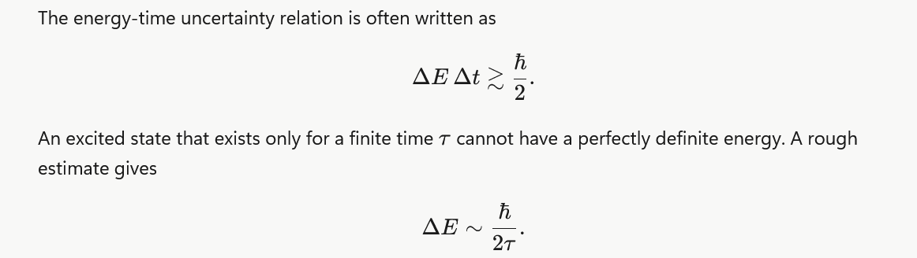

Slide 19
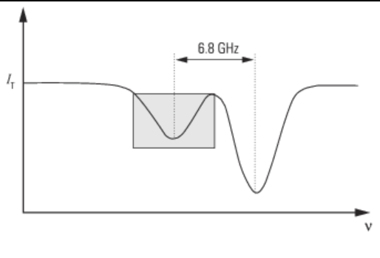
Natural line width and Doppler broadening line width of spectral line and line shape
THz

Slide 20
Doppler Broadening of the spectral lines

Slide 21
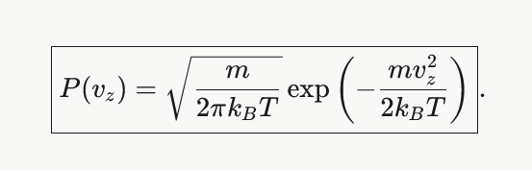
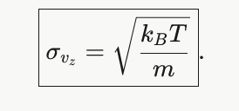
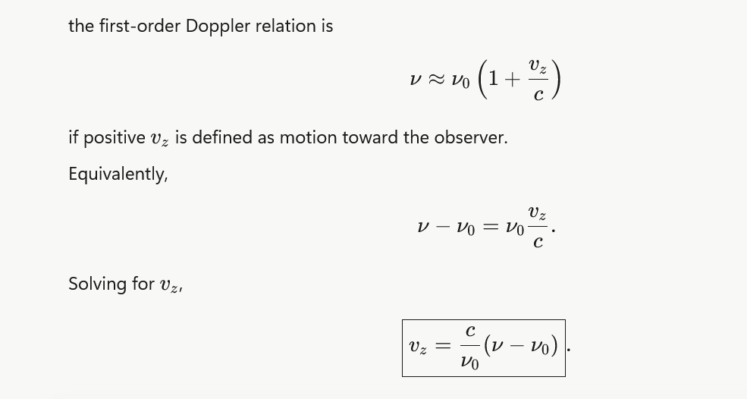

Slide 22
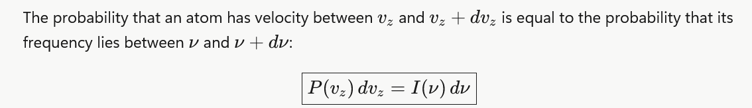
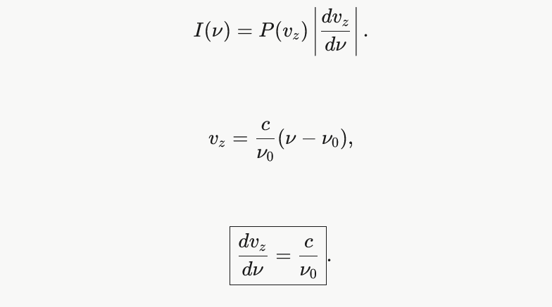

Slide 23
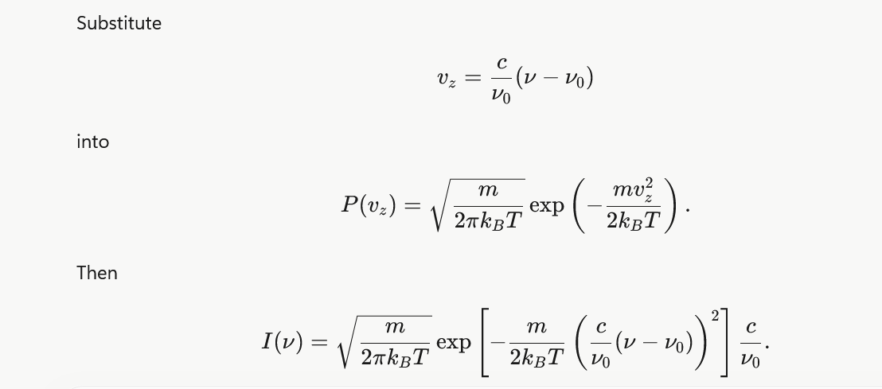
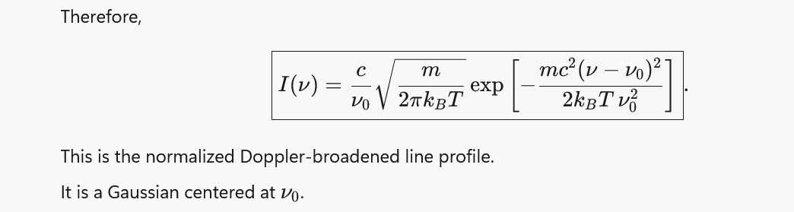

Slide 24
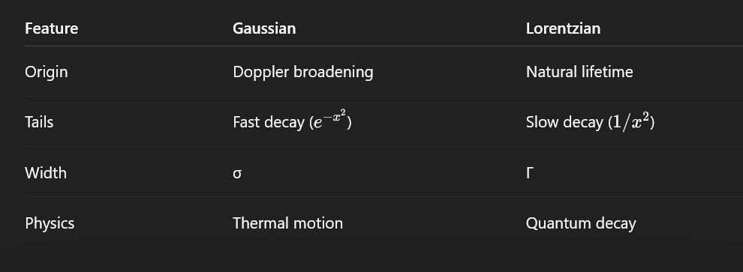

Slide 25

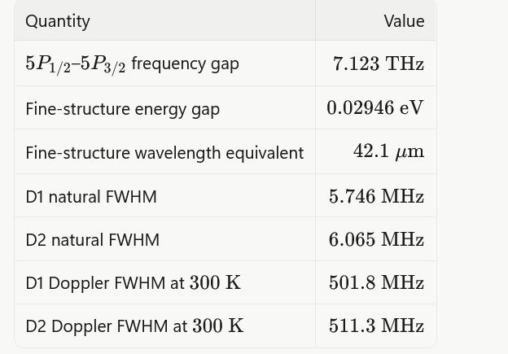

Slide 26
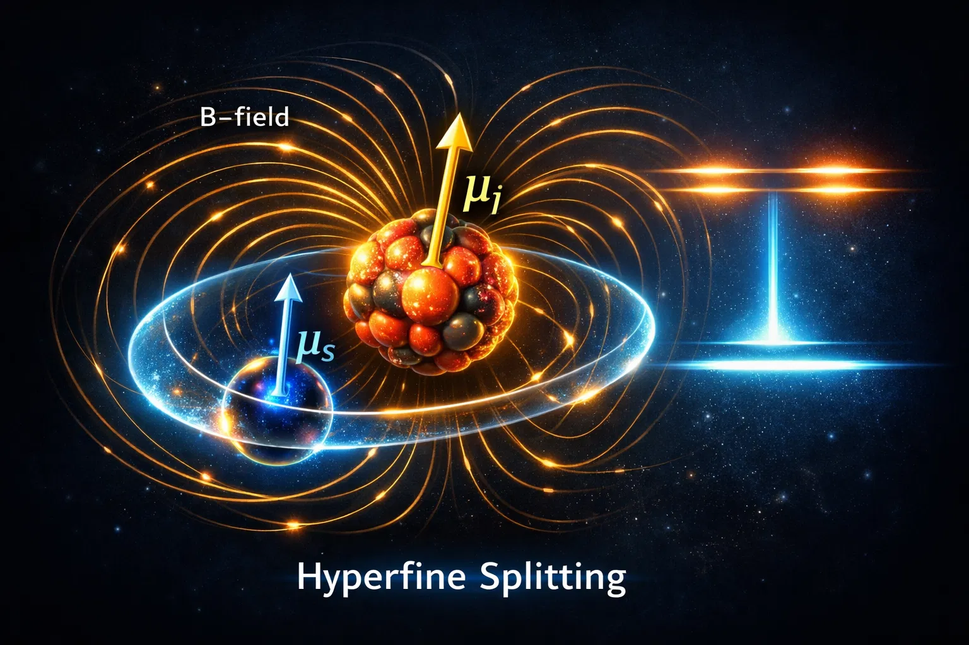

Slide 27
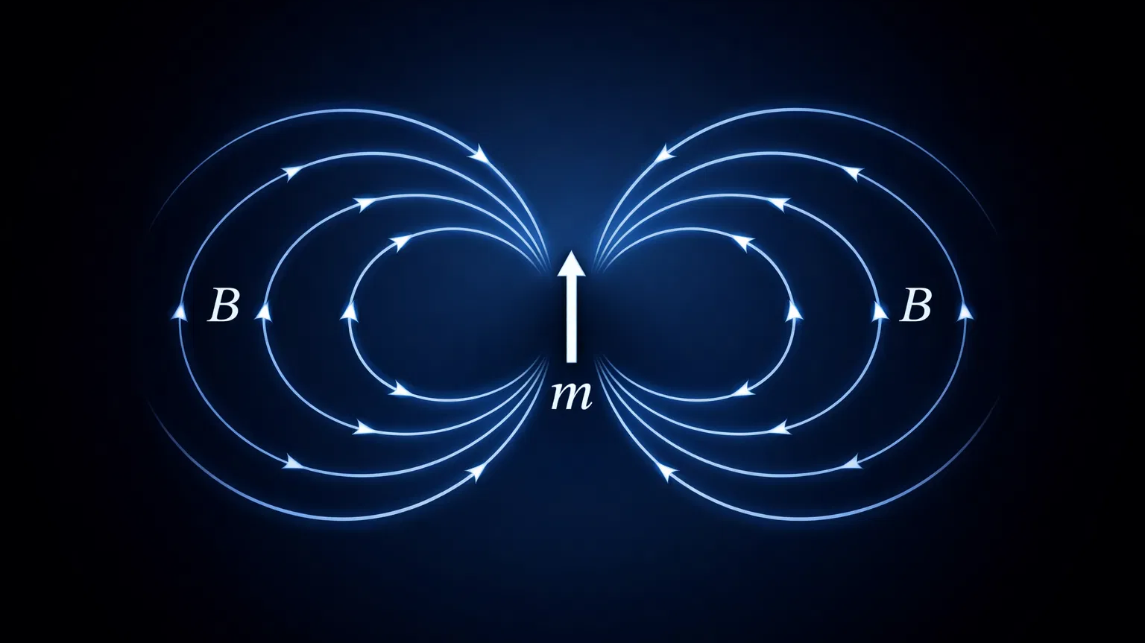

Slide 28
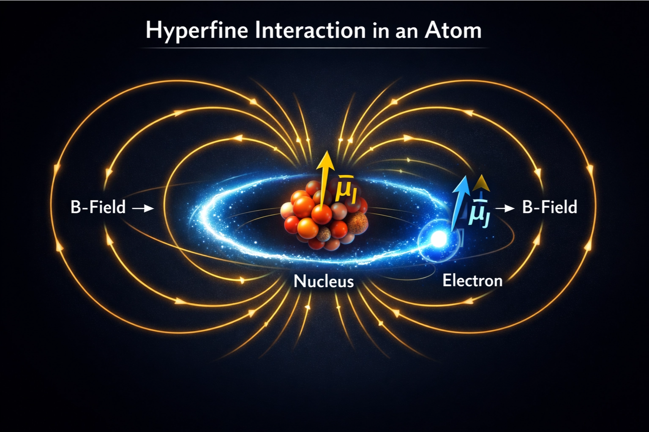

Slide 29
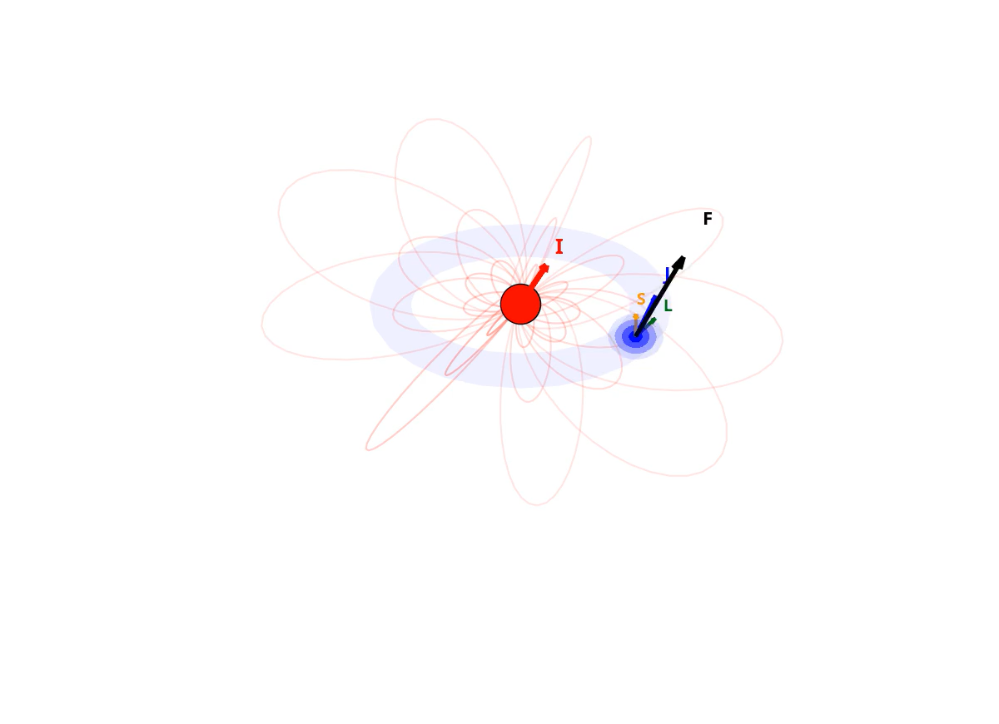

Slide 30
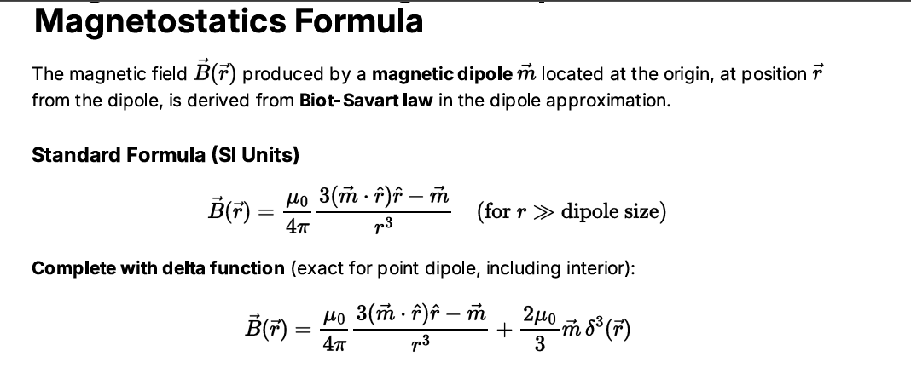
Step 1

Slide 31
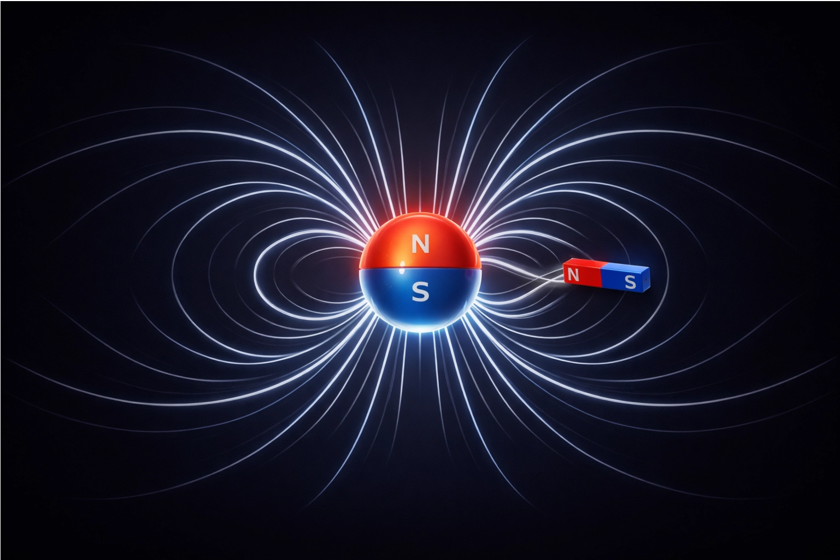

Slide 32
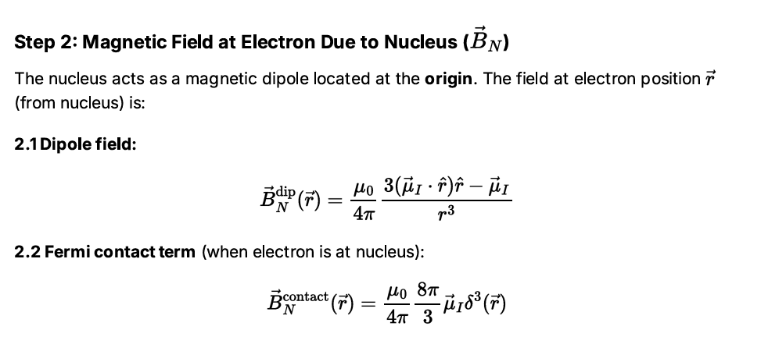
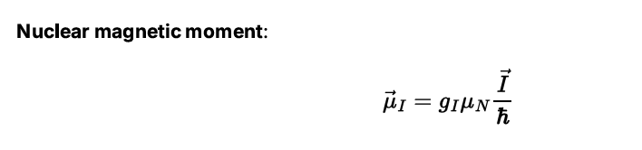

Slide 33
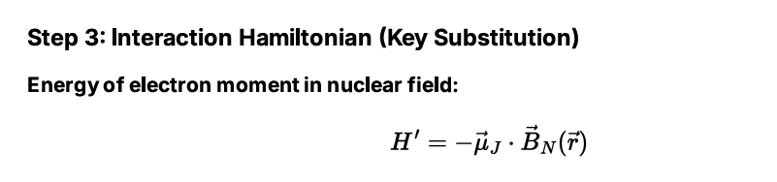
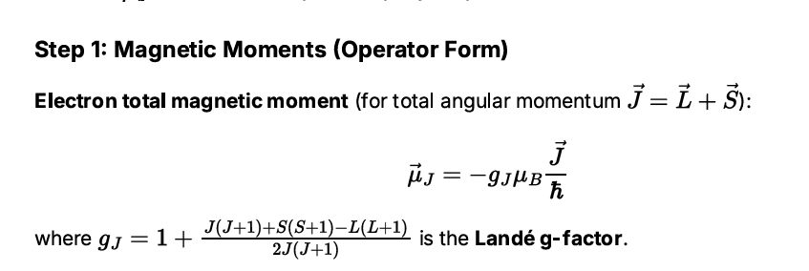

Slide 36
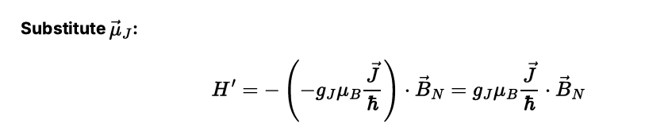
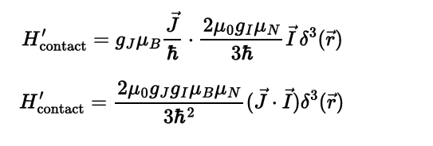
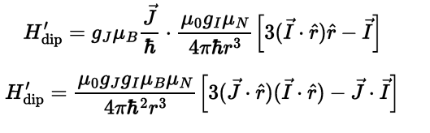
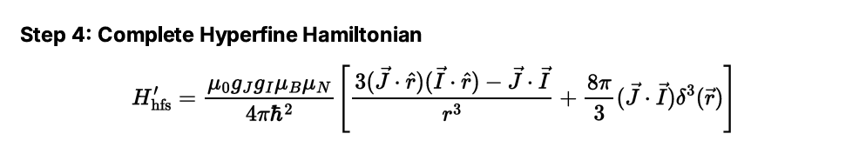

Slide 37
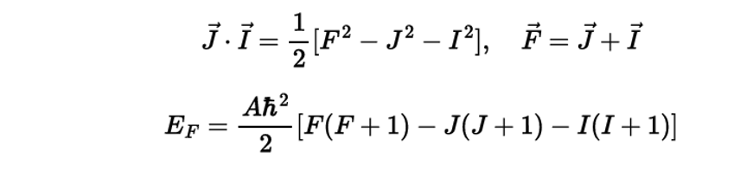
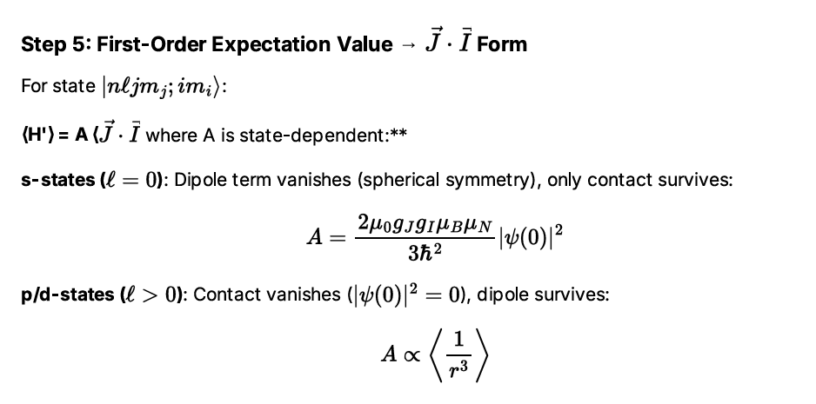
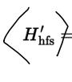





Slide 38
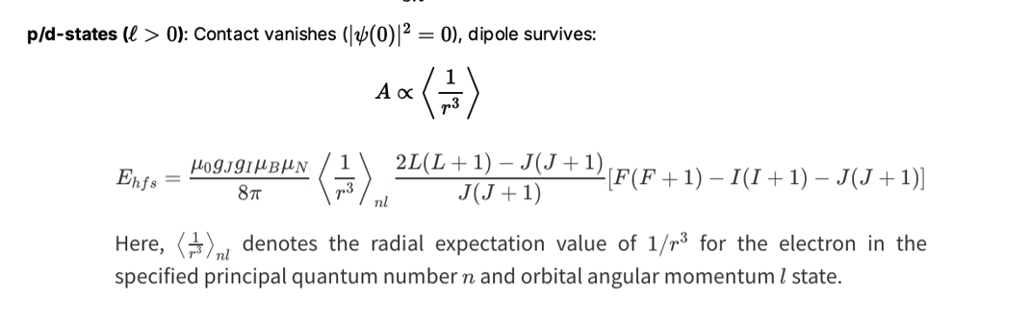
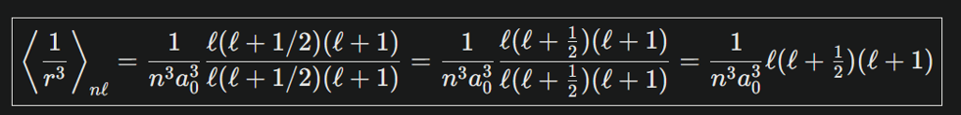

Slide 39
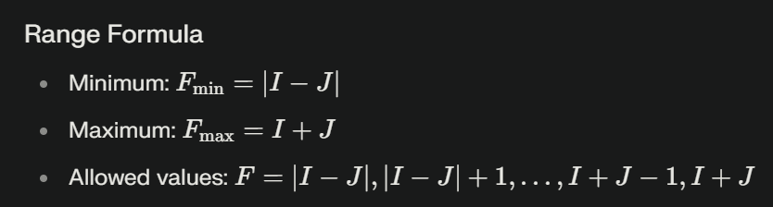
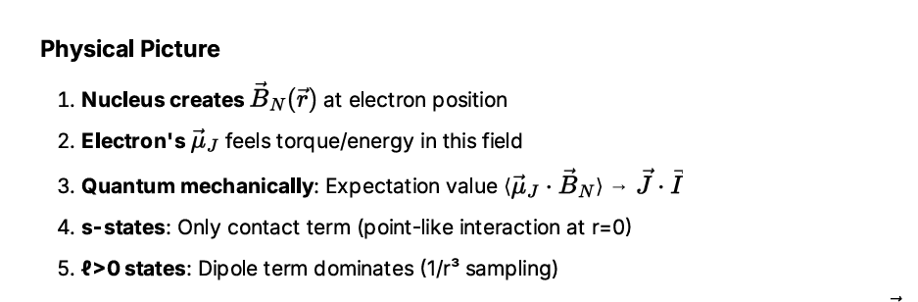

Slide 40
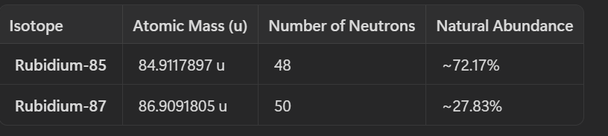



Slide 41
EP3203 Atomic and Molecular Physics
3-1-2-5

Slide 45
Doppler free atomic gas saturation absorption/pump probe (signal) hyperfine spectroscopy:
A land-mark/game changer experiment of modern cutting edge atomic physics

Slide 46


Slide 48


σ = 2GHz
MHz
MHz

Slide 49


Slide 52


Slide 53
Perturbation to the atom by an external magnetic field
Zeeman Splitting of atomic energy levels

Slide 54


