Slide 1
Highlights of the course
Co-ordinate Systems
Introduction to Vector Operators
Work , Energy and Conservation laws
Rigid body in motion
Oscillations and Waves
Quantum Physics

Slide 2
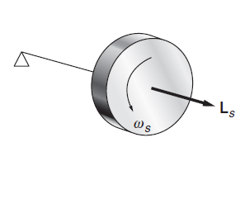
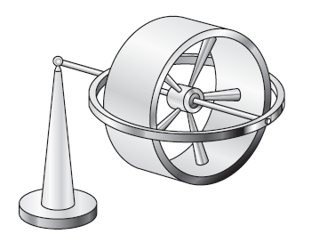
Gyroscope

Slide 3
Thought Experiment!

Slide 4
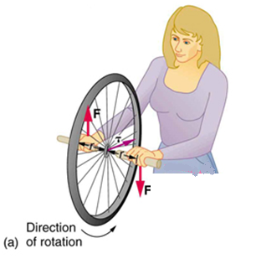
Disk rotated by twist in outer space
Y
τ, L, Ω
F for Δt time
X
(Axis of rotation)
F for Δt time
Directions of Torque, Angular momentum and Angular velocity?

Slide 5
Disk spinning in outer space
Y
L_{s}, ω_{x}
X
X
Directions of spin Angular momentum and Angular velocity?

Slide 6
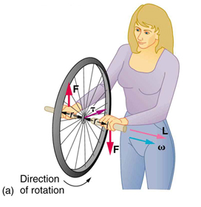
Disk (spin + twist) in outer space?
F for Δt time
F for Δt time
How will be the motion of Disk?
Spin and Rotate?

Slide 7
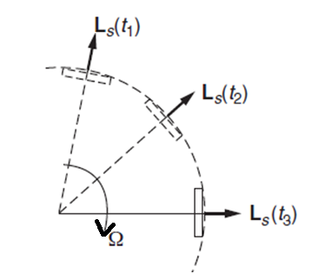
Disk (spin + twist) in outer space?
L_{s}
For the disk to spin and rotate, there must be an external torque (dL_{s}/dt) always, which will change the spin angular momentum.
Spin and rotation will not happen simultaneously!
Counter Intuitive!

Slide 8
Disk (spin + twist) in outer space?
τ
Z
L_{s}
Disk orients in the direction of torque, whereas the force was applied in the y direction!
Counter Intuitive!

Slide 9
View along X-axis side
L_{s}

Slide 10
Disk (spin + twist) when continuous torque applied externally?
F Continuosly
Δ
L_{s}
How will be the motion of Disk?
Spin and Rotate?

Slide 11
Gyroscope

Slide 12
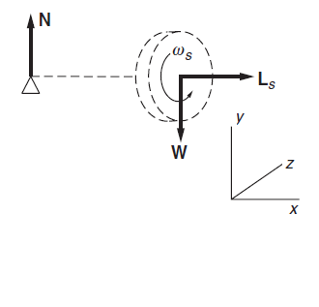
Gyroscope Precision
W

Slide 13
Gyroscope Precision
x
l
z
TOP VIEW
-Z
X

Slide 14
Vector nature of angular velocity and angular momentum
Direction of velocity is tangential to the circle

Slide 15
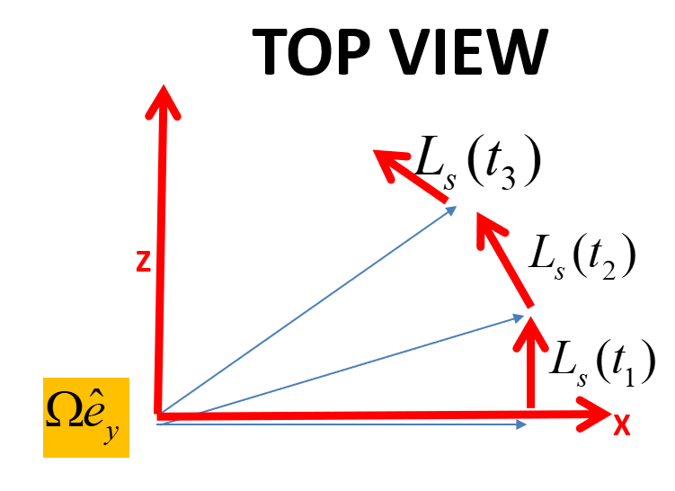
Gyroscope Precision
x
l
z
The torque on the gyroscope must account for the change in L_{s}

Slide 16
If there were no spin
L_{s} =0 then $∆L_{Z}$ = $∆L_{s}$=0
(Just like first case)
L_{s}+$∆L_{Z}$
$∆L_{Z}$ = $∆L_{s}$
x
L_{s}

Slide 17
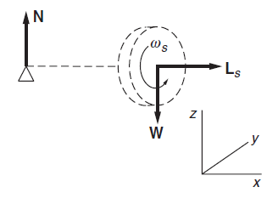
Gyroscope Precision
l

Slide 18
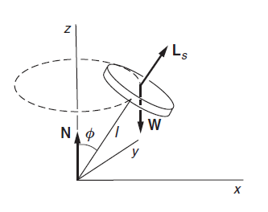
Gyroscope Precision
y
Consider a gyroscope in uniform precession with its axle at angle φ with vertical
The horizontal component of angular momentum is L_{s}sin φ
z
The precessional velocity is independent of φ

Slide 19
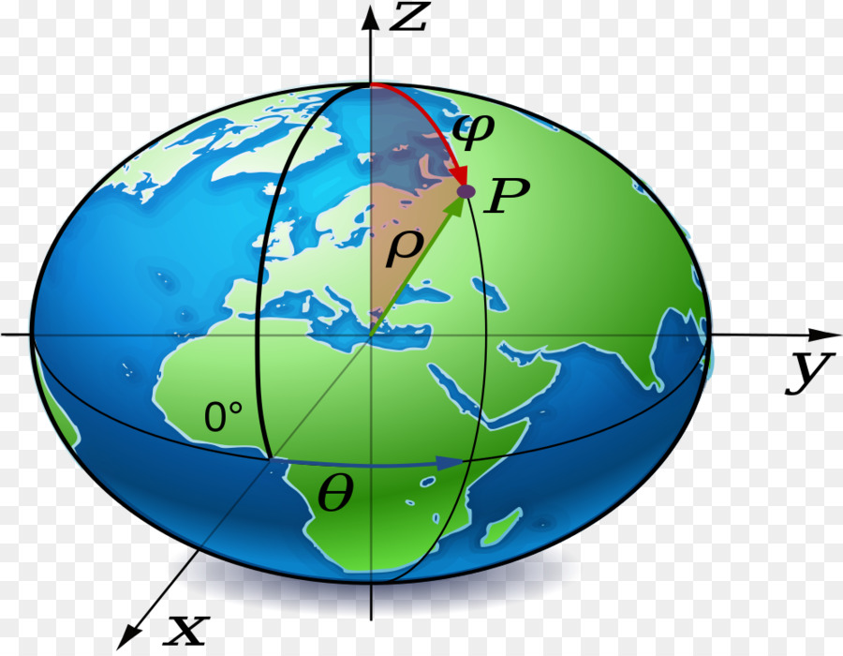
Some consequences of Gyroscopic motion
a. Precession of the spin axis
21 Km

