Slide 1
Quantum Physics

Slide 2
2
Particle in an impenetrable box
Are you kidding?

Slide 3
Consider a quantum mechanical particle trapped inside an impenetrable box of length L.
(a) Write the schrödinger equation for the system and solve it appropriately
(b) Obtain the energy from boundary condition .
(c) Plot the energy diagram.
(d) Plot the wave function
(e)Normalize the wavefunction and plot the |ψ(x)|²

Slide 4
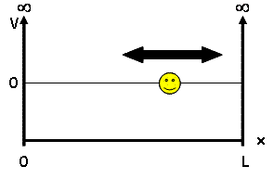
Solve the Schrödinger’s equation subjected to Boundary Conditions

Slide 5
Apply the Boundary Condition-1
Apply the Boundary Condition-2

Slide 6
n=1,2,3,….

Slide 7
(c) Plot the energy diagram.

Slide 8
Quantized energy levels

Slide 9
n=1,2,3,….

Slide 10
(d) Plot the wavefunction

Slide 11
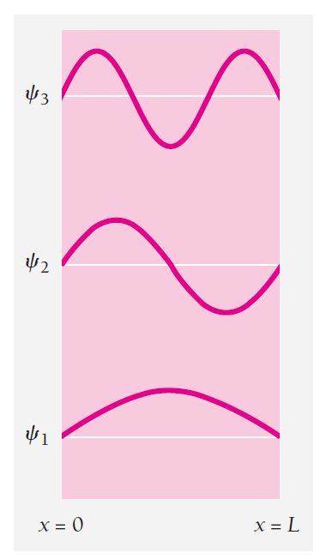

Slide 12
(e) Normalize and Plot the probability density

Slide 13
Normalize the ψ(x)
C²
=1
C²
=1

Slide 14
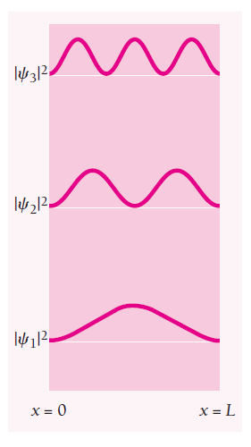

Slide 15
Expectation value of position

Slide 16
Expectation value of momentum
Guess why?

Slide 17
Particle in a box

Slide 18
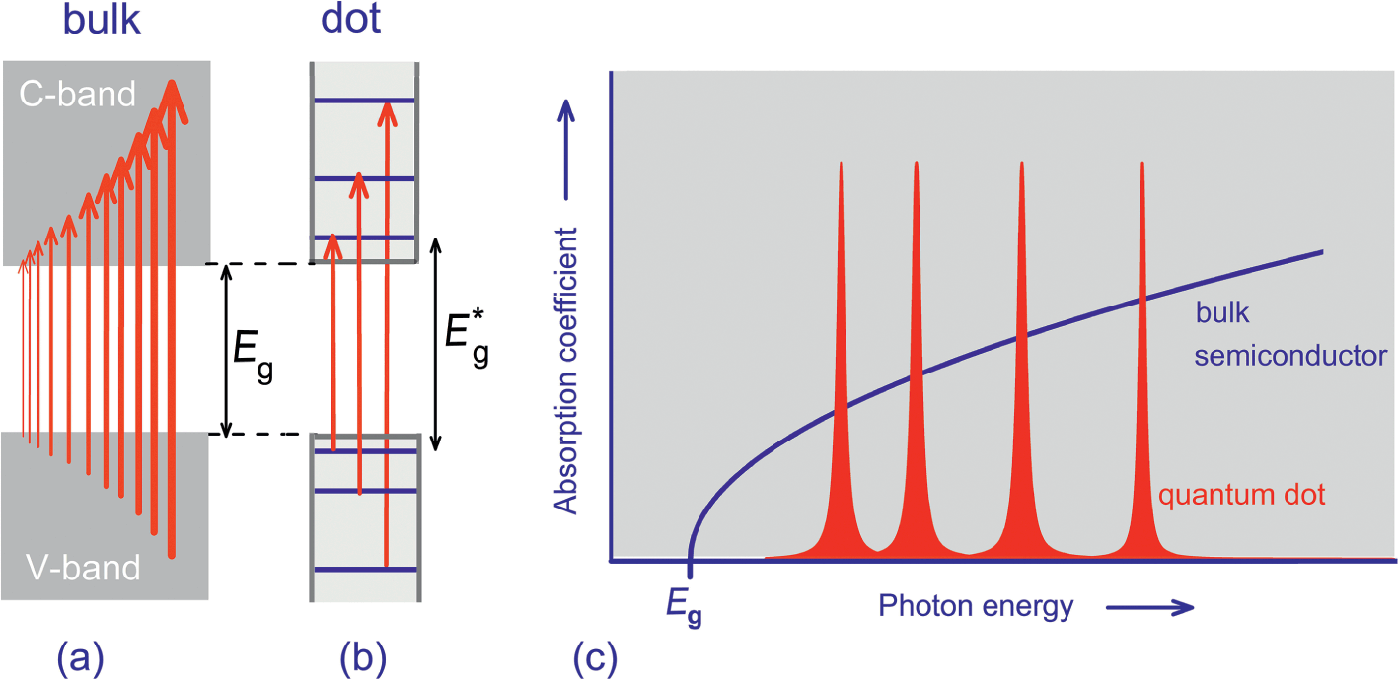
Electron confinement effects in semiconductor

Slide 19
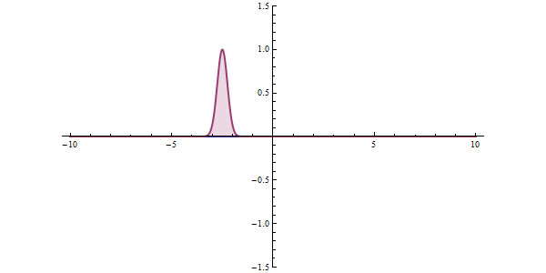
Quantum Tunneling

Slide 20
Quantum: Wave function
Classical
U
I
E
x

Slide 21
Solving in region II
Quantum wave function
U
II
E
x

Slide 22
Region III
V
III
x

Slide 23
Wave functions in 3 regions

Slide 24
Physical Interpretation
V
I
II
III
E

Slide 25
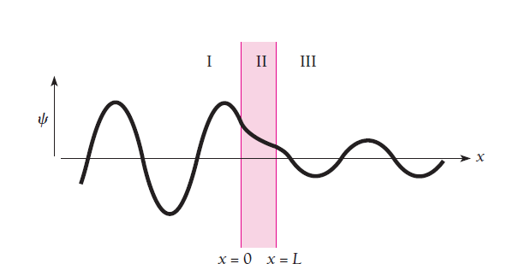
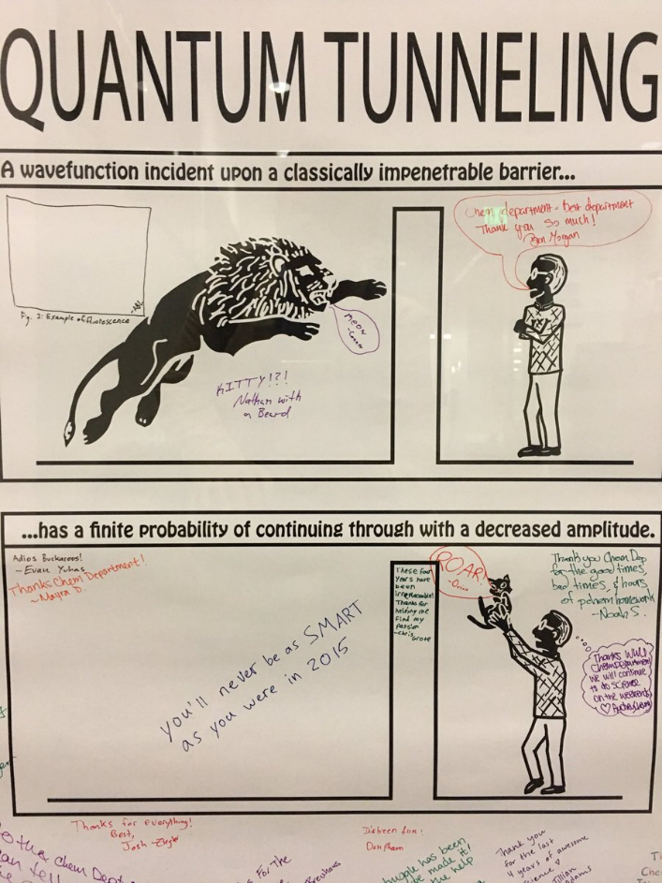
Effect of Tunneling!

Slide 26
Determining the relation between the coefficients A’s and B’s
Tunneling Probability or Tunneling coefficient

Slide 27
Using Boundary Conditions
Recollect
x=0

Slide 28
Using first boundary conditions
Using second boundary conditions

Slide 29
V
II
III
x=a

Slide 30
Using first boundary conditions
Using second boundary conditions

Slide 31
Find the relation between coefficients A_{III} and A_{I} from eqns 1,2,3 and 4

Slide 32
Tunneling Probability or Tunneling coefficient

Slide 33
Applications
Alpha decay
Scanning Tunneling Microscope (STM)

Slide 35
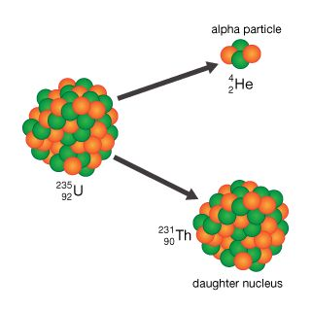

Slide 36
