Slide 2
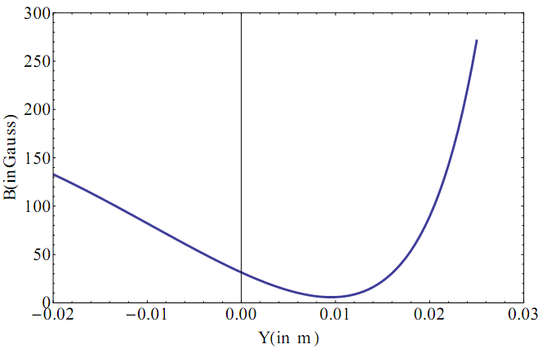
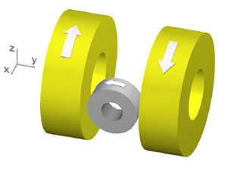
Technique to reach ultra low temperatures
Laser cooling and trapping
MOT
Temperature in a MOT is limited to Doppler Temperature T_{D} ≈ 200 µK
Magnetic trap - Quadrupole Ioffe trap
Z
X
O

Slide 3
MOT Coil
+
Ioffe Coil
Z
X
O

Slide 4
MAGNETIC TRAPPING
A conservative Trap/ Potential for laser cooled atoms
No Laser Cooling Lights, they are off

Slide 5
How to use this as a Conservative Trap?
Loading from MOT to Magnetic TRAP

Slide 6
Cooling phases
Doppler
Cooling
Milli Kelvin range
MOT
Atomic density
Increased
Cooling is limited
Upto Doppler Temp due to light
Magnetic Trapping
Need
Multi-Level
Treatment.
2 level model fails…
Cooling Beyond Doppler Limit
Quantum nature of atoms observed
Evaporative Cooling

Slide 7
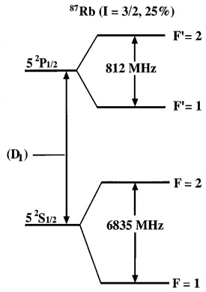
MOT
-B Location
-2
+2
For emission
ΔmF = 0, +/-1
ΔF=0, +/-1
Repump,
Π POLARIZED
+2
+1
mF
σ+Light, ΔmF = +1
-1
+1

Slide 8
MOT
+B
VICE VERSA

Slide 10
MOT
-B Location
-2
+2
For emission
ΔmF = 0, +/-1
ΔF=0, +/-1
Repump,
Π POLARIZED
+2
+1
mF
σ+Light, ΔmF = +1
-1
+1

Slide 11
MOT to MAGNETIC TRAP
LIGHT FIELD IS OFF
ATOMS REMAIN IN mF = +1 STATE

Slide 12
-B Location
a
-2
+2
Atom has electron in mF = +1 state
+2
+1
mF
-1
+1

Slide 13
What happens in +B location?

Slide 14
MOT
+B Location
+2
-2
For emission
ΔmF = 0, +/-1
ΔF=0, +/-1
Repump,
Π POLARIZED
-2
-1
mF
σ-Light, ΔmF = -1
+1
-1

Slide 15
MOT to MAGNETIC TRAP
LIGHT FIELD IS OFF
ATOMS REMAIN IN mF = -1 STATE

Slide 16
+B Location
a
-2
+2
Atom has electron in mF = -1 state
+2
+1
mF
+1
-1

Slide 20
MAGNETIC TRAP
IMMEDIATELY AS LIGHT GETS OFF MAGNETIC COILS FOR
MAGNETIC TRAP GETS ON
Nearly Harmonic

Slide 21
Doppler
Cooling
MOT
Magnetic
Trap
Laser
Power
ω₀-kv_{d}
Laser
Frequency
Cooling+
Repump
ω₀ - ω_{zeeman} - kv
MOT COIL
IOFFE
COIL

Slide 22
Potential seen by the atom in different mF states
1/2 kx²
mF = +1
mF = 0
-1/2 kx²
mF = -1

Slide 23
Restoring Force
Hence, restoring force is experienced for atoms having electron in mF =+1 state only (F=-Kx form)
Only those toms will ‘feel’ a trapping potential
This is like a trap for atoms having electron in mF =+1 inside this region
where +1g_{F}µ_{B}B(x) >>> ½ mv_{D}²

Slide 24
Atomic cloud
½ mv_{D}²
mF = +1
+1g_{F}µ_{B}B(x)
+1g_{F}µ_{B}B(x) >>> ½ mv_{D}²
Atoms who has ½ mv²>>> +1g_{F}µ_{B}B(x) will escape the trap leaving
Colder ones behind and they thermalize
Evaporation Process……

Slide 25
Coffee cup!

Slide 27
Self Evaporation
mF = +1
Overall temperature goes down

