Slide 1
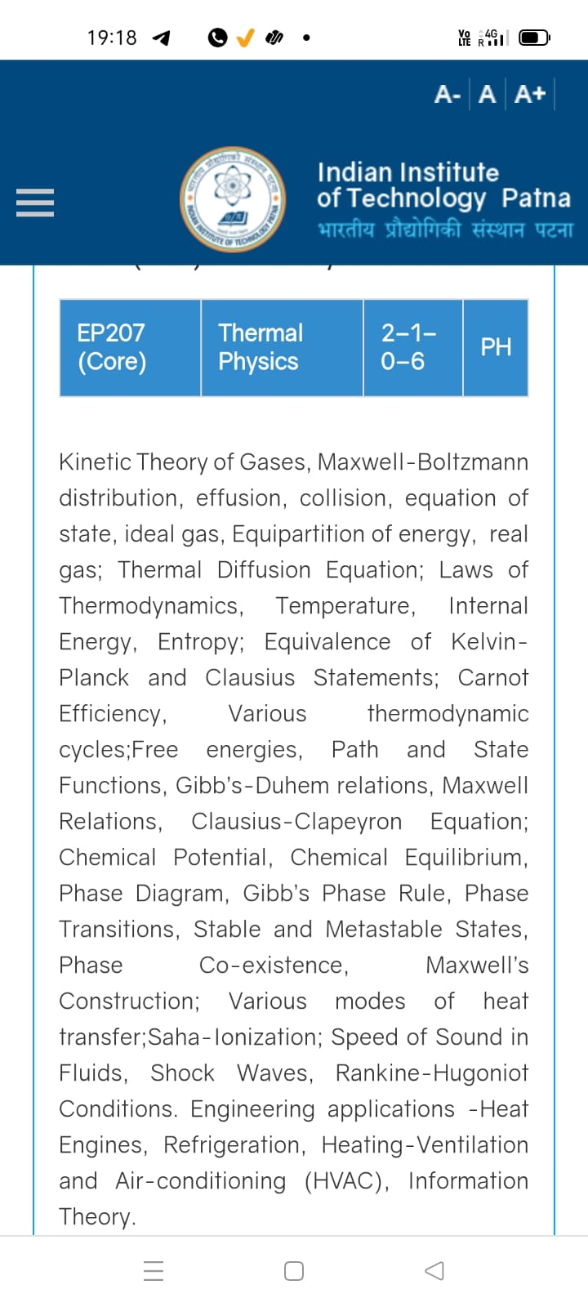
Season 5, Lecture 3 (S5,L3):
EP2104 Thermal physics with engineering applications
3-1-0-4

Slide 2
Time | 11:11:55 | 12-12:55 | 3-3:55 | 4- 4:55 | 02-02:55
Day
Monday |  | R103
Tuesday |  |  | R102
Wednesday |  |  |  | R103
Thursday | R103

Slide 3
 |  | L1 | L2 | L3
 | "Anirudh Karthikeyan" <anirudh_2501ph19@iitp.ac.in>; | p | p | p
2. | "Anshita Meena" <anshita_2501ph08@iitp.ac.in>; | p | p | p
3. | "Aritro Ghosh" <aritro_2501ph03@iitp.ac.in>; | p | a | p
4. | "Arunya Guha" <arunya_2501ph28@iitp.ac.in>; | p | p | a
5. | "Avala Venkata Hemanth" <avala_2501ph37@iitp.ac.in>; | a | a | a
6. | "Ayush Kumar" <ayush_2501ph24@iitp.ac.in>; | p | p | a
7. | "Badavath Madhulatha" <badavath_2501ph38@iitp.ac.in>; | p | p | a
8. | "Banothu Somanna" <banothu_2501ph36@iitp.ac.in>; | p | p | p
9. | "Chenche Shankara Suman" <chenche_2501ph07@iitp.ac.in>; | p | p | p
10. | "Davala Bhuvana Karthik" <davala_2501ph25@iitp.ac.in>; | p | p | p

Slide 4
 |  | L1 | L2 | L3
11. | "David Pratap Singh" <david_2501ph26@iitp.ac.in>; | p | p | q
12. | "Deepak Kumar" <deepak_2503ph03@iitp.ac.in>; | p | p | q
13. | "Dekka Nivas" <dekka_2501ph29@iitp.ac.in>; | p | p | q
14. | "Gamit Marlon Maheshbhai" <gamit_2501ph21@iitp.ac.in>; | p | p | q
15. | "Himesh Katare" <himesh_2501ph33@iitp.ac.in>; | p | p | q
16. | "Jadhav Vedant Rajesh" <jadhav_2501ph06@iitp.ac.in>; | p | p | q
17. | "Johaan Peter Thekkan" <johaan_2501ph05@iitp.ac.in>; | p | p | q
18. | "Karri Akshara" <karri_2501ph13@iitp.ac.in>; | p | p | q
19. | "Kashvi Mehta" <kashvi_2501ph32@iitp.ac.in>; | p | p | q
20. | "Kirti Chandra" <kirti_2501ph35@iitp.ac.in>; | p | p | q

Slide 5
 |  | L1 | L2 | L3
21 | "Krishna Mule" <krishna_2501ph04@iitp.ac.in>; | p | p | q
22. | "Kummetha Sai Darshan Reddy" <kummetha_2501ph17@iitp.ac.in>; | a | a | a
23. | "Maddirala Bhanu Kiran" <maddirala_2501ph31@iitp.ac.in>; | p | p | q
24. | "Manish" <manish_2501ph22@iitp.ac.in>; | p | p | q
25. | "Mohammad Owais Ansari" <mohammad_2501ph18@iitp.ac.in>; | p | p | q
26. | "Muhammed Rehaan Sharafudheen" <muhammed_2501ph20@iitp.ac.in>; | p | p | q
27. | "Nikhil" <nikhil_2501ph34@iitp.ac.in>; | p | p | q
28. | "Poodari Shivani" <poodari_2503ph04@iitp.ac.in>; | p | p | q
29. | "Rahul Yadav" <rahul_2501ph23@iitp.ac.in>; | p | p | q
30. | "Rohit David Paul" <rohit_2501ph11@iitp.ac.in>; | p | p | a

Slide 6
 |  | L1 | L2 | L3
31 . | "Ronak Jakhar" <ronak_2501ph10@iitp.ac.in>; | p | p | p
32. | "Rudraneel Shee" <rudraneel_2501ph15@iitp.ac.in>; | p | p | p
33. | "S Ragul Raagav" <s_2503ph02@iitp.ac.in>; | p | p | p
34. | "Sara Khan" <sara_2501ph30@iitp.ac.in>; | p | p | p
35. | "Shaik Jabeer Sulthan" <shaik_2501ph16@iitp.ac.in>; | p | p | p
36. | "Shourya Sharma" <shourya_2503ph01@iitp.ac.in>; | p | p | a
37. | "Shreyas Saraswatiprasad Waikar" <shreyas_2501ph02@iitp.ac.in>; | p | p | p
38. | "Snehardra Das" <snehardra_2501ph14@iitp.ac.in>; | p | p | p
39. | "Tejeswin R" <tejeswin_2501ph09@iitp.ac.in>; | p | p | a
40. | "Varkatam Akshaya" <varkatam_2501ph12@iitp.ac.in>; | p | p | p

Slide 7
 |  | L1 | L2 | L3
41. | "Vivanshu Chauhan" <vivanshu_2501ph01@iitp.ac.in>; | p | p | p
42. | "Yogesh Kumar" yogesh_2501ph27@iitp.ac.in | p | p | p
Attendance: 75% mandatory

Slide 8
Introduction to
Kinetic theory of gases

Slide 9
Focus on “gaseous system”

Slide 10
Will deal with only gases now
What is Temperature?
From Kinetic Theory of gases

Slide 11
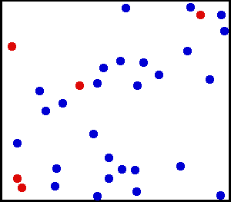
A theoretical model is required for a dilute gas enclosed in a container

Slide 12
Huge number of particles

Slide 13
What does classical gas consist of?
Point particles
Non-interaction
Only Kinetic energy
Only Elastic collisions

Slide 14
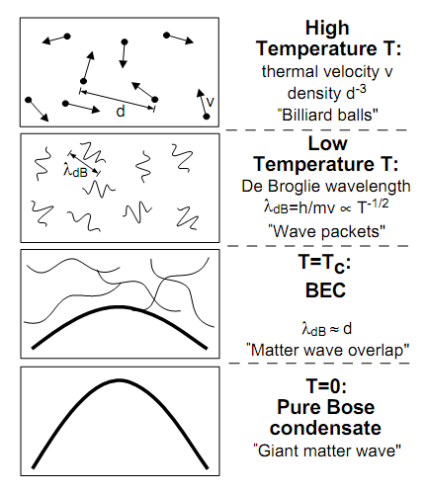

Classical and Quantum gas
Classical gas
The Approximation
Quantum gas
Larger T
$$d≫λ_{dB}$$
Lower density

Slide 15
Will discuss on “Classical Gas”

Slide 16
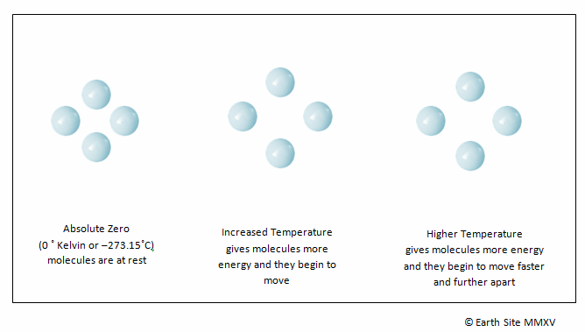

Slide 17
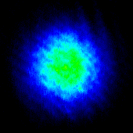
Hotter to colder
Imaging
Of
Atomic gas
Temperature of atomic gas is reduced as a function of time

Slide 18
Approach of “Kinetic Theory”
Distribution
Gas molecules
Classical Microscopic Theory

Slide 19
Kinetic Theory of Gases
Avagrado and Loschmidt – 19th century
“Kinetic theory of gas is a microscopic theory which concerns itself with the average motion of
atoms and their collisions with wall and other objects in order to calculate the equation of the
state for the ideal gas”
Kinetic theory of gas is limited to monoatomic gas with many assumption’s made on the
behavior of ideal gas

Slide 20
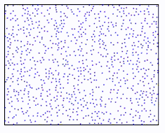
Kinetic Theory of Gas: It’s assumptions
Molecules/particles are moving in all random directions
Treat molecules/particles as point classical particles, since size of molecules are much smaller compared to their intermolecular
distance
No interaction between the molecules
No forces of attraction or repulsion
between molecules
N
Gas is under equilibrium condition
V
No gravity
Only elastic collisions
Uniform distribution of atoms such that N/V is a constant (homogenous)
dV is very small compared to V, still it can have large number of molecules in dN

Slide 21
Maxwell-Boltzmann Distribution: Kinetic Theory
how many molecules are moving between velocities v and v + dv
y
Random motion in all directions
N molecules/particles
x
z
Velocity components are completely independent
And completely Isotropic
Collisions with wall is always
Perpendicular and only linear

Slide 22
Kinetic Theory of Gas: It’s assumptions
Molecules can have any speed’s between 0 to infinity
V
N
Velocity distribution and distribution function
Kinetic theory help us to find Maxwell-Boltzmann distribution function which is used to determine
Probability of molecules/particles are moving between velocities v and v + dv

Slide 23
Approach of “Kinetic Theory”
Finding a Distribution Function
Microscopic theory

Slide 24
Finding a distribution function

Slide 25
Expectation or average: no of students v/s height
20
No of students
10
5
4
4.5
5
Height

Slide 26

Expectation or average position
Probability
0.6
0.4
1m
2m
Distance (x)

Slide 28
What type of distribution function?
Will it be a classical one or Quantum mechanical one?

Slide 29

De Broglie wave length of a man at room temperature
Velocity 5m/s
Mass=70 kg
Find the De-broglie wavelength!

Slide 30
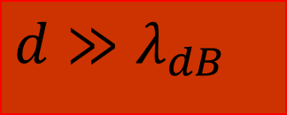
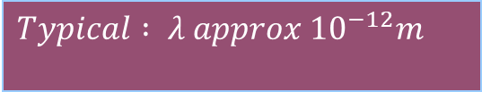
De Broglie wave length of atoms/molecules at room temperature
$$Typical : λ approx {10}^{−12}m$$
$$d≫λ_{dB}$$

Slide 31
At room temperature
Classical Theory holds good for atoms/
Molecules
Quantum effects
Are negligible

Slide 32
De Broglie hypothesis for an electron
Velocity 5m/s
Mass=9.1X10⁻³¹ kg
e
Find the De-broglie wavelength!

Slide 33
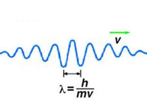
How do we understand the motion?
e

Slide 34
Expectation value of position of a quantum particle
Probability that the particle can be found in the interval dx
What is the expectation value of the position of the particle ?

Slide 35
For classical particles
Kinetic Theory is “good model”
Finding Distribution function
Microscopic theory

Slide 36
For convenience
Position space to Velocity space

Slide 37
Let us consider a small region of space

Slide 38
Let us consider a small infinitesimal region of space
“N” molecules
in container
Probability of molecules which are moving between
velocities v and v + dv?

Slide 39
Maxwell’s velocity distribution function and assumption’s

Slide 40
Maxwell’s velocity distribution function and assumption’s
A

