Slide 1
 |  |  | Lec5
1 | 1921PH19 | SAUMYASHREE BARAL | p
2 | 2321PH02 | ARYA KUMAR SIDDHARTH | p
3 | 2321PH07 | NAINCY SHRIVASTAVA | p
4 | 2321PH09 | PRITAM SAMANTA | p
5 | 2321PH10 | REETU SAINI | p
6 | 2321PH13 | SOUBHIK MUKHERJEE | p
7 | 2321PH14 | NEHA CHOUDHARY | p
8 | 2321PH15 | RABI DAS | p
9 | 2321PH19 | SHRUTI SARSWAT | p
10 | 2212PH02 | AMAN KUMAR | p
11 | 2212PH10 | BINAYAK ROUT | p
12 | 2212PH11 | DARPAN SARKAR | p
13 | 2212PH13 | GAURAV JAISWAL | p
14 | 2212PH17 | KAUSHIP SAHA | p
15 | 2212PH20 | NEELLOHIT KARMAKAR | p
16 | 2212PH23 | RITIK PAL | p
17 | 2212PH26 | SOUMIK KARMAKAR | p
18 | 2212PH32 | KAUSTAB BHARASA | a

Slide 2
Text Books/ References
First Pref: Class lecture notes/ Materials provided
Second Pref:
Textbooks:
C. J. Pethick & H. Smith, Bose-Einstein Condensation in Dilute Gases, Cambridge Univ. Press, Cambridge , 2008.
A. Griffin, D. W. Snoke & S. Stringari, Bose-Einstein Condensation, Cambridge Univ. Press, Cambridge, 1995.
Robert W. Boyd, Nonlinear Optics, Second edition, Academic press, 2003.
References
Scully, M. O., and M. S. Zubairy. Quantum Optics. Cambridge University Press, 1997.
Harold J. Metcalf, Peter van der Straten, Laser Cooling and Trapping, Springer, 1999.
Lambropoulos. P, Petrosyan. D, Fundamentals of Quantum Optics and Quantum Information, Springer 2007.
M. Lewenstein, A. Sanpera, and V. Ahufinger, Ultracold Atoms in Optical Lattices, Oxford University Press, 2012.

Slide 3
PH 603 Physics of ultracold atoms
Force experienced by atoms

Slide 6
Model: Force on a Hypothetical two level atom under motion interacting with
two lights (Co-prop and Counter Prop) simultaneously in 1-D

Slide 8
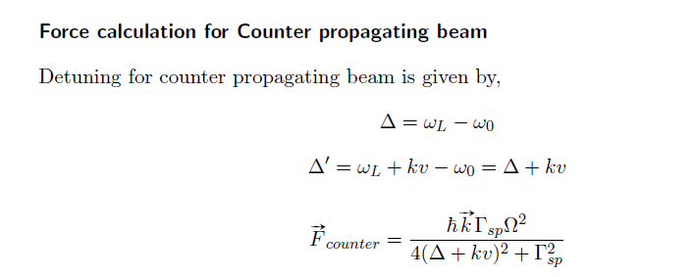

Slide 9
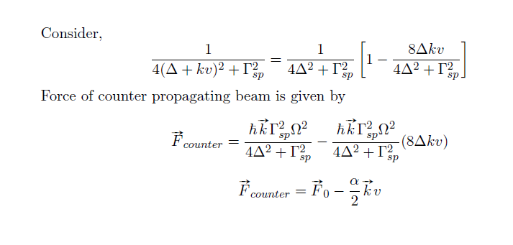

Slide 10
