Slide 1
Highlights of the course
Co-ordinate Systems
Introduction to Vector Operators
Work , Energy and Conservation laws
Rigid body in motion
Oscillations and Waves
Quantum Physics

Slide 2
Provisional Evaluation Scheme subject to approval

Slide 3
Materials to work out
David Morin, Introduction to Classical Mechanics, Cambridge University Press, NY, 2007
P. C. Deshmukh, Foundations of Classical Mechanics, Cambridge University Press, 2019
Mathematical Methods for Physicists Arfken
http://www.umich.edu/~ners312/CourseLibrary/MIT-CoordinateSystems.pdf
Chapter 1: Co-ordinate Systems
Mathematical Methods for Physicists Arfken
Introduction to electrodynamics, David J. Griffiths, Reed College. – Fourth edition
(Chapter 1)
P C. Deshmukh, Foundations of Classical Mechanics, Cambridge University Press, 2019
Introduction to Vector Operators
D. Kleppner and R. J. Kolenkow, An introduction to Mechanics, Tata McGraw-Hill, New Delhi, 2000.
David Morin, Introduction to Classical Mechanics, Cambridge University Press, NY, 2007
P. C. Deshmukh, Foundations of Classical Mechanics, Cambridge University Press, 2019
Work , Energy
and Conservation laws

Slide 4
Evaluation Time lines
Co-ordinate Systems
Introduction to Vector Operators
Quiz 1(Chapter 1 and 2)(Real time) 10 marks
Work , Energy and Conservation laws
Quiz 2 (Chapter3)(Real time) 10 marks
Mid Sem Exam(Chapter 1,2,3, 4 till
covered)(real time+ Assignment) 25 marks
Rigid body in motion
Scan and submit answers
In 24hrs
(Problems based)
Oscillations and Waves
Quantum Physics

Slide 5
Chapter-3:Work , Energy and Conservation laws

Slide 6
Recap….
If V(r) is path independent,
C
O
N
S
E
R
V
A
T
I
V
E
Curl of F is

Slide 7
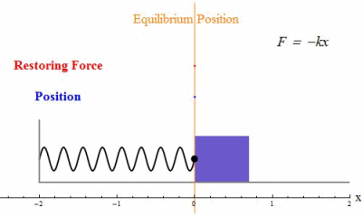
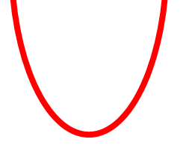
Concept of equilibrium
is useful for visualizing the stability of a system
Examples
1-D Harmonic Oscillator
V(x)
b
a
-X
c
X
Equilibrium of the system

Slide 8
Velocity Vs. Position plot
V
E₂ > E₁
Plot for energy = E₁
X
E₁
E₂

Slide 9
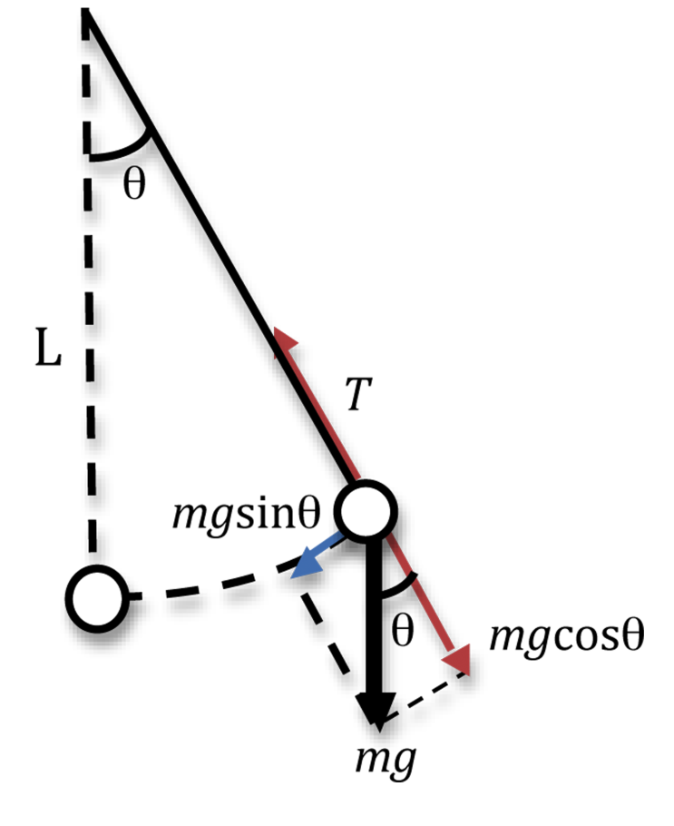
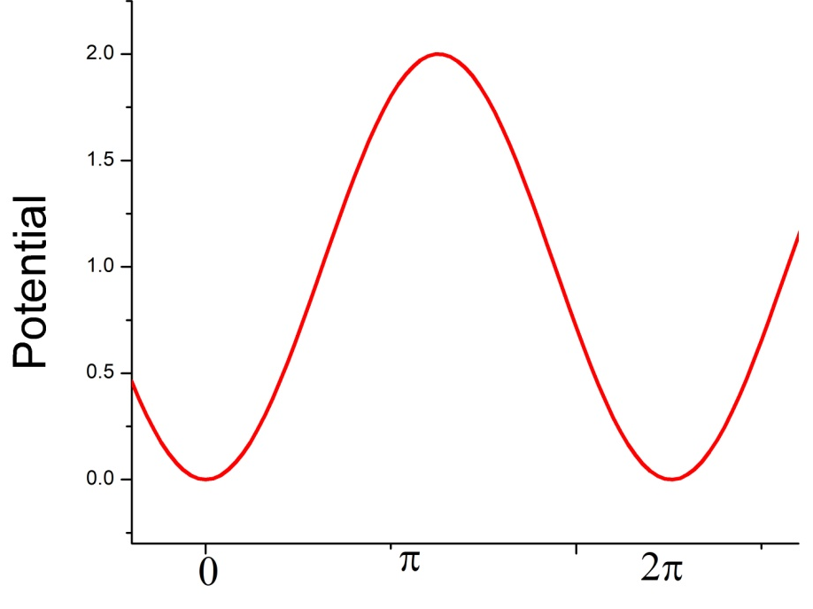
Concept of equilibrium
Simple Pendulum
Unstable equilibrium
$$θ=π$$
$$θ=0$$

Slide 10
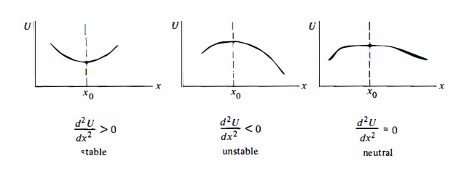

Slide 11
Plot v/s ?
Equation of ellipse
For small values of ɵ the equation is of ellipse. But as ɵ becomes larger it
Deviates from an ellipse

Slide 12
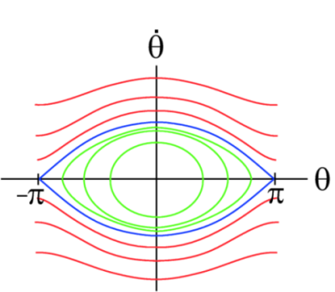
Plot v/s ?
For larger E , motion
Of the pendulum
Becomes
Circular motion

