Slide 1
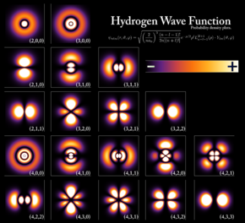
Chapter 6 Quantum Physics

Slide 2
RECAP: Quantum Physics
P
ΔP

Slide 3
Quantum nature of energy of matter

Slide 4
Shining light to a matter
LIGHT
SOURCE
Only
Discrete Energies
are absorbed
Something Quantum inside Matter?

Slide 5
What happens Inside?
Matter
is
Quantized
P.E. of atom is increased for a selective frequency by absorption
RECOLLECT HARMONIC OSCILLATOR: RESONANT FREQUENCY

Slide 6
Emission by spontaneous decay

Slide 7
Bohr atom model

Slide 8
Failure of Bohr Model
Energy spectra of multi electron atoms it could not explain
This theory could not explain the splitting of spectral lines in magnetic field (Zeeman effect) and in electric field (Stark effect). The intensity of these spectral lines was also not explained by the Bohr atomic model.

Slide 9
New mathematical framework is needed!

Slide 10
New frame work to understand Quantum Physics
Set of Postulates are made, first we need to believe them
They worked and could predict correctly many results

Slide 11
State of physical system
In classical mechanics how do you specify a state of a system or gain complete knowledge about the system?
Ans: by knowing x and P
Hence, to get full knowledge of a problem POSITION and MOMENTUM need to be known
Energy, Angular momentum etc could be known

Slide 12
State of physical system
In Quantum Physics this does not work. Why?
Ans: For QUANTUM particles its Uncertain
Uncertainty relation
This leads to first postulate in Quantum Physics

Slide 13
First Postulate Introduce a parameter called ψ(x)
This is obtained as Solution of Master Equation known as SCHRODINGER EQUATION, which give FULL INFORMATION

Slide 14
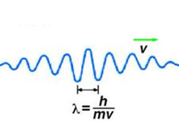
Postulate 1
The state of a quantum mechanical system is completely specified
by the wavefunction ψ(x).
Wavefunction gives a mathematical description of shape of the matter wave. This can be complex also.
ψ(x) and ψ’(x) must be single valued and continuous everywhere.

Slide 15
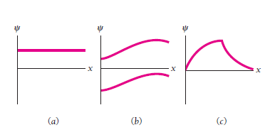
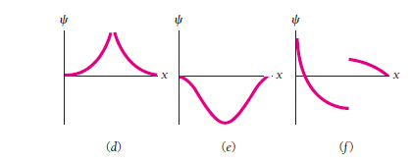
Lets See Some Examples….

Slide 16
Postulate 2
ψ*(x)ψ(x) is the probability density that the particle can be found at x.
For Quantum particles probability gives full information

Slide 17
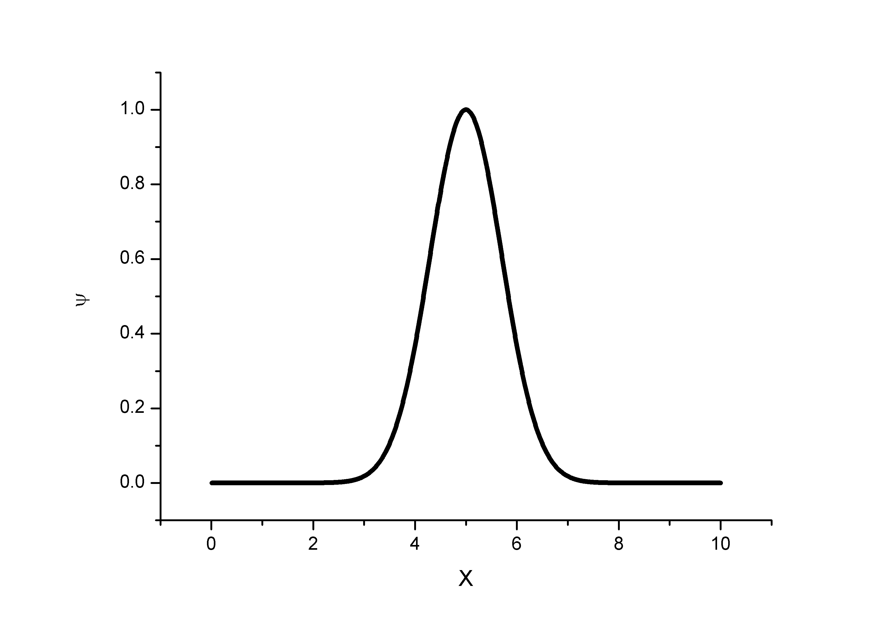
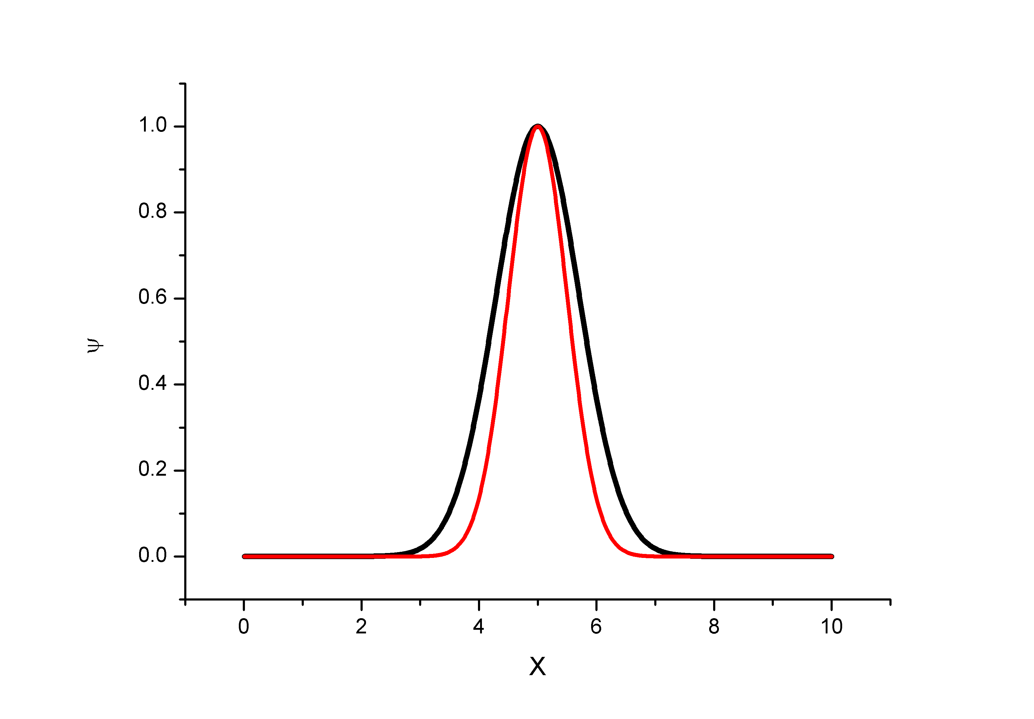
Lets See Some Examples….
ψ*(x)ψ(x)

Slide 18
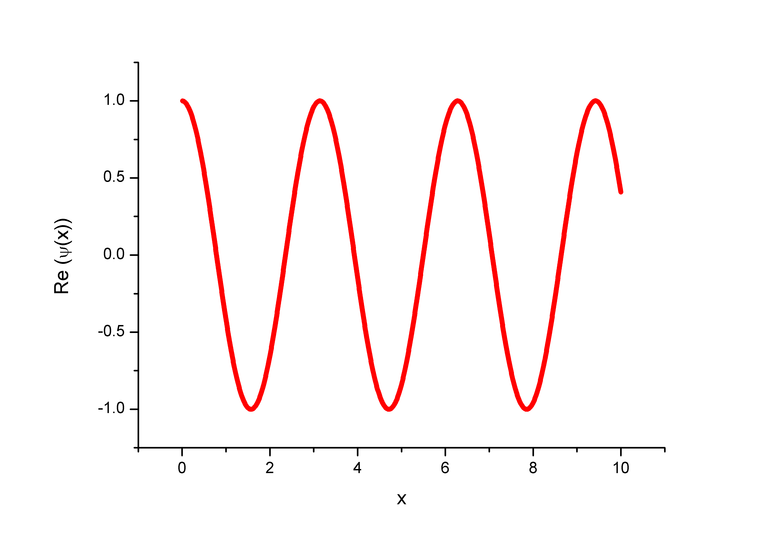
Lets See Some Examples….
A

Slide 19
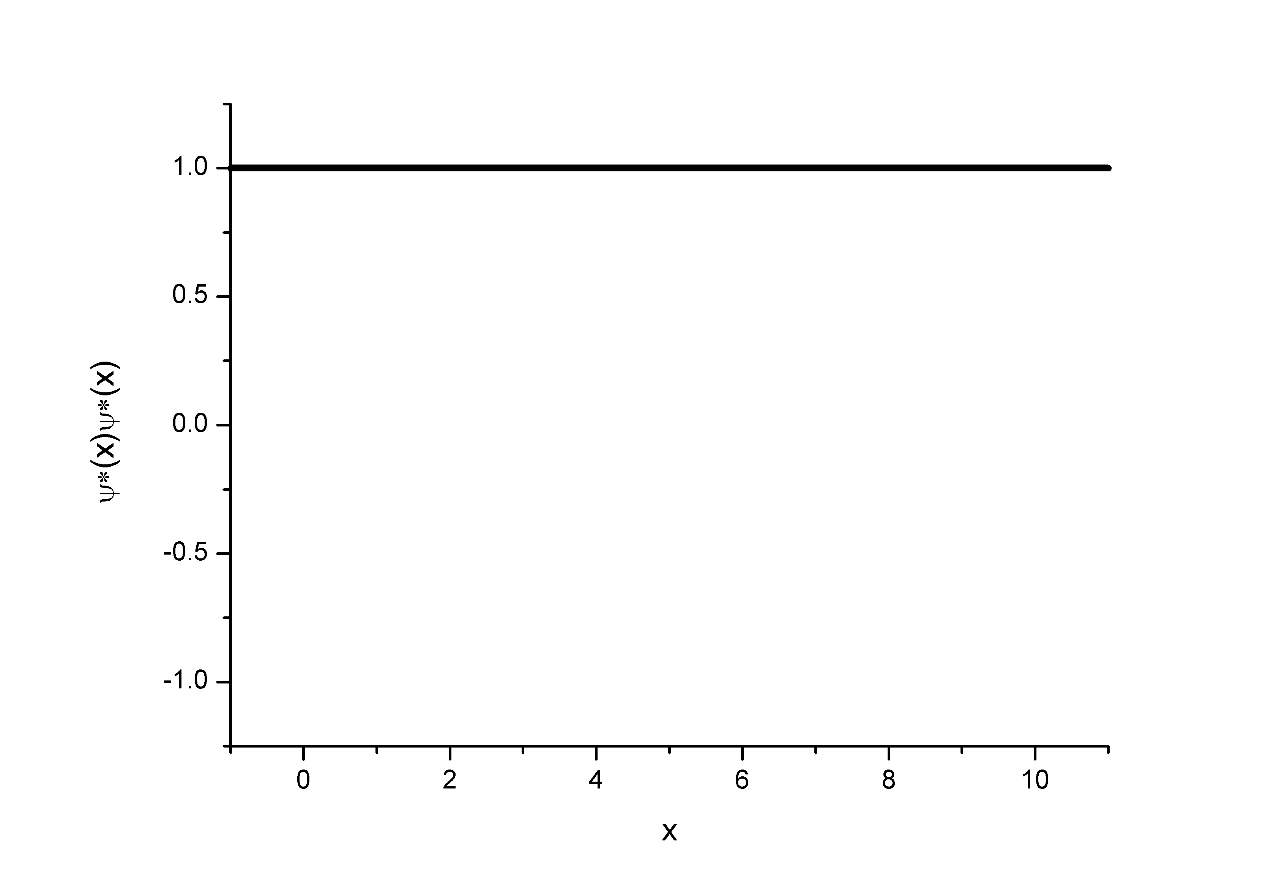
How about ψ*(x)ψ(x)?
/A²

Slide 20
Normalization
What is the total probability possible?
Probability that the particle can be found in the interval dx
Adds another quality:
ψ(x) has to be finite everywhere

Slide 21
Guess the dimension of wavefunction and probability density in 1-D!
What about Probability?

Slide 22
A particle is limited to the x axis has the wavefunction ψ(x) =Ax between x=0 and x=1; ψ(x) =0 elsewhere.
Find the probability that the particle can be found between x=0.45 and x=0.55
For what value of A the wavefunction will be normalized?

Slide 23
A given wave function of the form ψ(x) =Af(x) needs to get normalized such that total Probability = 1, using the condition for NORMALIZATION
Suitable A to be obtained

Slide 24
(b) For what value of A the wavefunction will be normalized?

Slide 25
Postulate 3
Linearity and Superposition
Let ψ₁(x) and ψ₂(x) represents the two wavefunctions of a quantum system, then the linear superposition will also be a valid wavefunction for the same quantum system.

Slide 26
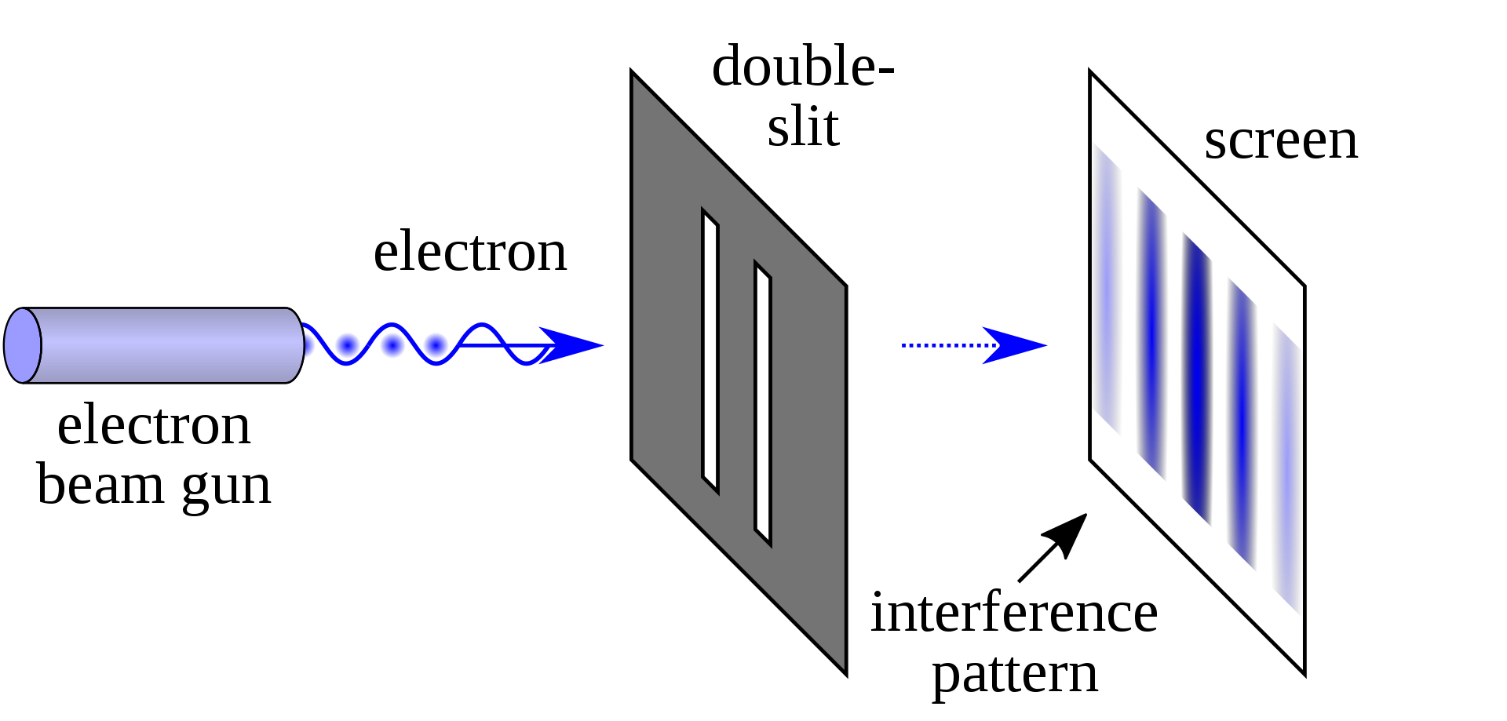
Demonstration of superposition

Slide 27
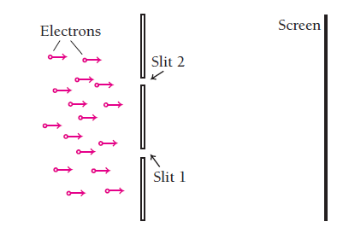
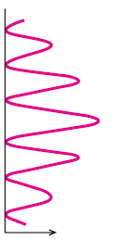
Interference term

Slide 28
Postulate 4
Expectation Value
OR
Average value

Slide 29
Postulate 4
Expectation values
Let ψ (x) describe the wavefunction of a quantum system, average value of the position (x) is given by the expectation value integral:
Note the difference in two expressions above, difference in representation will be clear
soon
Lets see some examples……

