Slide 1
PH603 Physics of Ultra-cold Atoms
ULTRA COLD ATOMIC GAS
Raghavan K E
Faculty, Department of Physics
IIT P, Bihta
Lecture 2
9/03/23

Slide 3
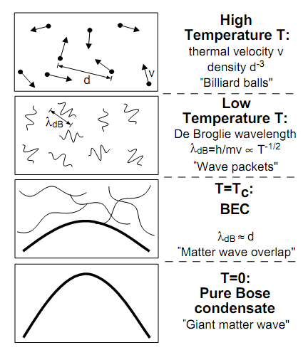
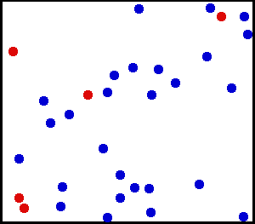
How Cold is Ultra Cold?
Kelvin
Celsius
300
26.8
Room Temperature
Water freezes
250
-23.2
200
-73.2
150
-123.2
100
-173.2
Air liquefies
50
-223.2
≈ 3K Deep space
0
-273.2
Absolute Zero
All motion stops
New state of Matter: Bose –Einstein Condensate
W.Ketterle, Cornell, C.Weimann, MIT
NOBEL PRIZE 2001
Laser Cooling and Evaporative cooling Technique

Slide 4
Bose-Einstein condensation
PREDICTION BY BOSE………………
BEC is a phenomena in which, below a critical temperature Tc, a macroscopic number of bosons occupies lowest energy state

Slide 5
Ultracold atoms
Quantum Behaviour of Light
Quantum matter
Quantum gas

Slide 6
Interesting experiment by Prof. Ashkin and his team
Atom
Stream of Photons
Atoms got deflected by laser beam ………………………..HOW?
Effect was very directional

Slide 7
Resonances in systems
Simple Pendulum
Spring mass system
LCR Systems
ATOMIC SYSTEMS

Slide 8
Possibility of Cooling of atoms by Light?
v
v
LIGHT interacts with ATOMS
Radiation Pressure from Light
Atom
Stream of Photons

Slide 9
Model using 2 level system

Slide 10
Two level atom interacting with Light
Atom
Stream of Photons
What are the possible phenomena’s?
Stimulated Absorption
Stimulated Emission
Spontaneous Emission

Slide 12
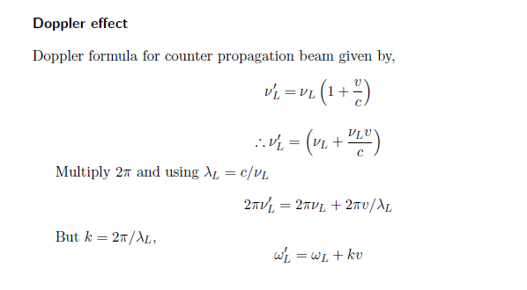
Doppler Effect

Slide 13
Doppler effect in radiation pressure
Laser cooling in 1-D
v
e
δ
ω_{L}- kv
ω_{L}+ kv
ω_{L}
ω_{o}
ω_{L}
g

Slide 14
SI | Roll Number | Name | P/A
1 | 2221PH23 | SONALI JANA
2 | 2112PH03 | ANUJ GUPTA
3 | 2112PH15 | NAYAN BISWAS
4 | 2112PH16 | NILESH TIWARI
5 | 2112PH17 | PEEYUSH SHARMA
6 | 2112PH19 | PRERNA JOSHI
7 | 2112PH23 | SOUNAK DUTTA
8 | 2112PH29 | VENU GOSWAMI

