Slide 1
PH603 Physics of Ultra-cold Atoms
Season 4, Lecture 2 (S4,L2)

Slide 2
 |  |  | Lec1
1 | 1921PH19 | SAUMYASHREE BARAL
2 | 2321PH02 | ARYA KUMAR SIDDHARTH
3 | 2321PH07 | NAINCY SHRIVASTAVA
4 | 2321PH09 | PRITAM SAMANTA
5 | 2321PH10 | REETU SAINI
6 | 2321PH13 | SOUBHIK MUKHERJEE
7 | 2321PH14 | NEHA CHOUDHARY
8 | 2321PH15 | RABI DAS
9 | 2321PH19 | SHRUTI SARSWAT
10 | 2212PH02 | AMAN KUMAR
11 | 2212PH10 | BINAYAK ROUT
12 | 2212PH11 | DARPAN SARKAR
13 | 2212PH13 | GAURAV JAISWAL
14 | 2212PH17 | KAUSHIP SAHA
15 | 2212PH20 | NEELLOHIT KARMAKAR
16 | 2212PH23 | RITIK PAL
17 | 2212PH26 | SOUMIK KARMAKAR
18 | 2212PH32 | KAUSTAB BHARASA

Slide 4
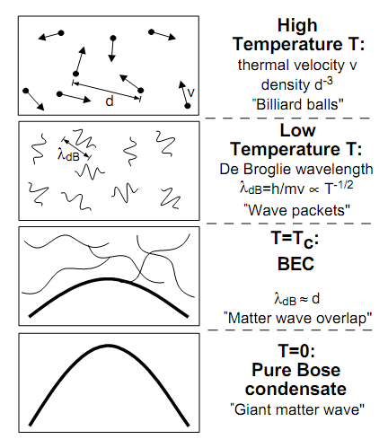
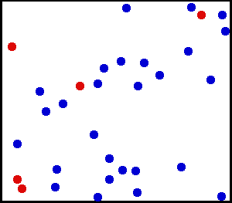
How Cold is Ultra Cold?
Kelvin
Celsius
300
26.8
Room Temperature
Water freezes
250
-23.2
200
-73.2
150
-123.2
100
-173.2
Air liquefies
50
-223.2
≈ 3K Deep space
0
-273.2
Absolute Zero
All motion stops
New state of Matter: Bose –Einstein Condensate
W.Ketterle, Cornell, C.Weimann, MIT
NOBEL PRIZE 2001
Laser Cooling and Evaporative cooling Technique

Slide 5
Bose-Einstein condensation
PREDICTION BY BOSE………………
BEC is a phenomena in which, below a critical temperature Tc, a macroscopic number of bosons occupies lowest energy state

Slide 6
Ultracold atoms
Quantum Behaviour of Light
Quantum matter
Quantum gas

Slide 7
Interesting experiment by Prof. Ashkin and his team
Atom
Stream of Photons
Atoms got deflected by laser beam ………………………..HOW?
Effect was very directional

Slide 8
Resonances in systems
Simple Pendulum
Spring mass system
LCR Systems
ATOMIC SYSTEMS

Slide 9
Possibility of Cooling of atoms by Light?
v
v
LIGHT interacts with ATOMS
Radiation Pressure from Light
Atom
Stream of Photons

Slide 10
Model using 2 level system

Slide 11
Two level atom interacting with Light
Atom
Stream of Photons
What are the possible phenomena’s?
Stimulated Absorption
Stimulated Emission
Spontaneous Emission

