Slide 1
lec7 |  |  | Lec5 | Lec 6
a | 1921PH19 | SAUMYASHREE BARAL | p | p
p | 2321PH02 | ARYA KUMAR SIDDHARTH | p | p
p | 2321PH07 | NAINCY SHRIVASTAVA | p | p
p | 2321PH09 | PRITAM SAMANTA | p | p
p | 2321PH10 | REETU SAINI | p | p
p | 2321PH13 | SOUBHIK MUKHERJEE | p | p
p | 2321PH14 | NEHA CHOUDHARY | p | p
p | 2321PH15 | RABI DAS | p | p
p | 2321PH19 | SHRUTI SARSWAT | p | p
p | 2212PH02 | AMAN KUMAR | p | p
p | 2212PH10 | BINAYAK ROUT | p | p
p | 2212PH11 | DARPAN SARKAR | p | p
a | 2212PH13 | GAURAV JAISWAL | p | a
a | 2212PH17 | KAUSHIP SAHA | p | a
p | 2212PH20 | NEELLOHIT KARMAKAR | p | a
p | 2212PH23 | RITIK PAL | p | p
p | 2212PH26 | SOUMIK KARMAKAR | p | p
p | 2212PH32 | KAUSTAB BHARASA | a | p

Slide 4
Experimental sequence of laser cooling

Slide 7
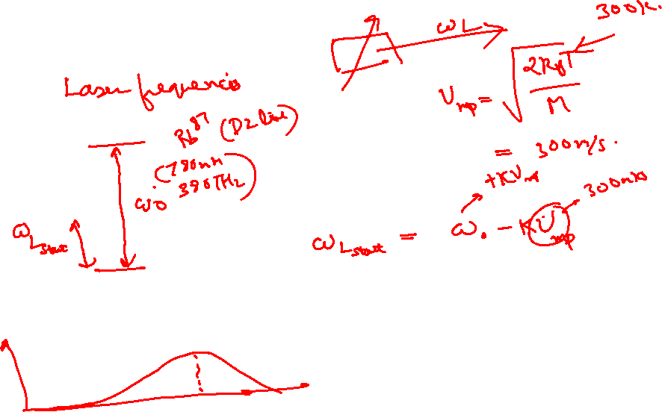

Slide 8
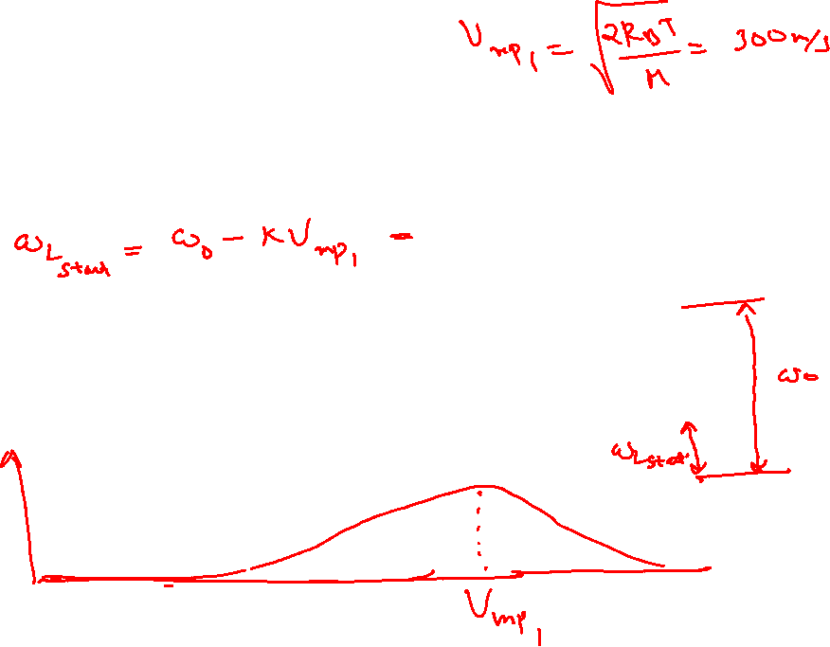

Slide 9
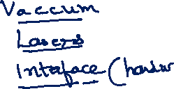
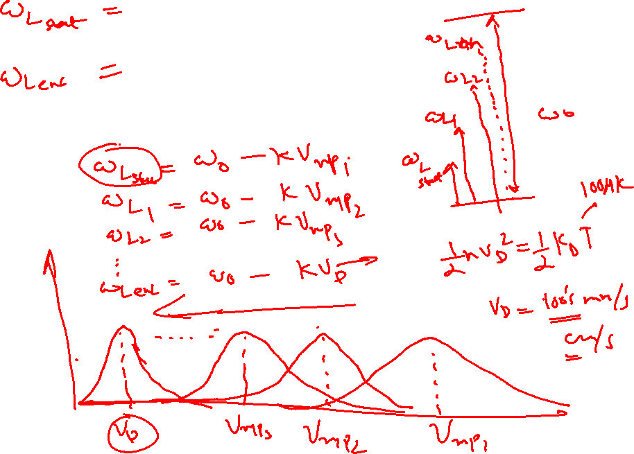

Slide 10
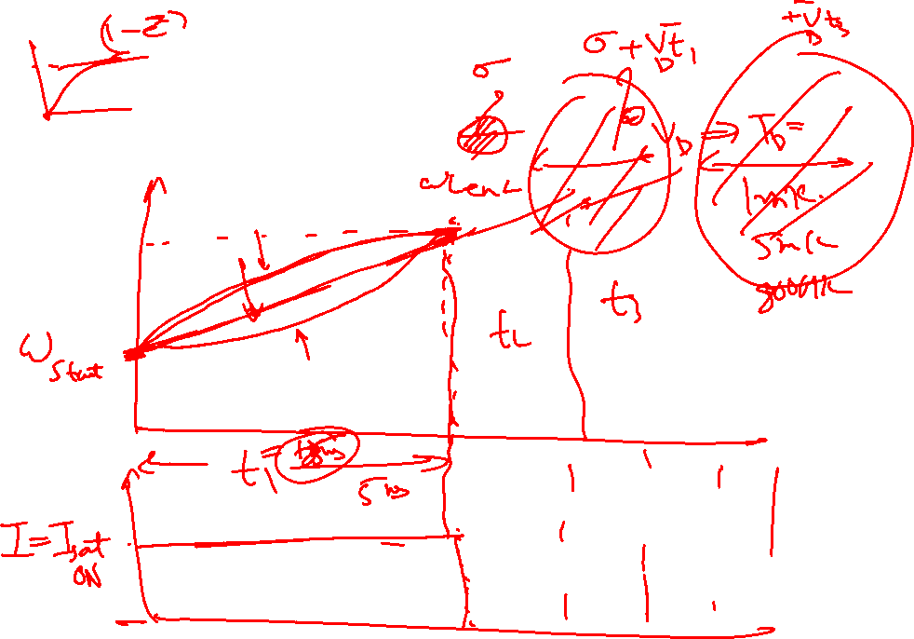

Slide 11
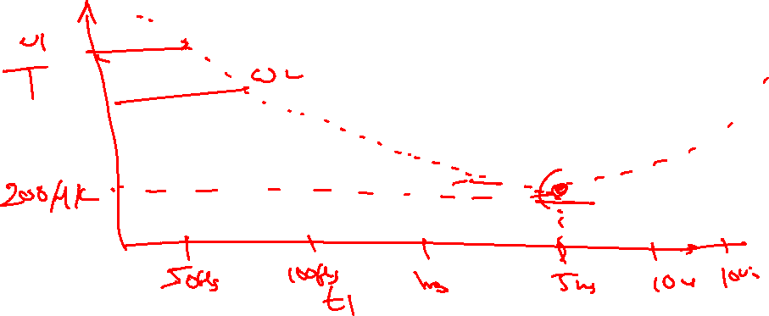

Slide 12
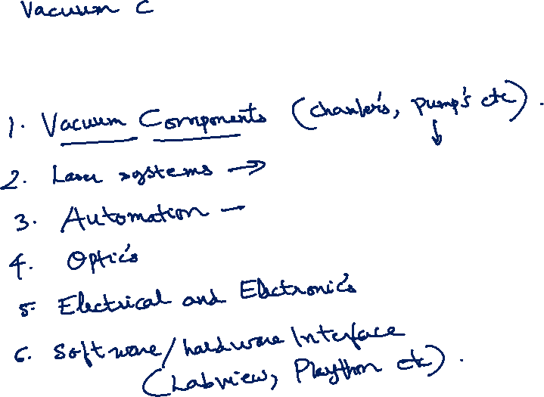

Slide 13
Concept of Doppler Cooling of Atoms

Slide 14
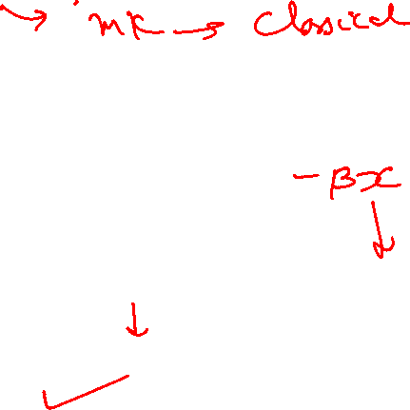
Some Limitations of Doppler Cooling
Minimum Temperature attained in range of fraction of milli Kelvin ONLY…..
For seeing Quantum Behavior of atoms need to reach order of Nano Kelvin
Doppler Cooling has no position dependent force, atoms in periphery leave the cooling region. Force F take a form of F = -αV
Laser Light has some heating effect also for some frequencies for certain velocity class of atoms: Not all the atoms experience the right frequency for cooling effect some atoms gets heating effects from co-propagating light as well………
A competition between heating and cooling arise which leads to an equilibrium temperature.

Slide 15
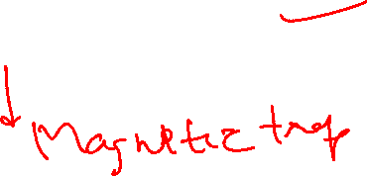
Some tricks to improve Doppler Cooling Using Magnetic field on Atoms
Magneto Optical Trap (MOT)

Slide 18
Effects of magnetic field on 2 Level atom
Uniform B
Uniform magnetic field (Helmholtz coil)
ZEEMAN SPLITTING
+1
0
-1

Slide 20
Effects of magnetic field on 2 Level atom (Using anti-helmhlotz coil)
-1
+1
0
0
+1
-1
-B
0
+B

Slide 21
Magneto optical trapping
Energy
m_{F} = -1
m_{F} = +1
F=1
m_{F} = 0
m_{F} = 0
o
m_{F} = +1
m_{F} = -1
σ⁺
σ⁻
Δm_{F} = +1
Δm_{F} = -1
F=0
0
Z’’
Z’

Slide 22
MOT
v
ω_{zeeman}
+1
ω₀
Counter propagating σ+ Light Absorb’s: ω₀ - ω_{zeeman} + kv
The atom emits: ω₀ - ω_{zeeman} in the perpendicular direction by spontaneous
Emission.
VICE VERSA FOR σ- LIGHT FOR THE ATOM IN OTHER SIDE

Slide 23
Effects of magnetic field on 2 Level atom (Using anti-helmhlotz coil)
σ+
Both these will see same energy gap
At identical locations
σ-
-1
+1
0
0
+1
-1
-B
0
+B

