Slide 1
Concept of LASER/Doppler Cooling of Atoms

Slide 6
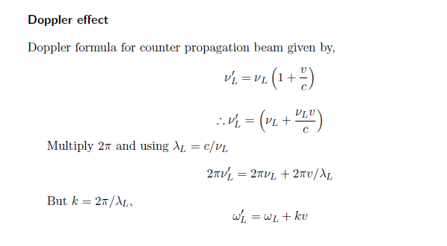
Doppler Effect

Slide 9
Red and blue detuning

Slide 10
Doppler effect in radiation pressure
Laser cooling in 1-D
v
e
δ
ω_{L}- kv
ω_{L}+ kv
ω_{L}
ω_{o}
ω_{L}
g

Slide 11
Atoms decelerate

Slide 13
Laser cooling in 3-D

Slide 14
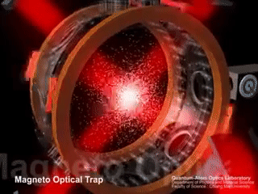

Slide 15
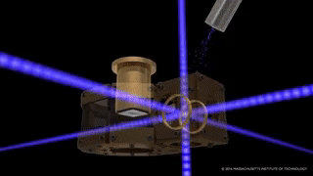

Slide 16
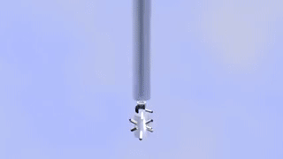

Slide 17
Some real experiments….

Slide 18
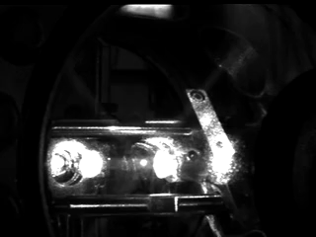

Slide 19
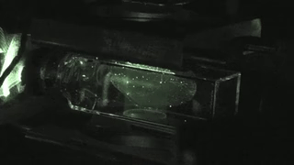

Slide 20
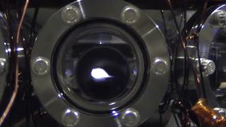

Slide 21
