Slide 1
Highlights of the course
Co-ordinate Systems
Introduction to Vector Operators
Work , Energy and Conservation laws
Rigid body in motion
Oscillations and Waves
Quantum Physics

Slide 2
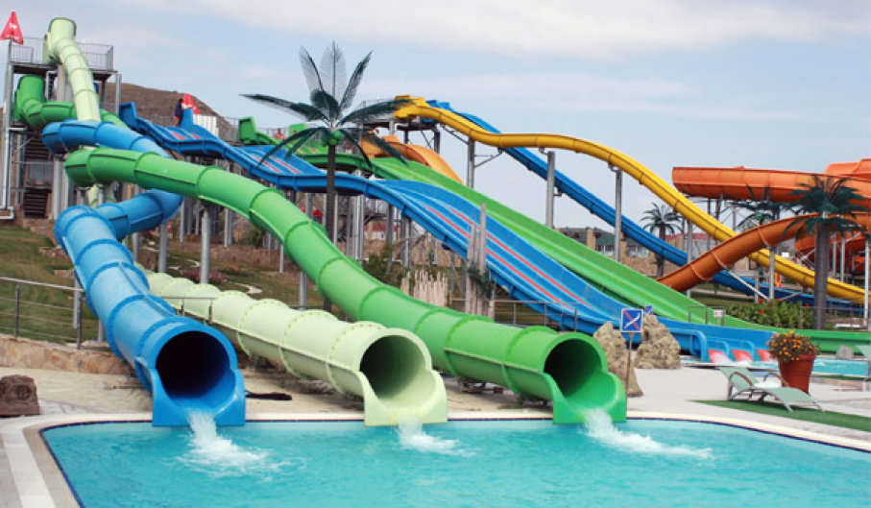
Chapter-3:Work , Energy and Conservation laws

Slide 3
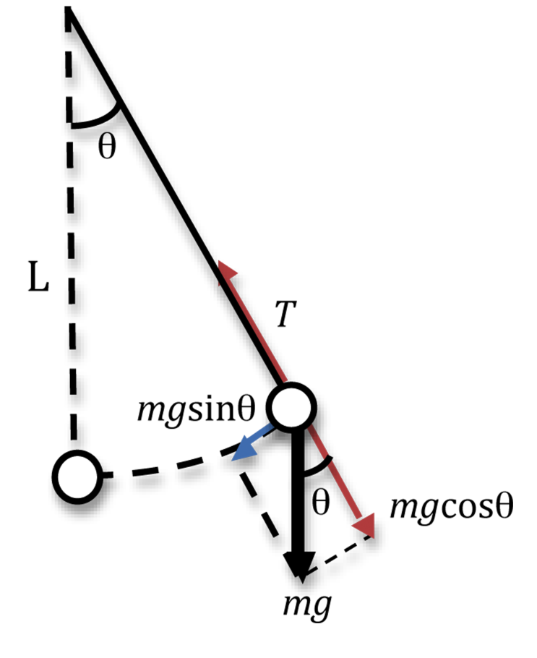
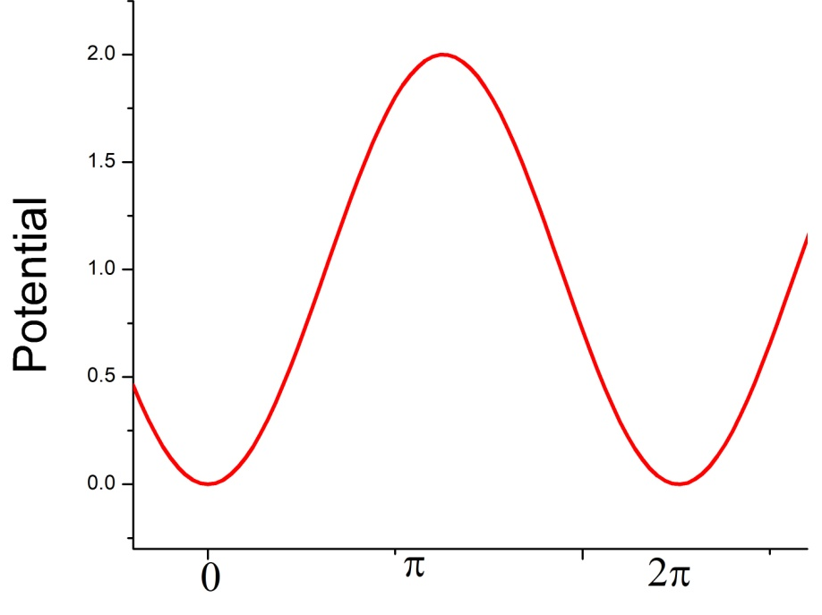
Concept of equilibrium (RECAP)
Simple Pendulum
Unstable equilibrium
$$θ=π$$
$$θ=0$$

Slide 4
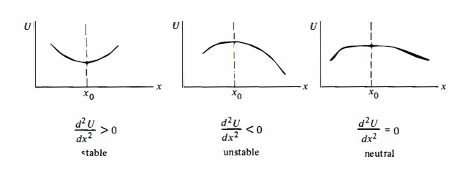

Slide 5
Plot v/s ?
Equation of ellipse
For small values of ɵ the equation is of ellipse. But as ɵ becomes larger it
Deviates from an ellipse

Slide 6
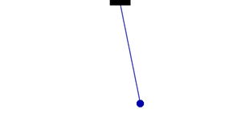
B
Small Oscillations

Slide 7
B
larger Oscillations
Deviated from ellipse
Deviated from ellipse

Slide 8
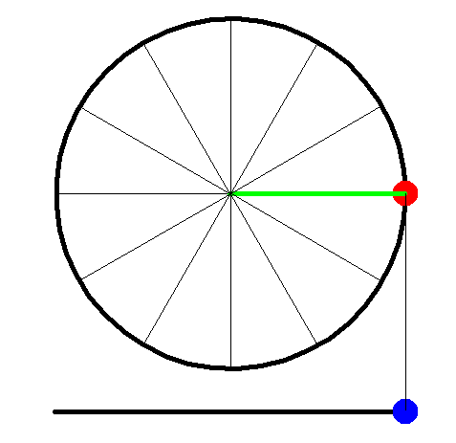
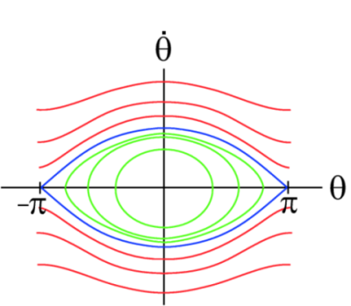
Finite speed ( )
Circular motion
Finite speed
B

Slide 9
Plot v/s
For larger E , motion
Of the pendulum
Becomes
Circular motion

Slide 10
Concept of equilibrium
Duffing Oscillator
Plot V(x) v/s x
How to Plot the graph?
Find Maxima and Minima
2. Find the zero crossing points
3. Imagine the function for smaller and larger values of x

Slide 11
1. Maxima and Minima
Condition for maxima and minima of a function

Slide 12
1. Maxima and Minima
To find maxima and minima:

Slide 13
1. Maxima and Minima

Slide 14
2. Zero crossing points

Slide 15
Plot for small and large values of x
1. Maxima at x =0
Minima at
and
2. Zero crossing at 3 points, x = 0,
0 crossing/maxima
0 crossing
0 crossing
0
minima
minima

Slide 16
Plot for small and large values of x
For small values of x , V(x) behaves as x²
For large values of x , V(x) behaves as x⁴
0 crossing/maxima
0 crossing
0 crossing
0
minima
minima

Slide 17
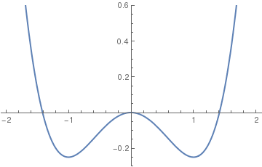
Concept of equilibrium
Duffing Oscillator
Plot V(x) v/s x
To Plot the graph
V(x)
Find Maxima and Minima
2. Find the zero crossing
points
1. Maxima at x =0
Minima at
and
3. Imagine the function
For smaller and larger
Values of x
X
2. Zero crossing at 3 points, x = 0,

Slide 18
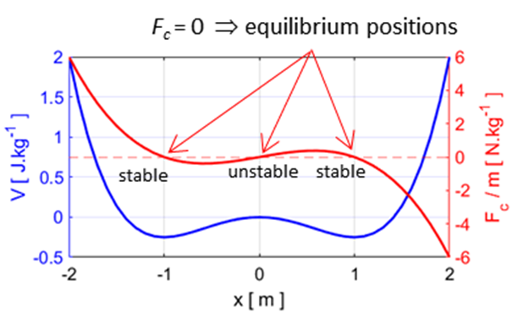
Concept of equilibrium
Duffing Oscillator
Component of Force F(x) = - $\frac{dV(x)}{dx}$ = -$βx − αx^{3}$
V(x)
X

Slide 19
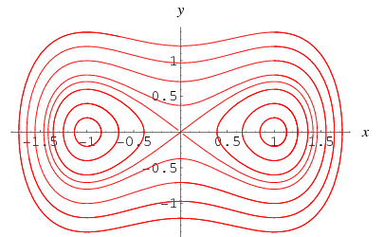
Velocity Vs. Position plot
V
X

Slide 20
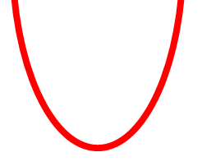
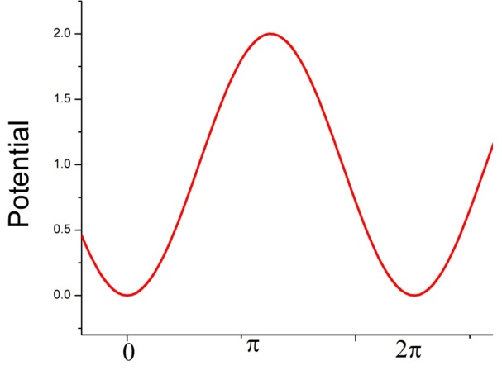
Velocity Vs. Position plot (Summary)
V
V(x)
X
E₁
E₂

Slide 21
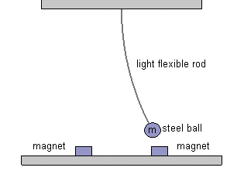
Physical Example of double well
Iron Ball

Slide 22
Interatomic Potential: Lennard Jones Potential

Slide 23
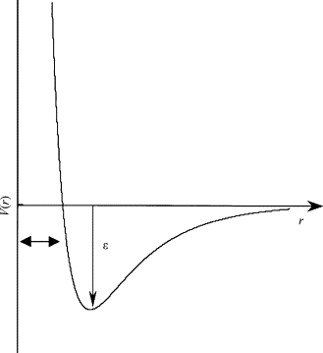
Interatomic Potential: Lennard Jones Potential
Lennard Jones Potential

Slide 24
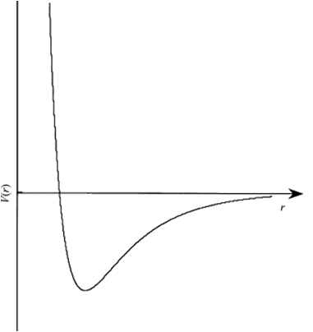
Interatomic potential
A
B
r_{a}
r_{b}
B
E

Slide 25
Interatomic potential
A
B
E
r_{a}
B

Slide 26
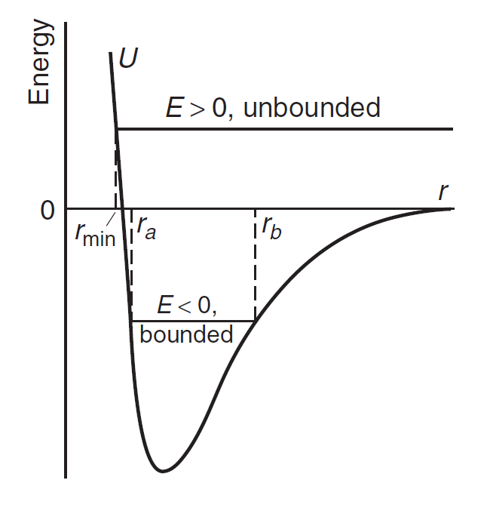
Interatomic potential
Lennard Jones Potential
Nearly Parabolic

