Slide 1
Highlights of the course
Co-ordinate Systems
Introduction to Vector Operators
Work , Energy and Conservation laws
Rigid body in motion
Oscillations and Waves
Quantum Physics

Slide 2
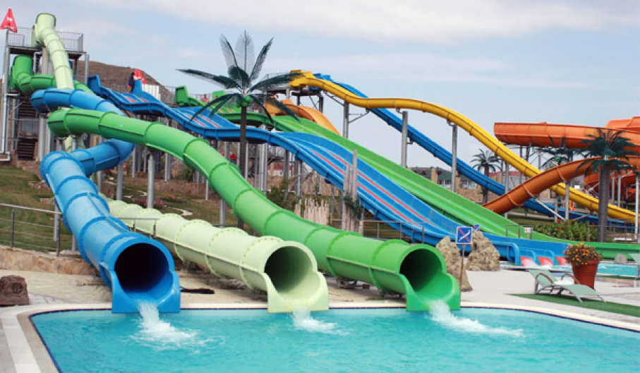
Chapter-3:Work , Energy and Conservation laws

Slide 3
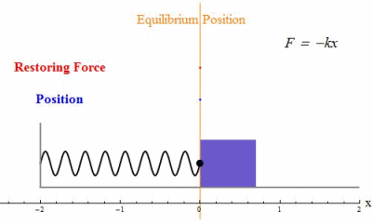
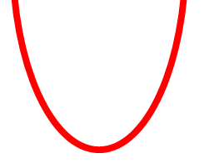
Recap
Bounded motion
V
X
B
E
-X
X

Slide 4
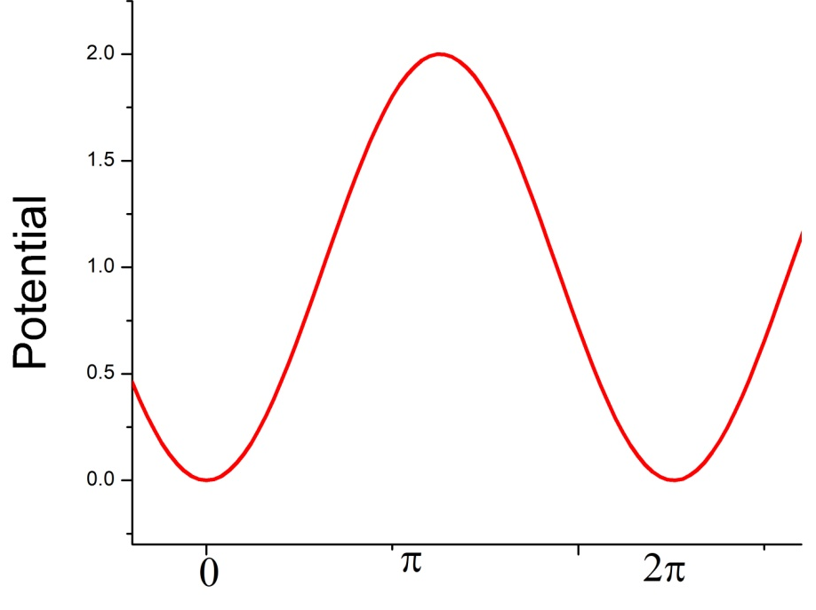
Simple Pendulum
Bounded motion
Unbounded motion
E
Finite speed
E
B
B
E
B
Small Oscillations
larger Oscillations
Circular motion

Slide 5
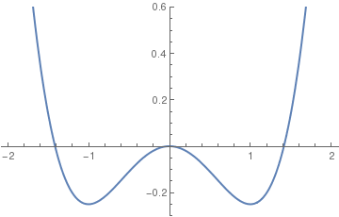
Duffing Oscillator (Georg Duffing, German engineer)
B
E
B

Slide 6
E
B

Slide 7
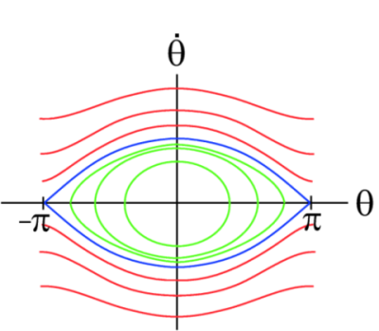
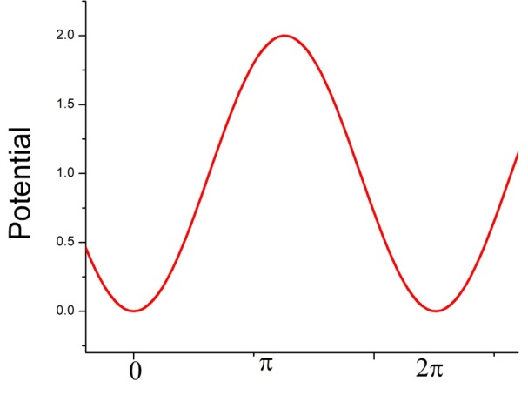
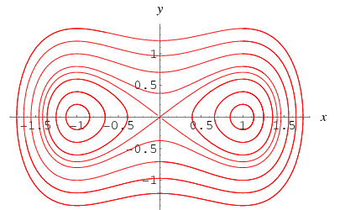
Velocity Vs. Position plot (Summary)
V
V(x)
X
E₁
E₂

Slide 8
Interatomic Potential: Lennard Jones Potential

Slide 9
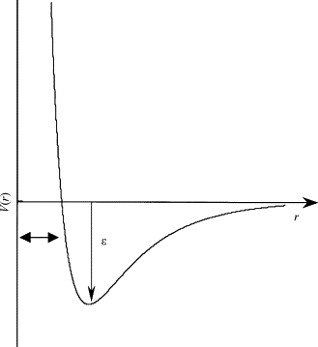
Interatomic Potential: Lennard Jones Potential
Lennard Jones Potential

Slide 10
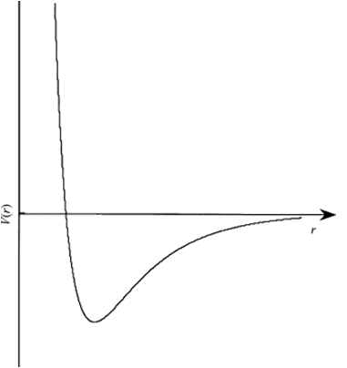
Interatomic potential
A
B
r_{a}
r_{b}
B
E

Slide 11
Interatomic potential
A
B
E
r_{a}
B

Slide 12
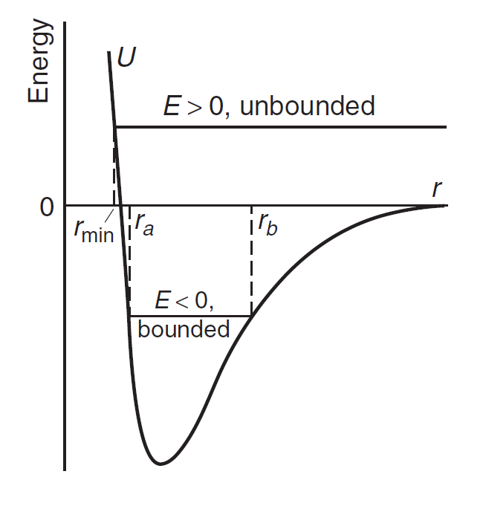
Interatomic potential
Lennard Jones Potential
Nearly Parabolic

Slide 13
Small Oscillations
Taylor series expansion of a function f(x), about
A point x=a is given as
Nearly Parabolic
Harmonic Oscillator

Slide 14
Velocity Vs. Position plot
V
Around
Equilibrium
For small oscillations only
r₀
r
Note that velocity will be maximum at equilibrium point

Slide 15
Practice Problems

Slide 16
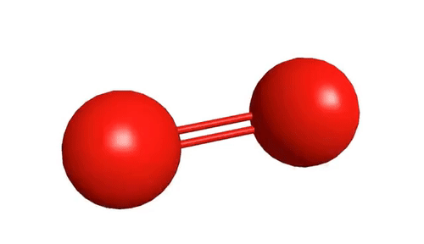
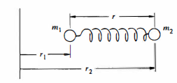
Molecular vibrations
How to find the vibration frequency of diatomic molecule which is bound with very low energy such that their separation is almost close to equilibrium distance r₀?
r₀

Slide 17
Equation of motion
r₀
Extend spring
Restoring force direction
Provided, r₀ is the equilibrium distance,

Slide 18
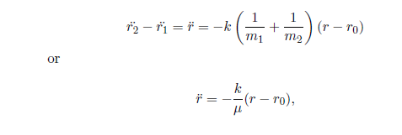
Equation of motion
By Comparing with Small Oscillations of Harmonic Oscillator. We get
Remember

Slide 19
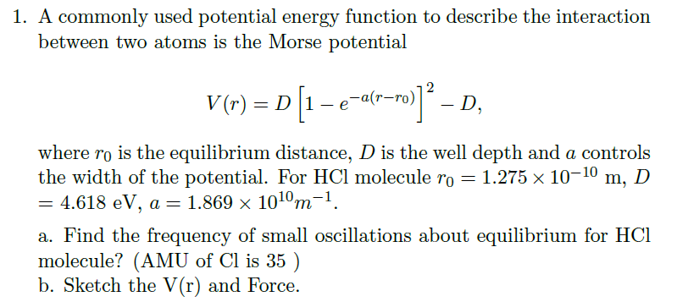
(a)
(b)

Slide 20
$$e^{−a\left(r−r_{0}\right)}=0$$
Zero crossings:
$${\left[1−e^{−a\left(r−r_{0}\right)}\right]}^{2}=1$$
$$e^{−a\left(r−r_{0}\right)}=2$$
r = infinity, r = r₀ - $\frac{1 }{a}ln2$
Minima/Maxima:
= 0
r = r₀
Is Positive, Stable equilibrium

Slide 21
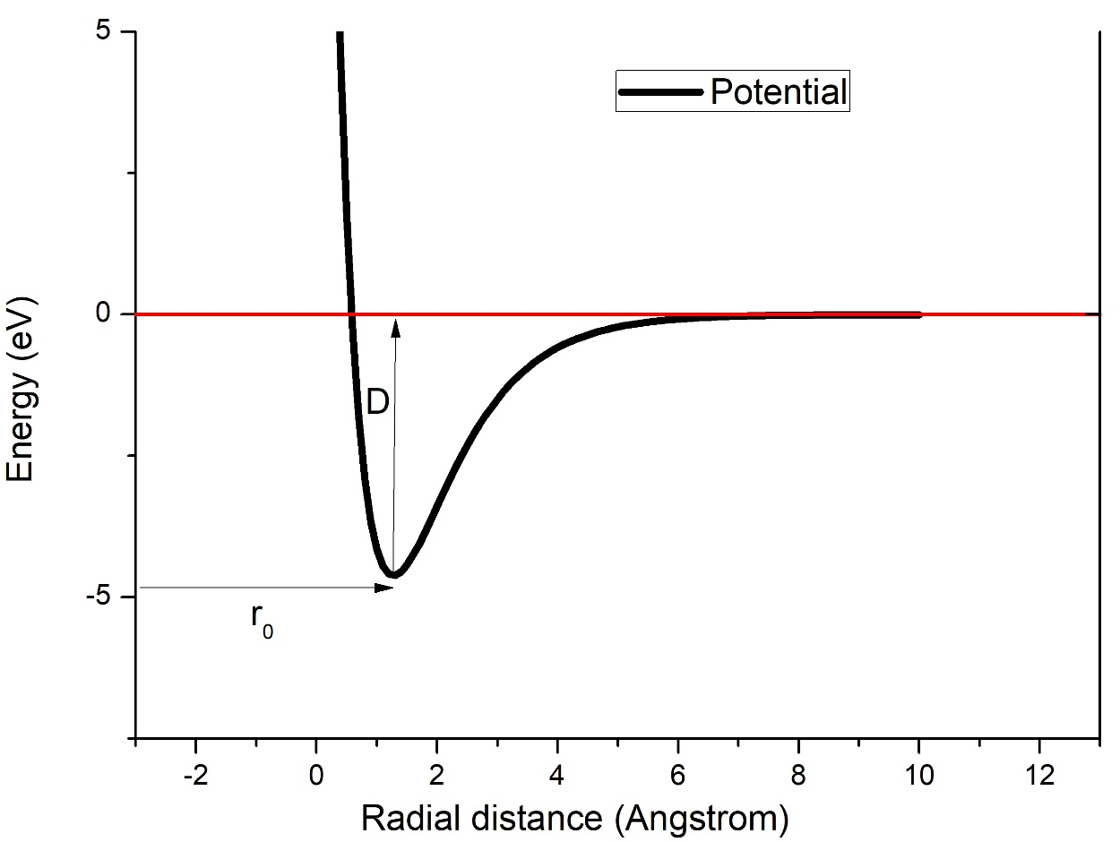
r = r₀ - $\frac{1 }{a}ln2$

Slide 22
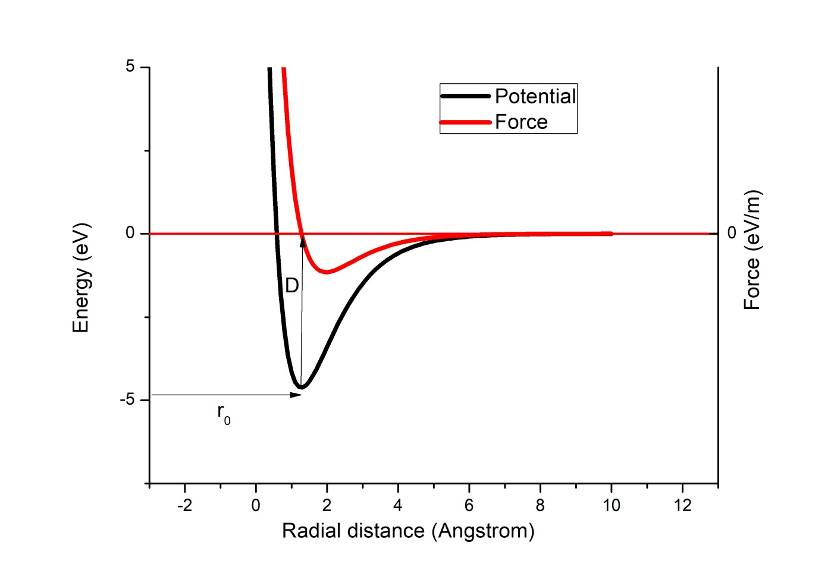
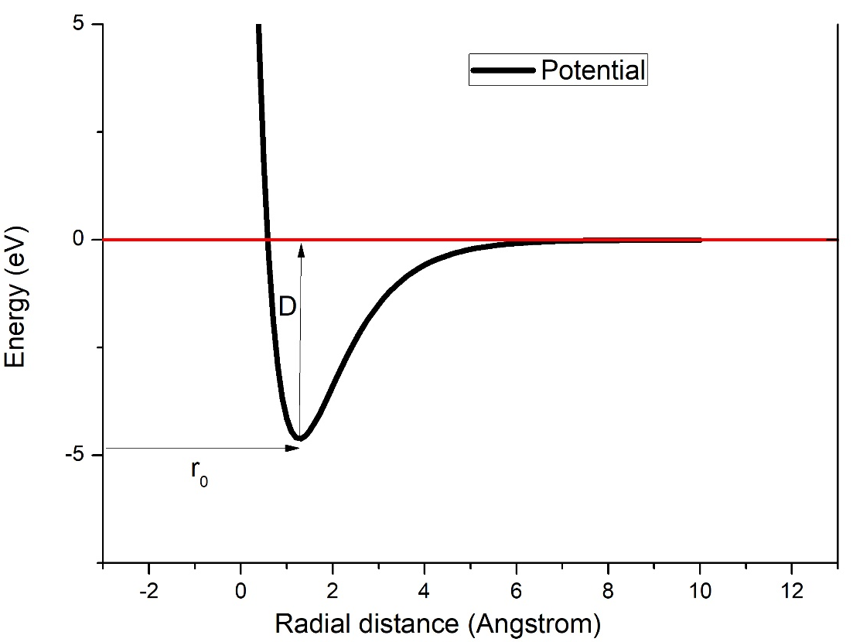

Slide 23
(b)
Potential V(r) is given, how to find the molecular vibrational frequency?
RECOLECT SMALL OSCILLATIONS (LOW ENERGY CASE)

Slide 24
A
B
r_{a}
r_{b}
B
E
Nearly Parabolic

Slide 25
(b)

Slide 26
(b)

Slide 27
Quiz 1 (Tomorrow)
31/12/2021
10 AM – 11 AM
Chapters: 1 and 2
MS TEAMS (Similar to Tutorials)
Must be Online Mandatorily
Google Form
MCQ type 7 Questions (10 marks)
Video should be ON

